Slide 1
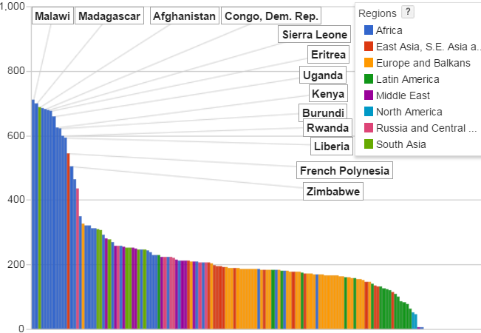
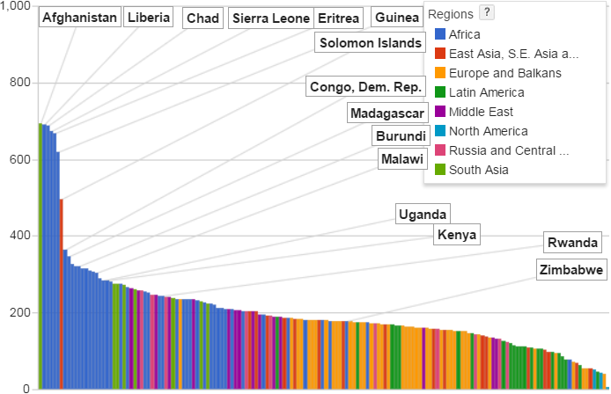
1,000
800
Satellite
Satellite
Satellite
Min RTT in msec.
600
400
2008
2008
200
2013
0

Slide 2
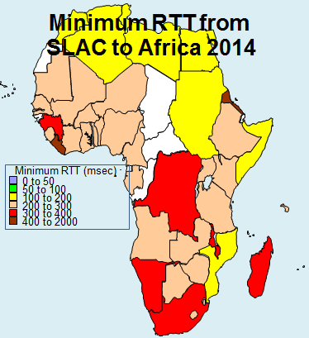
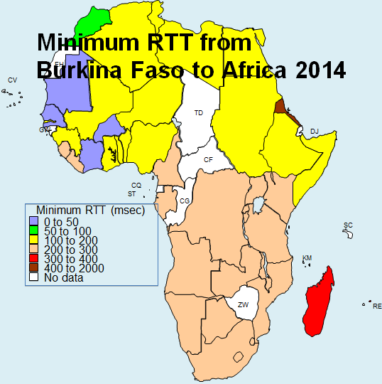
Burkina
Faso

Slide 3
