Slide 1
Monitoring the World’s Networks SCIC Monitoring Group (R. Cottrell et al.) Mapping the Digital Divide

Slide 2
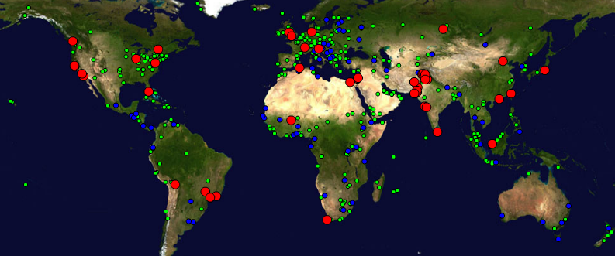
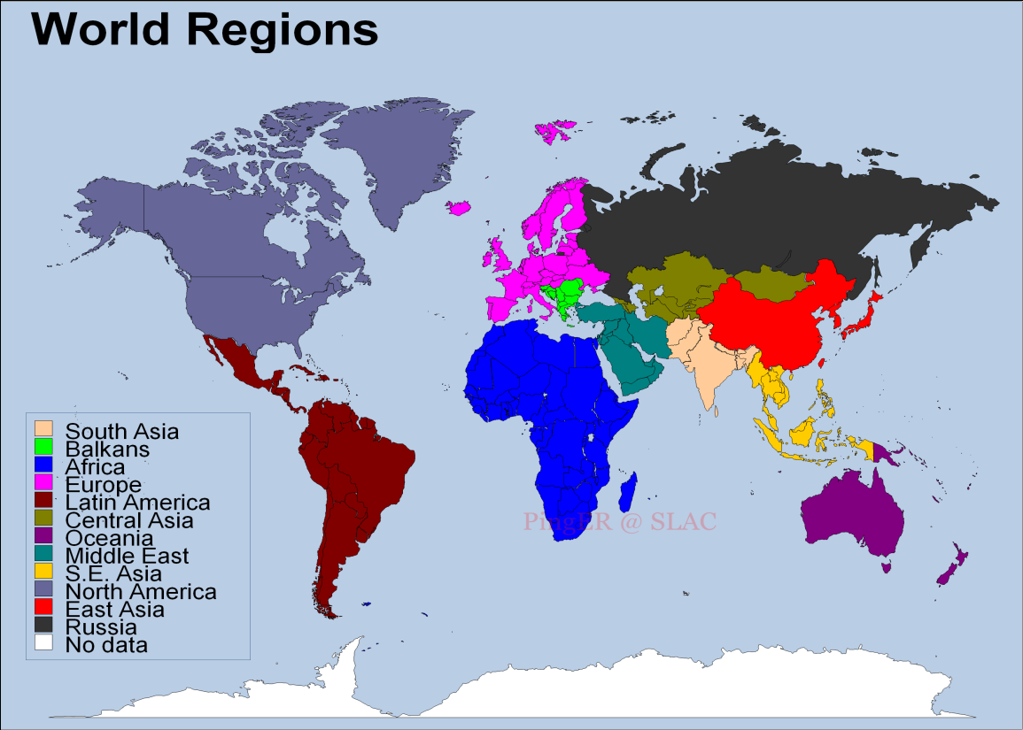
SCIC Monitoring WG PingER (Also IEPM-BW)
R. Cottrell
Monitoring & Remote Nodes Dec2013)
Measurements from 1995 On
Reports link reliability & quality
Countries monitored
Contain 99% of world pop.
99.5% of World’s Internet Users
950 remote sitesmonitored in 170 nations; 89 monitoring nodes;
Strong Collaboration with ICTP Trieste and NUST/SEECS (Pakistan) and three Malaysian universities
Excellent, Vital Work; Funding issue
Countries: N. America (3), Latin America (19), Europe (31), Balkans (10), Africa (49), Middle East (16), Central Asia (9), South Asia (8), East Asia (4),SE Asia (10), Russia (1), Oceania (5)
Notes:
Note there are some countries we should not monitor since they do not have a full Internet connection, and hence may pay dearly by byte for traffic. These include:
Code Country Conn Notes Further information
++++++++++++++++++++++++++++++++++++++++++++++++++++++++++++++++++++++++++
AF Afghanistan(Islamic St.) P C
BV Bouvet Island
CX Christmas Island C
EH Western Sahara
FX France (European Ter.) France Metropolitaine
GS South Georgia and
South Sandwich Islands C
HM Heard & McDonald Isl. C
KP Korea (North) P
MH Marshall Islands C
MM Myanmar *
MS Montserrat C
NR Nauru
PM St. Pierre & Miquelon C
PN Pitcairn C
TF French Southern Terr. C
TK Tokelau
UM US Minor outlying Isl.
VC St.Vincent & Grenadines P
WF Wallis & Futuna Islands
YT Mayotte
ZR Dem. Rep. of Congo Deleted - Replaced by Code CD

Slide 3
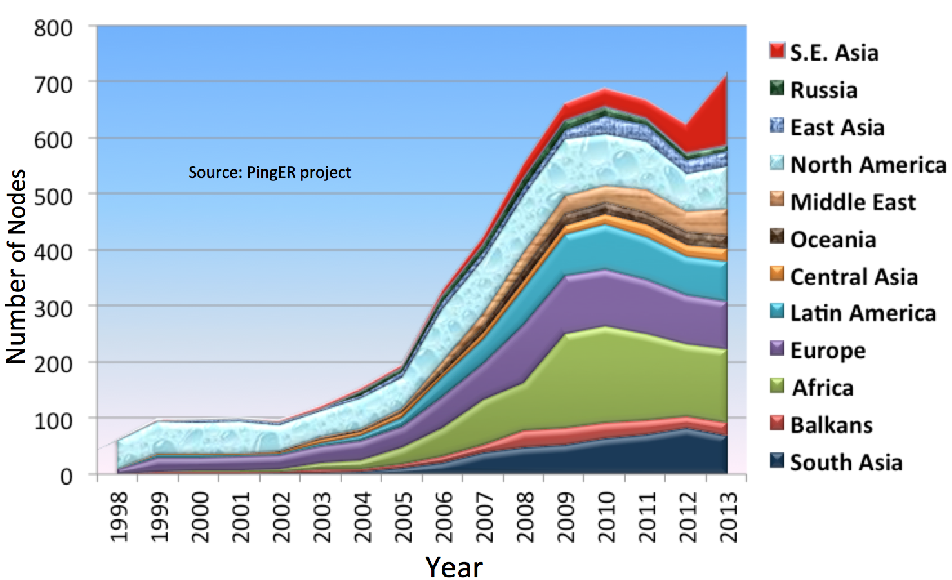
Number of Hosts Monitored By Region: 1998 - 2012
R. Cottrell
S. E. Asia
Africa
Notes:
Note there are some countries we should not monitor since they do not have a full Internet connection, and hence may pay dearly by byte for traffic. These include:
Code Country Conn Notes Further information
++++++++++++++++++++++++++++++++++++++++++++++++++++++++++++++++++++++++++
AF Afghanistan(Islamic St.) P C
BV Bouvet Island
CX Christmas Island C
EH Western Sahara
FX France (European Ter.) France Metropolitaine
GS South Georgia and
South Sandwich Islands C
HM Heard & McDonald Isl. C
KP Korea (North) P
MH Marshall Islands C
MM Myanmar *
MS Montserrat C
NR Nauru
PM St. Pierre & Miquelon C
PN Pitcairn C
TF French Southern Terr. C
TK Tokelau
UM US Minor outlying Isl.
VC St.Vincent & Grenadines P
WF Wallis & Futuna Islands
YT Mayotte
ZR Dem. Rep. of Congo Deleted - Replaced by Code CD

Slide 4
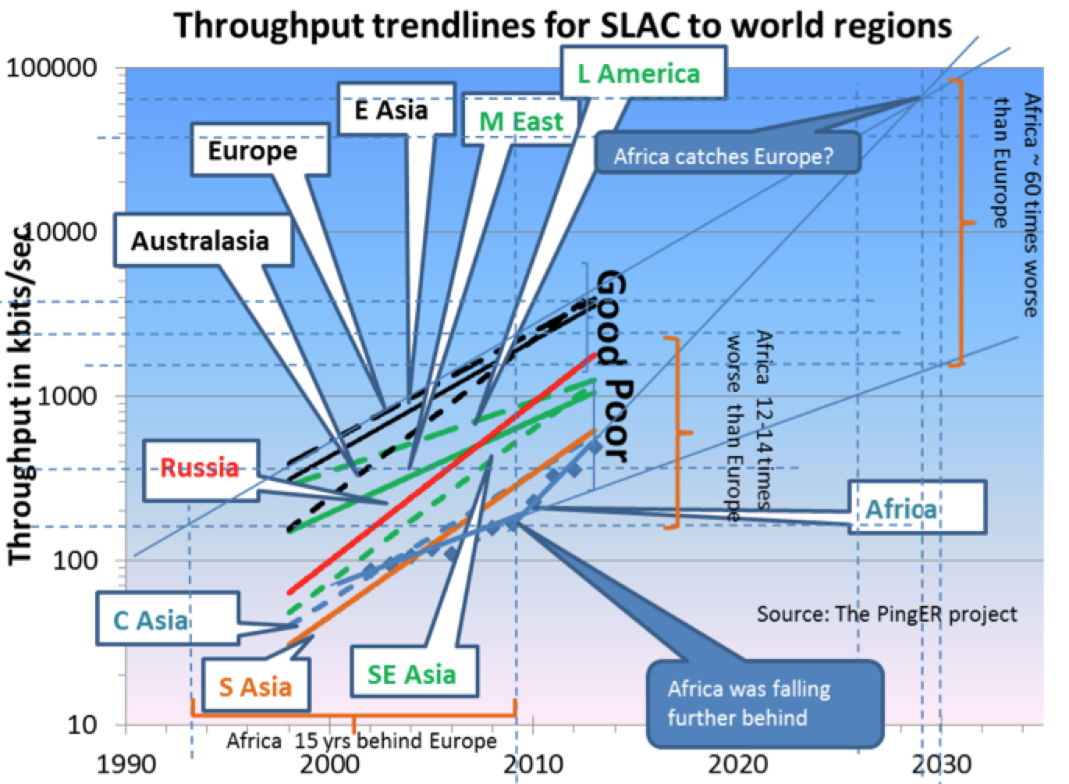
Throughput Trendlines from SLAC 1998 - 2014
Top 4 Europe, N. America, East Asia & Australasia
Behind Europe
5 Yrs: Russia, Latin America, Middle East
9 Yrs: Southeast Asia
12-14 Yrs: So+Central Asia
15 Years: Africa
Jan 2014
Derived TCP Throughput = 1460 Bytes*8bits/Byte/ (RTT * Sqrt(loss)); Matthis et al.
In 10 years: Russia and Latin America should catch up with top 4. Africa was falling farther behind; But new cables are making a difference since 2012

Slide 5
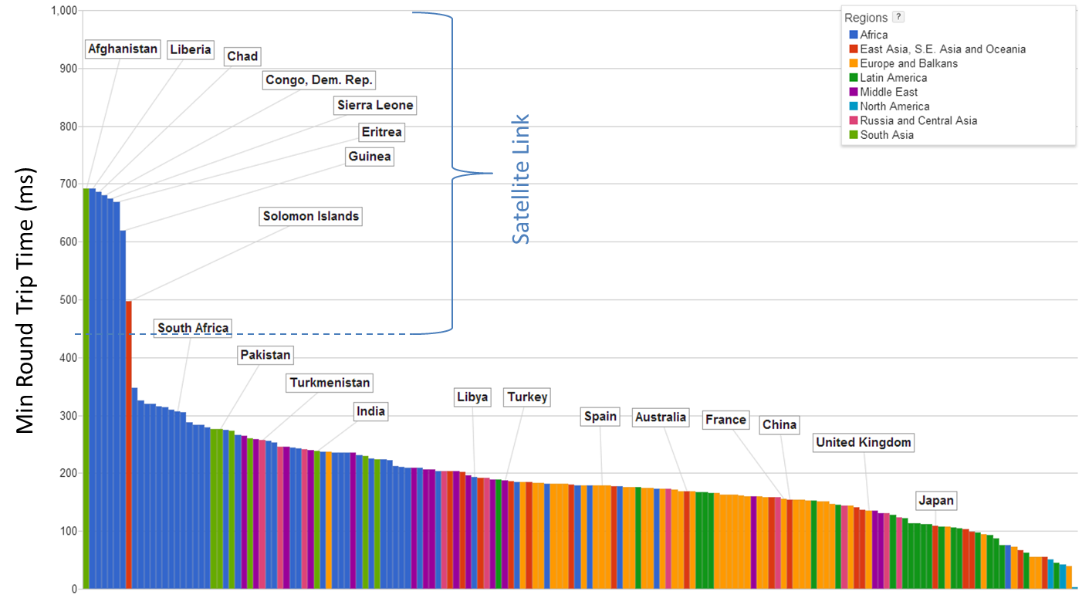
Minimum Round Trip Time (RTT) From SLAC to Countries of the World December 2013
Showing the effect of the use of Geo-stationary Satellites (270 msec and up)
Vs. Terrestrial fiber optic networks
800
Minimum Round Trip Time (ms)
600
400
200
R. Cottrell
Cuba now has terrestrial link, Africa & Afghanistan still satellite

Slide 6
World Map: Minimum RTT from SLAC
Countries Still on Geosynchronous Satellite are in Red
2008
Dec 2013
Note also the increased coverage, i.e reduced white countries, e.g
Congo-Brazzaville, Central Africa Republic, Myanmar
R. Cottrell

Slide 7
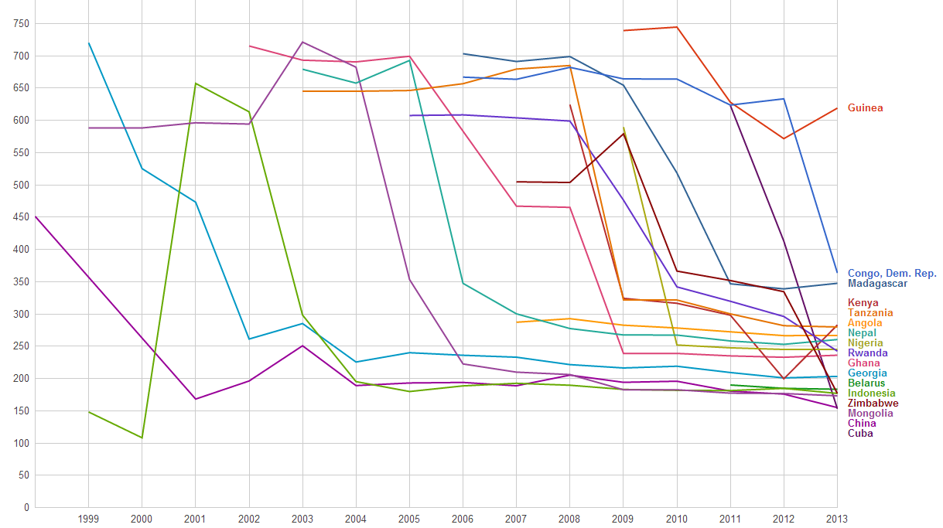
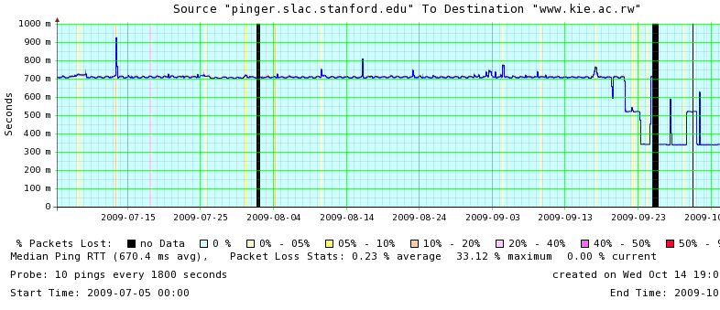
Round Trip Time (from SLAC) Drops as African Nations Move from Geostationary Satellites to the New Undersea Cables
Minimum RTT (msec)
Rwanda: RTT shift from GEOS to Fiber
Nepal
Madagascar
700 ms
Cuba
1000
DR Congo
800
500
600
300
400
200
100
China
Nigeria
Ghana
0 msec
Rwanda
Kenya
Dec 2013
R. Cottrell

Slide 8
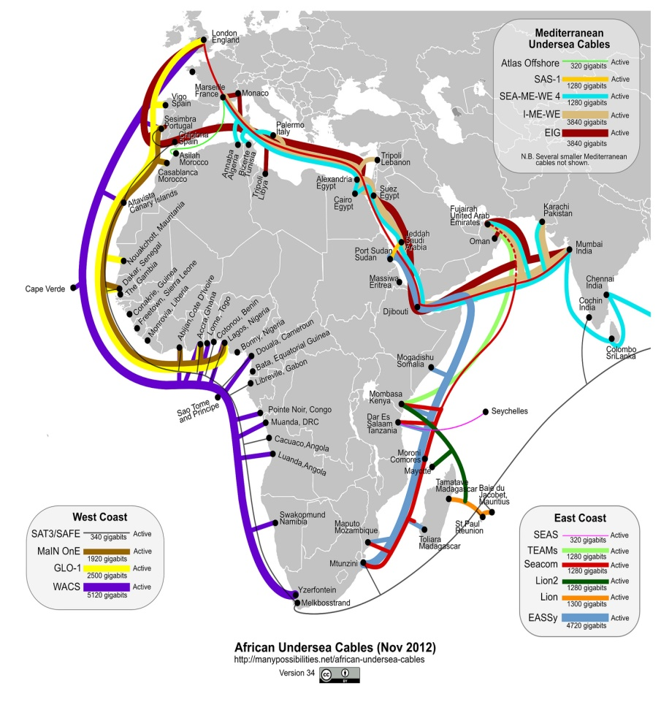
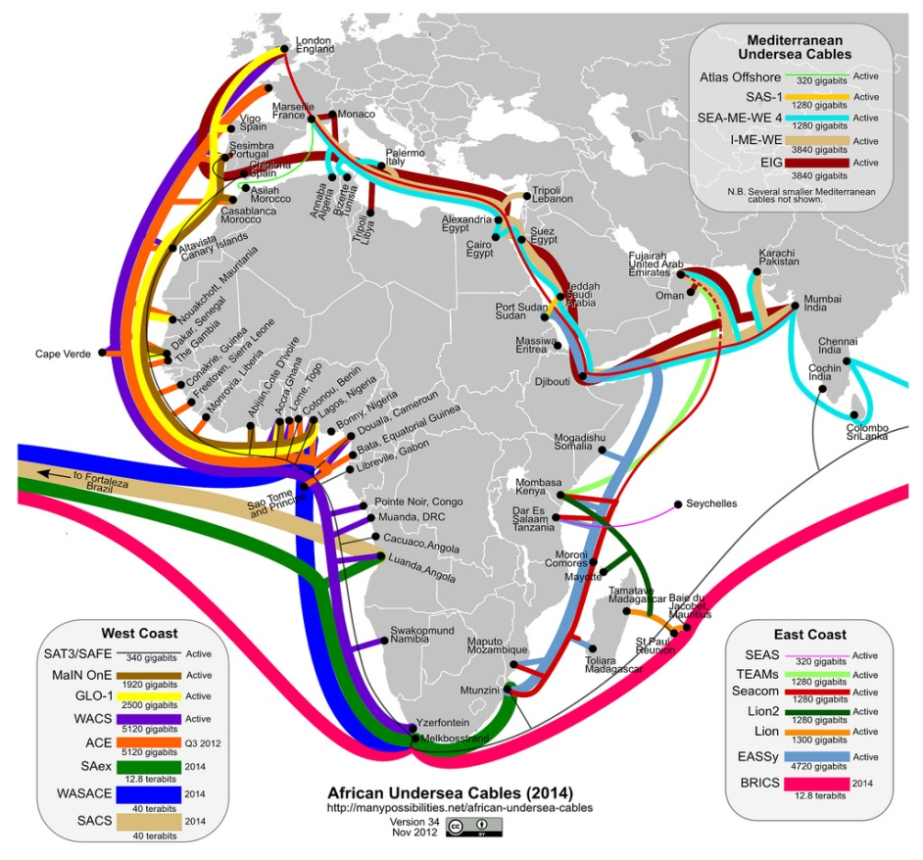
New African Undersea Cables to Europe, India, Middle East
New Cables to Mid East + South Asia
Undersea cables continue to arrive at both African coasts (since 2009); 1000X Potential capacity
To multi-Terabits/sec; 10X more by 2014
Seacom, EASSy, TEAMS, Lion, Lion2, MainOne, GLO1, WACS in production
+ ACE, BRICS, SAex, WASACE, SACS by 2014
Triggered by the 2010 World Cup.
Connections to the African interior spreading
Plus new Mediterranean Cables to Mideast+Gulf
http://manypossibilities.net/african-undersea-cables
More comprehensive map (with terrestrial fiber):
http://www.ubuntunet.net/sites/ubuntunet.net/files/Intra-Africa_Fibre_Map_v6.pdf
Seacom | EASSy | TEAMs | MainOne | WACS | GLO1 | ACE | SAex | WASACE | BRICS
$ 650M | $ 265M | $ 130M | $ 240 M | $ 600M | $ 800 M | $ 700M
13.7 kkm | 10 kkm | 4.5 kkm | 7 kkm | 14 kkm | 9.5 kkm | 14 kkm | 9 kkm | 9 kkm | 34 kkm
1.28 Tbps | 4.72 Tbps | 1.28 Tbps | 1.92 Tbps | 3.84 Tbps | 2.5 Tbps | 5.12 Tbps | 12.8 Tbps | 40 Tbps | 12.8 Tbps
Active 2009 | Active 2010 | Active 2009 | Active 2010 | Active 2012 | Active 2010 | 2013 | Q2 2013 | 2014 | 2014

Slide 9
Normalized TCP Throughput in 2011 vs. UN Human Development Index (HDI)
UNDP HDI:
A long and healthy life, as measured by life expectancy at birth
Knowledge as measured by the adult literacy rate (with 2/3 weight) and the combined primary, secondary and tertiary growth enrollment ratio (with 1/3 weight)
A decent standard of living, measured by GDP per capita
1.0
0.8
0.6
0.4
100k
1M
10M
Normalized Throughput (bps)
Clear Correlation Between the UNDP HDI and the Throughput
Notes:
Dec 2003, 27% unmeasured, 1% bad, 5% v. poor, 4% poor, 46% acceptable, 17% Good.
Note this is not for a fixed set of hosts rather it tracks the sites measured. As time goes forward we add more and more sites in countries with poorer connectivity.

Slide 10
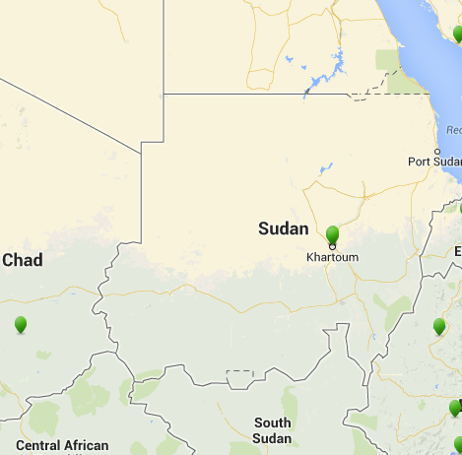
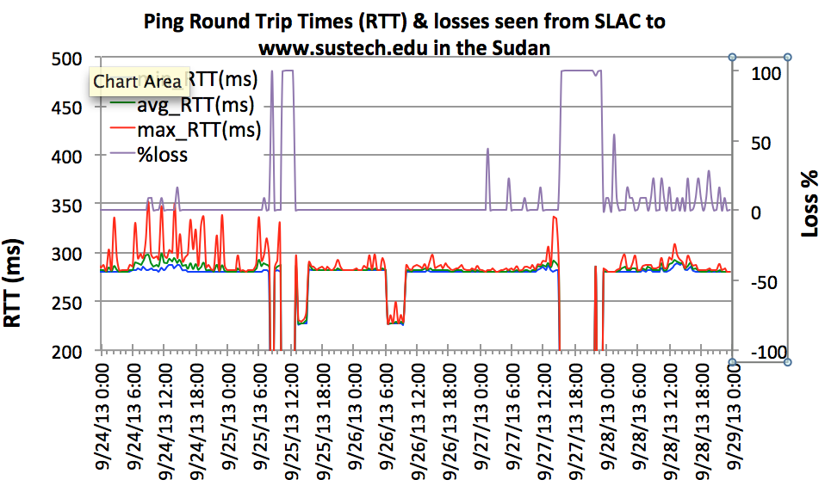
Sudan Internet Blackout
Monitored: www.sustech.edu
Loss
Sept 25 2013
Loss %
RTT (ms)
“We initially stated that Sudan’s outage began at 12:47 UTC because that was when virtually all Sudanese routed networks were withdrawn from the global routing table. However, once we plotted our active measurement data, we observed traffic into Sudan dropping off dramatically 2.5 hours earlier at 10:23 UTC” −Renesys
RTT
The initial loss of connectivity (RTT=unknown=0, loss=100%) is seen between 8:00 and 8:30am September 25th GMT, there is a recovery between 9:00 and 10:15, and then a further loss of connectivity until 13:00. The drops in minimum RTT from ~280ms to ~230ms is probably due to the use of an alternate route.
R. Cottrell

Slide 11
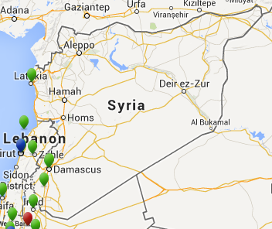
Syria went offline
Monitored: www.inet.sy, www.thawraonline.sy
PingER Measurements from SLAC to 2 hosts in Syria showed both not responding from 18:37 May 7, 2013 to 13:37 May 8, 2013
May 7-8
2013
R. Cottrell
“Internet in Syria has been restored on Wednesday at 14:13 UTC. The country went offline on Tuesday at around 18:45 UTC as Internet connectivity was completely cut across the nation.” −The Next Web
1
SLAC to www.inet.sy
RTT (s)
0
SLAC to www.thawraonline.sy
May 7
May 8
May 9
Blue line = Avg RTT, Background color = Loss
No loss
<5% loss
<10% loss
<20% loss
<20% loss
<50% loss
<100% loss, no response, disconnected

Slide 12
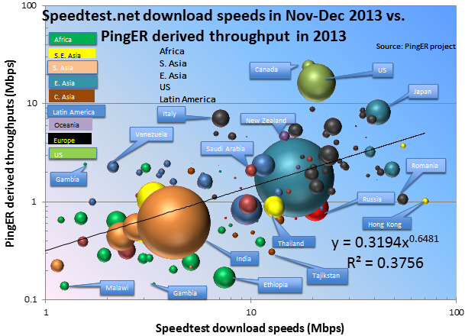
Comparison of Speedtest.net with PingER December 7 2013
The Household Download Index from Ookla is based on millions of recent test results from Speedtest.net, this index compares and ranks consumer download speeds around the globe. The value is the rolling mean throughput in Mbps over the past 30 days where the mean distance between the client and the server is less than 300 miles. We downloaded the data for ~180 countries from Ookla on December 7th, 2013.
A bubble plot comparing the measurements is shown. The X-axis is for the PingER derived throughput, the Y-axis for the Speedtest download speeds. The bubble size is proportional to the population. The trendline is a power series fit to the data.
R. Cottrell
Bubble size
Proportional
To Population
There is a positive correlation despite the very different methods
Notes:
As might be expected the PingER values are lower than those of Speedtest since Speedtest measurements are made from within 300km (and thus lower Round Trip Times) than the PingER measurements made from SLAC with distances up to 11,000km . Thus measurements from SLAC in the US (shorter distances) to the US have better agreement,. Despite the differences in measurement time window, and measurement method there is a positive correlation (R²=0.38)between the results.

Slide 13
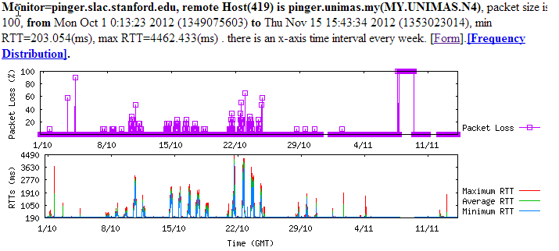
Congestion at UNIMAS Malaysia
Nov to Oct. 2012
We noticed severe diurnal variations to most hosts measured from UNIMAS. We suspected that maybe UNIMAS itself is congested. Congestion is usually an edge effect since the backbones are well provisioned.
Traffic shaping was applied at the end of October. See the time series on right where there is seen to be a dramatic improvement in (flat line, cyan background shows no losses) November compared to October.
R. Cottrell
October ‘12
November ‘12
Notes:
The black areas

Slide 14
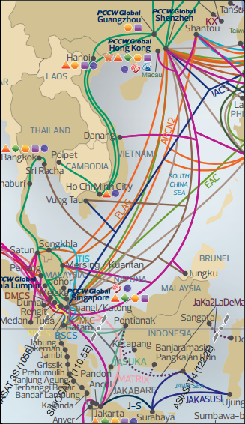
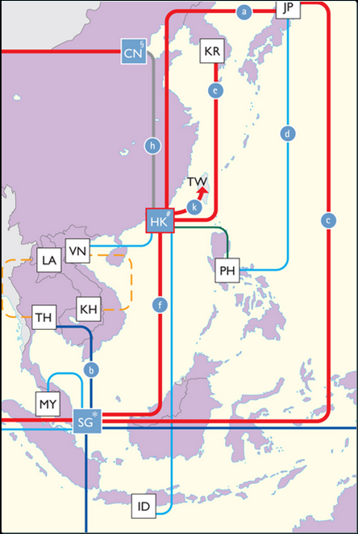
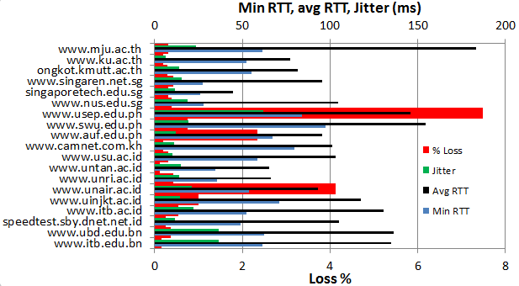
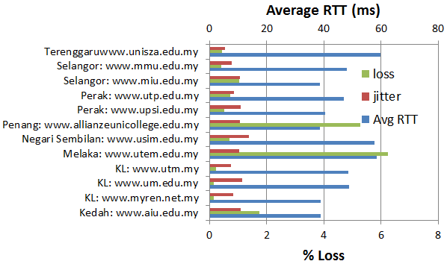
Routing from UNIMAS (Borneo/W Malaysia) Malaysia, Jan 2013
RTT & jitter (ms) from UNIMAS to S.E. Asia
To Malaysia
UNIMAS
Routes in S.E. Asia
Apart from within Western Malaysia the routes are very indirect
R. Cottrell

Slide 15
PINGER: Events and Presentations by R. Cottrell, et al. in 2013
“Africa 'leapfrogs' to wider Internet access”. Al Jazeera, Sept 2, 2013. Also appeared on SlashDot Front Page, Sept 3, 2013, referenced in SLAC Today as "SLAC expert weighs in on Internet access in Africa ", Sept 6, 2013
Two day workshop on PingER at the University of Malaya in Kuala Lumpur, June 2013
"Pinger: Measuring the Worldwide Internet's end-to-end performance”
"Navigating the PingER web site”
“PingER: Research Opportunities and Trends”,
“High Energy Physics Computing and Network Needs for Worldwide Collaborations”
“The Emergence of the Internet and Africa”, invited SLAC wide coloquium, May 6th 2013
“PingER project data on the health of Africa’s Internet networks”, in oAfrica Journal, April 15, 2013.
“Why continuous investment and improvement in African ICT infrastructure is important”, contributed by Les Cottrell to EGy Africa News, Number4, February, 2013.
Submitted paper on dynamic ping delay based Geolocation to ACM/IEEE
“Pinging Africa: A decadelong quest aims to pinpoint the Internet bottlenecks holding Africa back”, R. Les Cottrell, IEEE Spectrum magazine Feb 2013.

Slide 16
Key Network Monitoring WG Report Updates, 2013
The addition of case studies on:
Internet disconnections: Sudan, Syria.
Study on routing an internet performance from the University of Malaysia in Sarawak (UNIMAS) to Malaysia & Identification of congestion at UNIMAS
Compared PingER and Speedtest.com throughputs to see how they correlate
Initiated collaboration with University of Malaya in Kuala Lumpur and the Technical University of Malaysia in Johor Bahru
Hosted:
PhD student from NUST in Pakistan as a 1 year visiting scientist at SLAC
Student for UERJ Brazil for 3 months internship at SLAC
Added extra monitoring hosts in Malaysia and Pakistan.
Increased the coverage of PingER
Created prototype Linked Open Data access to PingER
Started development of geolocation Visual traceroute

Slide 17
PingER Project Issue: Funding for Managing the Effort
The management and operation includes maintaining data collection and archiving, explaining needs, identifying and reopening broken connections, identifying and opening firewall blocks, finding replacement hosts, making limited special analyses and case studies, preparing and making presentations, responding to questions. The equipment performing this in this country is currently in place at SLAC . There is also an archive/analysis site in Pakistan.
Management, operation and supervision requires central funding at a level of about 20% of a Full Time Equivalent (FTE) person, plus travel. This had been provided by discretionary funding from the HEP budgets of SLAC and FNAL, until the beginning of 2008.
Google are interested in the preserving the history of the Internet implicit in the PingER data

Slide 18
PingER: Uncertainty for Managing the Future
Many agencies/organizations have expressed interest (e.g DoE, ESnet, NSF, ICFA, ICTP, IDRC, UNESCO, IHY) in this work, also Google is interested in the historical interest now and going forward, but none have so far stepped up to funding the management and operation.
Without funding, for the operational side, the future of PingER and reports such as this one is unclear, and the level of effort sustained in previous years will not be possible.

Slide 19
Extra Slides

Slide 20
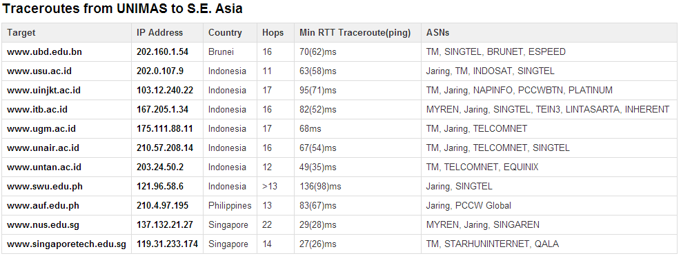
Routing from UNIMAS Malaysia
Jan 2013
R. Cottrell

Slide 21
PINGER: Events and Presentations by R. Cottrell, K. Satar et al. in 2012
Pinging Africa: A decadelong quest aims to pinpoint the Internet bottlenecks holding Africa back, R. Les Cottrell, IEEE Spectrum magazine Feb 2013.
ICSU Grant Progress Report.
PingER status report June 2012, for eGYAfrica
MOU between SLAC & the University of Malaysia in Sarawak (UNIMAS), Presentation by R. Cottrell to SLAC CIO, June 15, 2012.
Summer 2012 Joint Techs, Stanford CA, July 16, 2012: R. Cottrell: PingER: Getting a lot from a simple utility
eGYAfrica Workshop, Better Internet Connectivity for Research and Education in Africa, Nairobi October 2012: R. Cottrell, The Worldwide Digital Divide and Africa
PingER Submission to the Silicon Valley Tech Awards 2012, November 2012.
Malaysia National Research and Education (MYREN) meeting, Kuala Lumpur, December 12, 2012: (1) Anjum Naveed, PingER Deployment for PERN Performance Monitoring (2) R. Cottrell, PingER: Actively measuring the worldwide Internet's end-to-end performance, by Les Cottrell
Univ. of Malaysia Workshop in Sarawak, December 13-17, 2012: (1) R. Cottrell, PingER: Navigating the Web Site and Mining the Data (2) Kashif Satar, PingER Installation Notes from hands-on session (3) Kashif Satar, PingER in Pakistan (4) R. Cottrell, Actively measuring the worldwide Internet's end-to-end performance Extended version (5) Anjum Naveed, PERN Performance Monitoring in Pakistan

Slide 22
Key Network Monitoring WG Report Updates, Fall 2011 through 2012
The addition of case studies on: Nigeria, Syria, Pakistan, & Malaysia.
Signing of an MoU between SLAC and the University of Malaysia in Sarawak (UNIMAS).
Added extra monitoring hosts in Malaysia and Pakistan.
Improved the main web reporting tool to add access to the most recently measured data and routing information.
Lectures in the Democratic Republic of the Congo, 3 day workshop on PingER at the University of Sarawak in Malaysia; invited presentations to: Internet2 Joint Techs at Stanford (opening presentation), Malaysian National Research and Education Network (MYREN) in Kuala Lumpur, and eGYAfrica 2012 Workshop in Nairobi, Kenya, among others.
Added new metrics to show the performance of Voice over IP, and the directness of connectivity

Slide 23
Key Observations 2012
After many years of falling further and further behind the rest of the world, following the soccer world cup and the installation of new terrestrial fibre cables, Africa appears to be starting to catch up. This is important since it enables Africa to contribute to science
Square Kilometre Array
Strategic plan for a synchrotron light source in southern Africa
CERN’s donation of 220 computer servers to Ghana university, e.g. to enable student participation in simulation of LHC data.
Bi-monthly reports to the Pakistan Educational Research Network which have clearly demonstrated the problems with reliability and power, and mis-routing. Pakistan is an LHC collaborator.
We have signed an MoU with a Malaysian university. We are working on getting funding from Malaysia higher education.
We are beginning to make headway on providing an end-to-end active monitoring infrastructure for Malaysia.

