Slide 1
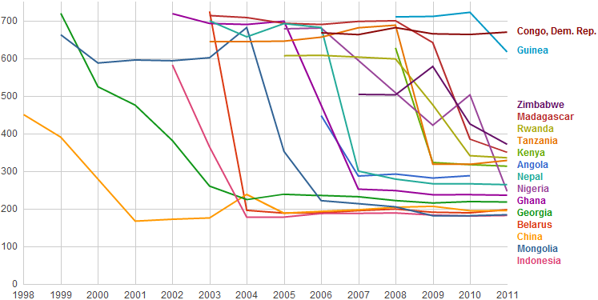
Minimum RTT
Minimum RTT from SLAC to Various Countries since 1998
Year

