Slide 1
Pulse Shaping with MIIPS
SASS 8/22/2012
David Nicholson

Slide 2
Outline
Pulse shaping introduction
MIIPS
MATLAB Simulations
Actual implementation

Slide 3
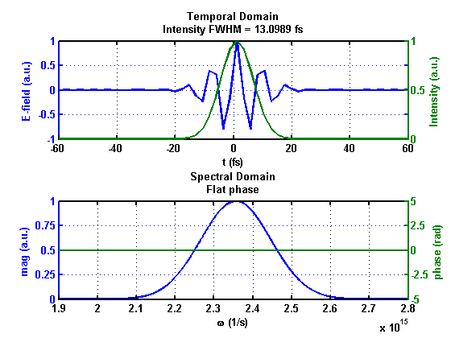
Laser pulses can be defined in the time or frequency domains
Electric field of pulse is equivalently defined in both
Time:
Freq.:
Typical fourier transform properties apply

Slide 4
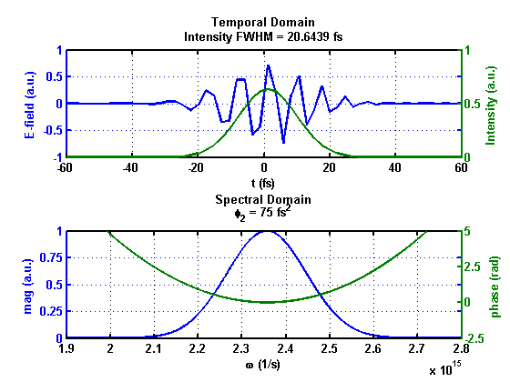
The spectral phase components determine the temporal structure of pulse
Constructive and destructive interference determines temporal profile
As pulse propagates through air and optics, dispersion affects the temporal structure

Slide 5
2nd Order Phase

Slide 6
3rd Order Phase

Slide 7
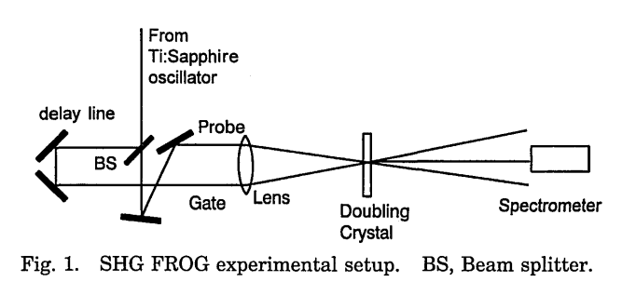
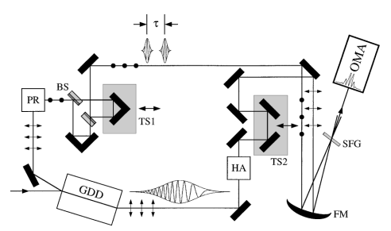
There are many methods to measure the temporal profile of fs pulses.
FROG
Split beam in two
Cross in SHG crystal and scan time delay
Phase retrieval problem
SPIDER
Split beam in three
Chirp one pulse and cross three in SFG crystal

Slide 8
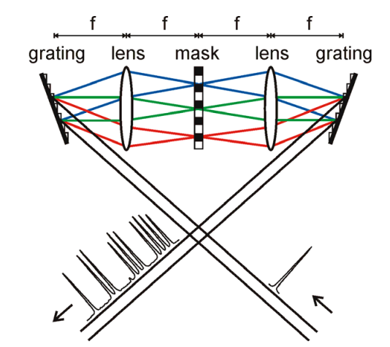
The 4-f shaper allows the adjustment of spectral phase components.
Once you have measured the phase, a simple way to correct it, or apply any phase is the 4-f shaper
Spectral components modulated in fourier plane by SLM

Slide 9
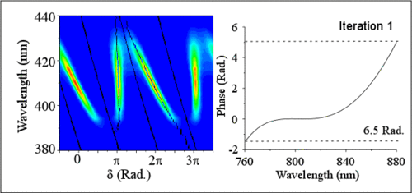
MIIPS allows for pulse characterization and shaping in a single 4-f device.
Takes advantage of SHG sensitivity to phase profile of input pulse
Place SHG crystal and spectrometer anywhere downstream of 4-f shaper to measure and correct phase at the point
SHG Crystal
Spectrometer

Slide 10
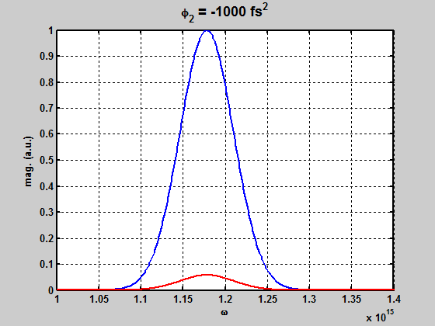
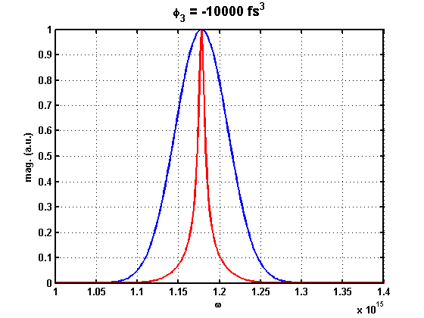
MIIPS leverages SHG’s dependence on the spectral phase profile.

Slide 11
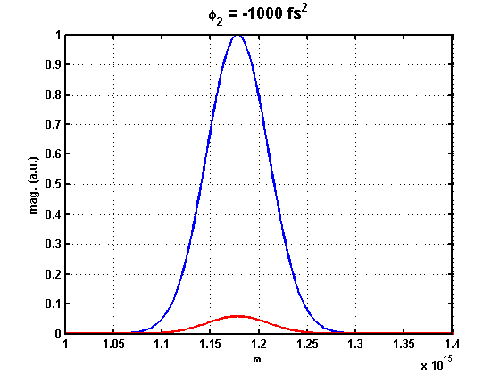
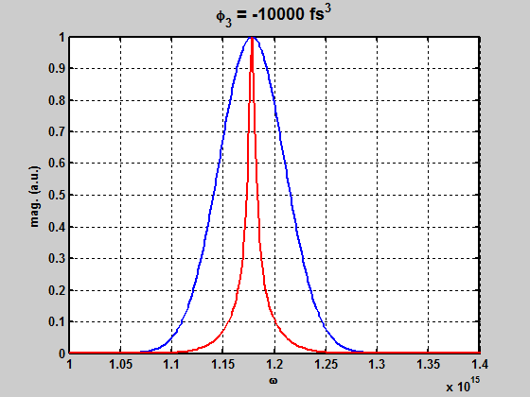
MIIPS leverages SHG’s dependence on the spectral phase profile.

Slide 12
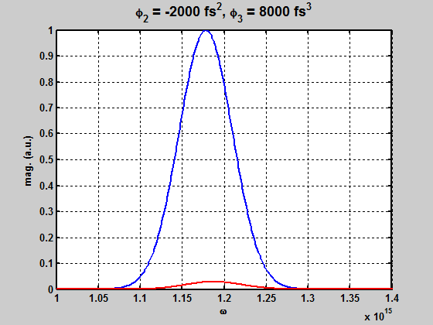
MIIPS leverages SHG’s dependence on the spectral phase profile.

Slide 13
MIIPS leverages NL signals to measure the input pulse’s phase profile.
Input phase is unknown
Apply reference phase modulation with variable parameter, watch SHG
For each step in parameter variation, maximum SHG signal occurs when curvature of total phase is 0.
Construct 2nd derivative, double integrate to find phase
Apply inverse of phase to correct on SLM

Slide 14
MIIPS iterates on this procedure to find the correct phase to apply.
Apply reference phase on top of unknown phase,
scan the δ parameter.

Slide 15
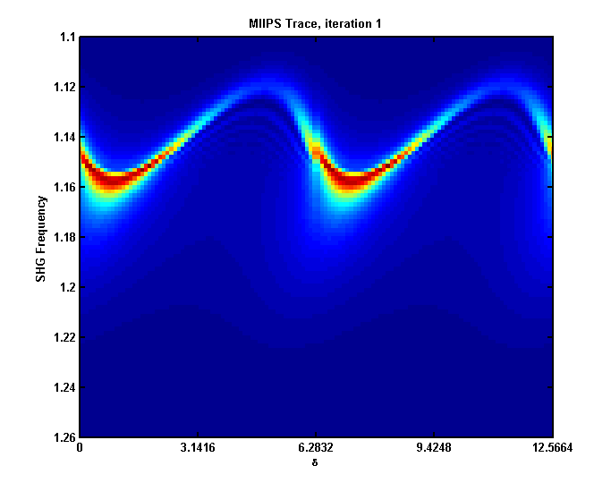
MIIPS iterates on this procedure to find the correct phase to apply.
The SHG signals are arranged to give the MIIPS trace.
Each column is a SHG spectrum reading.

Slide 16
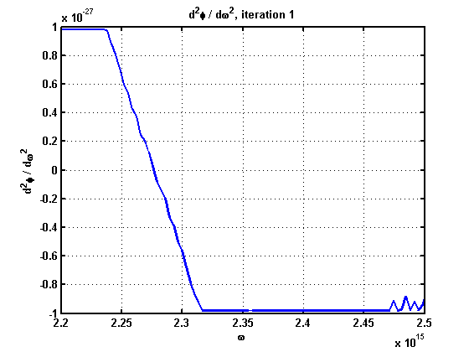
MIIPS iterates on this procedure to find the correct phase to apply.
At each frequency, the peak signal is taken to give
From this, is generated as:

Slide 17
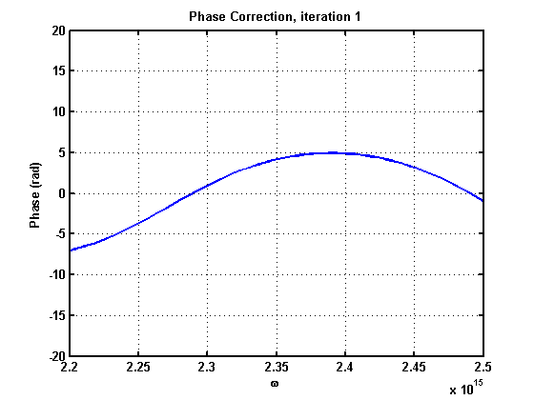
MIIPS iterates on this procedure to find the correct phase to apply.
Knowing that , we integrate to find:

Slide 18
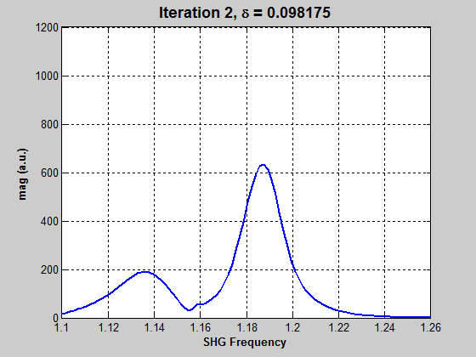
MIIPS iterates on this procedure to find the correct phase to apply.
Now start the next iteration, by reapplying the sin modulation.

Slide 19
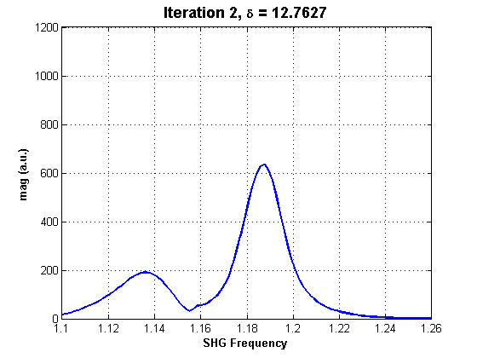
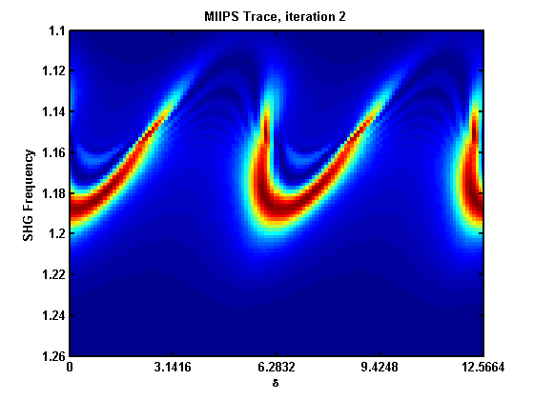
MIIPS iterates on this procedure to find the correct phase to apply.
The SHG signals are arranged to give the MIIPS trace.
Each column is a SHG spectrum reading.

Slide 20
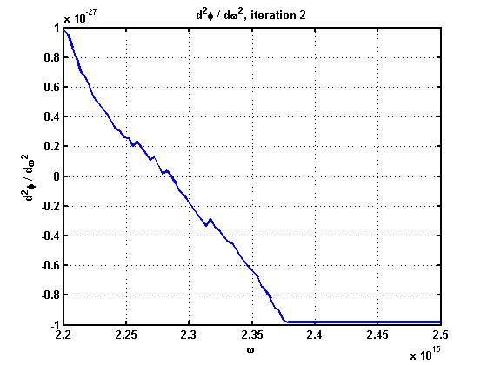
MIIPS iterates on this procedure to find the correct phase to apply.
At each frequency, the peak signal is taken to give
From this, is generated as:

Slide 21
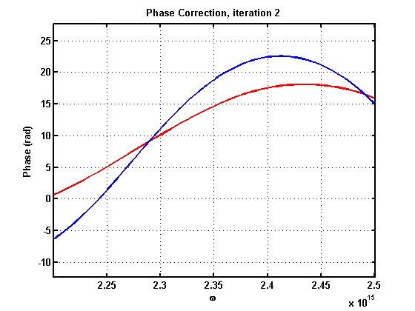
MIIPS iterates on this procedure to find the correct phase to apply.
Red curve is correction from this iteration, blue curve is total correction from all iterations
Knowing that , we integrate to find:

Slide 22
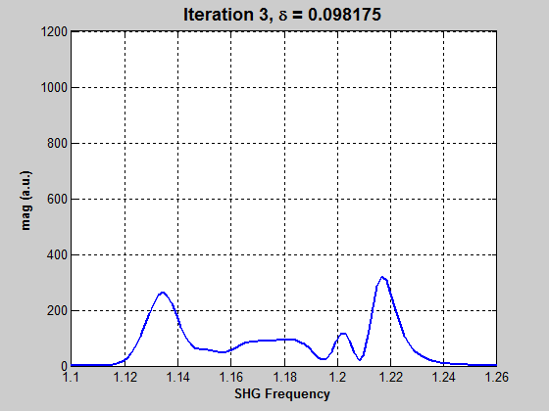
MIIPS iterates on this procedure to find the correct phase to apply.
Now start the next iteration, by reapplying the sin modulation.

Slide 23
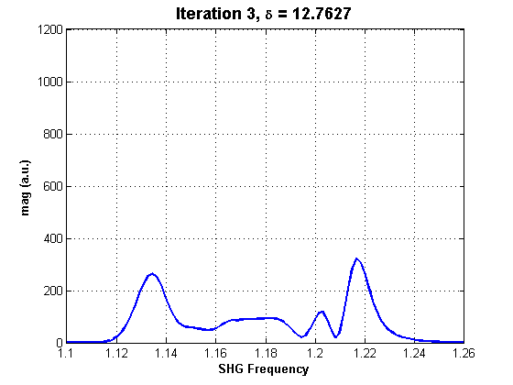
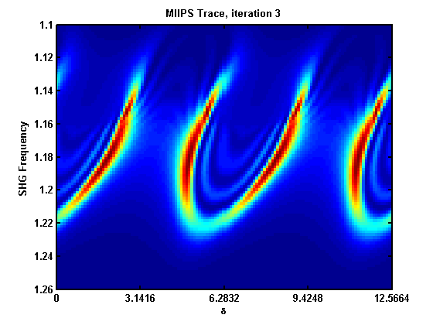
MIIPS iterates on this procedure to find the correct phase to apply.
The SHG signals are arranged to give the MIIPS trace.
Each column is a SHG spectrum reading.

Slide 24
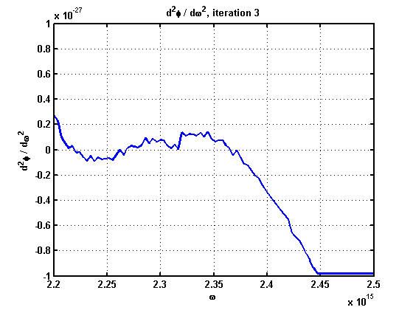
MIIPS iterates on this procedure to find the correct phase to apply.

Slide 25
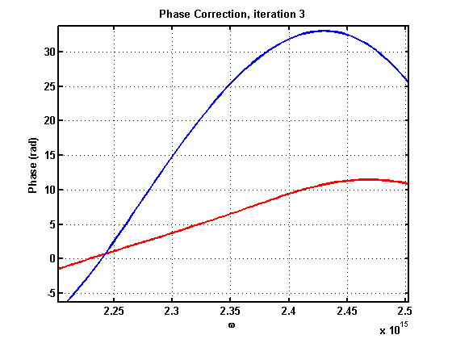
MIIPS iterates on this procedure to find the correct phase to apply.

Slide 26
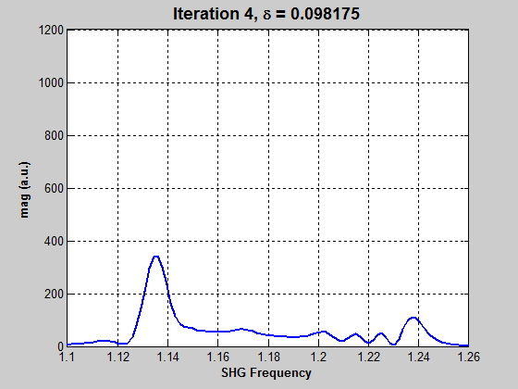
MIIPS iterates on this procedure to find the correct phase to apply.

Slide 27
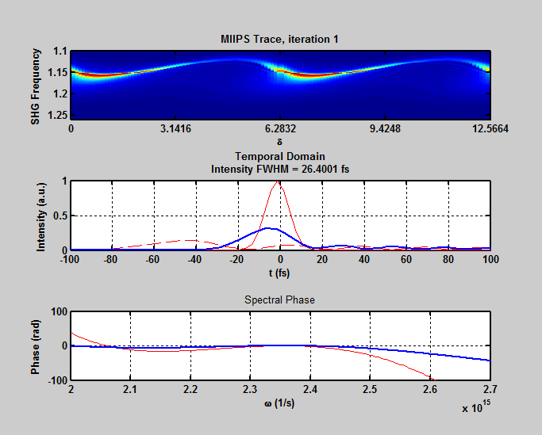
MATLAB simulations demonstrate MIIPS ability to correct unknown phase profiles
MIIPS trace, sin wave scanned over 4π
Time reconstruction of pulse.
Solid red = TL pulse
Dashed red = initial pulse
Blue = pulse after current iteration
Phase profile of pulse
Red = Initial phase profile of pulse
Blue = MIIPS determined phase profile after each iteration

Slide 28
A MIIPS based shaper was built in one of David Reis’s building 40 labs.
Actual setup

Slide 29
A MIIPS based shaper was built in one of David Reis’s building 40 lab.
Shaping done between oscillator and regen amplifier
Phase profile maintained through amplifier
SLM is CRi, dual mask 128 pixels
Lens is 6” achromat
Grating is 300 l/mm
Coherent Evolution Regen Amp
Femtosource Synergy Ti:Sapph Oscillator
SLM

Slide 30
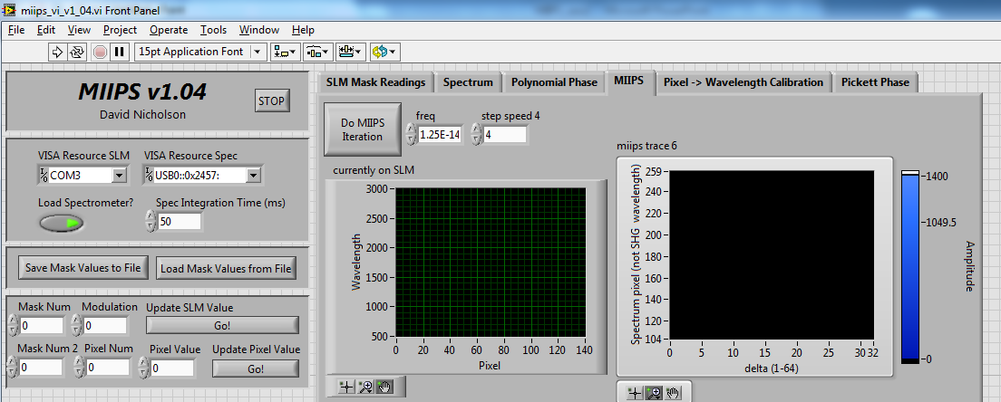
A LabVIEW VI was programmed to talk with instruments and do MIIPS

Slide 31
The setup was used to compress the oscillator pulse.
SHG spectrum from OO USB2000
Temporal profile measured with A.P.E. SPIDER
Dotted red = TL pulse
Blue = temporal profile after each iteration (iteration 0 is pulse with 0 phase applied on SLM)
Spectrum measured with SPIDER
Slight positive quadratic phase from path difference between MIIPS SHG and SPIDER.
Higher order negative phase at wings likely due to low SPIDER signal

Slide 32
There is still room for improvement and work to do.
Switch from lens-based 4f shaper to all reflective
Improve calibration routines for determining applied phase
Increase routine speed
More options in VI
Route the shaped pulse through the Regen amplifier

Slide 33
There are plans to use the pulse shaper for HHG experiments.
SLM allows phase and amplitude shaping
Plan to explore pulse bandwidth and phase profile parameter space to see effect on HHG signals.
Next gen FELs may be HHG-seeded
We hope to gain control over spectral properties of HHG
Linewidth of each harmonic, etc.

Slide 34
Bibliography
V. Lozovoy, I. Pastirk, & M. Dantus. Multiphoton intrapulse interference. IV. Ultrahshort laser pulse spectral phase characterization and compensation. Opt Lett 29, 2004.
I. Pastirk, M. Dantus, et al. No loss spectral phase correction and arbitrary phase shaping of regeneratively amplified femtosecond pulses using MIIPS. Opt Exp 14, 2006.
J. Vaughan. Ultrafast Pulse Shaping. Chapter 13, Ultrafast Optics. (via http://frog.gatech.edu/prose.html)
R. Trebino, et al. Frequency-resolved optical gating with the use of second-harmonic generation. JOSA B 11, 1994.
I. Walmsley, et al. Characterization of sub-6-fs optical pulses with spectral phase interferometry for direct electric-field reconstruction. Opt Lett 24, 1999.

