Slide 1


Photon-Enhanced Thermionic Emission
A New Approach to Solar Energy Harvesting
Jared Schwede
schwede@stanford.edu
SLAC Association for Student Seminars
September 8, 2010

Slide 2
Outline
Global Context
  Renewable energy is a large (but achievable) endeavor
  Importance of solar
Existing harvesting technologies
  Photovoltaic (PV) cells
  Solar Thermal
Photon-Enhanced Thermionic Emission
  Describe process
  Theoretical Efficiency
  Experiments on temperature dependence of [Cs]GaN emission

Slide 3
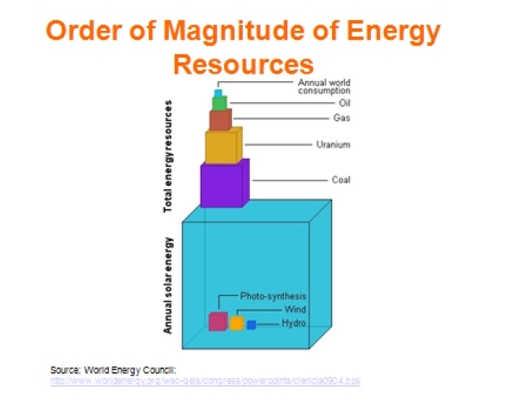
Total Energy Resources
Image credit: Joan Ogden

Slide 4

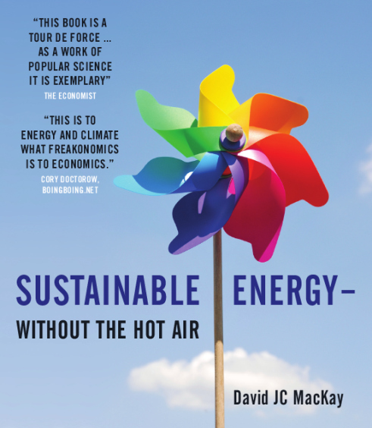
Land Requirements
Wheat
3 TW
Roads
Map credit: Nate Lewis
Road and wheat information from: Lester Brown, Plan B, 2003
Notes:
Quote from Nate Lewis presentation:
Nuclear (fission and fusion)
10 TW = 10,000 new 1 GW reactors
i.e., a new reactor every other day for the next 50 years

Slide 5
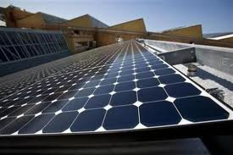
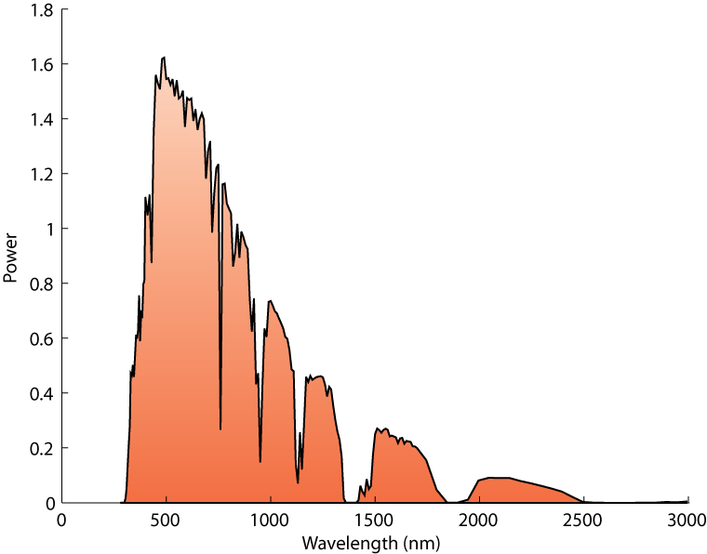
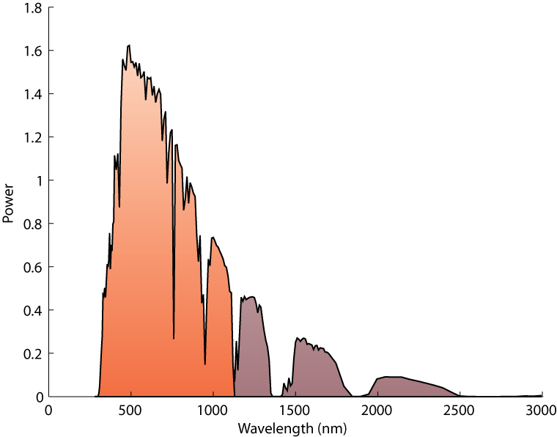
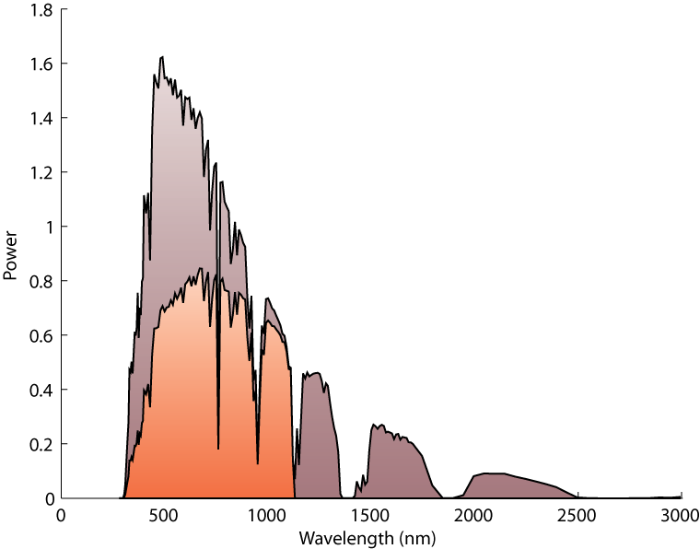
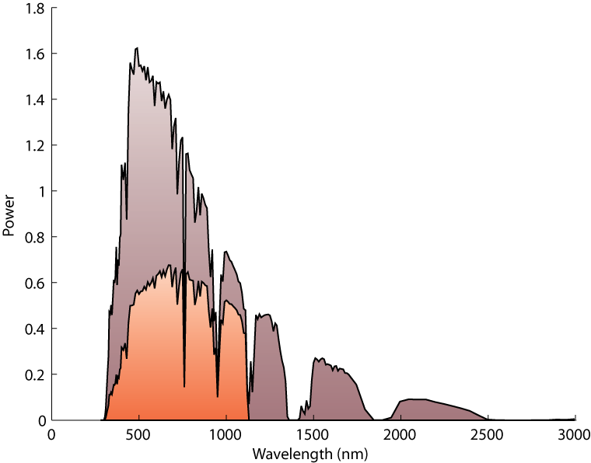
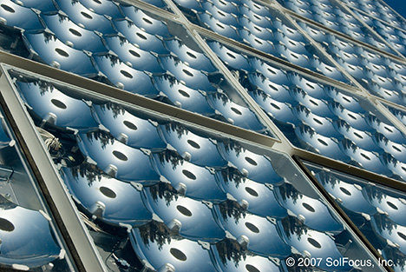
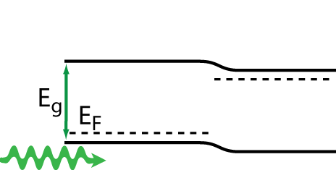
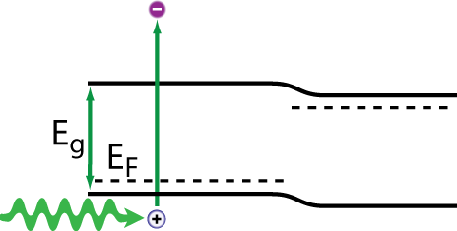
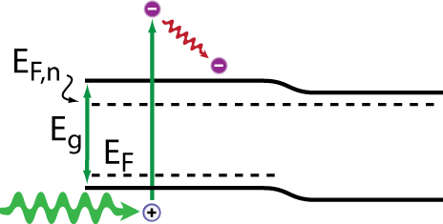
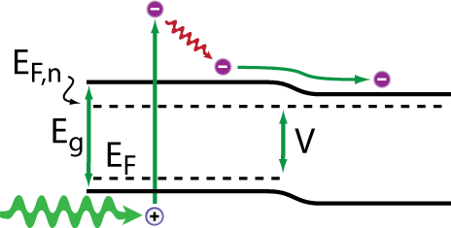
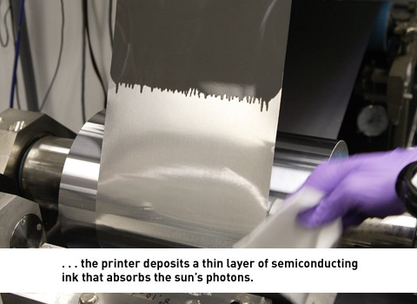
Photovoltaic Cells: Quantum Based Conversion
Total ~12% of GWhr/yr in approved plants in PG&E’s Renewable Portfolio From “Status of RPS Projects”
Absorption
Thermalization
Charge extraction
SunPower
SolFocus
NanoSolar

Slide 6

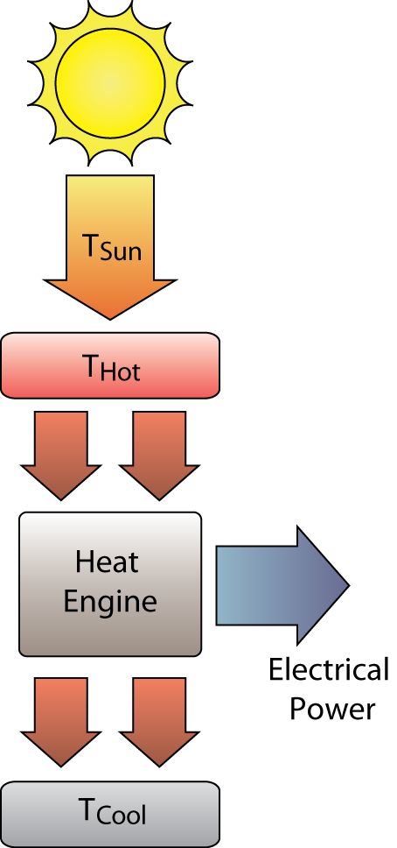
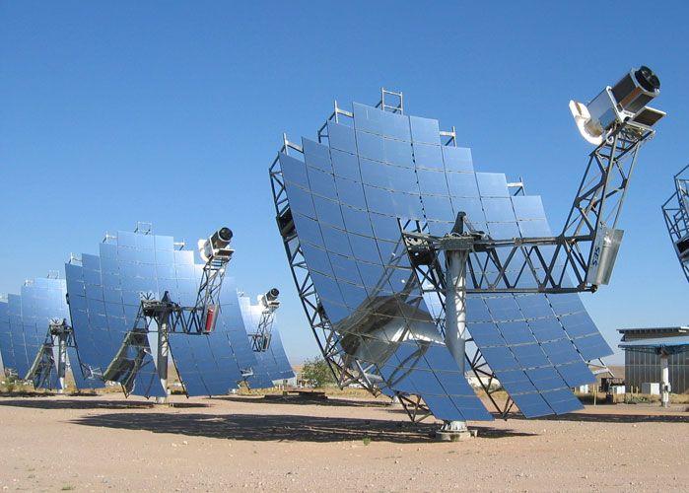
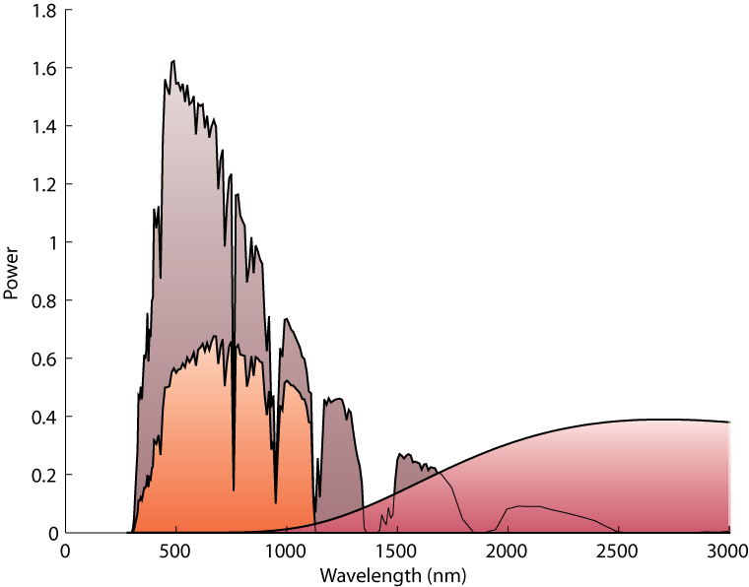
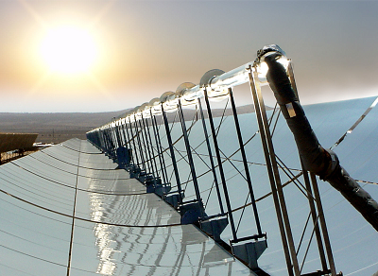
Solar Thermal Conversion
Total ~34% of GWhr/yr in approved plants in PG&E’s Renewable Portfolio
Solar radiation as heat source
High energy photons down-converted
eSolar
Stirling Energy Systems
SCHOTT Solar
Notes:
Weird solar thermal? Microscope on the ant. Actually leveraging a bunch of tech we already know.
Whether your working fluid is steam, hydrogen, or electrons, ultimate efficiency limited by the temperature of the device.
Solar thermal devices do not exploit the high per-photon energy of the solar spectrum, as the same power could be achieved from a blackbody at a much lower temperature.
An efficient way to harvest the solar spectrum would be to use the high per-photon energy of solar photons in a quantum process and deliver the remainder of the energy as heat to a thermal cycle. However, PV cells rapidly lose efficiency…

Slide 7
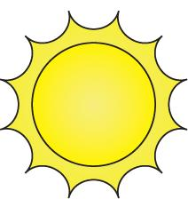
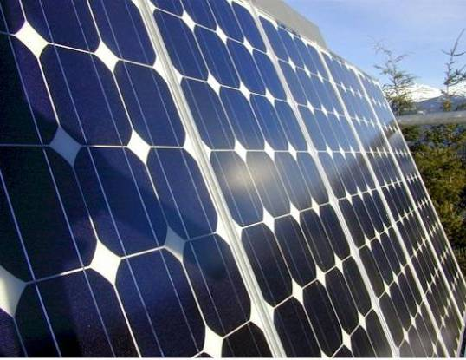
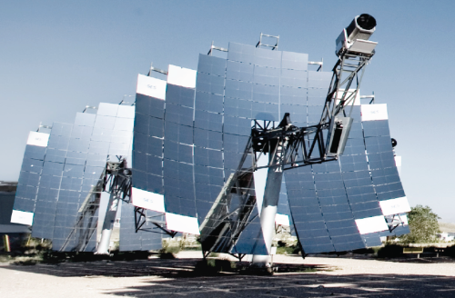
Combined Cycles
photo-electricity out
waste heat
thermo-electricity out
Backing thermal cycle captures waste heat of high-temperature photovoltaic

Slide 8
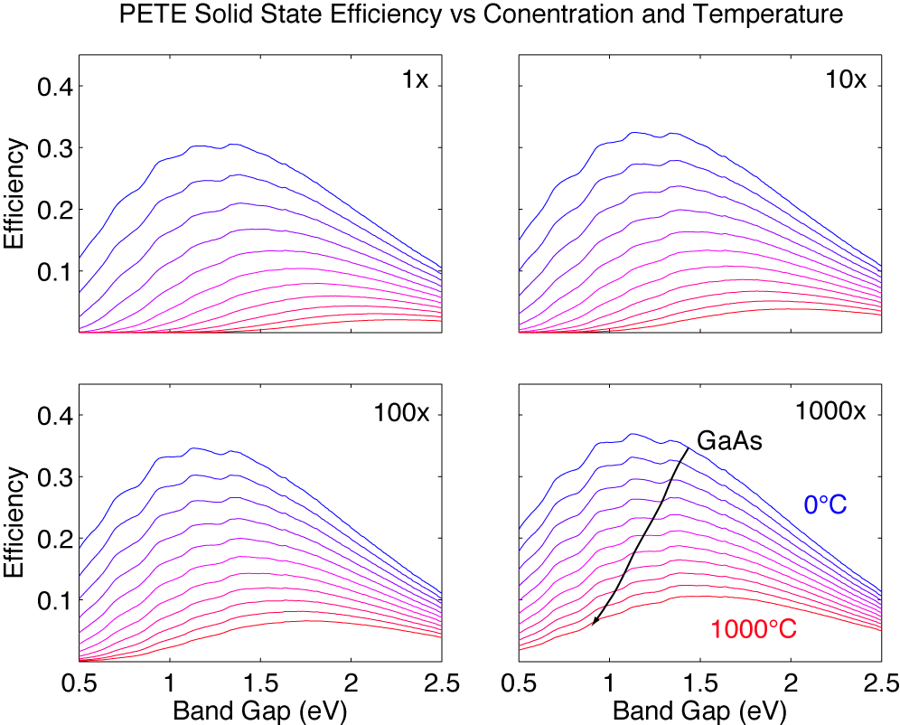
Photovoltaics and Temperature

Slide 9
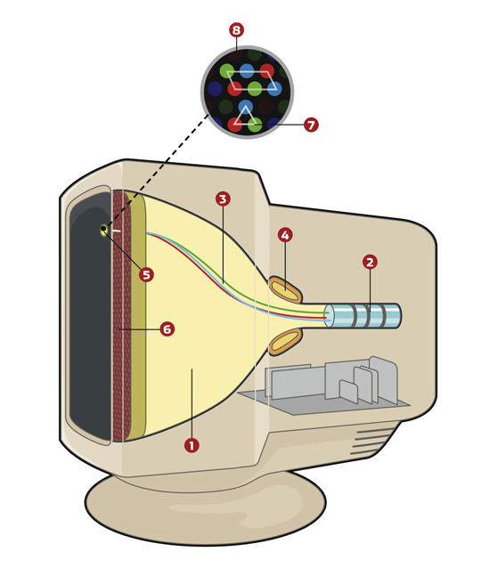
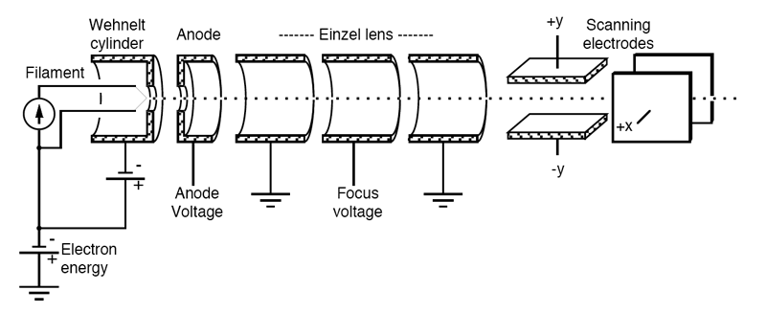
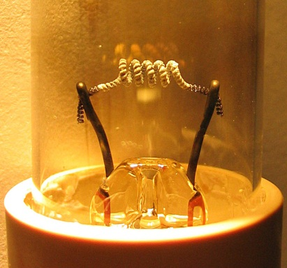
Thermionic Emission
Images from:
- http://en.wikipedia.org/wiki/Thermionic_emission
- eaps4.iap.tuwien.ac.at/~werner/qes_tut_exp.html
- computershopper.com/feature/how-it-works-crt-monitor
Notes:
Talk about work functions here

Slide 10
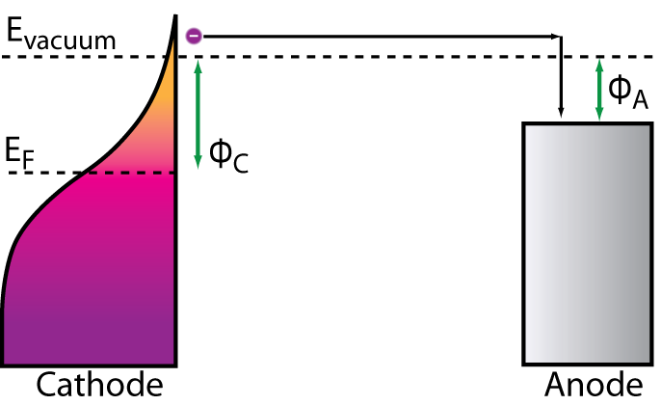
Thermionic Emission
J = AT² e^{-φC/kT}
P = J (φ_{C} – φ_{A})
Notes:
Lower phi, lower T anode
Vacuum gap

Slide 11
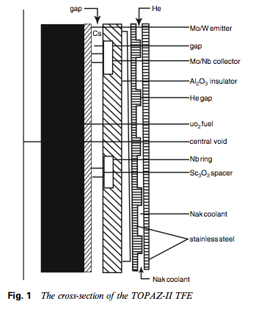
Thermionic Energy Converters for Space Applications (1956 - 1989)
Work in the US and USSR space programs culminated in the Soviet flights of 6 KW TOPAZ thermionic converters in 1987
Source of heat: fission
Basic technology: vacuum tubes
Machined metal with large gaps (>100 μm) and required cesium plasma to reduce work function and neutralize space charge

Slide 12
Thermionic Emission
J = AT² e^{-φC/kT}
P = J (φ_{C} – φ_{A})
Notes:
Lower phi, lower T anode
Vacuum gap

Slide 13
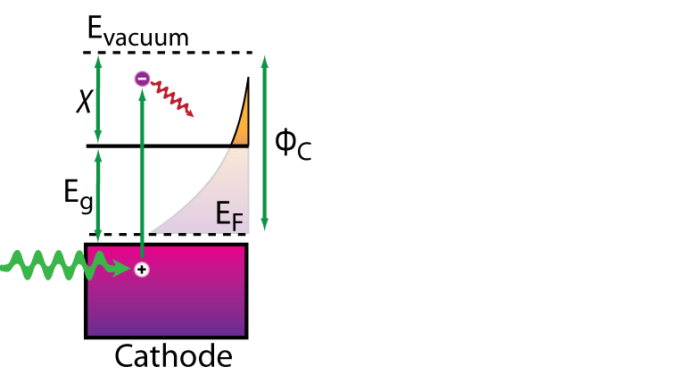
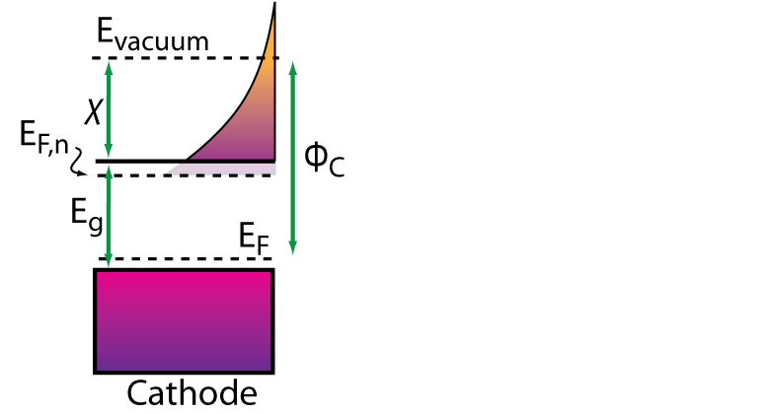
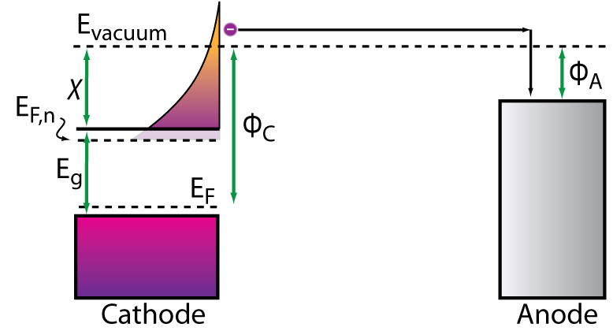
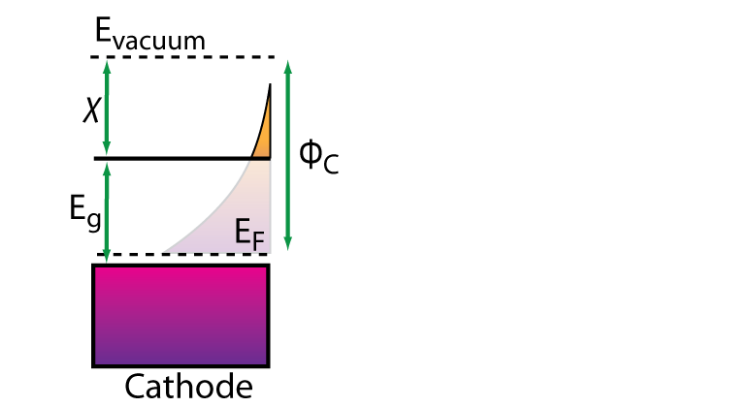
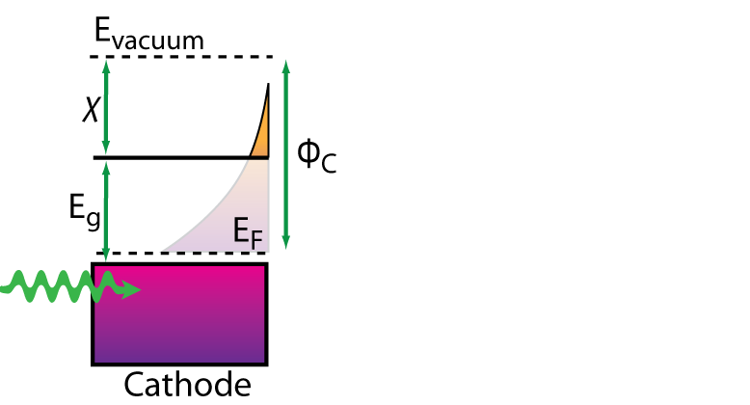
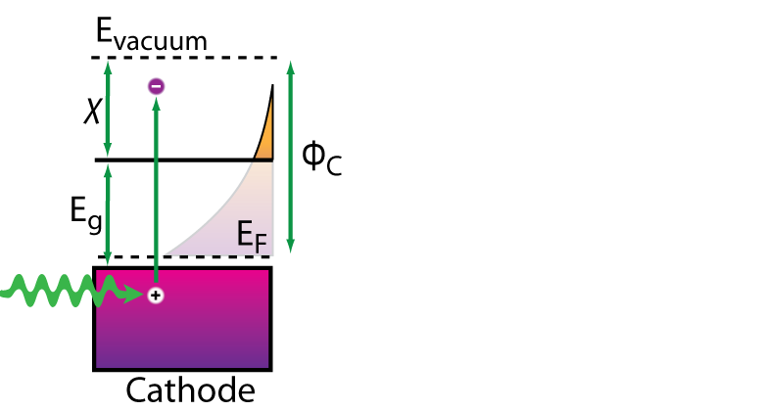
Photon Enhanced
Thermionic Emission
Photovoltaic + thermionic effect
Higher conduction band population from photoexcitation
Higher V at same T and J than in thermionic emission
PV-like efficiency at high temperatures: excess energy no longer “waste heat”
Notes:
Photon enhanced thermionic emission combines a quantum and thermal process into a single electricity generating mechanism.
A combination of two well known effects: photovoltage, thermionic emission
Vacuum gap

Slide 14
Photon Enhanced
Thermionic Emission
J = AT² e^{-φC/kT} e^{ΔEf/kT}
J = q_{e}n<v_{x}>e^{-χ/kT}
Notes:
Recombine or emit in this slide. Competition.

Slide 15
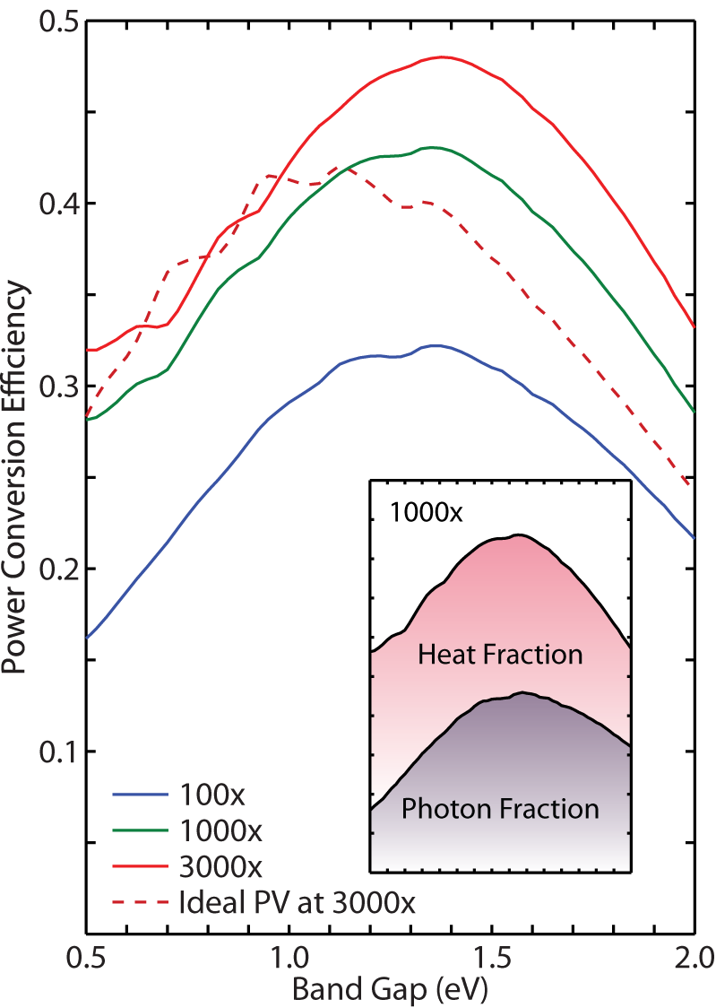
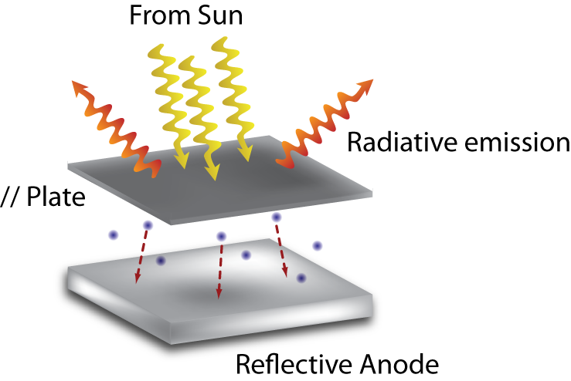
Theoretical efficiency of a parallel plate PETE device
To adjust: E_{g}, χ ,T_{C}
φ_{A} = 0.9 eV
  [Koeck, Nemanich, Lazea, & Haenen 2009]
T_{A} ≤ 300°C
Other parameters similar to Si
  1e19 Boron doped
Schwede, et al. Nature Materials (2010)
Notes:
Contrast to PV cells detailed balance

Slide 16
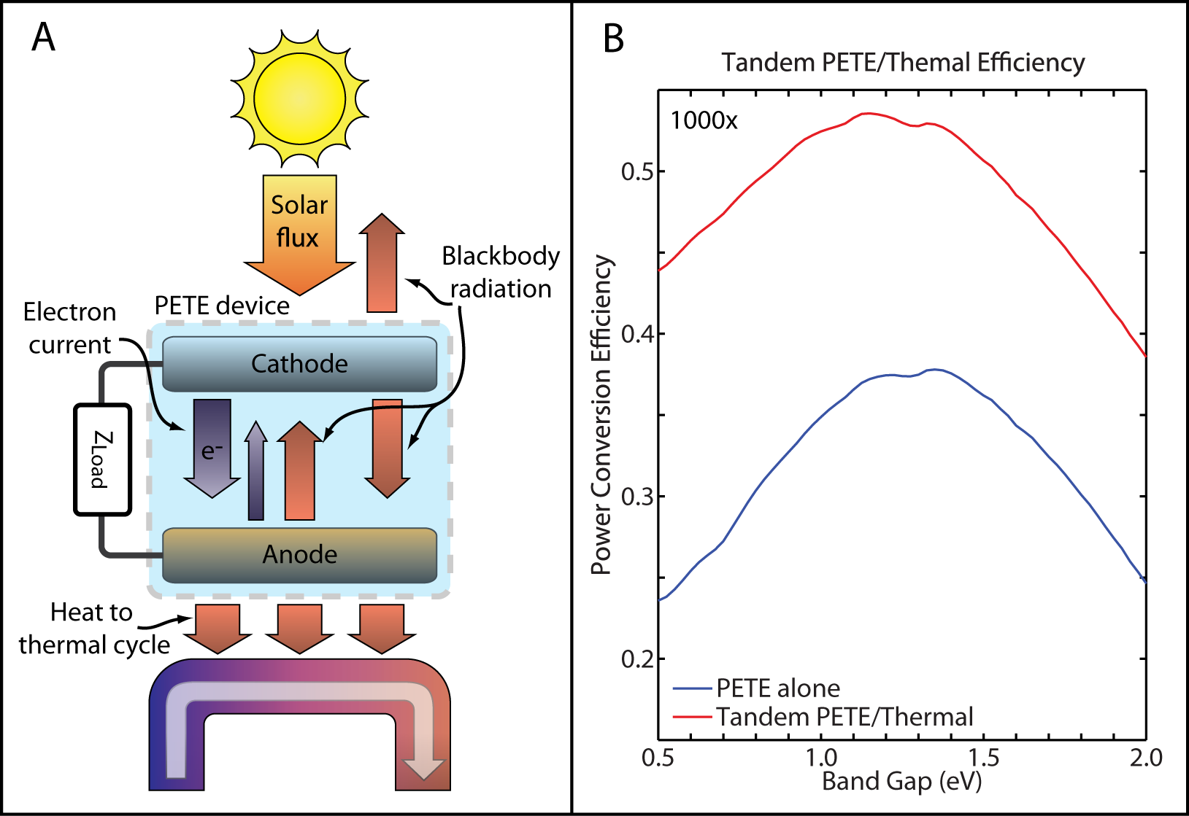
Theoretical tandem cycle efficiency
31.5% Thermal to electricity conversion [Mills, Morrison & Le Lieve 2004]
285°C Anode temperature [Mills, Le Lievre, & Morrison 2004]

Slide 17
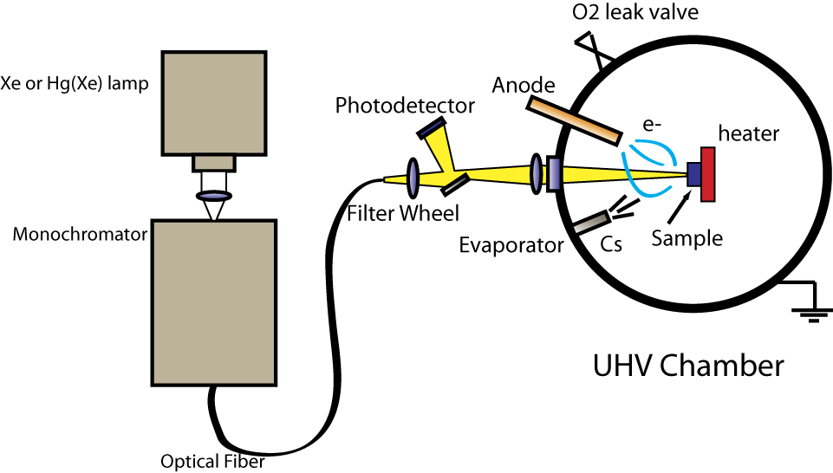
Proof of Principle from [Cs]GaN
[Cs]GaN thermally stable
  Resistant to poisoning
  E_{g} = 3.4 eV
  0.1 μm Mg doped
  5x10¹⁸ cm⁻³
  Work function controllably varied using Cs to a state of negative electron affinity

Slide 18
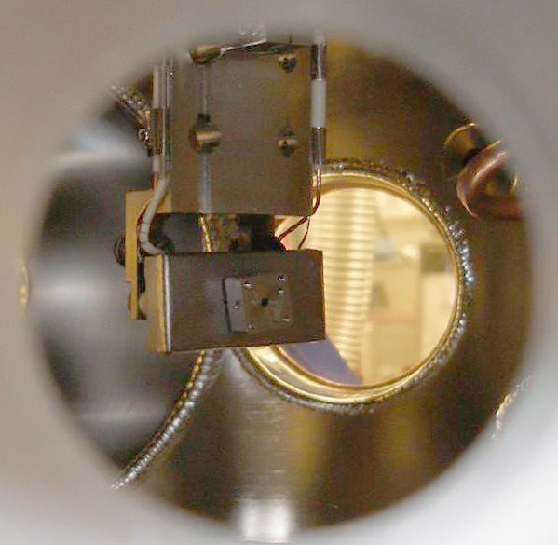
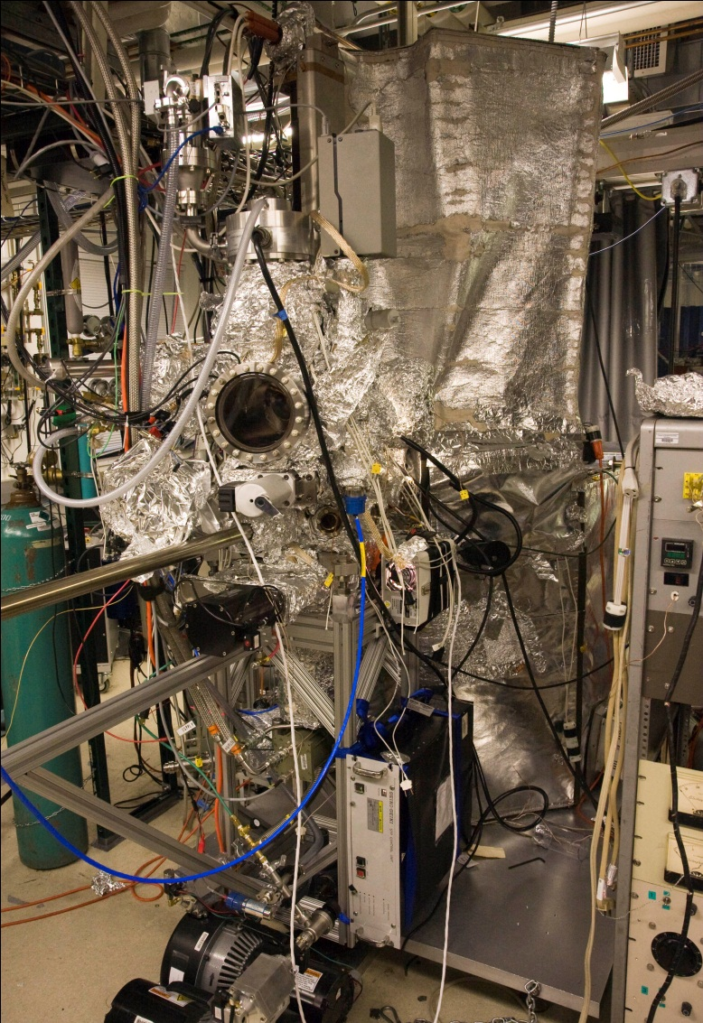
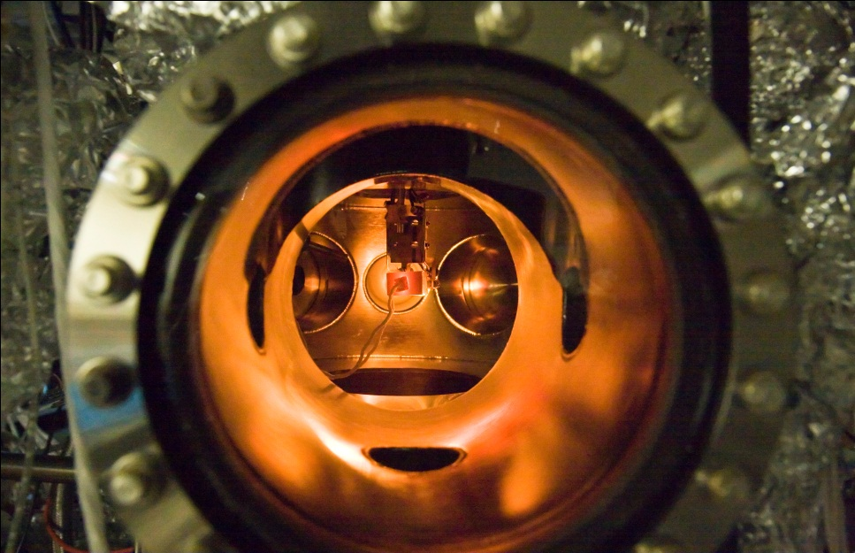
Experimental Apparatus
optical access
removable sample mount
not visible:
- anode
- Cs, Ba deposition sources
heater

Slide 19
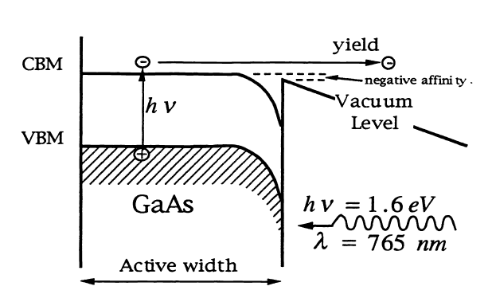
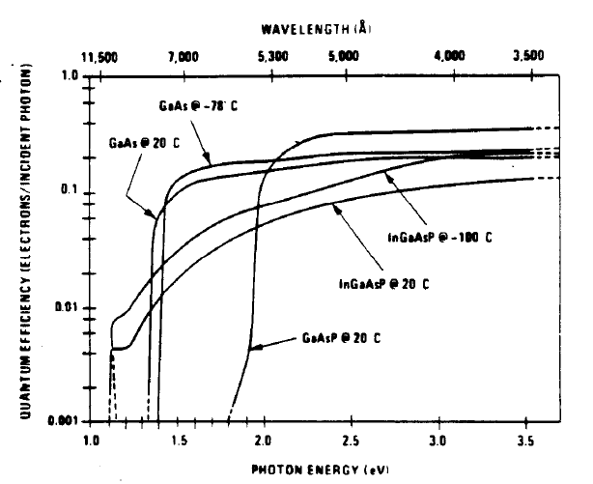
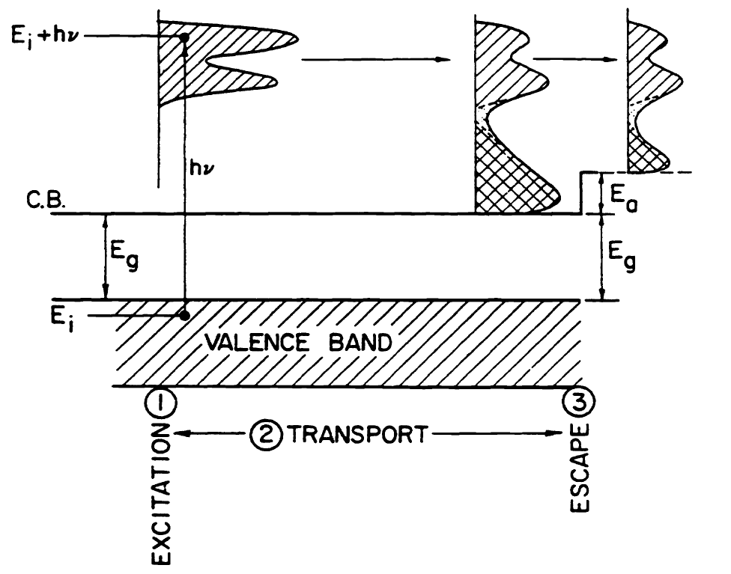
Photoemission
From Spicer and Herrera-Gomez (1993)
From Herrera-Gomez and Spicer (1993)

Slide 20
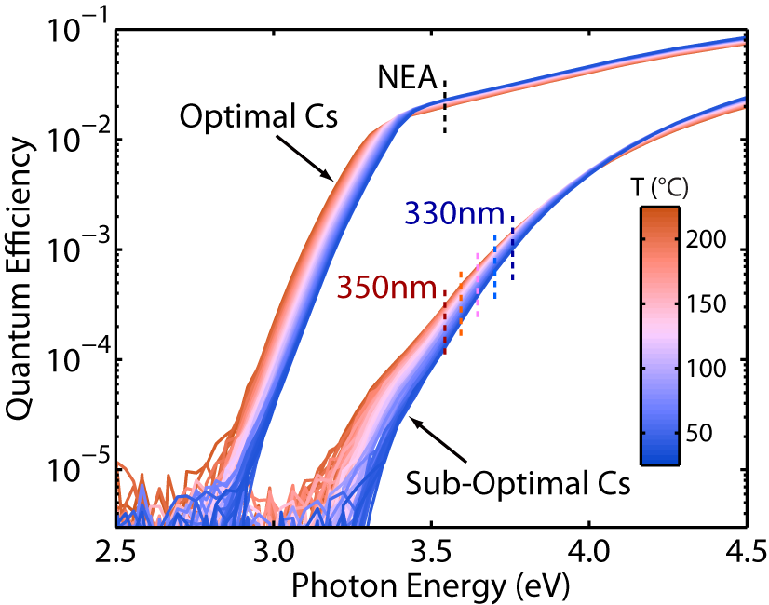
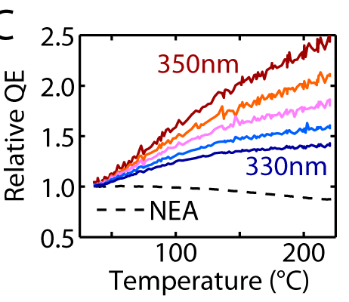
Temperature Dependent Yield
From Photoemission
vs. PETE
Notes:
EA large: photoemission. Increasing temperature increases scattering, reducing hot electron emission. If there is a small thermal component for photon energies near the threshold, we cannot resolve them with our experimental sensitivity.
When EA is decreased, we have two effects: direct photoemission, and an emission process dependent both on photoexcitation and thermal processes. Again, direct photoemission is decreased with temperature. The thermal tail increases with temperature. Futhermore, we can see features at the band edge. This means our electrons are excited band to band, and even electrons excited to the band edge can emit.
When EA is highly negative, temperature effect is generally negative due to decrease of the diffusion length through increased scattering. Only at the very edge of the band, where the effect of temperture on absorption plays an especially large role, do we see increase of yield with temperature.
20

Slide 21
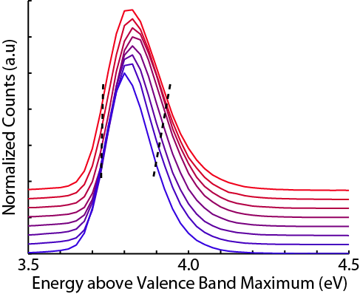
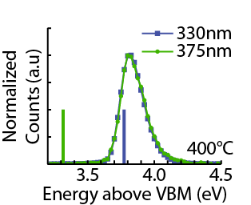
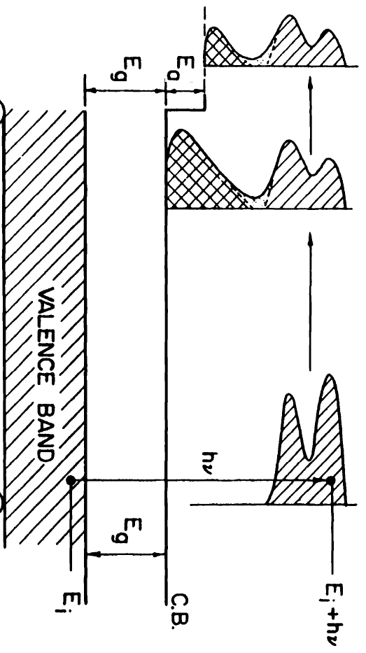
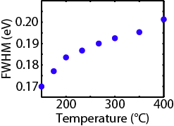
Temperature Dependent Emission Energy
Energy Distribution for
Different Excitation Energy
Increasing T
Distribution Width
Electrons excited with 375 nm photons acquired ~0.5 eV energy
Electrons come from a thermalized population
Energy measurements performed
at SSRL BL 8-1 with Y. Sun
Notes:
21

Slide 22
Evidence for PETE
Yield dependence on temperature
  Decreases for direction photoemission
  Increases below a threshold
Emitted electron energy increases with temperature
  More than 0.1-0.2 eV greater than photon energy
Emitted electrons follow thermal energy distribution
330nm and 375nm illumination produce same electron energy distributions at elevated temperature
  Electrons acquire up to 0.5 eV additional energy from thermal reservoir

Slide 23


Acknowledgements
Igor Bargatin
Dan Riley
Brian Hardin
Sam Rosenthal
Vijay Narasimhan
Kunal Sahasrabudhe
Jae Lee
Steven Sun
Felix Schmitt
Prof. Z.-X. Shen
Prof. Nick Melosh
Prof. Roger Howe

Slide 24
Thanks!

