Slide 1
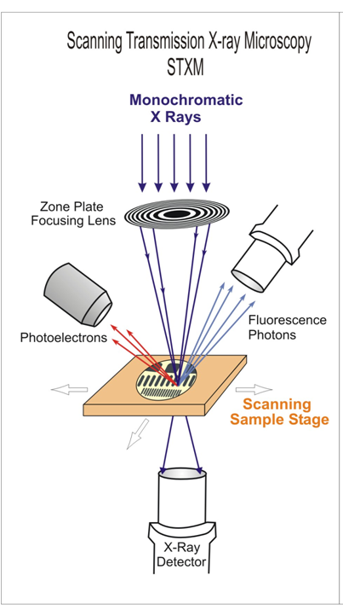
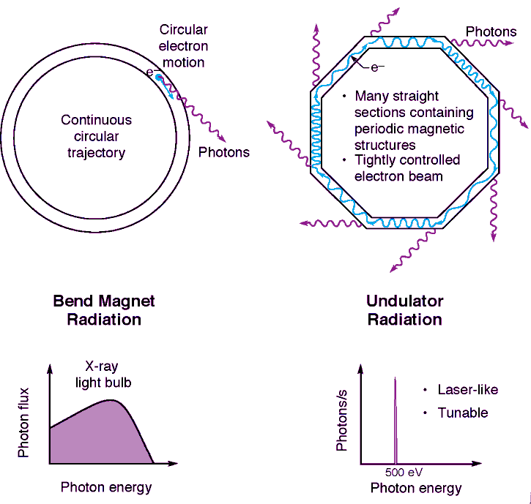
STXM
Cat Graves
Stöhr Group
SASS Talk
09/30/09

Slide 2
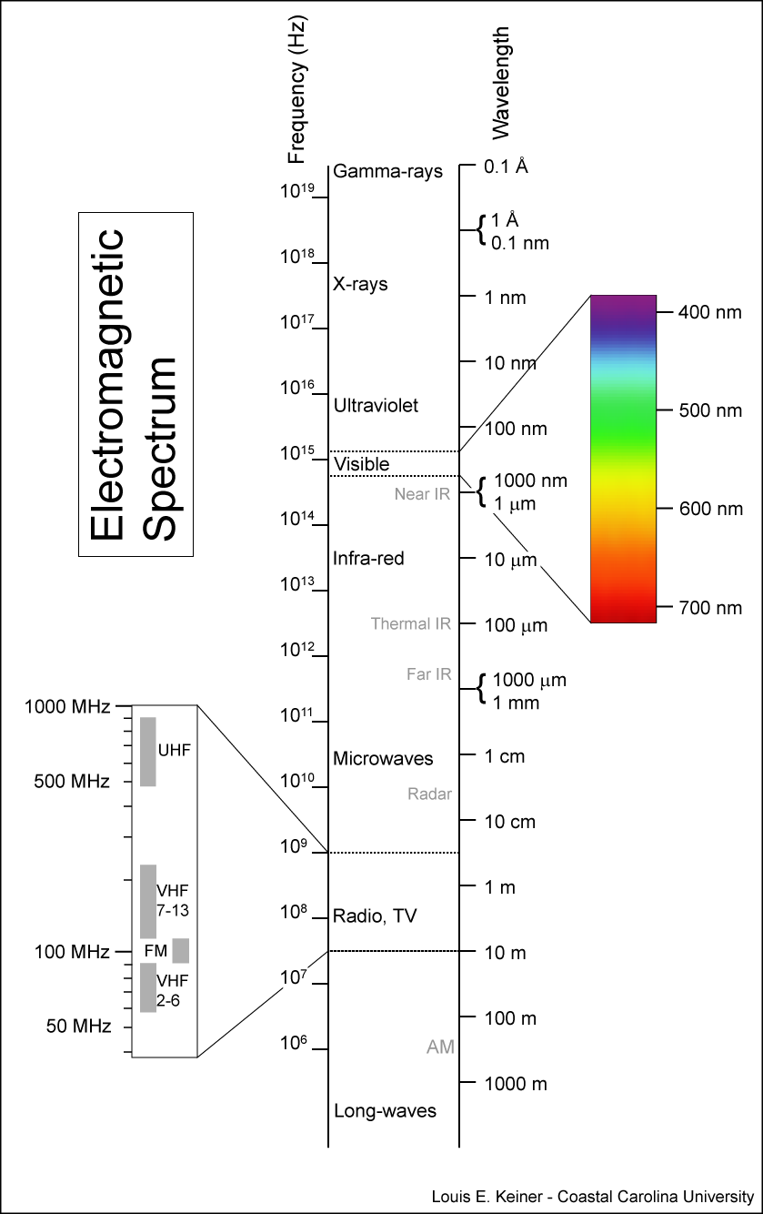
Why use soft X-rays?
Fast and small
Elemental specificity
Magnetic contrast
Penetration depth
Notes:
Energies/wavelengths. EM spectrum.

Slide 3
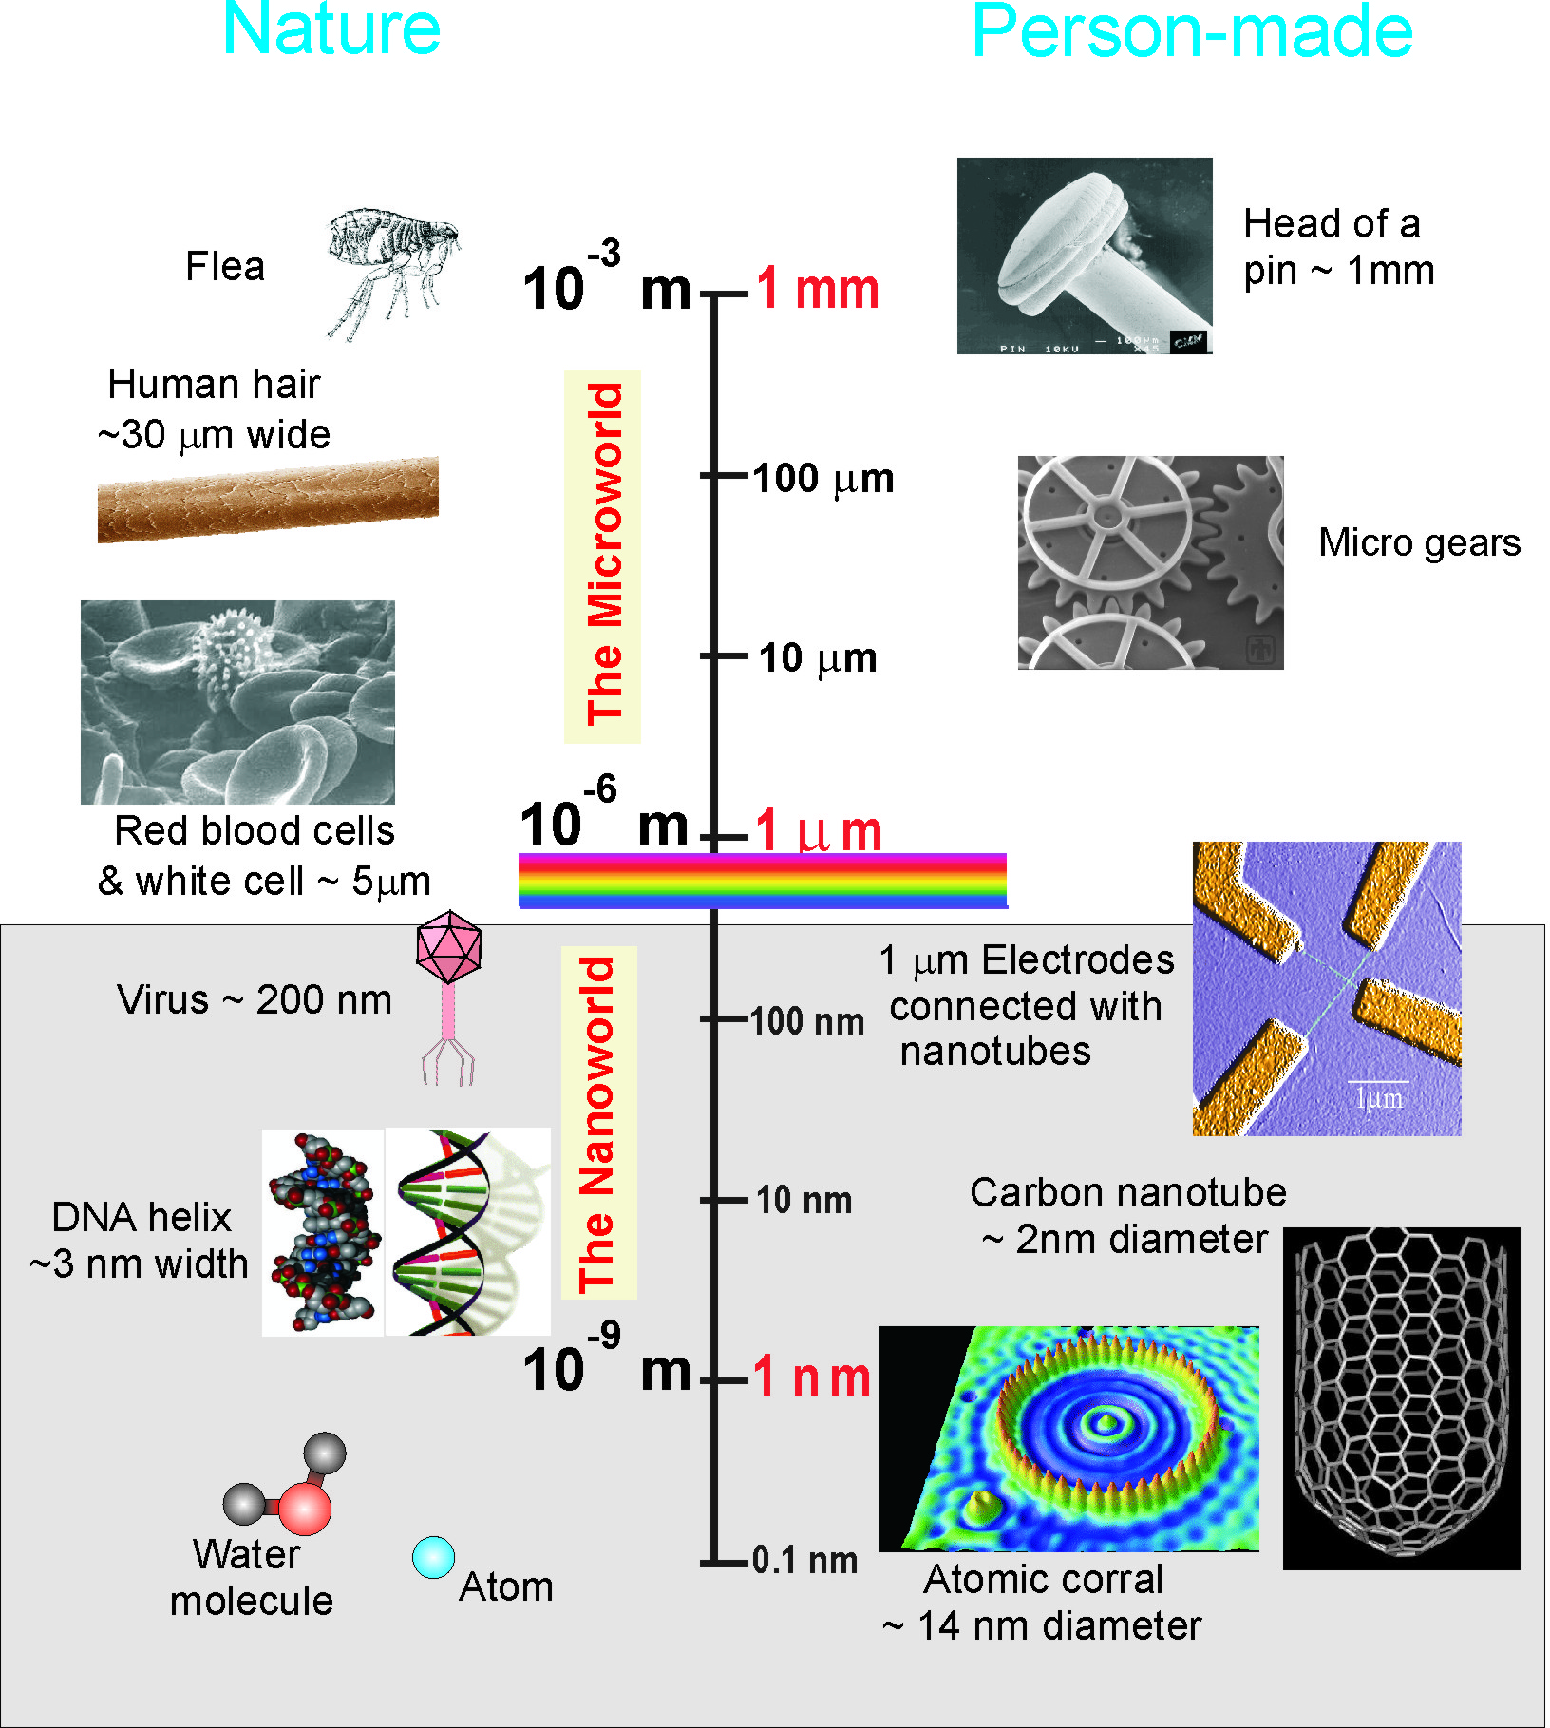
Why use soft X-rays?
Fast and small
Elemental specificity
Magnetic contrast
Penetration depth
ALS: Electron Bunches in Storage Ring
Bunch width ~70 ps
Bunch spacing 2 ns
Gap
larger “Camshaft” pulse
Notes:
Right balance btw fast and small for domain wall motion, etc.

Slide 4
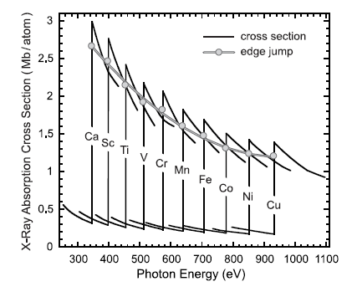
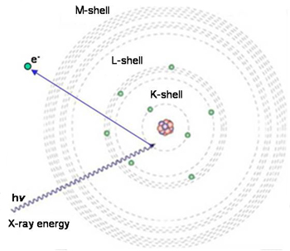
Why use soft X-rays?
Fast and small
Elemental specificity
Magnetic contrast
Penetration depth
Figure adapted from Stöhr and Siegmann, Magnetism (2006)
Notes:
TUNABILITY! Soft X-rays have a photon energy of 100-1000 eV, or wavelength of 1-10nm
Turn photon energy to prominent resonance in absorption spectrum, like the L3 or L2 edges in transition metals etc. The photon energy is well matched to the inner-shell electron binding energy in low-Z elements. This provides very good intrinsic contrast between organic material and water.
Between the Carbon and Oxygen absorption edges at 284 and 543 eV, X-rays provide very good contrast between protein and water and therefore for organic materials in their natural environment

Slide 5
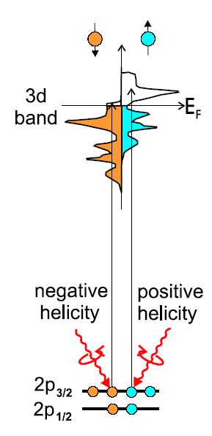
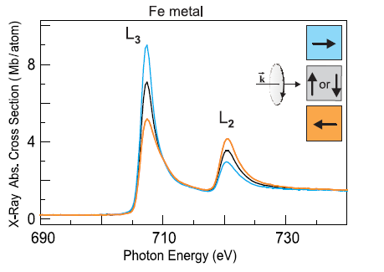
Why use soft X-rays?
Fast and small
Elemental specificity
Magnetic contrast
Penetration depth
Notes:
In XMCD, one measures the difference in absorption spectra with left and right circularly polarized light.
Incoming x-rays possess angular momentum Excites spin-polarized core electrons
Valence levels are exchange split in Ferromagnet
→ Absorption signal depends on number of holes available. Difference in spin-up holes vs spin-down holes = magnetic moment

Slide 6
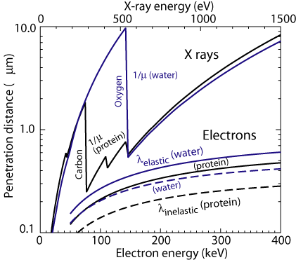
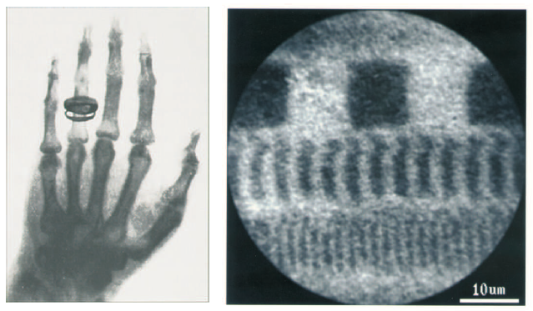
Why use soft X-rays?
Fast and small
Elemental specificity
Magnetic contrast
Penetration depth
Notes:
Energies/wavelengths. EM spectrum.

Slide 7
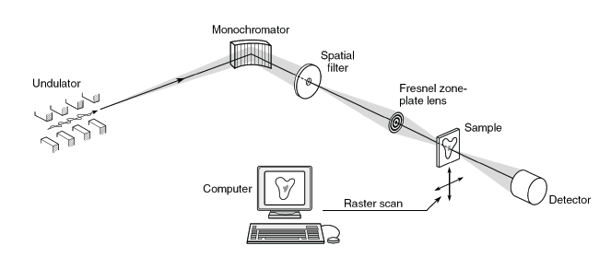
What is a STXM?
Scanning Transmission X-ray Microscopy
How is it different from an optical microscope?
EPU
Zone plate - OSA
Energy tunability - Polarization control (EPU)
Raster scan - Synchrotron radiation
Notes:
Size of one scan? One point?

Slide 8
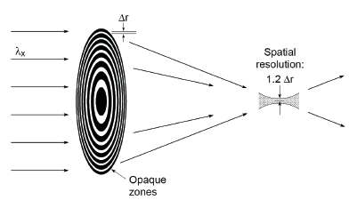
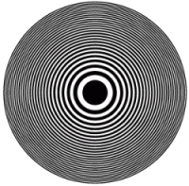


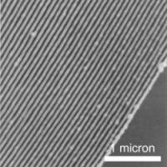
What is a STXM?
Scanning Transmission X-ray Microscopy
Zone plates
  Fresnel diffraction
  E-beam litho
  Spatial Resolution Limit
Notes:
the refractive index for X-rays differs from 1 by only about 0.1% or less in different materials, therefore diffraction lenses used.
Light hitting the zone plate will diffract around the opaque zone
In order to get complete constructive interference at the focus, the amplitude of the diffracted light waves from each zone in the zone plate must be the same. This means that for an evenly illuminated zone plate, the area of each zone is equal.
made of Nickel or Germanium and has a diameter of 160 µm with outermost zones as fine as 30 nm

Slide 9
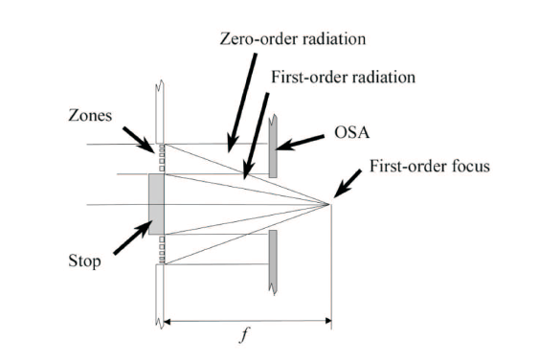
What is a STXM?
Scanning Transmission X-ray Microscopy
Order Sorting Aperture (OSA)
  Requires careful alignment with Zone plate

Slide 10
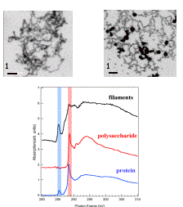
What is it good for?
Example 1: Environmental applications
Advanced Light Source Molecular Environmental Science (ALS-MES) Beamline 11.0.2.
Notes:
Environmental science program at the ALS.
Left image: STXM images of natural iron filaments and lab made at the Fe L3 edge, with carbon spectra

Slide 11
What is it good for?
Example 2 : Ultrafast spin dynamics
Electron flow
Ferromagnet 1
“Fixed Layer”
Ferromagnet 2
“Free Layer”

Slide 12
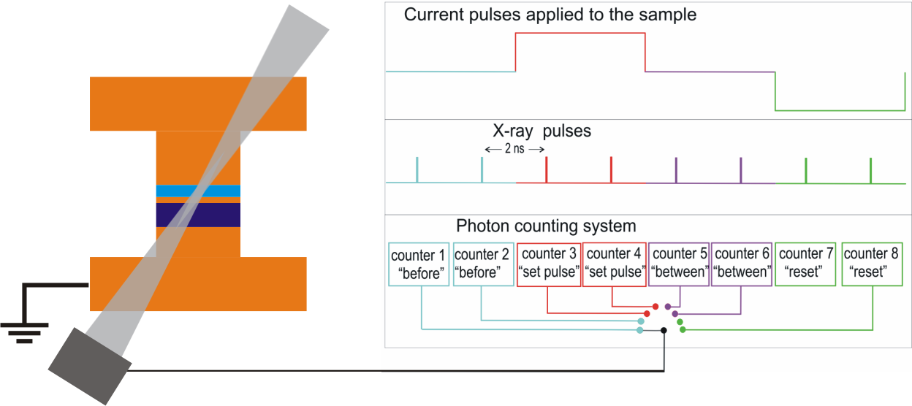
What is it good for?
Example 2 : Ultrafast spin dynamics
Pump
X-rays
Probe
Free Layer
Spacer Layer
Fixed Layer
Detector
Co/Cu/Co pillar

Slide 13
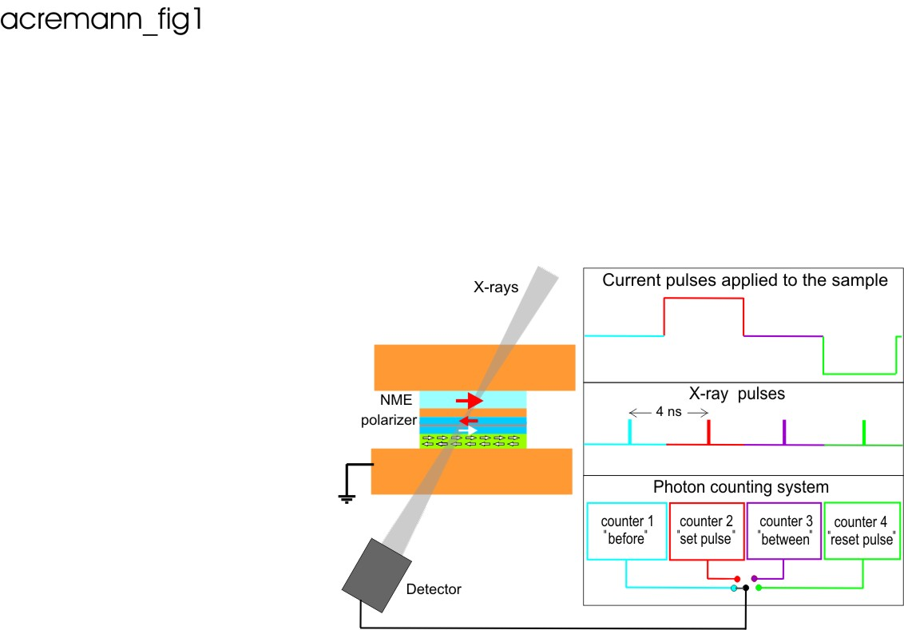
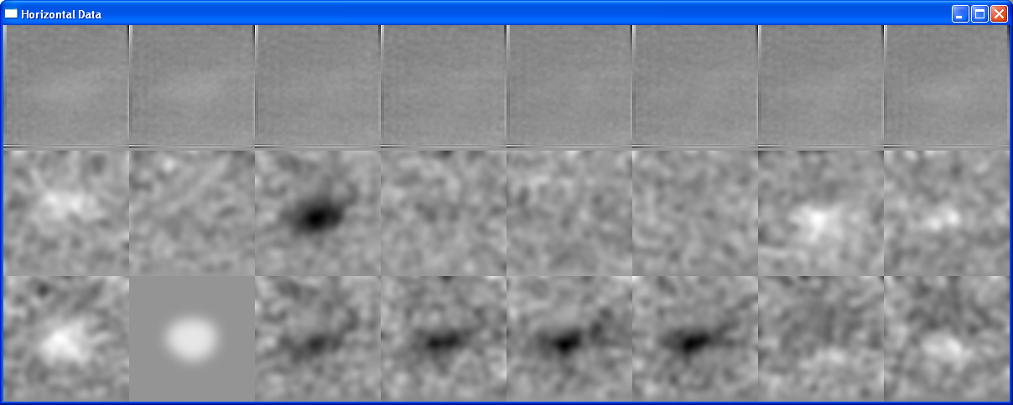
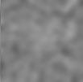
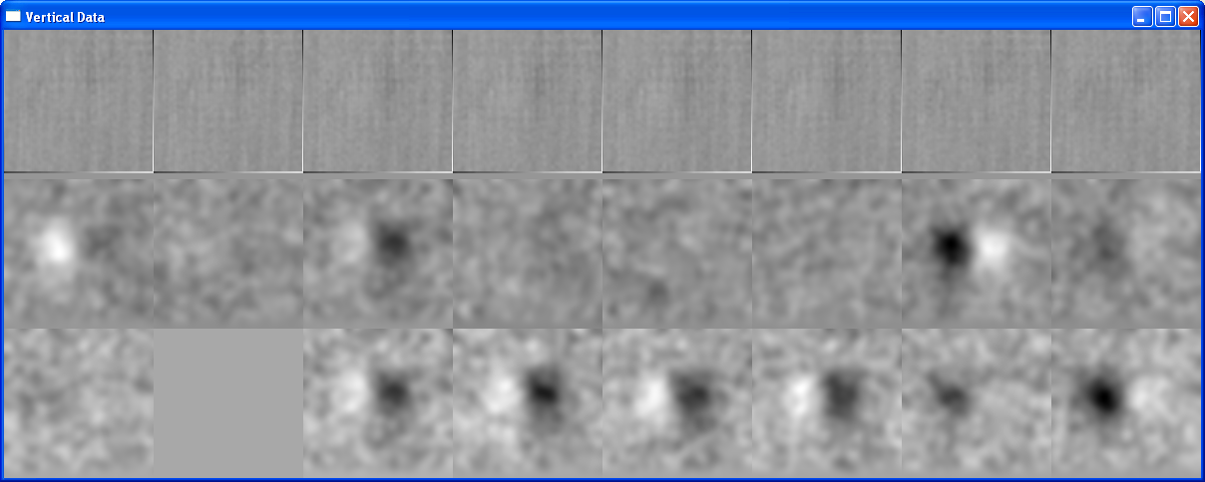
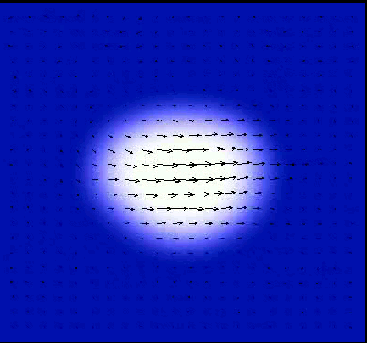


+I
Pulse Sequence
-I
X-component
100nm
Y-component
Vector field of magnetization
Notes:
Can measure x, y, and z components of magnetization
Spatial resolution ~35 nm (from zoneplate)
Time resolution 70ps (x-ray pulse width)

Slide 14
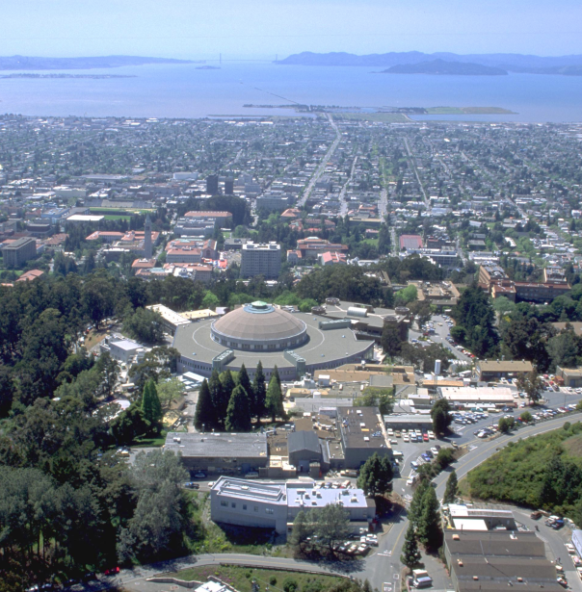
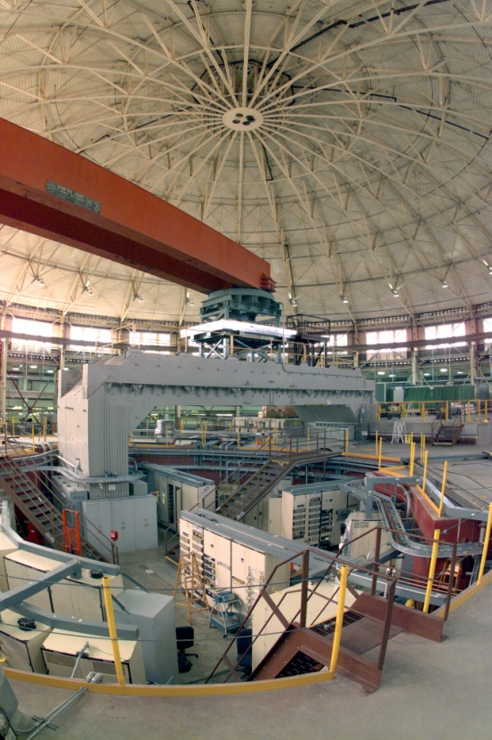
Where are they now?
Current locations of STXM
  ALS, Berkeley
  Stony Brook, Brookhaven
  King’s College, Daresbury UK
  Swiss Light Source
  Bessy II, Berlin
  PLS, Korea
  Canadian Light Source

Slide 15
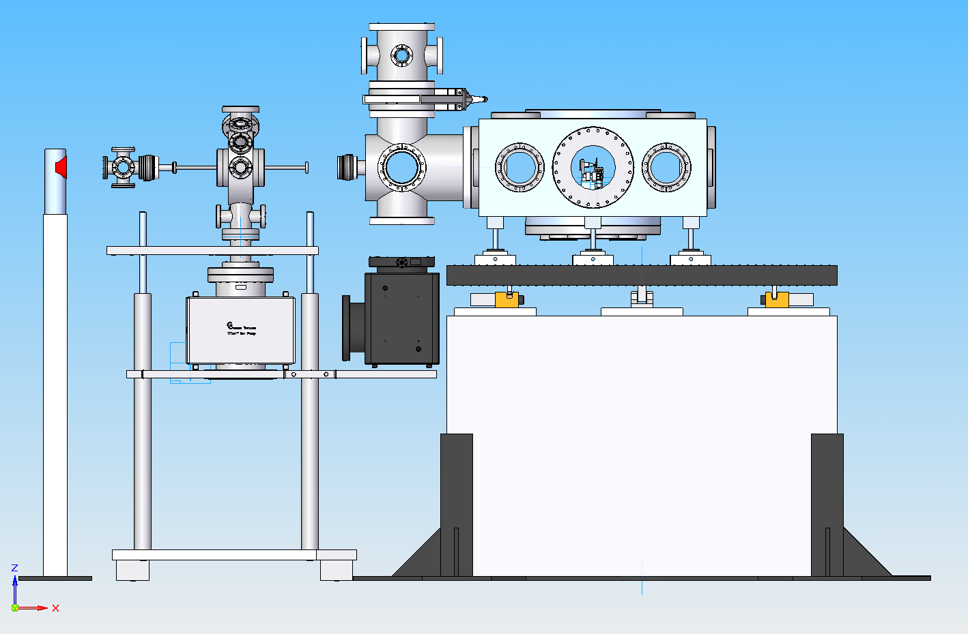
To the future: STXM at SSRL
Under construction at BL 13-3
  Condensed Matter
  Surface and thin film

Slide 16
