Slide 1
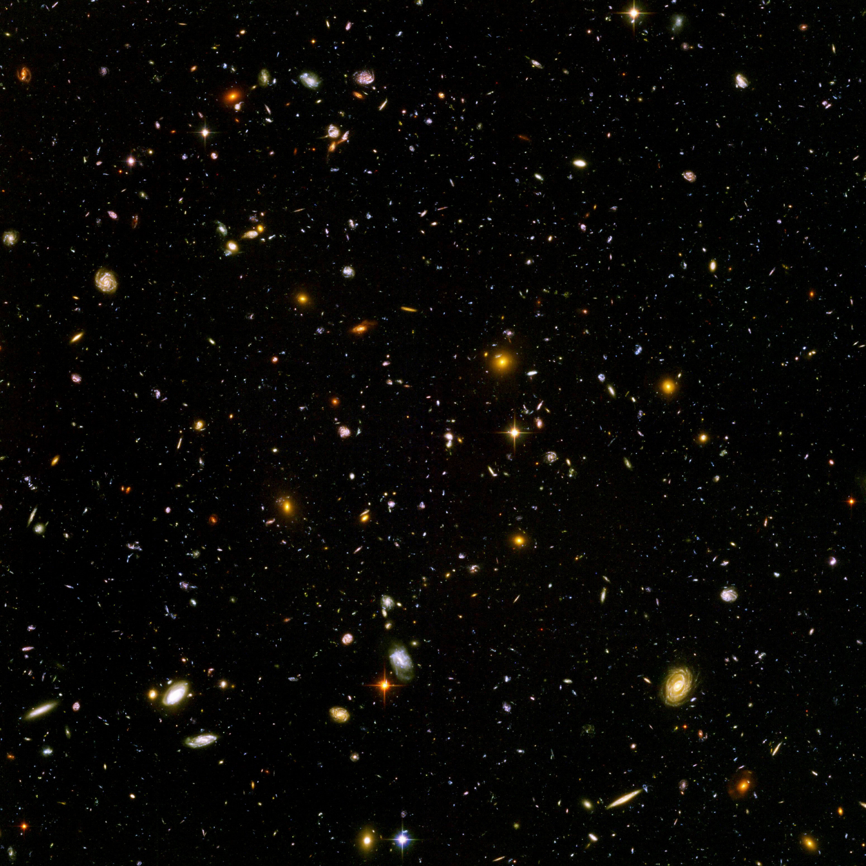
Modern Cosmology: The History of the History of the Universe
Alex Drlica-Wagner
SASS June 24, 2009

Slide 2
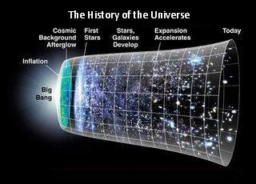
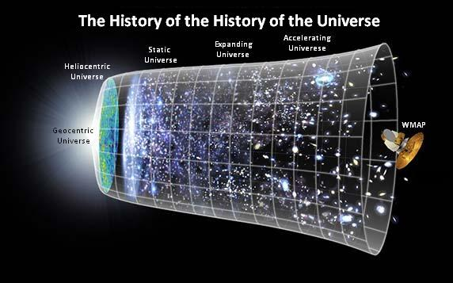
Timeline
Not so much …
… more like this

Slide 3
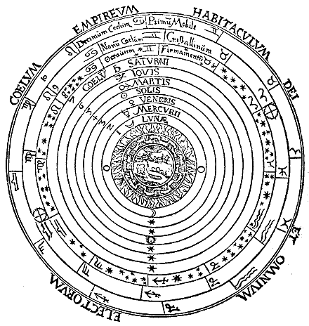
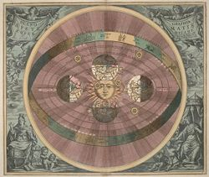
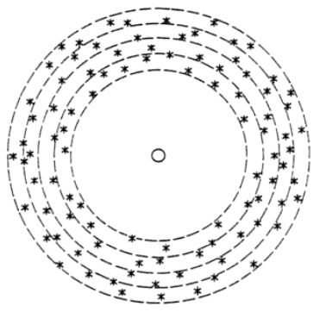
Old School
Geocentric Universe
Problems:
Motion of the Sun
Motion of planets
Phases of Venus
Moons of Jupiter
Heliocentric Universe
Problems:
Sun not at the center
Motion of the Sun
Sun is not unique
Infinite Static Universe
Problems:
Olber’s Paradox
Exact Isotropy

Slide 4
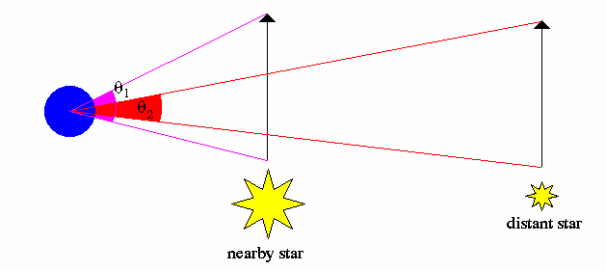
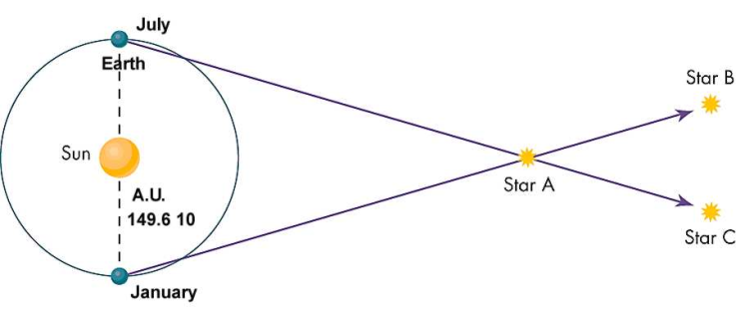
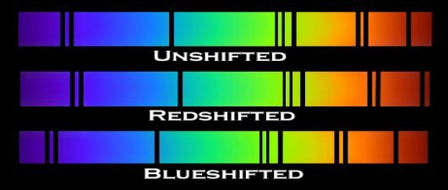
Looking at the Universe
Distance Information
Parallax
Standard candles
Motion Information
Proper motion
Doppler Shift
Assume that the laws of physics do not change

Slide 5
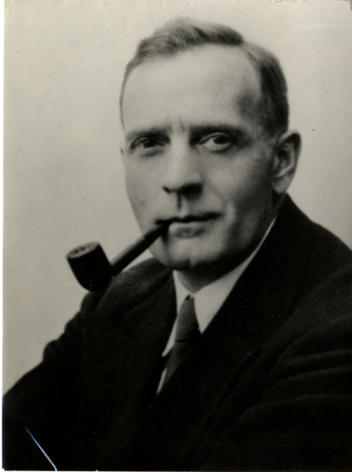
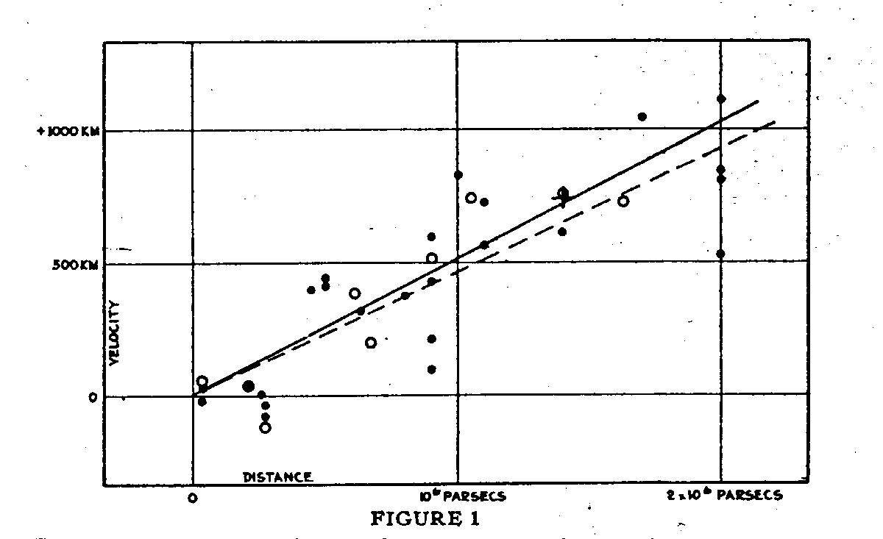
Birth of Modern Cosmology
Edwin Hubble
Standard Candle:
Cepheid Variables
Motion Measure:
Galactic Redshift
The Universe is Expanding!
Redshift:
Hubble Parameter:
Hubble Time:
(Hubble, 1936)

Slide 6
Expanding How?
Steady-state Universe
Big Bang Universe

Slide 7
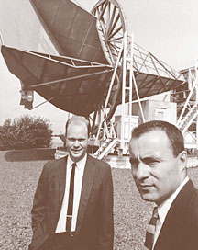
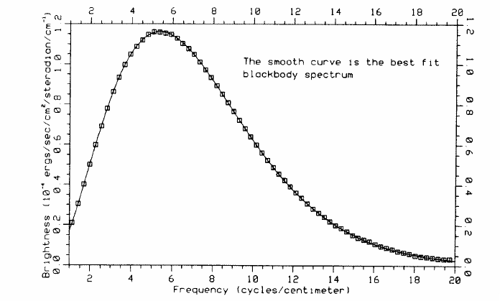
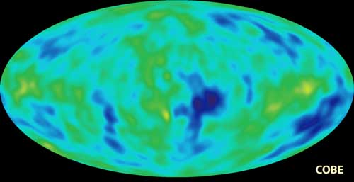
Death of Steady State
Big Bang, should make the early universe very hot
Penzias and Wilson
Cosmic Microwave Background (CMB) Radiation
COBE satellite
Blackbody radiation at 2.73 K
Slight anisotropies in CMB
(Mather et al., 1990)

Slide 8
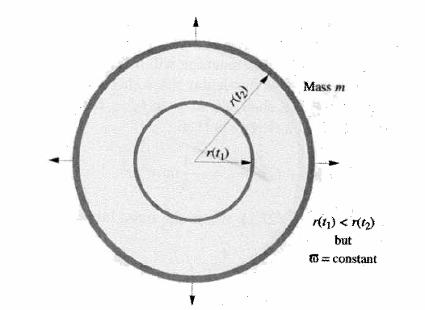
A Simple Model … (Carroll and Ostlie, 2007)

Slide 9
… Not the Whole Story …
Same as Friedman Equation
k is now curvature of spacetime
Need to add in pressure
Cosmological constant
Can keep our conclusions with some replacements

Slide 10
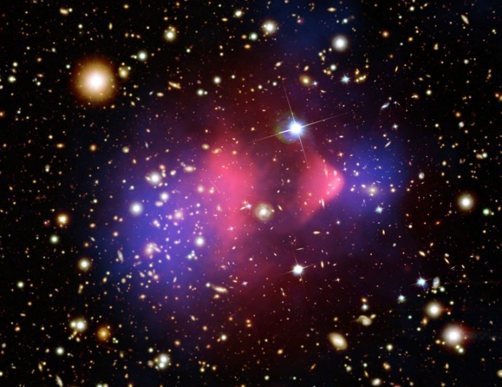
… And More Complications
Matter density includes dark matter
Have 70 years of experimental evidence for dark matter
No direct detection or non-gravitation indirect detection

Slide 11
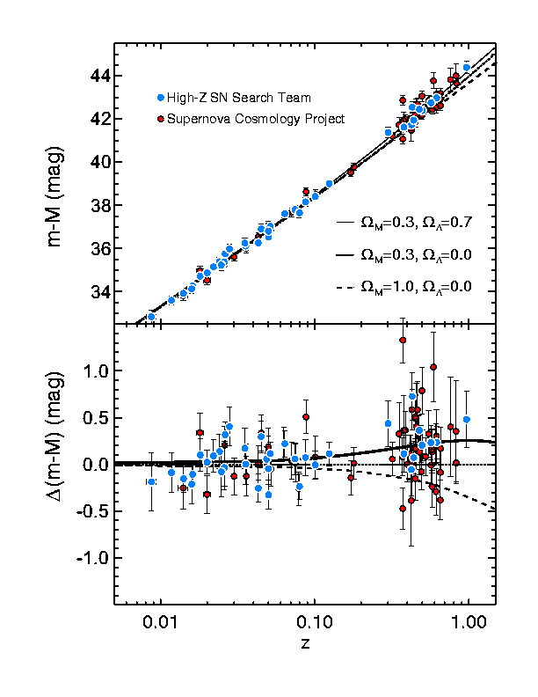
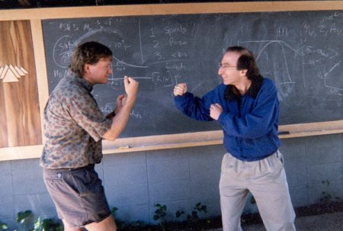
The Accelerating Universe
Find “braking” parameter
Standard Candle:
Type 1a Supernovae
Compare to redshift
Examine Ω
Actually accelerating!
(Reiss et al, 2004)
(Perlmutter and Schmidt)

Slide 12
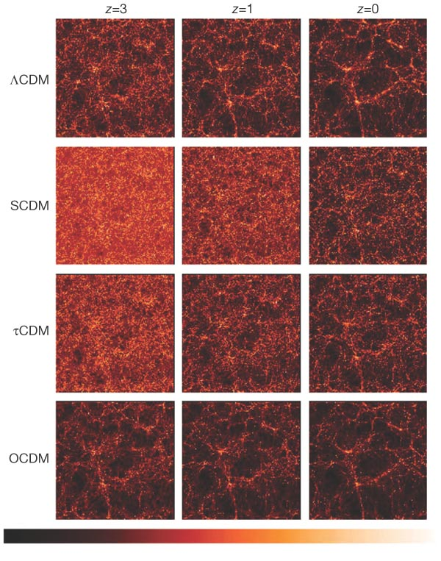
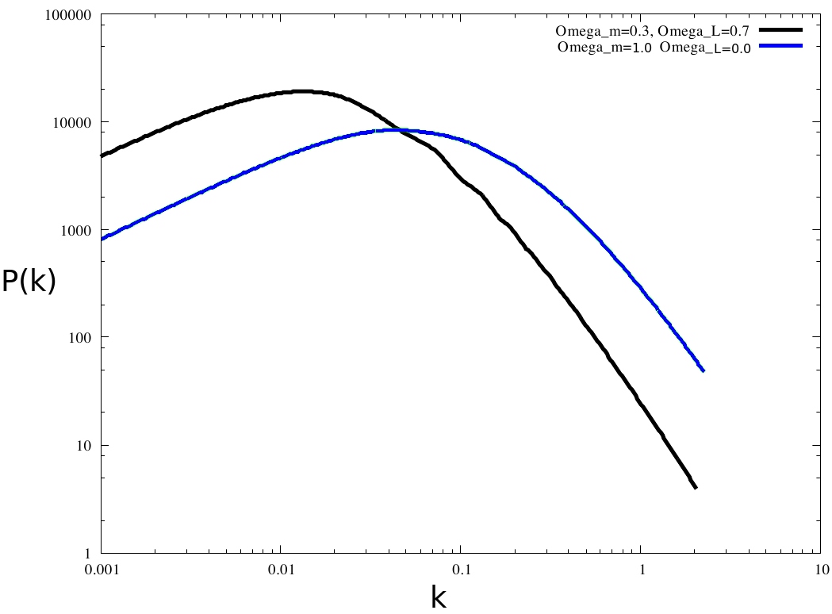
Large-Scale Structure
Another way to constrain cosmological parameters
Growth of structure is very sensitive to cosmology
Examine power spectra
(Mustafa Amin, 2008)
(Virgo Consortium, 1998)

Slide 13
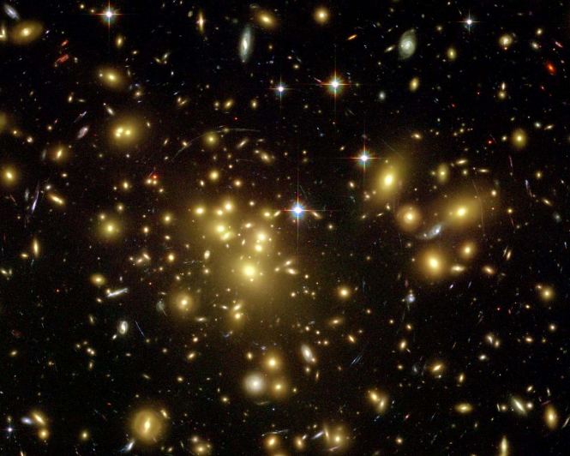
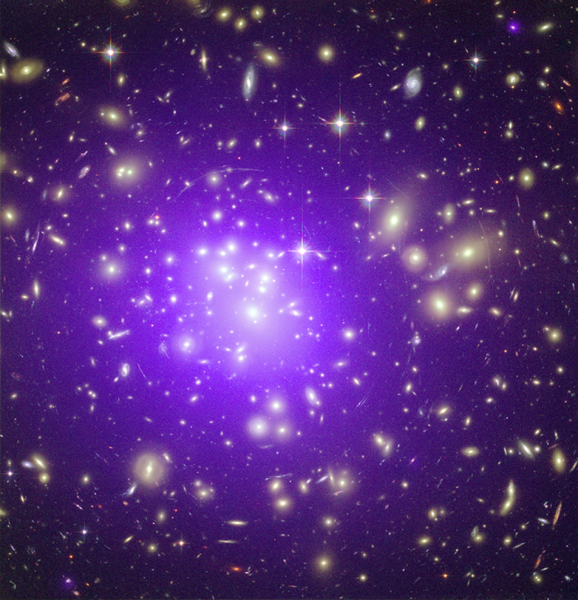
Cosmology with Clusters
Examine growth of structure at low redshift
Largest gravitationally bound structures (Ω_{m})
Need mass proxy
Optical weak lensing (mass)
X-ray gas mass fraction (distance)
Cluster number counts (growth of structure)

Slide 14
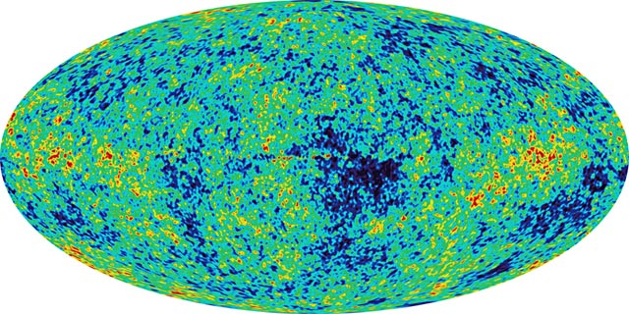
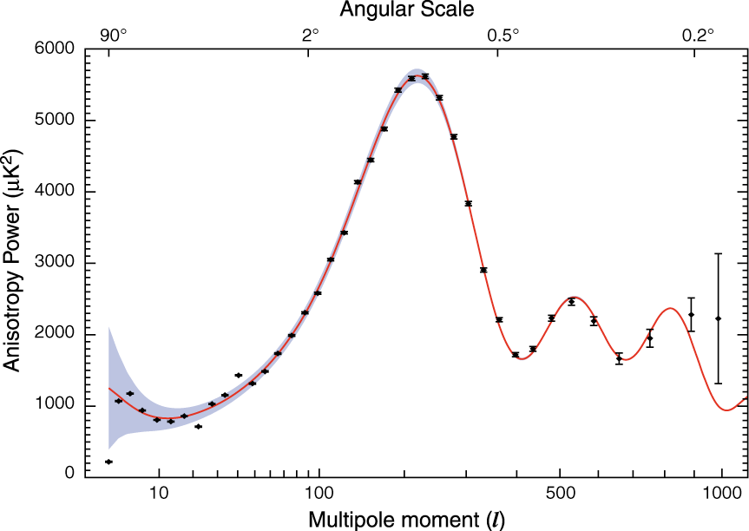
WMAP
COBE on steroids
Growth of structure at high redshift
Baryon Acoustic Oscillations
Constrains just about everything
Still some degeneracy
(NASA/WMAP Science Team)

Slide 15
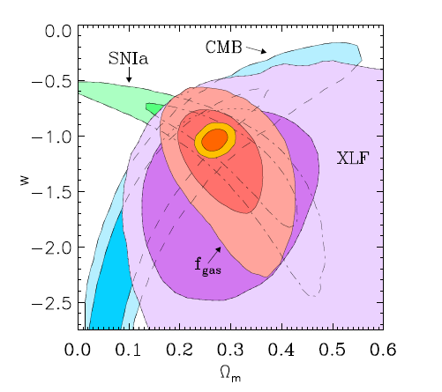
Breaking Degeneracy
Multi-dimensional parameter space
Combining experiments can narrow parameter space
Combining experiments can also break degeneracy
(Mantz et al., 2008)

Slide 16
The Universe is …
ΛCDM Universe
Problems:
Dark matter
Dark energy
Cosmological constant
(NASA/WMAP Science Team)

Slide 17
References
Carroll, B. W. and Ostlie, D. A. 2007, “Introduction to Modern Astrophysics”
Mantz, A. 2008, SASS Presentation “Cosmology, Gravity, and Large-scale Structure”

