Slide 1
Comon Git based EPICS Module Development
Bruce Hill
Murali Shankar
Sept 6, 2016

Slide 2
Motivation
Several groups within SLAC use EPICS, but with different build systems, some using CVS and some using subversion for version control.
This makes collaboration within the lab difficult.
For packages such as EPICS base, modules, and extensions, the primary owner of the package is someone in the worldwide EPICS collaboration.
Most of these collaboration packages are now being hosted on github, with more packages moving there as time goes by.
This proposal outlines a git based workflow w/ common build support tools that attempts to meet the above needs.

Slide 3
Git Workflow Objectives
For local development, we need git repo’s which any developer can pull or push to so that anyone can create new releases as needed.
These local SLAC master git repos need to be reachable from our development environments so build scripts can checkout and build releases as needed. For now, these SLAC master repos will be under /afs/slac/g/cd/swe/git/repos/package/epics
Once we have a gitlab accessible from our development systems, we can move the SLAC master git repos to gitlab.
Github master branch should not be committed to locally, as it’s history is controlled by the package owner.
To ensure we preserve locally added features/fixes, we need the git repo to have access to the latest versions from CVS and svn, and preferably the full history from each.
Following common naming and build strategies will facilitate sharing of module development and new features.

Slide 4
Workflow template for EPICS modules
SLAC master repo directory for EPICS modules: /afs/slac/g/cd/swe/git/repos/packages/epics/modules
Github repo added as remote github-origin
Github master branch mapped to github-master
A pre-receive hook is enabled for the SLAC repo to block pushing changes to github-master. It can only be updated by pulling from github-origin.

Slide 5
Initial import from CVS and SVN to Git
Initial import to a dedicated git repo for each CVS and svn module
CVS imported using cvs2git script in the cvs2svn package. Based on the existing cvs2git support in eco_tools w/ addition of an authors file to provide git style author and email for each commit.
CVS history exported via eco_tools script to /afs/slac/g/cd/swe/git/repos/package/epics/modules/from-cvs/$MODULE
MAIN_TRUNK imported as master branch
Other branches imported using branch name
Tags imported as is
SVN imported using “git svn clone” using a new eco_tools script, svnModuleToGit.py
SVN history git repo: /afs/slac/g/cd/swe/git/repos/package/epics/modules/from-svn/$MODULE
trunk/pcds/epics/modules/$MODULE/current imported as master
Other branches imported using branch name
Tags imported using just the version specific portion. i.e. R2.1-0.1.0

Slide 6
Merging history in git
The version history from cvs and svn, not that it’s in git, can be easily fetched to a git repo like this:
git fetch cvs-origin master:cvs-history
git fetch svn-origin master:svn-history
These new branches aren’t easily merged w/ the github-master, as they share no common ancestors. Merges create many, many conflicts which must be resolved. If you view the repo via a gui such as gitk, the branches don’t join.
As git allows rewriting history, I fix this by using the GitPython package in a new eco_tools script to recreate a new commit path for each branch with a merge parent for the oldest commit on the branch, along w/ any other merge points created as we updated our modules.
Git commit’s are identified either by a tag, if it exists, or via the first 6-7 digits of the SHA-1 hash of the commit. These commit id’s can be identified using a tool like gitk which graphically shows the history for desired branches and tags.
Example usage for gitRecommitBranch.py:
gitRecommitBranch.py -v -p github-master -d pcds-trunk -s svn-history -m a867313:sscan-R2-5-2-lcls3 -m 394b04f:R2-6-6 -m f105d05:sscan-R2-7 -m 0a70337:sscan-R2-8-1
LCLS branch name: lcls-trunk
PCDS branch name: pcds-trunk

Slide 7
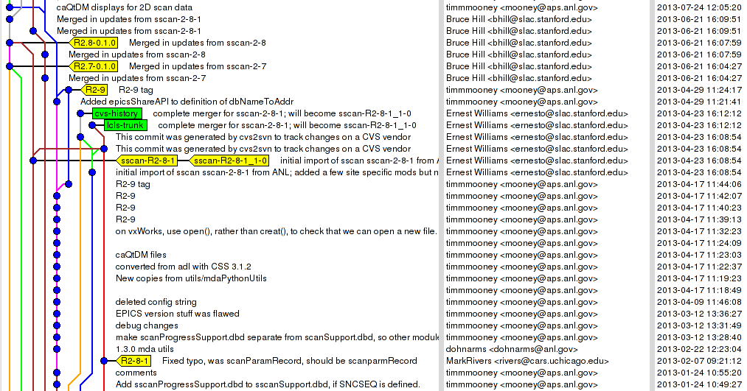
Example of gitk for sscan showing lcls-trunk and pcds-trunk

Slide 8
rhel6-x86_64
We’ll need to support building modules for different RedHat releases, which often don’t have compatible builds
Currently PCDS uses:
linux-x86_64 # RedHat 5 64 bit builds
rhel6-x86_64 # RedHat 6 64 bit builds
rhel7-x86_64 # RedHat 7 64 bit builds
I propose we move to this naming scheme for new base releases and the modules/iocs built for them.
This can be handled w/ a simple change to $EPICS_BASE/startup/EpicsHostArch

Slide 9
EPICS_BASE and RELEASE.local
Moving forward we’ll need to support building modules for different versions of EPICS_BASE, ideally w/o needing to create new module release tags.
EPICS V4 has -include $TOP/configure/RELEASE.local in all V4 modules, as do many of the areaDetector modules. Sometimes CONFIG_SITE.local as well. These .local files are not included in the distribution. I propose we follow this model to allow building our modules w/ only the addition of a RELEASE.local and possibly a CONFIG_SITE.local
i.e. No more $TOP/RELEASE_SITE

Slide 10
Deriving relative EPICS_BASE
$EPICS_SITE_TOP/$BASE_VERSION/RELEASE.local
BASE_VERSION = R3.15.0.1-0.1.0
EPICS_MODULES = $EPICS_SITE_TOP/$BASE_VERSION/modules
Module releases follow the pattern
$EPICS_SITE_TOP/$BASE_VERSION/modules/sscan/R2.9.1-0.1.0
$TOP/configure/RELEASE.local
-include $TOP/../../RELEASE.local
ASYN_MODULE_VERSION = R4.26-0.1.0
ASYN = $EPICS_MODULES/asyn/$ASYN_MODULE_VERSION
$TOP/configure/CONFIG_SITE.local
Optional, add if needed
CROSS_COMPILER_TARGET_ARCHS = linuxRT_glibc-x86_64

Slide 11
Release tags
To facilitate common scripted build support, such as automatic creation of new module versions on demand, I propose a common scheme for release tags.
All tags will be normalized to the form R2.1.3-0.2.0
The first portion, R2.1.3 is based on the collaboration version number. Other variants could include R3.14.12.4, or R3.5
The second portion, 0.2.0, represents local modifications
Local releases starting w/ 0 indicate little to no changes vs collab and are generated from a branch named R2.1.3-0.branch
Local releases starting w/ 1 indicate at least one major change and are generated from a branch named R2.1.3-1.branch
Higher numbered release branches can be created as needed. For example, if both LCLS and PCDS have introduced different features/fixes to the same module.
The second number in the local release indicates a change in the src or build settings, not including module dependencies. Any changes to compilation flags and/or cross compiles should also increment this 2nd number.
The final number will be incremented as needed by build scripts to create new module versions which only differ by their dependencies. i.e. A new version of asyn is released and a script could create, tag, and build new releases of modules which depend on asyn by updating the appropriate version number in configure/RELEASE.local.
If a module release can be built locally w/ only the addition of a RELEASE.local file by the epics checkout script to specify EPICS_BASE, it would get the tag R2.1.3-0.0.0

Slide 12
Git Workflow
Local development is done using the SLAC git repos as the master upstream repo.
Feature development is done on topic branches, which can be kept in the developer’s local repo and rebased as desired until pushed to the SLAC repo.
No branches or other work which has been pushed to the SLAC repo should be rebased.
No work is pushed to github from our SLAC repo. Instead, users should create their own github forks and push topic branches to their github fork where they can become pull requests.
New updates from the collaboration are handled by a local developer who pulls github-master directly from github.
New release branches can be created by merging the new github tag w/ our prior level 0 release branch.
Once a new release branch is created, it is pushed to our SLAC repo.
Releases are created by an epics-release script
Pull the latest updates from the SLAC repo
Conflicts cause the release to fail and user must resolve them.
Validate the tag name
Prompt for comments, tag, and push to SLAC Repo.
Build the release by cloning the SLAC repo to the release directory and checking out the tag

Slide 13
The End
Thanks for your attention
Comments welcomed

