Slide 1

Stanford Synchrotron Radiation Lightsource (SSRL)
Michael Toney
Synchrotron Materials Sciences Division, SSRL
SLAC National Accelerator Laboratory
http://www-ssrl.slac.stanford.edu/toneygroup

Slide 2
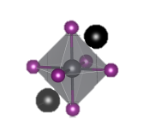
Outline
SSRL & Synchrotron Radiation
  What is SSRL?
  What is Synchrotron Radiation?
Research Focus
  How do we use X-rays?
  Quantum materials (strongly correlated electron systems)
  Energy materials research
Opportunities for grad students

Slide 3
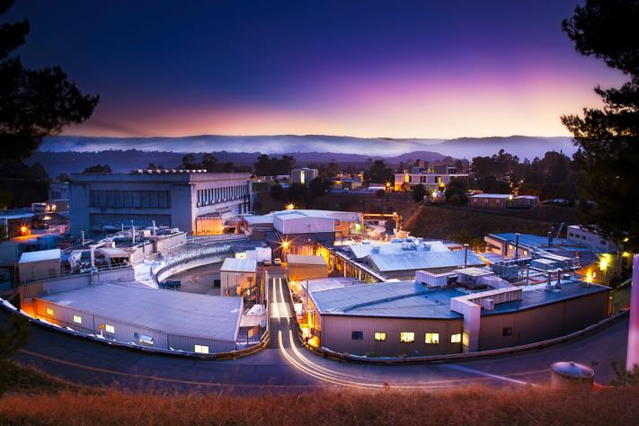
SSRL Overview

Slide 4
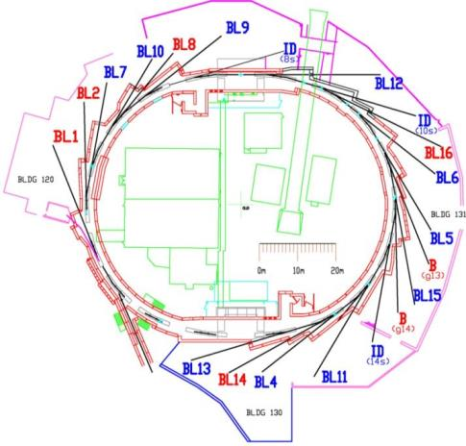
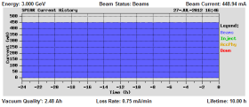
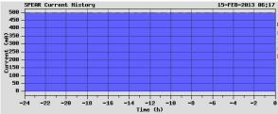
SSRL Overview
SPEAR3
      New ring - 2004
      3 GeV, 500 mA
      Top-off injection every 5 minutes
      Reliability >97%; > 5,100 hrs/yr
      6 nm-rad emittance
operates 33 stations
supports ~1,600 user annually
      Annual growth >5%
>400 journal pubs/yr, 1/3 hi-impact
~50 thesis per year
      Strong educational focus
Strong programs in quantum materials, energy materials
Change to 500mA plot
SPEAR3 @ 500 mA
operating current -
5-min frequent fill

Slide 5
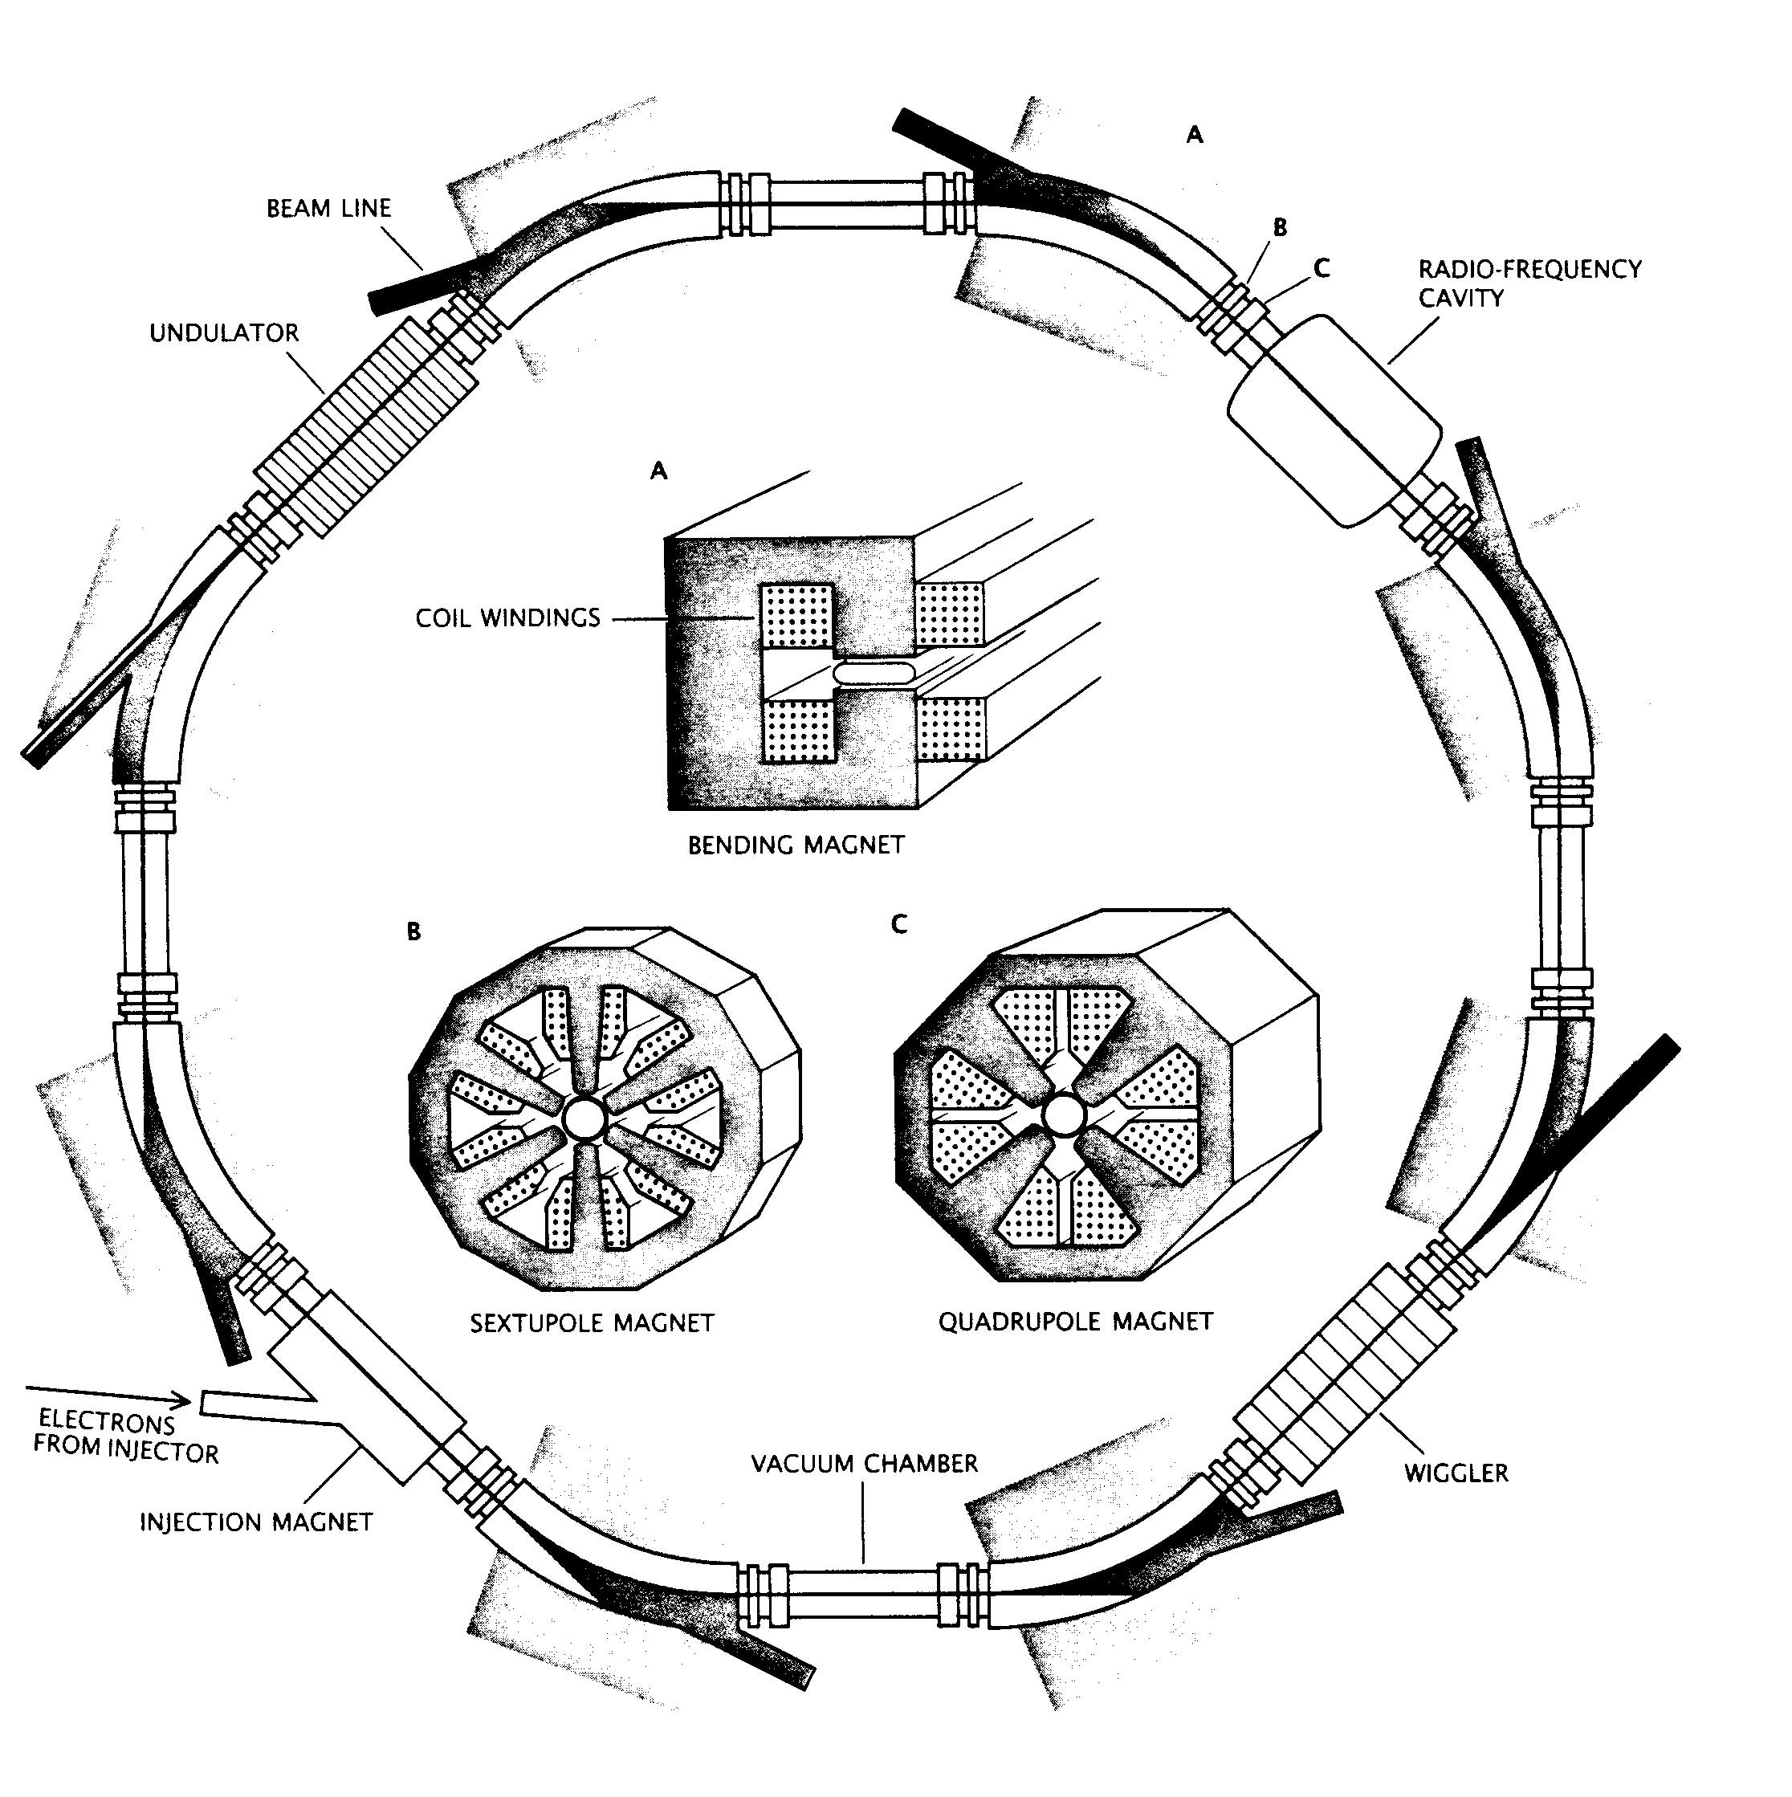
SSRL Overview
c/o Aaron Lindenberg

Slide 6
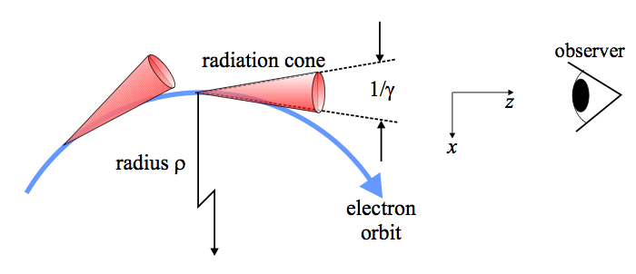
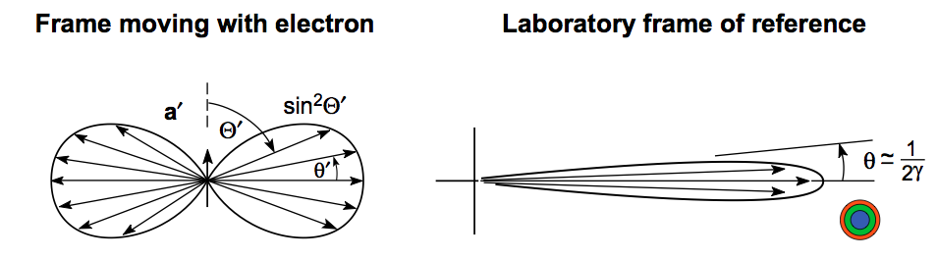
SSRL Overview
c/o Aaron Lindenberg

Slide 7
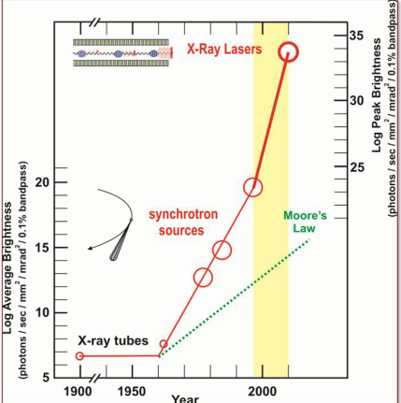
SLAC: Synchrotron Radiation

Slide 8
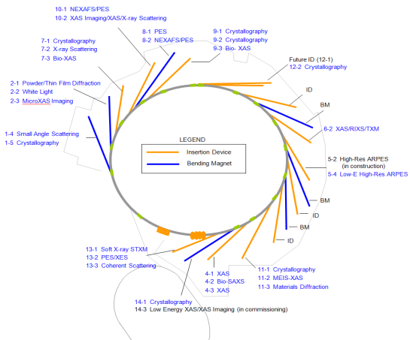
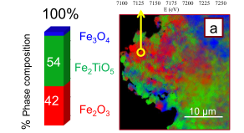
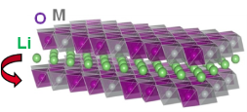
X-ray Beamlines / Techniques
X-ray Scattering/Diffraction
  Crystallite Properties, Phase, Defects
X-ray Microscopy (XM)
  10s nms morphology & topography
X-ray Absorption Spectroscopy (XAS)
  Local Structure & Chemistry
Photoemission Spectroscopy
  Electronic structure

Slide 9
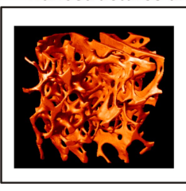
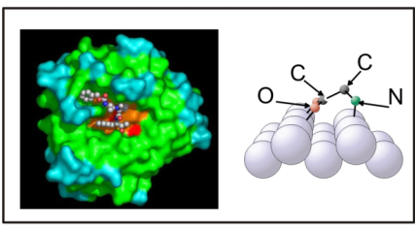
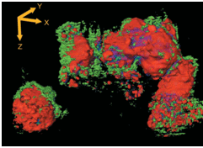
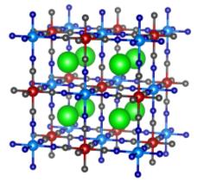
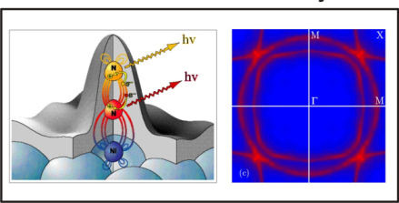
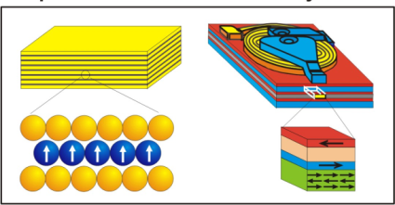
X-Rays - Seeing the Invisible
Nanostructures
Positions of Atoms & Molecules
Electron Distributions &Dynamics
Spin Distributions & Dynamics
Notes:
How does SLAC contribute to this?
One way is through x-rays
This is just a transition slide—basically use the pictures to talk about how x-rays are used to “see” the structure of materials both at the level of the bone to the level of atoms
Next slides will be examples

Slide 10
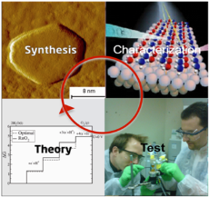
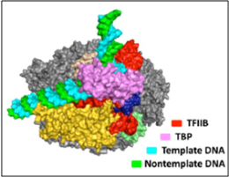
SSRL Enables & Supports World-class Science in Targeted Areas
Materials by Design
Emergent Behavior
Complex Bio-processes

Slide 11
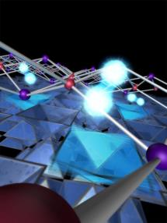



Substrate phonons enhance superconductivity at the interface
Scientific Achievement
  SIMES researchers have discovered a mode coupling between electrons in iron selenide (FeSe) and phonons in strontium titanate (STO) which enhances the superconducting transition temperature in the interfacial layer of FeSe.
Significance and Impact
  This coupling points to ways of possibly engineering materials with higher T_{c} and also gives insight into the general mechanism behind high-T_{c} superconductivity.
Research Details
  Used molecular beam epitaxy (MBE) to grow single-unit-cell-thick films of FeSe on STO, which were studied in-situ with angle-resolved photoemission spectroscopy (ARPES).
  Observed “shakeoff” bands in the ARPES spectra, indicating electron-phonon coupling of a very specific nature.
  Extracted the electron phonon coupling magnitude and calculated the enhancement of T_{c}, which agrees with other experiments.
Right: Image representing interfacial electron-phonon coupling. Bottom: Band structure showing the shakeoff bands.
Work was performed at Stanford University and SSRL, SLAC
J.J. Lee, F.T. Schmitt, R.G. Moore et. al., Nature 515, 245 (2014).
Notes:
Notes: Single-unit-cell iron selenide grown on SrTiO₃ (1UC FeSe/STO) has recently demonstrated signatures of superconductivity close to the boiling point of liquid nitrogen, a record for iron-based superconductors. This is also a dramatic enhancement of the T_{c} measured for bulk FeSe. Understanding the causes for enhancement would lead to ways of engineering higher T_{c}’s and possibly help explain how high-T_{c} emerges in systems such as the cuprates. SIMES scientists have used angle resolved photoemission spectroscopy (ARPES) to study in-situ the 1UC FeSe/STO system. So-called shakeoff bands (see figure) are observed, which manifest as replicas of the original band structure shifted downwards in energy. These shakeoff bands represent electrons coupling to a boson of energy equal to the magnitude of the shift; in this case the bosons are phonons in STO. The sharpness of the replica bands indicates the coupling type is low-momentum transfer, which is beneficial for superconductivity in many cases. By extracting the relative intensities of the shakeoff bands the researchers were able to extract the magnitude of the electron phonon coupling and estimate the enhancement of T_{c}. The enhancement obtained agrees qualitatively with materials which have similar band structures in bulk but do not have the additional phonon coupling due to STO.
Reference: J. J. Lee, F. T. Schmitt, R. G. Moore, S. Johnston, Y.-T. Cui, W. Li, M. Yi, Z. K. Liu, M. Hashimoto, Y. Zhang, D. H. Lu, T. P. Devereaux, D. -H. Lee, Z.-X. Shen, “Interfacial mode coupling as the origin of the enhancement of T_{c} in FeSe films on SrTiO₃”, Nature 515, 245 (2014); doi:10.1038/nature13894.
Funding: This work was supported by the US Department of Energy, Office of Science, Basic Energy Sciences, Materials Sciences and Engineering Division. D.-H.L. is supported by the Department of Energy, Office of Basic Energy Sciences, Division of Materials Science, under the Quantum Material programme DE-AC02-05CH11231. Measurements were performed at the Stanford Synchrotron Radiation Lightsource, a national user facility operated by Stanford University on behalf of the US Department of Energy, Office of Basic Energy Sciences (DE-AC02-76SF00515).

Slide 12
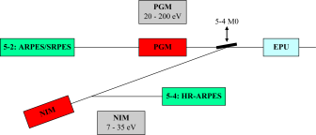
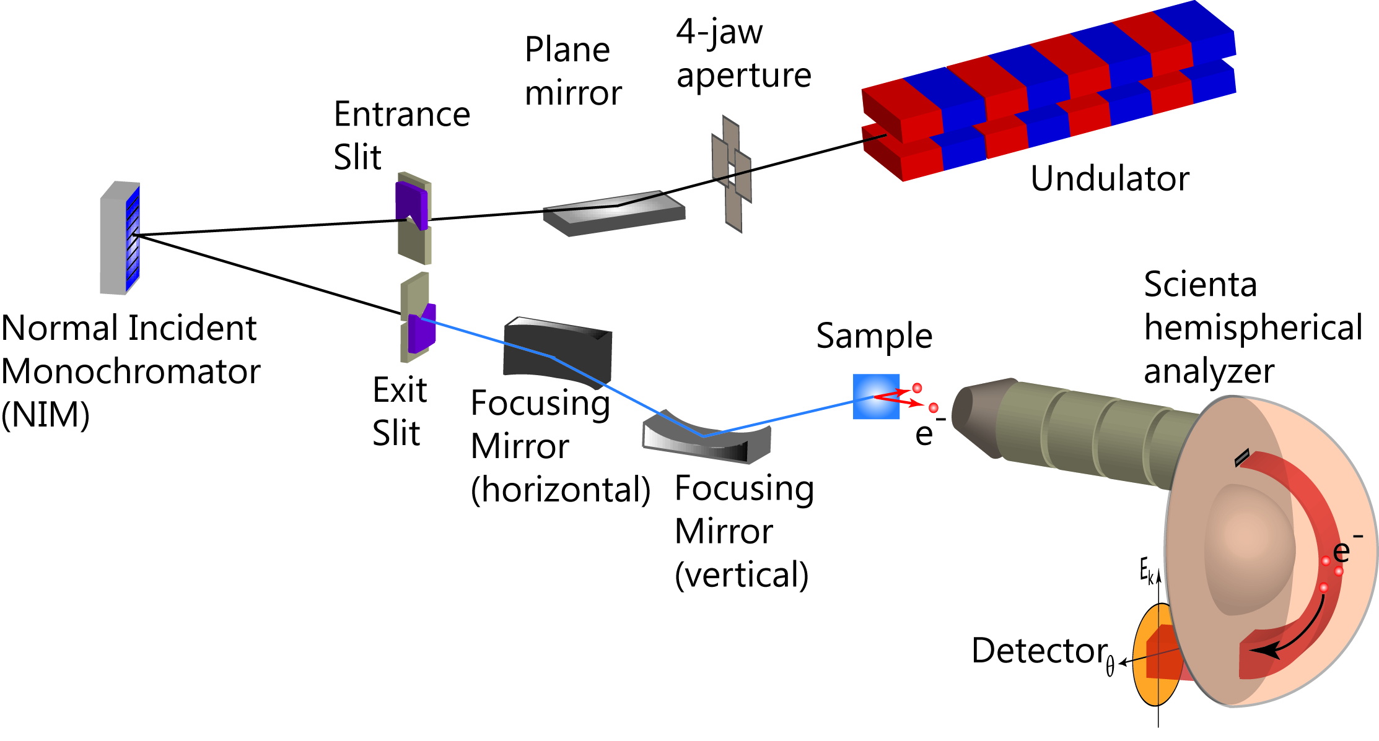
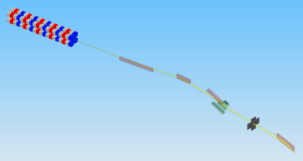
BL5: A state-of-the-art ARPES facility
Excellent control of the photon polarization (7-200 eV)
  EPU: 2.33 m, 31 pole, LH, LV, CL, CR
Two complementary branch lines/end stations
  NIM branch line: high resolution, high stability, low photon energy range
  PGM branch line: high flux, wider photon energy, small spot, spin-detector
Sophisticated material synthesis chamber
Enable rich science with both depth and diversity
  High Tc superconductors;
  Materials with novel spin-orbit physics;
  Novel low dimensional materials;
  Surface and interface…
BL5-4
BL5-2
7-35 eV
E/ΔE~20,000
20-200 eV
E/ΔE~40,000
> 2×10¹¹ ph/s @ 10,000 RP
0.2(H)×0.1(V) mm² (FWHM)
> 3×10¹² ph/s @ 10,000 RP
0.032(H)×0.005(V) mm² (FWHM)

Slide 13
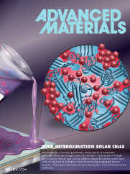
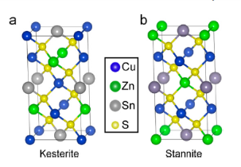
Sustainable Energy Materials Research
Sustainable (Renewable) Energy - Materials and Processes – In-Situ
Photovoltaics (PV)
  Si contacts, CIGS, CZTS, OPV, RTP, printing, …
energy storage
  anodes: Si, Ge, Sn, alloys, Mn hexacyanomanganate, …
  cathodes: LiMnNiCoO_{x}, LiFePO₄, sulfur, Cu hexacyanoferrate, …

Slide 14




Effect of Molecular Orientation on Ultrafast Electron Transfer
(A)
Scientific Achievement
  Measured dependence of photoexcited electron transfer rate on relative molecular orientation an organic heterojunction interface.
Significance and Impact
  Showed that face-on interfaces (larger intermolecular π-electron overlap) have significantly faster electron transfer rates at donor/acceptor interfaces and that control of relative molecular orientation is important to maximize charge generation in organic solar cells.
Research Details
  The core-hole clock implementation of resonant Auger electron spectroscopy was used to measure electron transfer rates on ultrafast sub-50 fs time scales.
  Face-on interfaces show electron transfer (ET) times below 35 fs, whereas edge-on interfaces lead to ET times of > 50 fs.
(B)
Resonant Electron Spectroscopy shows that donor/acceptor electron transfer is faster at face-on vs. edge-on orientations. (A) Cartoon illustrating the relative orientations between the Cu phthalocyanine donor (blue) and C₆₀ acceptor (black). (B) Resonant Auger electron spectra, which were used to measure the branching ratio of Auger electron decay processes. This branching ratio is related to the average time it takes an electron to hop from the excited donor to a nearby acceptor.
Work performed at Stanford University and Stanford Synchrotron Radiation Lightsource
A.L. Ayzner, D. Nordlund, D.H. Kim, Z. Bao, M.F. Toney J. Phys. Chem. C 6, 6-12 (2015)
SSRL
Notes:
Organic semiconductors – molecules that absorb visible light and conduct electricity when charged – form the backbone of a number of promising new technologies, including displays, transistors and photovoltaic cells. The tunable molecular nature of these materials leads to inexpensive, light-weight and highly-tunable optoelectronic devices. In organic photovoltaic cells, electrons in light-absorbing molecules get excited under solar illumination. These excited electrons must then transfer from donor molecules (typically a polymer or small molecule) to a nearby acceptor molecule (a fullerene derivative). It is this electron transfer step that ultimately leads to current flow. This raises a question: how should donors and acceptors be arranged in space with respect to each other to maximize the rate of electron transfer and thus photocurrent?
We set out to answer this question using a model interface between a Cu phthalocyanine (CuPc) donor and a C₆₀ fullerene acceptor. Because C₆₀ is a spherical molecule and CuPc resembles a flat pancake, varying the relative orientation of the CuPc allowed us to measure the electron transfer rate at different molecular arrangements. Since electron transfer is extremely fast at such interfaces (~10-100 fs), we used X-ray photons, which are able to follow this process faster than the time it takes for a typical chemical bond to vibrate. Using this approach, we found that electron transfer was sensitive to precisely how the donor and acceptor molecules were positioned with respect to each other. When the molecules were oriented face-on, i.e. when the sphere was placed on top of the stack of pancakes, the excited electron jumped significantly faster than if the sphere and pancake were oriented side-on (the side of the pancake stack). The fact that the quantum mechanical probability for the photoexcited electron to jump from the donor to the acceptor is larger in the face-on than side-on orientation is due to a larger interface surface area in the sphere-on-pancake arrangement. This finding implies that to optimize the current in organic solar cells, the relative orientation between the donor and the acceptor must be carefully controlled.

Slide 15
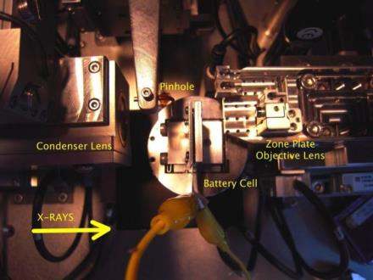
Transmission X-ray Microscopy
Capabilities:
Morphology – 30 nm resolution. 30 µm field of view
2D & 3D imaging (density, porosity)
Elemental/chemical maps
X-ray Microscopy

Slide 16
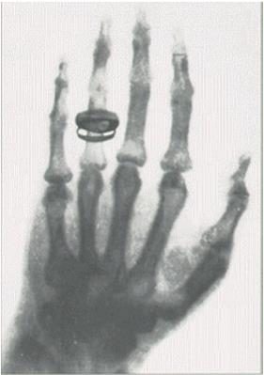
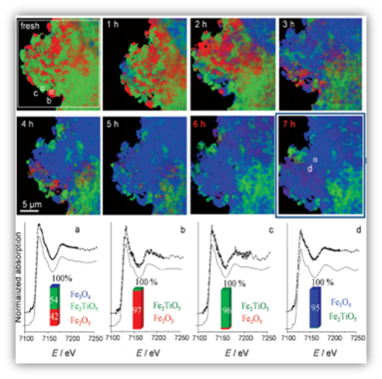
Transmission X-ray Microscopy
Imaging now
Imaging 1895

Slide 17


2D and 3D in Situ Imaging of Battery Anodes
Scientific Achievement
  Operando imaging shows size dependent cycling characteristics of Ge particles. In situ 3D imaging demonstrates fracturing of anode material into completely unconnected pieces.
Significance and Impact
  This work demonstrates the value in linking electrochemical performance with morphological evolution to better understand battery failure and further the search for high capacity electrode materials.
Research Details
  Only Ge particles with diameters larger than a few microns crack during cycling.
  Small particles lose electrical contact by the second cycle.
  The density changes due to lithiation are consistent with partial transformation into a Li₁₅Ge₄-like phase.
Upper: Schematic showing irreversible deformation of the conductive carbon matrix (blue) electronically isolates the small particles, making them inactive in the second cycle.
Lower: Volume renduring of Ge particles (a) before cycling, (b) after lithiation, and (c) after delithiation
J. Nelson Weker, N. Liu, S. Misra, J. C. Andrews, Y. Cui, M. F. Toney, Energy Environ. Sci. 7, 2771 (2014).
Work was performed at Stanford Synchrotron Radiation Lightsource
Notes:
Notes:
In order to successfully replace fossil fuels with cleaner, renewable energy sources, the rechargeable battery for electric vehicles needs dramatic improvements. One improvement is to find a high capacity anode material that is robust under cycling. Alloying anodes such as silicon and germanium are excellent candidates due to their high capacity. However, during cycling these materials are known to undergo dramatic volume changes which are believed to be responsible for their rapid failure after a few cycles. One possible failure mechanism is the fracturing of particles, which render fragments electronically isolated.
Using 2D transmission X-ray microscopy (TXM) during battery operation, we have observed significant size dependencies in the cycling behavior of Ge particles. During the first cycle, only particles with diameters larger than a few microns show cracks, and smaller particles experience volume expansion and cracking before their larger counterparts. By the second cycle, the small particles lose electrical contact. Using tomographic TXM of Ge particles within an operating battery at key points along the electrochemical cycle, we have visualized the particles in 3D. The density changes correlate to a partial transformation into a Li₁₅Ge₄-like phase after lithiation and an incomplete delithiation process. There is also the first unambiguous evidence of the fracturing of an anode material into completely isolated pieces.
This work represents the first direct demonstration of the physical and electronic disconnection of active electrode materials during cycling, which suggest possible paths to mitigating capacity fade in these high capacity alloying anodes.

Slide 18
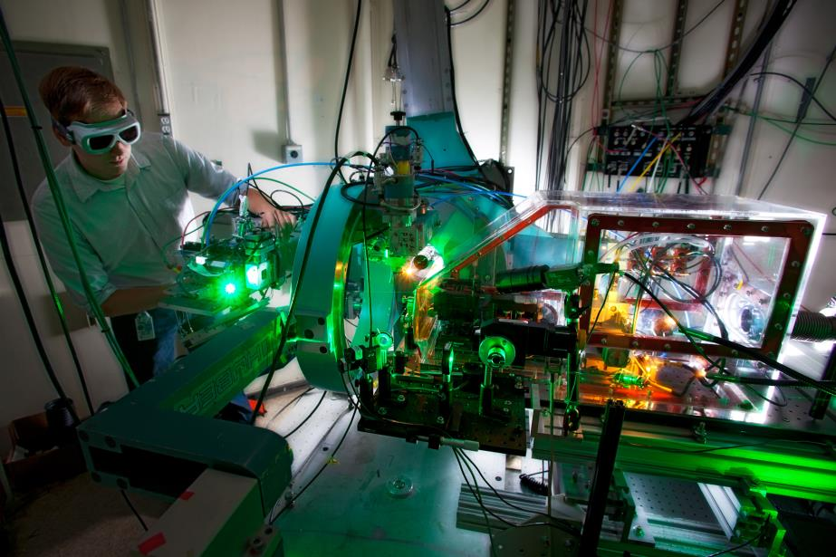
Time resolved X-ray Science

Slide 19
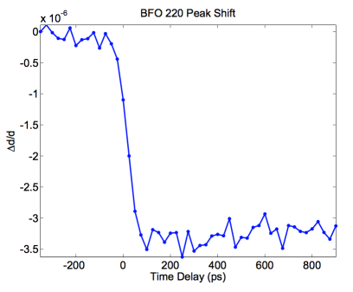
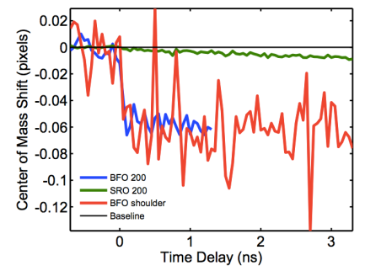
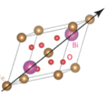
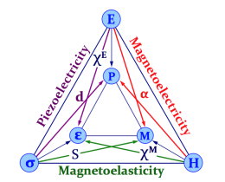
Multiferroic thin films; Ultrafast thermal transport
M. Kozina et al., Struct. Dyn. (2014)

Slide 20


Influence of Amorphous Structure on Crystallization of Different Polymorphs
Outline:
Pulsed Laser Deposition (PLD)
Electrochemical Deposition
Deposition
Characterization of the amorphous structure:
- Grazing Incidence Pair Distribution Function (GIPDF)
- X-ray Absorption Spectroscopy (XAS)
Modelling of GIPDF data (LBNL)
Amorphous films
Structure of crystallized thin films (Identification of polymorphs):
- GIXRD, Powder XRD on scraped films, in-situ XRD
- Modeling of structural relationships (LBNL)
Crystallization

Slide 21
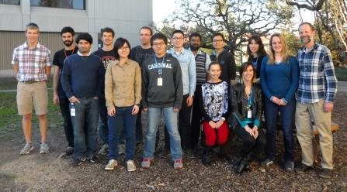
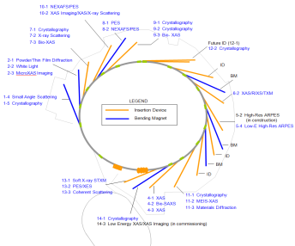

Summary – Opportunities
Research opportunities at SSRL
  PV, energy storage, catalysis
  Strongly correlated electrons

