Slide 1
Photon Science Research at SLAC
Physics and Applied Physics Graduate Student
Open House

Slide 2
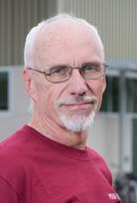
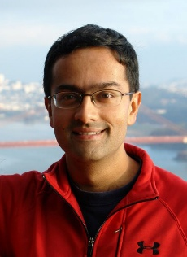
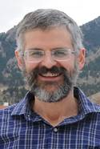
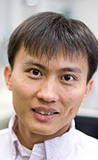
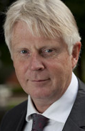
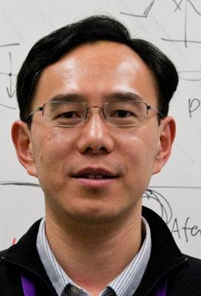
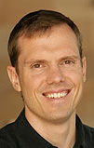

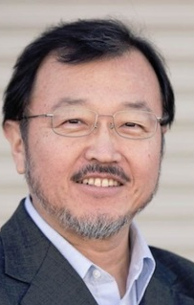
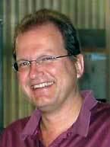
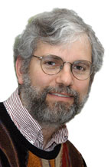
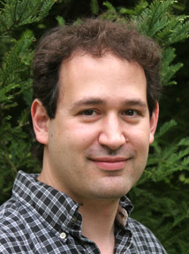
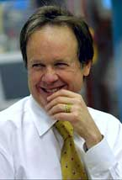
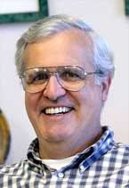
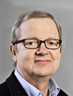
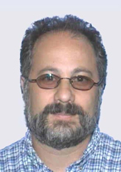
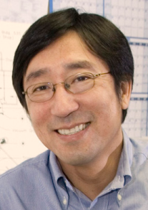
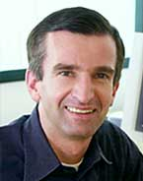
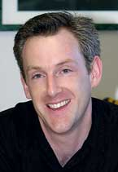
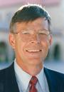

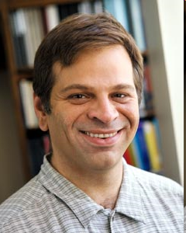
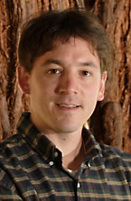
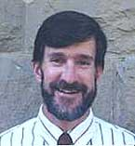
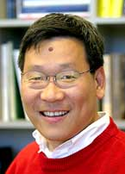
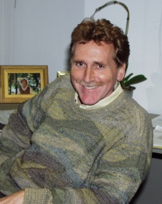
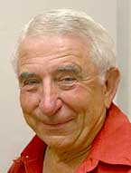
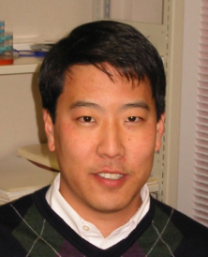
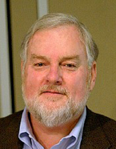
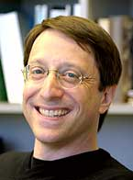
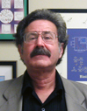
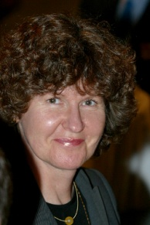
Photon Science Faculty: Who We Are
Galayda
Raghu
Irwin
Cui
Holtkamp
Huang
Melosh
Raghu
Wakatsuki
Nilsson
Bucksbaum
Reis
Hodgson
Pianetta
Norskov
Devereaux
Kao
Brunger
Gaffney
Byer
Hastings
Martinez
Lindenberg
Mao
Clemens
Shen
Stohr
Doniach
Hwang
Brown
Weis
Solomon
Hedman

Slide 3
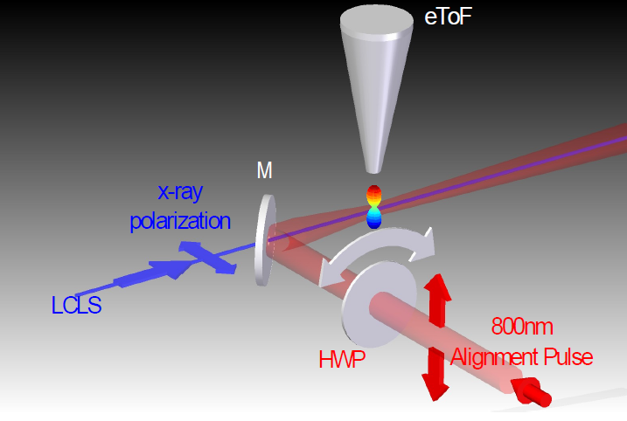
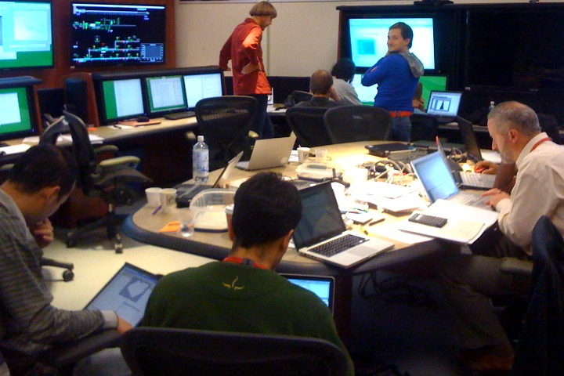
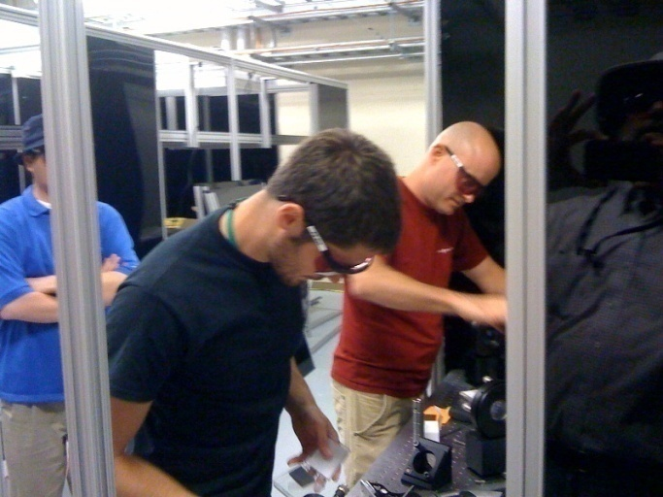
Stanford Students Helping Commission the LCLS
Helping to commission
2-d hard x-ray detection at LCLS
Students integral to the research at SLAC

Slide 4
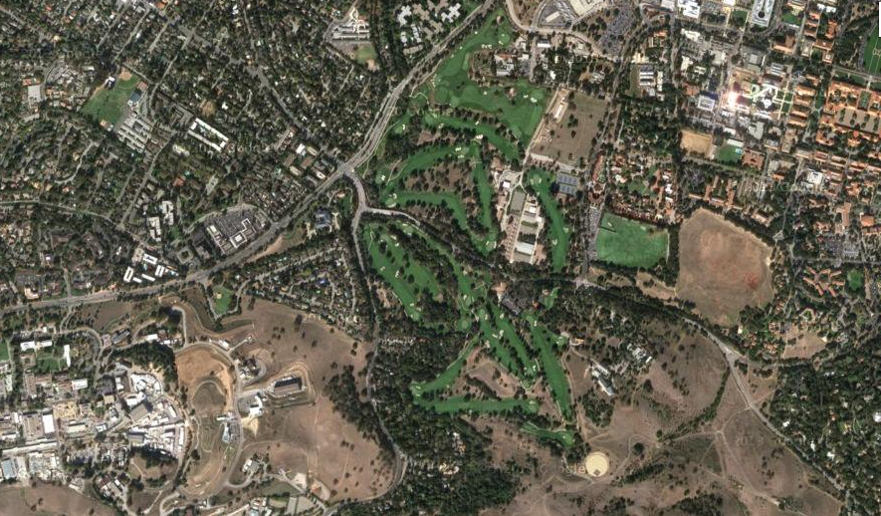
Where We Are
Physics
and
Applied Physics
Stanford
Golf Course
SLAC
10 minute bike ride from Varian

Slide 5





Three Stanford Institutes at SLAC, a Synchrotron, the world’s first
X-ray free electron laser and more…
  Ultrafast science, from attoseconds to picoseconds, terahertz to x-rays.
The science of energy-related materials.
Atomic-scale design of catalysts for chemical transformations.
Active programs in Materials, Structural Biology, Chemistry, Accelerator Physics
Ultrafast and high field x-ray laser-matter interactions; x-ray imaging.

Slide 6
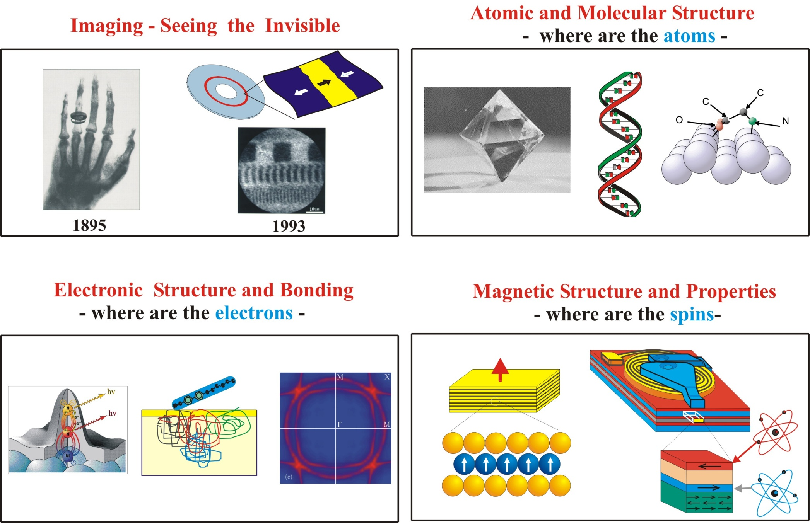
Research in Photon Science…
revolves around the generation and utilization of X-rays

Slide 7
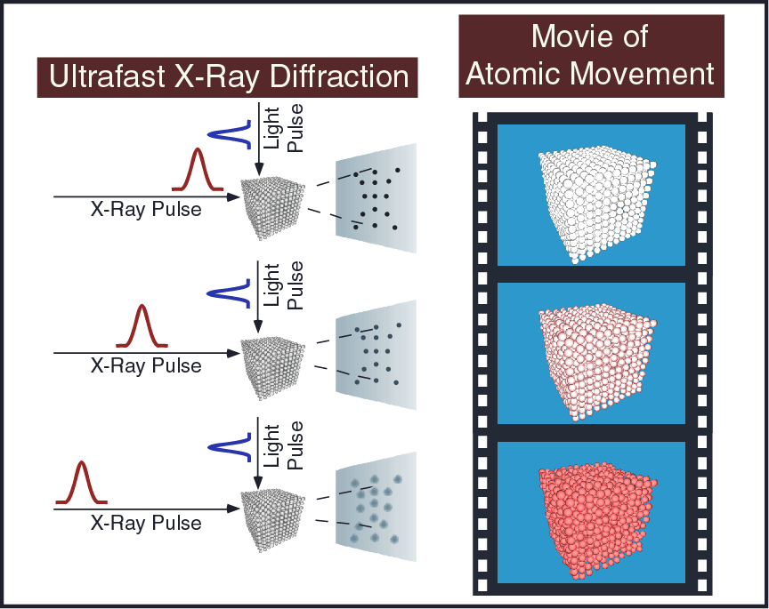
Ultrafast x-rays probe structural dynamics
atoms move
in 0.01-10 ps
Source: LCLS – The First Experiments

Slide 8
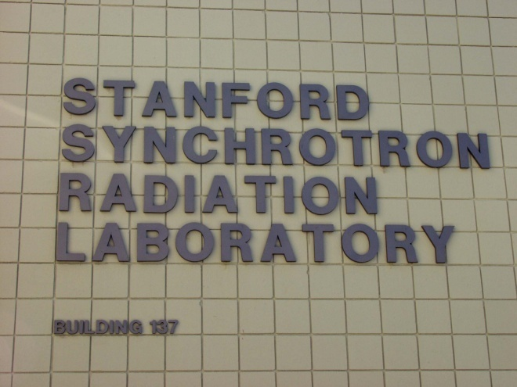
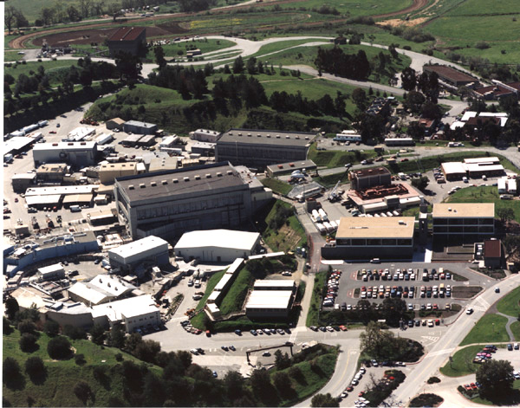
SSRL – SPEAR3
Third Generation Synchrotron
32 beamlines
serving 1,600 scientists a year
Precision x-ray measurements in:
Condensed matter physics
biophysics
Molecular and chemical physics
Molecular electronics
ring

Slide 9
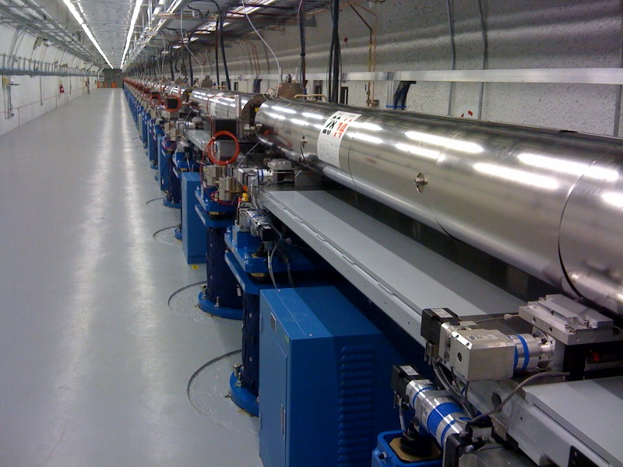
LCLS: the world’s 1st x-ray laser
Peak brightness billion times higher than previous x-ray sources
X-ray laser
0.5-3 mJ
0.4 – 9.5 keV
5-500 fs

Slide 10
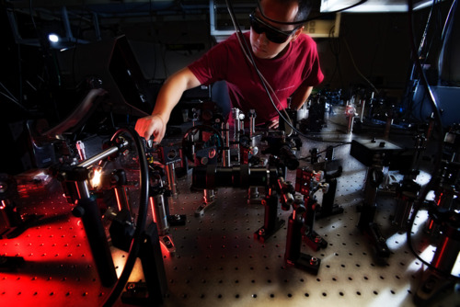
Introduction to Research Opportunities
in Photon Science

Slide 11
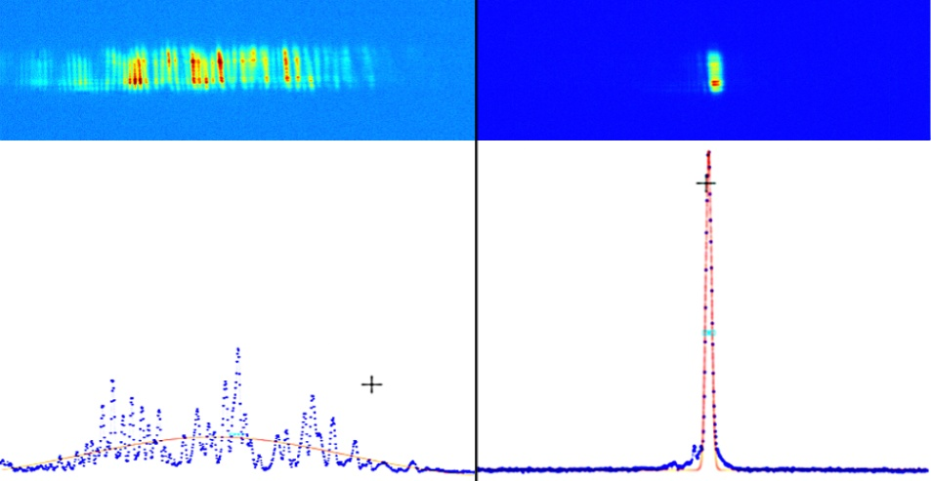
FEL R&D opportunities @ SLAC
Zhirong Huang
Jerry Hastings
John Galayda
Norbert Holtkamp
SASE spectrum
Seeded spectrum
Seeding can improve its spectral brightness
LCLS is currently the world’s brightest x-ray source
You have the opportunities to make it even brighter and impact the design of next-generation FELs
Many opportunities to pursue theoretical, computational and experimental research

Slide 12
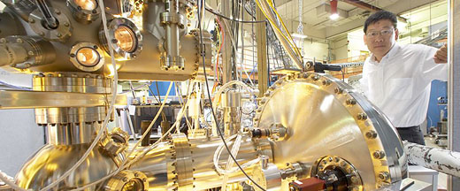
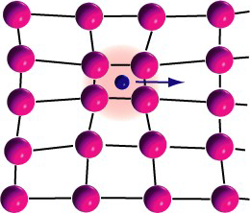
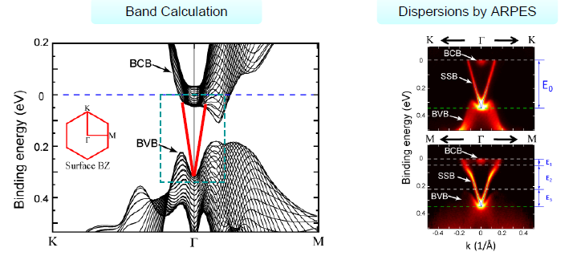
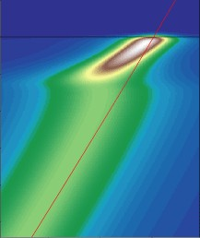
Emergent Properties of Quantum Materials
Tom Devereax
Harold Hwang
Chi-Chang Kao
Srivinash Raghu
Z.X. Shen
E_{F}
Energy
Kink at Lattice mode
Angle-Resolved Photoemission (ARPES)
Momentum

Slide 13
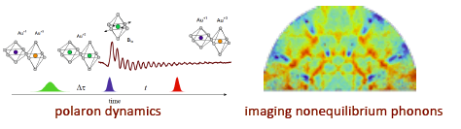
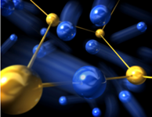
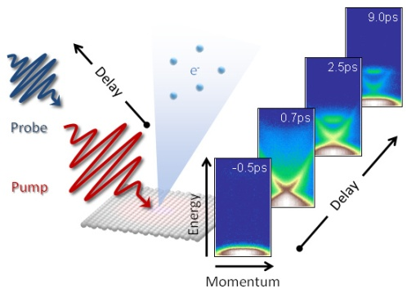
Ultrafast Photonic and Electronic Properties
David Reis
Aaron Lindenberg
Jo Stöhr
Tom Devereax
Z.X. Shen
Ultrafast phase transitions in nanomaterials

Slide 14
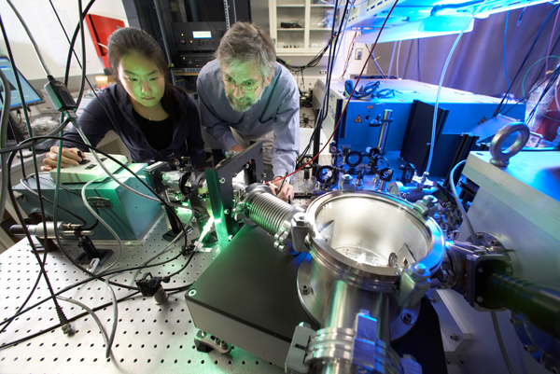
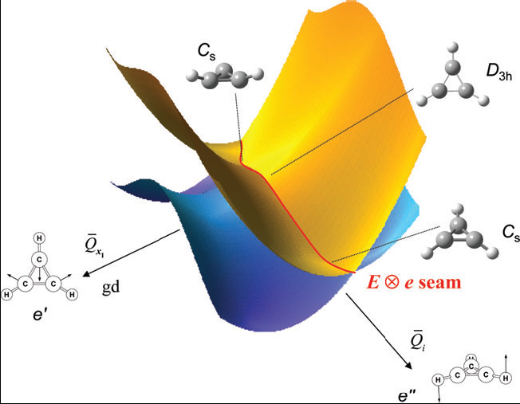

Dynamics in Atomic, Molecular, and Chemical Physics
Phil Bucksbaum
Todd Martinez
Anders Nilsson
Kelly Gaffney
Theory of quantum chemical dynamics
Attosecond dynamics in strong fields

Slide 15




Macromolecular Crystallography –
An Atomic Resolution view of the Biological World
Keith Hodgson
Britt Hedman
Axel Brunger
Bill Weiss
Soichi Wakatsuki
  Allows study of very complex biological systems simply not accessible at the molecular level by any other approach
  Wide ranging impact - from understanding basic biology to design of drugs
Protein crystal
Diffraction data
Electron density
Molecular model of protein

Slide 16



LCLS: Advances in Bioimaging Methods and Applications
Keith Hodgson
Axel Brunger
Bill Weiss
Soichi Wakatsuki
Seb Doniach
LCLS x-rays revealed the atomic-scale structure of an enzyme key to the survival of the parasite that causes African sleeping sickness

Slide 17



Interfacial Chemistry relevant to Energy and the Environment
Jens Norskov
Anders Nilsson
Gordon Brown
Materials by design: predicting catalyst function with ab initio theory

Slide 18
How to find us:
www.pulse. slac.stanford.edu
www.simes.slac.stanford.edu
www.ssrl.slac.stanford.edu
www.lcls.slac.stanford.edu
http://suncat.slac.stanford.edu/default.asp
home.slac.stanford.edu/photonScience
Faculty.html

