Slide 1
Exploration and Challenges at the Large Hadron Collider
Su Dong

Slide 2
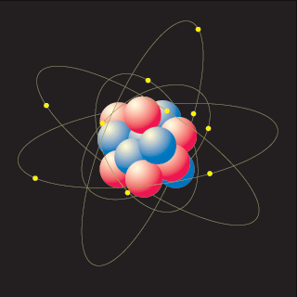
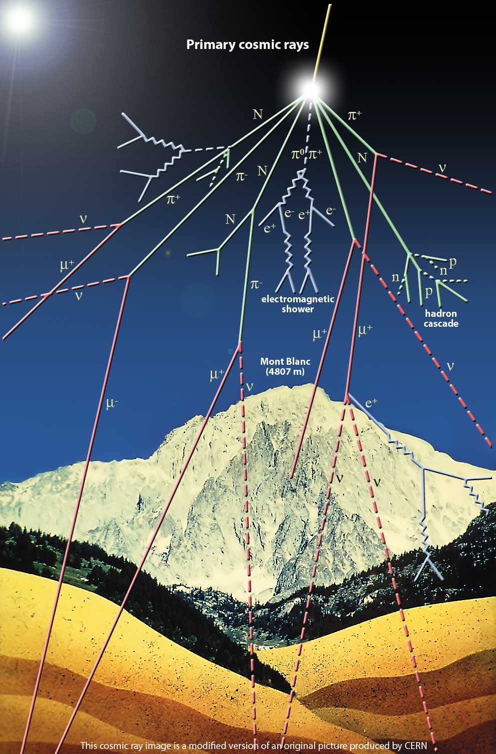
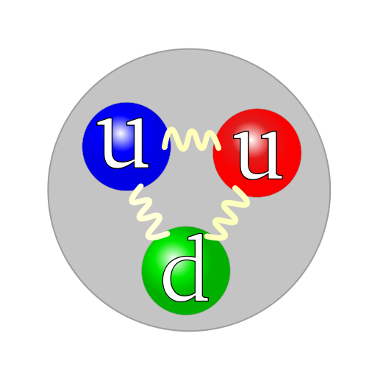
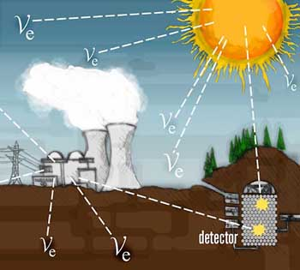
Fundamental Building Blocks
proton
e⁻
p
n
Proton and neutrons
are composite objects
made of quarks (u,d)
Q_{u}= +2/3 Q_{d}= -1/3
Can also form mesons
π⁺
Muon ~ “heavy electron”
Cosmic μ flux ~70/m²/s/sr
Solar ν flux ~6x10¹⁴/m²/s

Slide 3
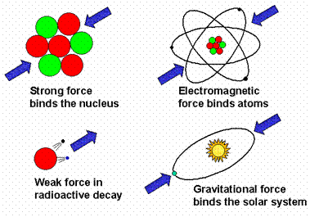
Fundamental Forces
Strong
Interaction:
Gluon g
m=0 Q=0
Spin=1
Electro-magnestism:
Photon γ
m=0 Q=0
Spin=1
Weak
Interaction:
W⁺, Z⁰
m=80, 91GeV
Spin=1
Gravity:
Graviton G
m=0 Q=0
Spin=2
Forces/interactions can be described as exchange
of mediating gauge bosons

Slide 4
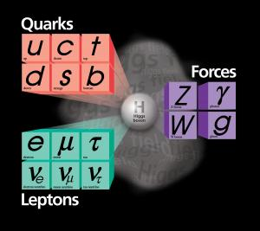
The Standard Model
Very successful in describing nearly all measurements so far, but we know we are missing something…
Large number of free parameters
Origin of the mass scales ?
Neutrino mass <1 eV
top quark mass 174 GeV
M_{plank} ~10¹⁵ GeV
Why 3 generations ?
None of the existing particles could explain dark matter.
How does gravity fit in ?
but the mysterious Higgs boson
responsible for generating the
masses is still to be found…

Slide 5
Beyond the SM ?
There are many interesting ideas on the market:
Super symmetry; extra dimensions…
SUSY particles, KK gravitons, Z’, mini black holes…
Many ideas support the notion that something ought to happen at the TeV energy scale (if we don’t find Higgs <1 TeV, then we also know we are fundamentally on the wrong track)
but there is a huge chasm between what looks so nice and might be true, and what is actually true.
The only way to really move forward is to do experiment at the TeV scale.

Slide 6
The Large Hadron Collider
The next major facility at energy frontier. Located at CERN, Geneva, Switzerland.
Proton Proton collisions @ 7+7 TeV
(compared to Tevatron at Fermilab 1+1 TeV)
Two general purpose large experiments: ATLAS and CMS.
First collision Dec/09 Now operating at 3.5+3.5TeV.

Slide 7
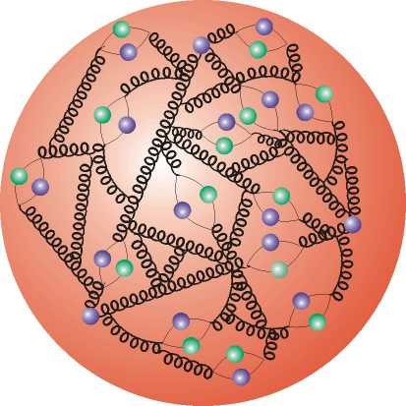
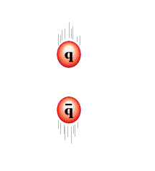
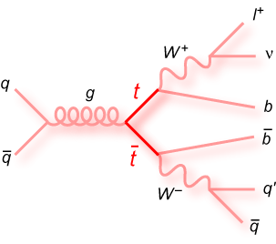
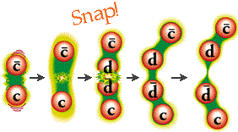
PP Collisions
A closer look at the proton
reveals a sea of partons.
qq,gg,gq interactions
and remaining proton debris.
Quarks fragment into jets of hadrons

Slide 8
Physics Processes at LHC
7 TeV
Cross sections for heavy objects such as top, Higgs or possible new particles grew substantially compared to Tevatron
but they are still under a huge mountain of QCD background.
Multiple interactions in each beam crossing at LHC luminosity also gets much worse.
Very challenging environment to pull out the interesting physics.

Slide 9
Physics Signatures
The overwhelming background at LHC is jet production, primarily gluons and light quark which all fragment into jet of light hadrons.
The more interesting objects typically decay more democratically to other particles:
__ __
Z⁰ -> bb~15%; cc~12%; e⁺e⁻:μ⁺μ⁻:τ⁺τ⁻ ~3.3% each
W -> eν,μν, τν ~11% each
top quark -> b~100%; eν+X,μν+X each ~9%
Devise experiment to detect the distinctive signatures:
e, μ, τ leptons
b quarks
Missing energy

Slide 10
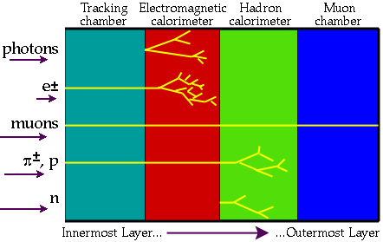
Particle Signatures
ν and other non-interacting dark matter candidates => Missing Energy

Slide 11
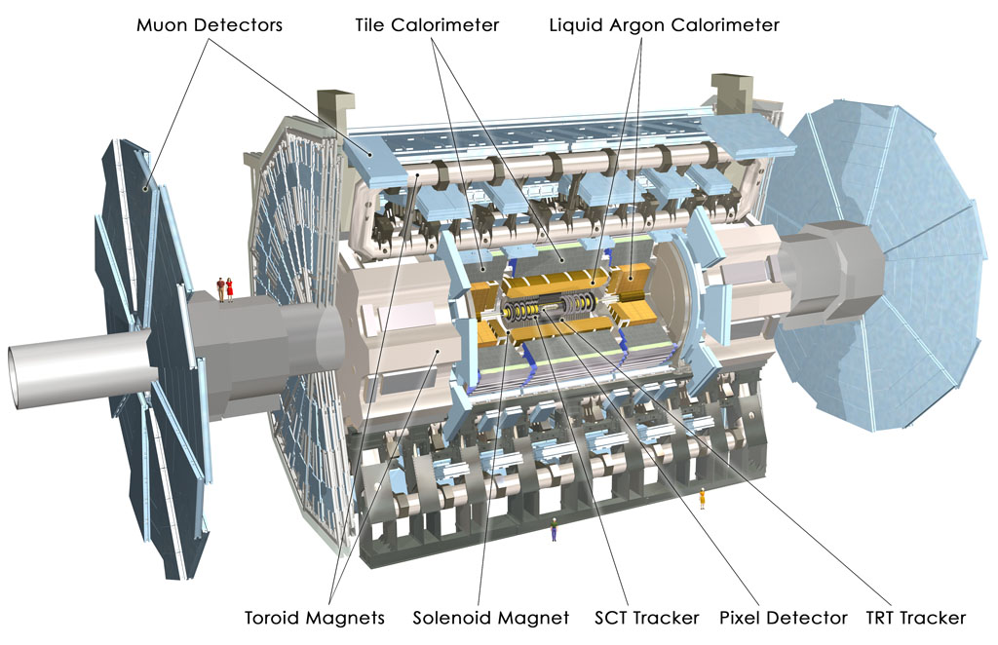
The ATLAS Experiment

Slide 12
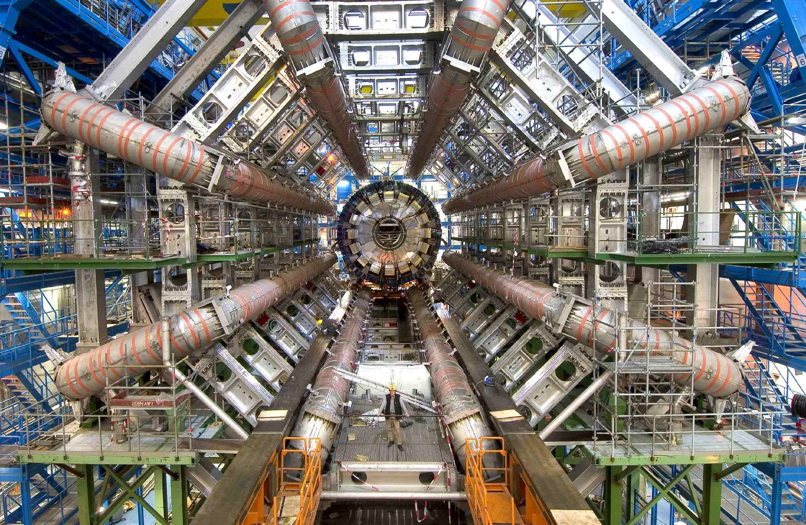

Slide 13
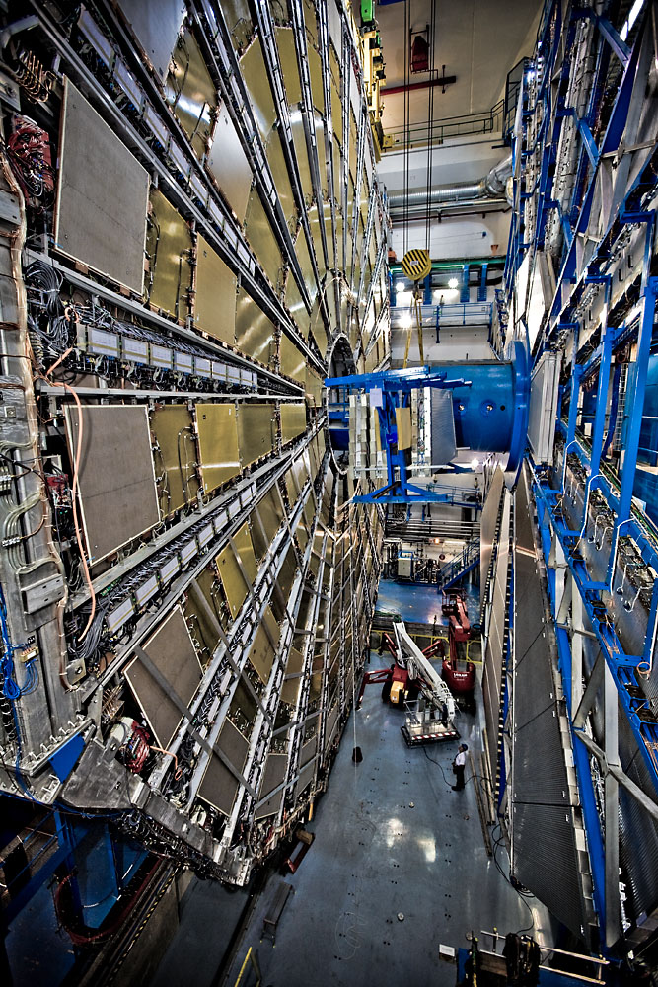
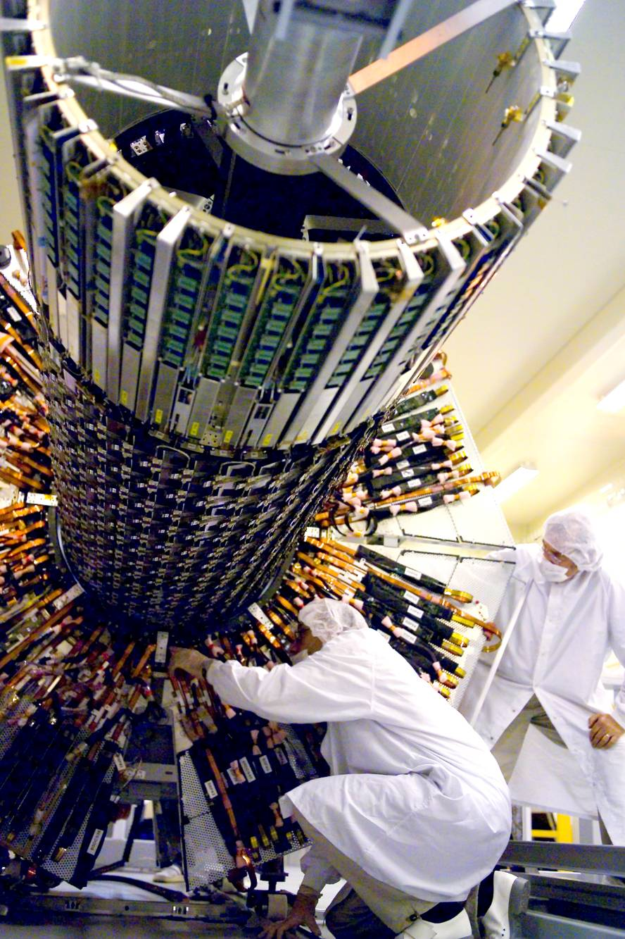

Slide 14
Trigger & DAQ
500 CPUs
1600 CPUs

Slide 16
Z⁰ -> e⁺e⁻ candidate event

Slide 18
1 cm

Slide 19
Challenge of Detecting Interesting Physics
Simulation
~23 interactions
per beam crossing
at 10³⁴ luminosity
Higgs → ZZ → 2e+2μ
Pile up background

Slide 20
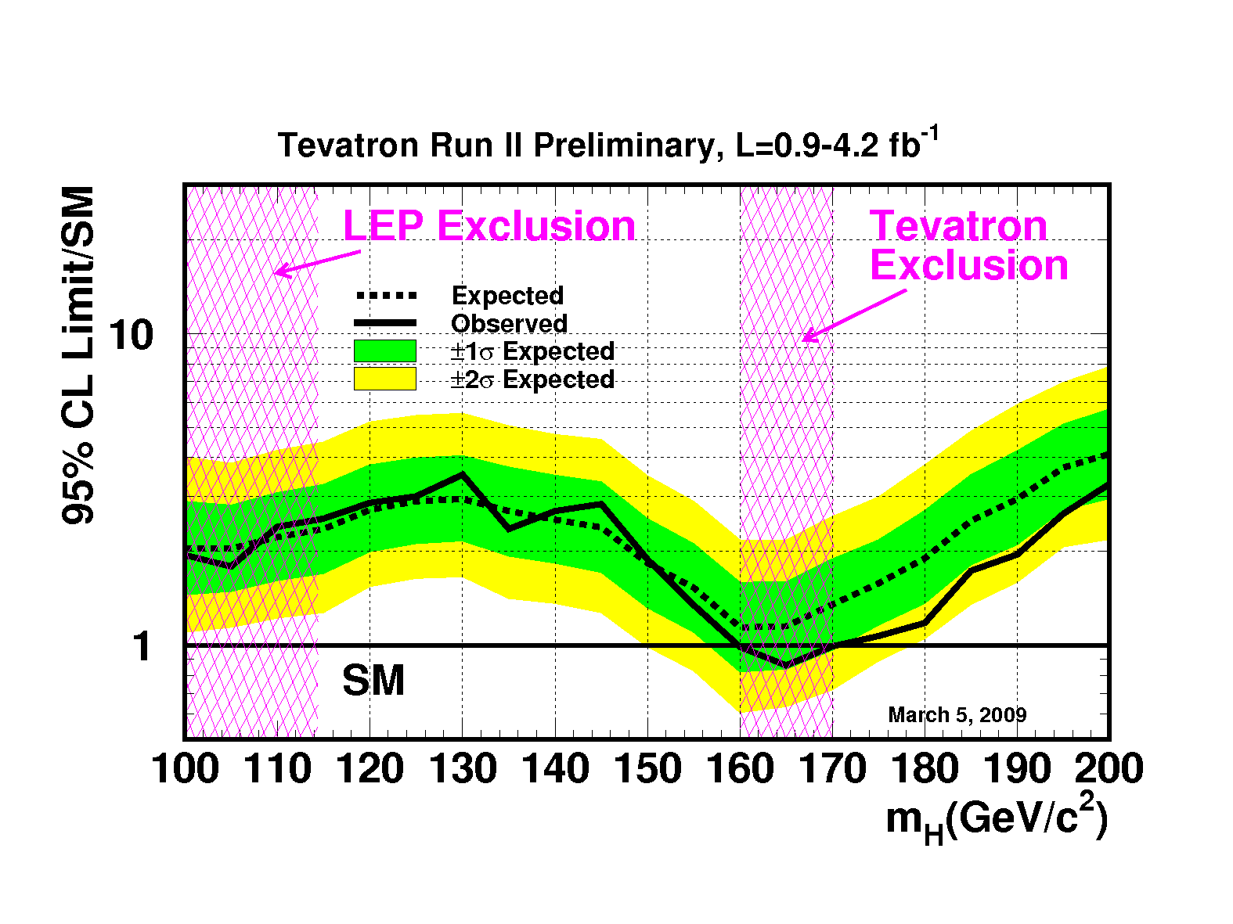
Status of Higgs Search ?

Slide 21
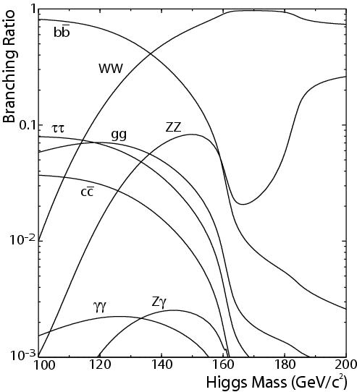
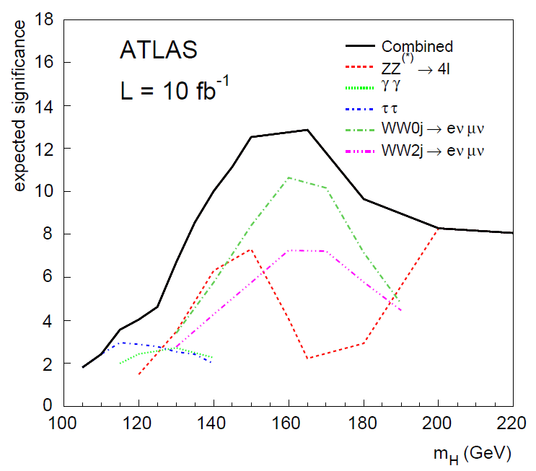
Searching for Standard Model Higgs
It’s a tough road ahead and will take some time (10 fb⁻¹ by 2014 ?)

Slide 22
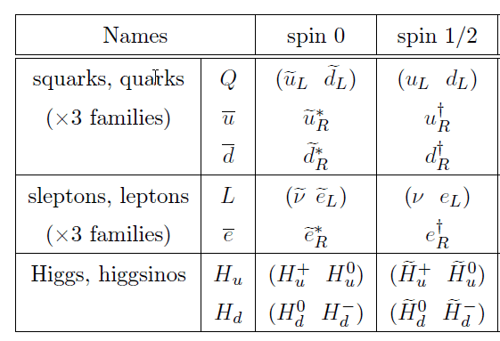
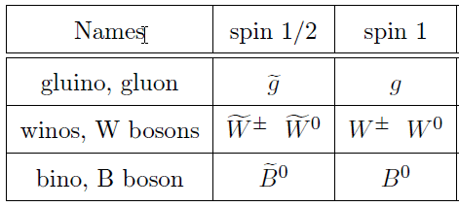
SuperSymmetry (SUSY)
Very attractive theoretically. Offers solution to many problems simultaneously.
Many different variations of SUSY with large number of free parameters. Most studies on subset of SUSY
Minimal SuperSymmetric
Model (MSSM)

Slide 23
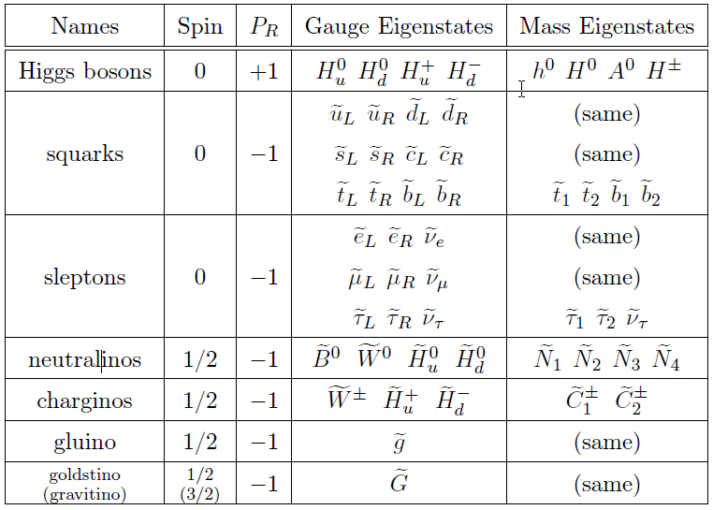
MSSM Particle Catalog
h⁰ ~SM Higgs
χ⁰_{1,2,3,4}
χ⁺_{1,2}

Slide 24
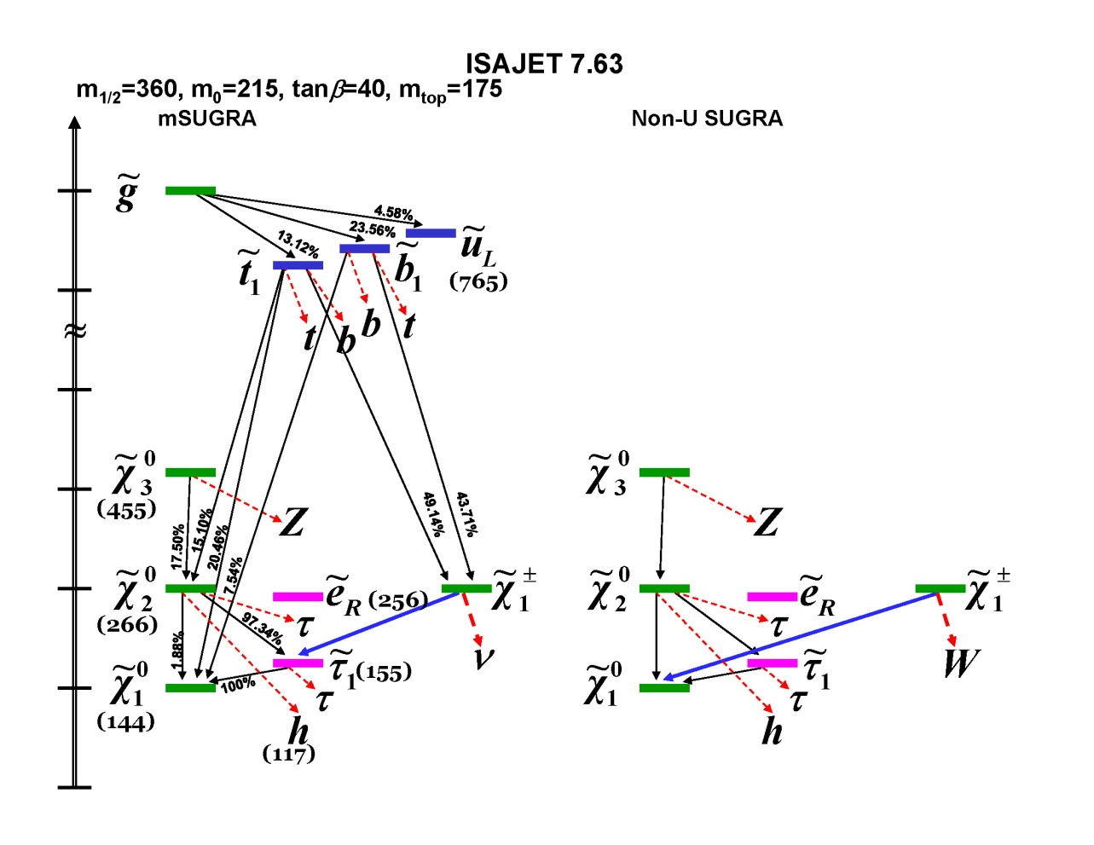
MSSM Phenomenology
Signatures:
quark/gluon -> jets
leptons: e, μ, τ
W,Z
Higgs !
Stable χ⁰₁-> Missing energy
One example out
of many possible
mass hierachies
Among viable SUSY models, the lowest mass SUSY particle (LSP) is often the
lightest neutralino which is stable and escaping direct detection. Thus one
very popular candidate for dark matter. There are also classes of models with
the gravitino as the LSP.

Slide 25
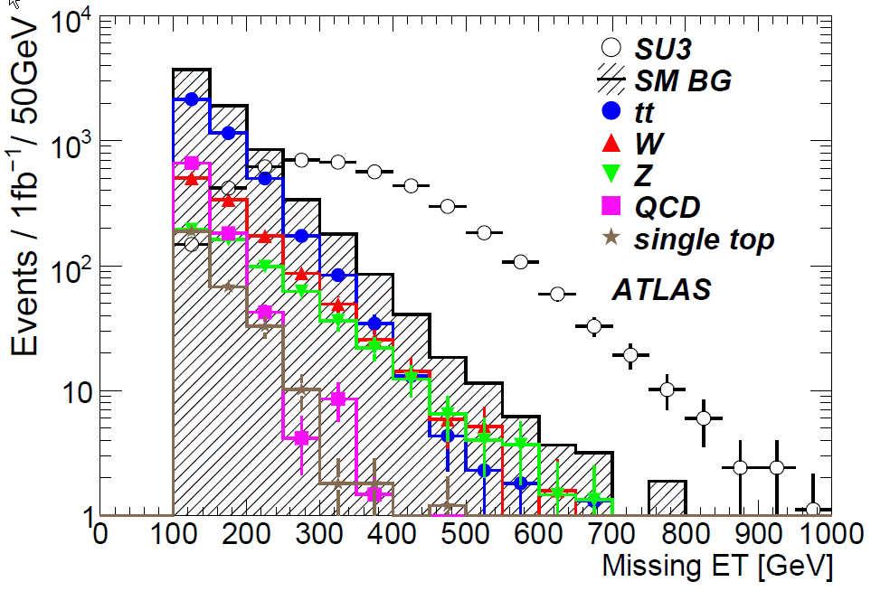
Detecting SUSY in ATLAS
Some cases are easy, and with luck we may even see them in 2011 !
but covering all scenarios is a lot of work !

Slide 26
Summary
Very exciting times as the physics exploration with LHC is finally underway.
The experiment is challenging.
Vast range of new physics possibilities beyond just discovering the Higgs.
A great opportunity for young physicists to explore.

Slide 27
Online Resource and Contacts
Large Hadron Collider:
Wikipedia: https://en.wikipedia.org/wiki/Large_Hadron_Collider
LHC: https://home.cern/science/accelerators/large-hadron-collider
ATLAS experiment public info:
https://atlas.cern
SLAC ATLAS Activities
https://atlas.slac.stanford.edu/
Contact me:
sudong@slac.stanford.edu
(650)-926-2284

