Slide 1
Implementation of PingER on Android
Rohan Sampson Shivnarayan Rajappa
Prof (Dr) A. Sai Sabitha Prof (Dr) Abhay Bansal
Prof (Dr) Bebo White Prof (Dr) Les Cottrell

Slide 2
About SLAC and Amity
SLAC National Accelerator Laboratory, originally named Stanford Linear Accelerator Center, is a United States Department of Energy National Laboratory operated by Stanford University under the programmatic direction of the U.S. Department of Energy Office of Science and located in Menlo Park, California.
Amity University is a multi campus private research university in India. Amity School of Engineering and Technology consists of seven departments namely Applied Sciences, Computer Science & Engineering, Information Technology, Electronics & Communication Engineering, Electronics & Electrical Engineering, Mechanical & Automation Engineering and Civil Engineering.
SLAC and Amity have been working together on the PingER project since 2015.

Slide 3
The PingER Project
PingER is an Internet End to End Performance Measurement (IEPM) tool developed by SLAC. It stands for Ping End-to-End Reporting and was started to identify the Digital Divide in terms of internet performance.
The ubiquitous ping command is used at the heart of the project to record the responses or the absence of responses.
PingER collects latency, jitter and packet loss. The project monitors roughly 700 sites across approximately 160 countries worldwide
The project aims to measure round-trip travel time between nodes sending ping packets of data over the Internet.
Among the monitoring hosts involved, Amity has the only such host in India.

Slide 4
The limitations of a traditional host
High power consumption
Complexity of installation
Maintenance
Storage dimensions
Cost of a full server being expensive
Portability
Scalability

Slide 5
Solution: PingER on Android
An Android phone is an appropriate choice for the project as it is easy to use, portable, robust, inexpensive (especially second hand) and is scalable to the needs of the system.
PingER MA (Measuring Agent) on Android is targeted towards Android Lollipop 5.0 and the code ensures both forward and backward compatibility. A github repository has been maintained to ensure version control of the code.
The Monitoring host at Amity was studied and used to develop a mirror implementation on Android through native Android development tools and strategies

Slide 6
Implementation on Android
The model chosen was a model which relied on the Android platform’s support for Java. This model proposed to rewrite the implementation for the iterative pinging of hosts in pure Java.
The implementation is divided into:
Iteratively pinging the beacons from an Android device.
Fetching a beacon list from the SLAC website as an xml list, parsing that list to extract relevant data
The beacons are pinged and the collected data is stored locally on the Android device and then transferred to an intermediate proxy.
This proxy acts as a medium for SLAC servers to pull the raw data collected by the Android PingER devices from one place.

Slide 7
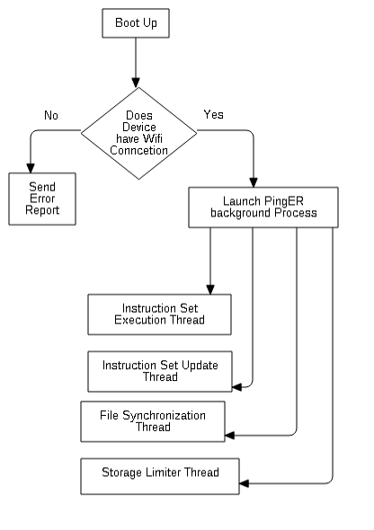
Thread division
In order to optimize performance and make use of the abundance of multicore processors available in the present generation of Android devices, the process was divided into threads

Slide 8
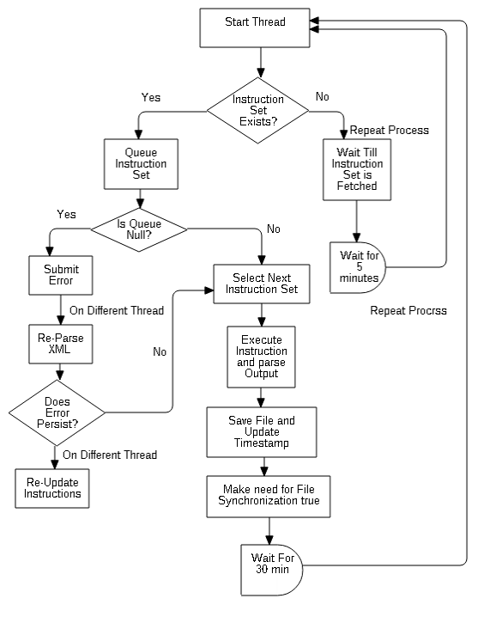
Instruction set execution thread
The instruction set execution starts off by checking whether an instruction set exists. In case of a failure, the process waits for the specified duration and then rechecks for the same. If found, the instruction set is then queued. If the queue is empty at this point a new error report is generated, and a recheck involving the complete repetition of the parsing of the XML file fetched containing the beacon list is done. If a failure is found yet again, the instruction set is fetched again. If not null, a queue manager is called, which checks the validity of each instruction and assigns which instruction is to be performed next. The selected instruction is executed, the output is parsed and stored on the device locally.

Slide 9
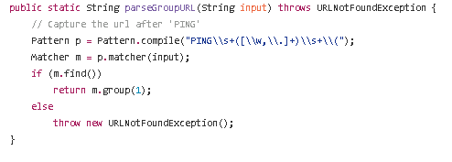
The extraction process
The shown images detail how the data actually received by the Android device is parsed using Regex and later stored as a set of strings on the host Android device.

Slide 10
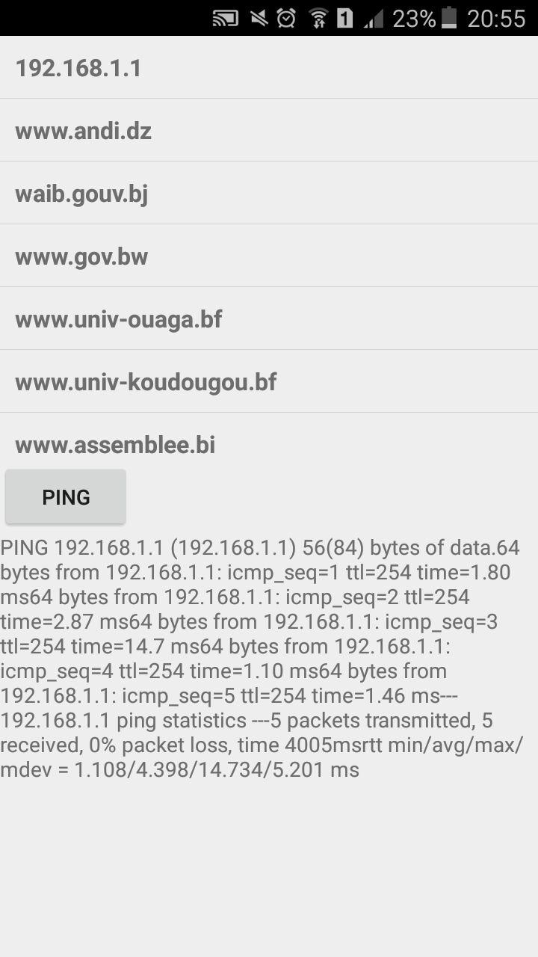
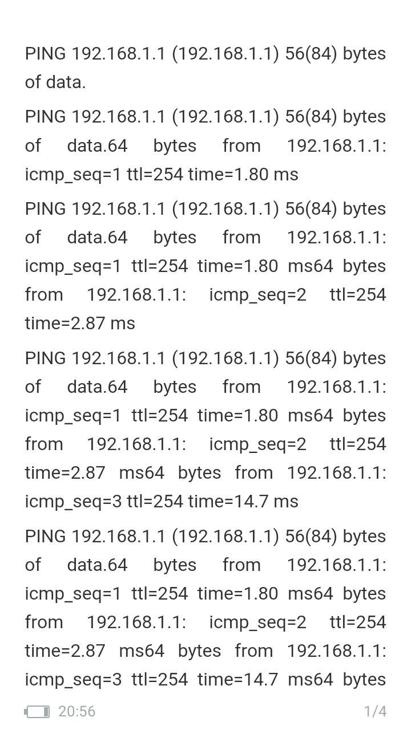
Screenshots of the working Application
The first image shows the application running and recording data using a subset of the beacon list chosen. The output is displayed in a scrollable list.
The second image shows, the entire data recorded by the application, stored in a text file.

Slide 11
Results and Conclusions
The paper focusses on creating a lightweight, easy to use and a scalable model of the PingER framework for Android. It has identified the drawbacks of directly using Perl on Android and shows the process of sending the pings in Android and collecting the pings locally and setting up a proxy so for SLAC to pull the data.
The paper also shows how the ping data is parsed to fit the specific format. The two services created send the pings and transfer data to the proxy. These services run independently of each other but work together to ensure the app works as desired.
The study and implementation of the concept of PingER on an Android device tries to demonstrate the viability of using Android devices as a low cost monitoring devise that require minimal monitoring, investment and support.

Slide 12
Future Scope
The future scope of the project involves using the entire beacon list in the android implementation. This would ensure that all the data from different monitoring sites can be collected.
The data recorded through the application would have some differences from a standard host server in latencies and this difference will be explored in future work.

