Slide 1
Monitoring the World’s Networks PingeR Project (R. Cottrell et al.) Mapping the Digital Divide
Notes:
ICTP, ICFA, Caltech provide inspiration, publicity etc.
NUST provides the backup archive, analysis, presentation site, support for Pakistani A&R network monitoring via PingER, students in Pakistan and SLAC
Malaysia setting up A&R monitoring in Malaysia using PingER, student and faculty working on extending PingER
SLAC provides primary archive site, analysis, presentation and project leadership, hosts postgraduate students as visiting scientists for periods of typically 1 year

Slide 2
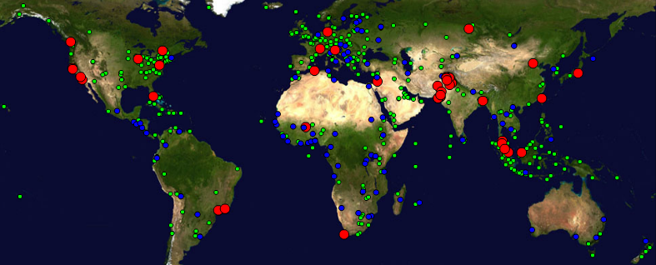
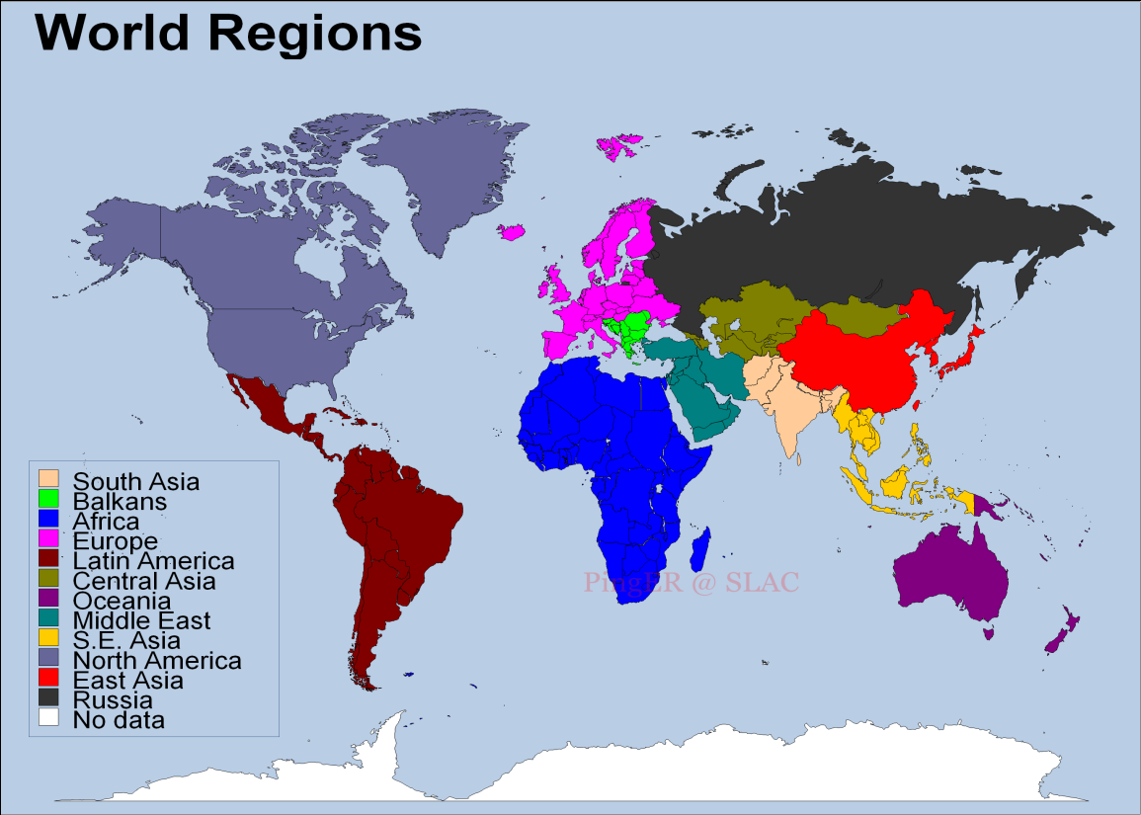
SCIC Monitoring WG PingER (Also IEPM-BW)
R. Cottrell
Monitoring & Remote Nodes Jan 2016)
Measurements from 1995 On
Reports link reliability & quality
Countries monitored
Contain >99% of world pop.
99.5% of World’s Internet Users
950 remote sites monitored in 171 nations; 70 monitoring nodes;
Strong Collaboration with ICTP Trieste and NUST/SEECS (Pakistan) and three Malaysian universities
Excellent, Vital Work; Funding issue
Countries: N. America (3), Latin America (25), Europe (36), Balkans (10), Africa (47), Middle East (16), Central Asia (9), South Asia (8), East Asia (5),SE Asia (11), Russia (1), Oceania (5)
Notes:
PingER does not currently monitor 57 countries of the world. Of these 4 have > 1 million population. These include: Central African Republic(4845K), Chad(10543K), Guinea-Bissau(1565K), North Korea(24326K),
Uses:
Identifying sites that need upgrading (early Esnet)
Identifying last mile problems(Pakistan, Malaysia)
Choosing an ISP (for home connectivity)
Setting a collaborations expectations
Deciding where to site a software library effort
Choosing routes
Setting expectations for VoIP
Evaluating the impact of upgrades
Quantifying the Digital Divide
Comprehensive Nuclear-Test-Ban Treaty Organization
Hotmail
Internet History
Used in multiple reports and books

Slide 3
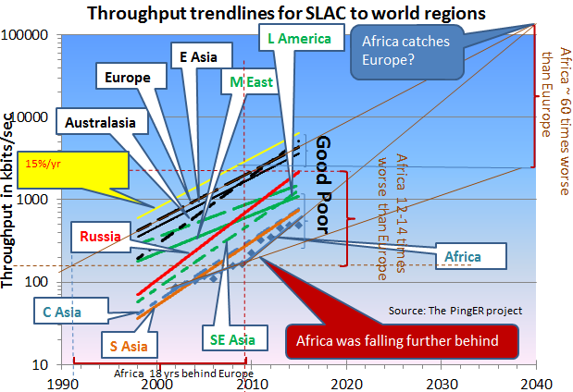
Throughput Trendlines from SLAC 1998 - 2014
Top 4 Europe, N. America, East Asia & Australasia
Behind Europe
5 -9 Yrs: Russia, Latin America, Middle East, Southeast Asia
12-14 Yrs: So+Central Asia
16 Years: Africa
Derived TCP Throughput = 1460 Bytes*8bits/Byte/ (RTT * Sqrt(loss)); Matthis et al.
In 10 years: Russia and Latin America may catch up with top 4.
Africa was falling farther behind; new cables made a difference since 2010; now slowing down once again, catchup in 2013 was 2030, now 2040.
New cable down East coast with 10 times capacity in 2 years should help

Slide 4
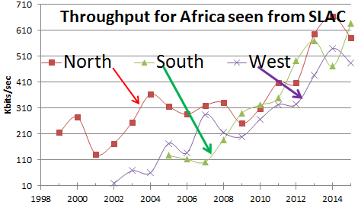
Africa by region
N. Africa being caught by West & South Africa
Notes:
Africa catch up may be slowing down. End 2013year looked like 2030 to catch up to Europe now 10 years later

Slide 5
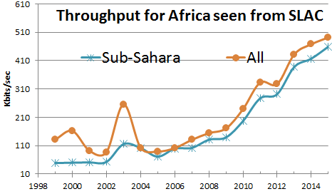
Africa by region
Sub Sahara 10% below Africa in general,

Slide 6
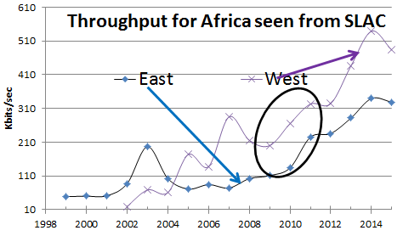
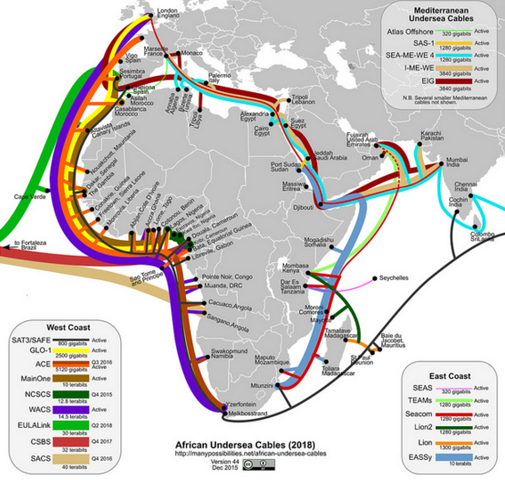
Africa by region
East & West Africa big improvement in 2010
East Africa slowed down
West Africa better than East
More cable capacity

Slide 7
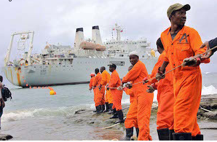
New East Africa undersea cable
Liquid Telecom started project 10,000km S. Africa to M. East
Fully funded,
2 years to complete
Up to ten times capacity (20-20Tbps) of existing undersea cables in region
Adds new landing stations
Leverage extensive terrestrial fibre network
http://www.huffingtonpost.com/david-tereshchuk/a-giant-leap-in-2016-africa_b_8901556.html
Notes:
Africa catch up may be slowing down. End 2013year looked like 2030 to catch up to Europe now 10 years later

Slide 8
Key Network Monitoring WG Report Updates, 2015
Case studies:
Case Study on Columbia in collaboration with RENATA and ICT Ministry in Colombia
Correlation between Fertility rates and PingER measured Internet performance
Hosted:
Student from Rural Federal University in Rio de Janeiro as a 3 month intern at SLAC.
Published papers:
Worldwide Internet Performance Measurements Using Lightweight Measurement Platforms. – Raspberry Pi
Applying Data Warehousing and Big Data Techniques to Analyze Internet performance
Adaptive Geolocation of Internet hosts using ping response time
PingER Malaysia-Internet Performance Measuring Project: A Case Study
Extended:
the Malaysian collaboration to include MYREN
The collaboration to Amity University in New Delhi

Slide 9
PINGER: Events and Presentations by R. Cottrell, et al. in 2015
Keynote presentation at the CITA 9th International Conference on IT in Asia
Presented 5 papers on PingER at a special session of the 4th International Conference on Internet Applications Protocols and Services [NETAPPS2015], CyberJaya Malaysia 1-3 Dec 2015

Slide 10
Minimum Round Trip Time (RTT) From SLAC to Countries of the World December 2013
R. Cottrell
Showing the effect of the use of Geo-stationary Satellites (GEOS) (450 msec and up) Vs. Terrestrial fiber optic networks
Cuba & Afghanistan now have terrestrial links, parts of Africa and remote islands still on GEOS

Slide 11
World Map: Minimum RTT from SLAC
Countries Still on Geosynchronous Satellite are in Red
2008
Dec 2013
Note also the increased coverage, i.e reduced white countries, e.g
Congo-Brazzaville, Central Africa Republic, Myanmar
R. Cottrell

Slide 12
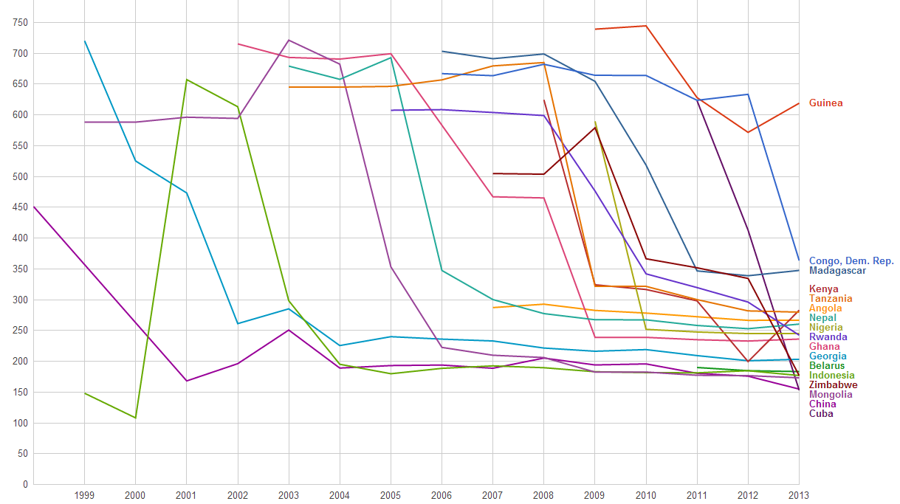
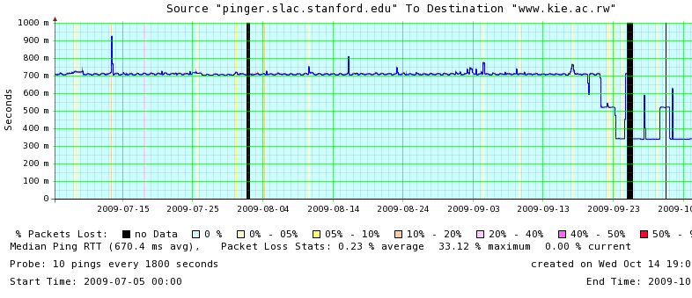
Round Trip Time (from SLAC) Drops as African Nations Move from Geostationary Satellites to the New Undersea Cables
Minimum RTT (msec)
Rwanda: RTT shift from GEOS to Fiber
Nepal
Madagascar
700 ms
Cuba
1000
DR Congo
800
500
600
300
400
200
100
China
Nigeria
Ghana
0 msec
Rwanda
Kenya
Dec 2013
R. Cottrell

Slide 13
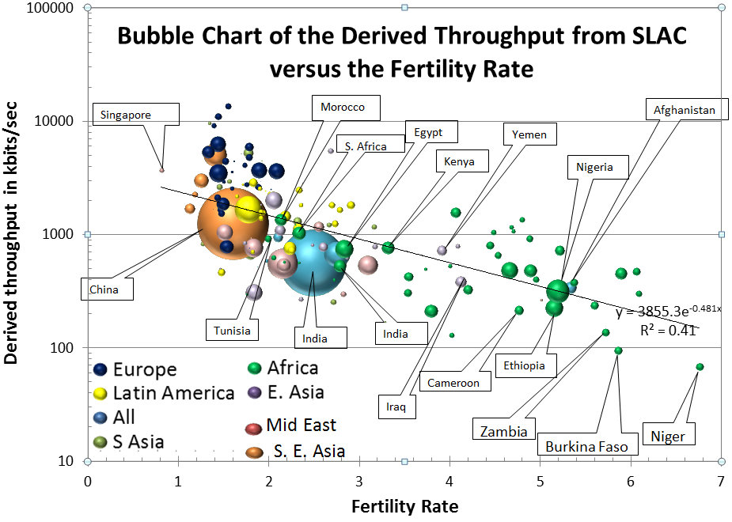
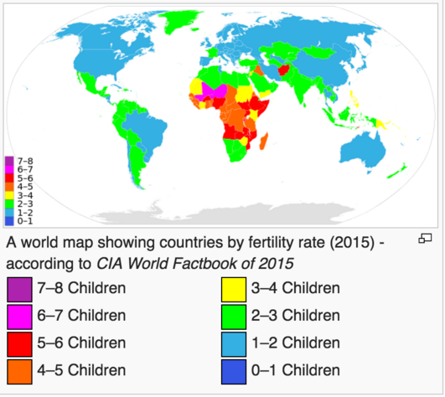
Correlation: PingER Internet Performance vs Fertility Rate
Fertility Rates drive population growth predictions indicate the world population will exceed 11Billion by 2100.
Driven by Africa for which the population could exceed 6Billion by 2100. “Six Billion in Africa, Robert Engleman, Scientific American February 2016.”
Achieving significant fertility declines requires education and easy access to information
Internet a major enabler
Africa and particularly countries such as Niger, Burkina Faso and Zambia with high Fertility Rates and low Internet performance are particularly at risk

Slide 14
TCP Throughput in 2015 vs. Fertility Rate
UNDP HDI:
A long and healthy life, as measured by life expectancy at birth
Knowledge as measured by the adult literacy rate (with 2/3 weight) and the combined primary, secondary and tertiary growth enrollment ratio (with 1/3 weight)
A decent standard of living, measured by GDP per capita
1.0
0.8
0.6
0.4
100k
1M
10M
Normalized Throughput (bps)
Clear Correlation Between the UNDP HDI and the Throughput
Notes:
Compares well with economic indicators, which is important since Internet is agreed to be important for development
HDI takes army of statisticians and data gatherers, 1-3 years out of date, may rely on government data which may be subjective
PingER not subjective, data is current.

Slide 15
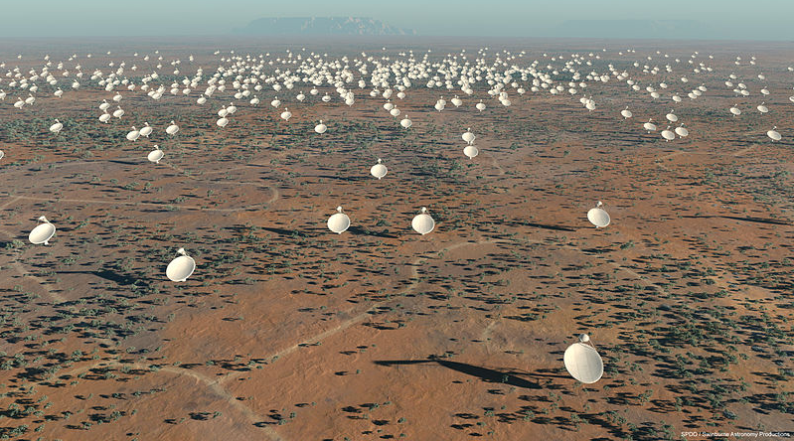
Science Opportunities: Square Kilometre Array (SKA)
“…equivalent to ten times the global internet traffic today”
“…equivalent to ten times the global internet traffic today”
Build in Sub-Saharan states with cores in South Africa and Australia,
€1.5 billion, construction start 2016, initial observations 2019

Slide 16
Examples of Other Scientific Opportunities
Aug 30, 2012: CERN donated 220 computer servers from CERN to the Kwame Nkrumah University of Science and Technology in Ghana.
Strategic plan for a synchrotron light source in southern Africa championed by SLAC’s own Herman Winick
Drugs from rain-forest, environment studies, geo-physics
Six HEP International Conferences in Madagascar
Notes:
More funding and better Internet connectivity access are helping [Africa]. The number of scientific papers produced by Africans has tripled in the past decade, to over 55,400 in 2013 according to Reed Elsevier. That still only accounts for 2.4% of the world’s total but is quite a jump. The quality is rising too. From Economist August 9th, 2014.
Synchrotron Light Source see http://indico.saip.org.za/conferenceDisplay.py?ovw=True&confId=12 and http://www.aps.org/units/fip/newsletters/201202/mtingwa.cfm
"Code for Africa: The Emergence of Computer Science in Ghana and Uganda"
A TALK BY Gregg Zachary, ASU
A CITRIS RESEARCH EXCHANGE SEMINAR

Slide 17
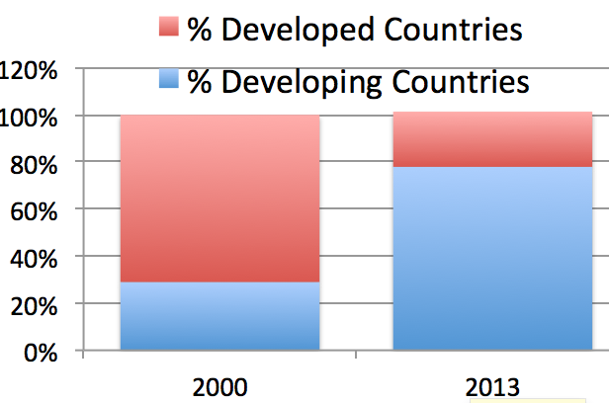
How to reach the rest of World: Mobile phones
WiFI & Mobile to the rescue, overlay cell network with fibre net
Mobile phones huge in developing world.
0.7 Billion
6.9 Billion

Slide 18
How to reach the rest of World: GEOS
Geostationary Satellites (GEOS)
ViaStat
High bandwidth satellites
Long delays (~0.5sec) avoid by aggregating multiple request/response for web objects in a page
Not good for real time
Focus:
aviation (Jet Blue & United), military, business
Americas, Europe, E. Asia
2016 launch ViaSat-2 250-300Gbps
2020-2021 ViaSat3 (3 satellites) in Terabit range

Slide 19
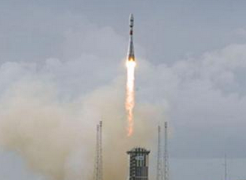
How to reach the rest of World: MEOS
Also O3B (Other 3 Billion)
Refers to population of world without broadband
Constellation of 8 Medium Earth Orbit Satellites at altitude 8000km
Min RTTs factor of 4 less than GEOS
~125ms, similar to inter-continent land lines
Backed by SES World Skies, HSBC, Google…
First 4 Launched June 2013
Second 4 launched July 2014
Needs steerable ground stations
Lifetime ~ 10 years, maybe

Slide 20
How to reach the rest of World: LEOS
Low Earth Orbiting Satellites
Google
Plans to invest> $1B in satellites
Fleet 180 satellites
Follow on?
Virgin and Qualcomm invested in launching 648 low orbit satellites
using Launcher 1
SpaceX also interested

Slide 21
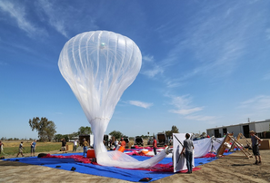
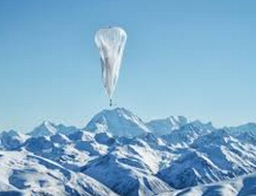
How to reach the rest of World: Project Loon
Google balloons are active, early adopters Sri Lanka, Indonesia
Stay aloft at 12 miles for 150 days thousands of balloons flying in the stratosphere (20km)
10Mbps to connected devices
Notes:
The Google Project Loon weather balloons fly at 12 miles in the stratosphere. Beneath each lighter-than-air balloon are hung: two radio transceivers to receive and send data streams, plus a third back-up radio; a flight computer and GPS location tracker; an altitude control system, which is used to move the balloon up and down to find winds that will take it in the desired direction; solar panels to power all the gear. They are moved up and down to find the right winds to direct them into position usually travelling along an easterly or westerly latitude. Balloons regularly stay aloft for 150 days. Cover a circular area spanning 50 miles diameter. Balloons transmit using radio frequency and can also transmit to each other (up to 100km apart transferring data at ~500Mbps) to extend the Internet where there is no base station nearby. Can now supply connected devices with about 10 megabits a second to connected devices via antennae on the ground. Mike Cassidy, who heads project Loon, believes the total cost for Internet from balloons could be 10% or even 1% of Internet from satellites. He anticipates paying customers to be connecting to its web of balloons by 2016. See http://www.wsj.com/articles/the-internets-future-lies-up-in-the-skies-1418603566. Google's balloons are already active. Indeed, the firm hopes to start providing connections to early adopters in Indonesia and Sri Lanka soon."We put transponders on all our balloons, which is not required," says Mr Cassidy, "so, just like an aeroplane, air traffic control can always see where the balloons are." http://www.bbc.com/news/technology-34780127. "[We need] about 300 balloons or so to make a continuous string around the world." Google believes it is on course to have enough internet-beaming balloons in the stratosphere to form a ring over part of the world next year. The declaration coincides with the announcement that three of Indonesia's mobile networks intend to start testing Project Loon's transmissions next year. Sri Lanka previously signed a separate agreement signaling its wish to be another participant in the giant helium balloon-based scheme. Seehttp://www.bbc.com/news/technology-34660205

Slide 22
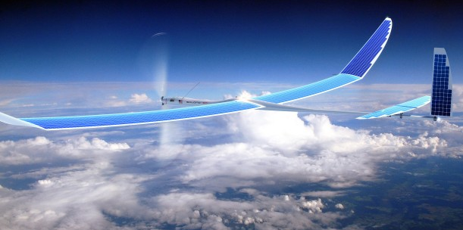
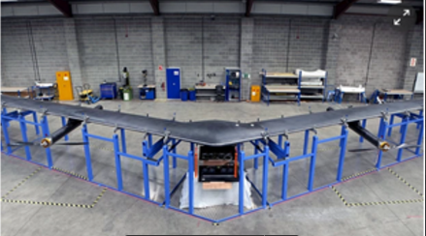
How to reach the rest of World: Drones
Google acquired UAV maker Titan Aerospace in 2014, little since
Facebook and Ascenta
Wingpan 43m, weight < Prius
Launch by helium balloons
Fly for 3 months, circle 2 mile radius black spots
Communicate by lasers, low power high-speed
Hit a dime at 11 miles, source & destination moving,
27km above earth, temp changes of 200degrees
Notes:
Facebook aims to build a network of laser-beaming drones that will tightly circle known black-spots. Facebook drones (Aquila) fly for 3 months, operate 60Kft – 90Kft (above planes), launched by helium balloons (drone weighs 880lbs), circle a 2 mile radius. "The whole structure is 142ft (43m) wide but weighs less than a Toyota Prius," Mr Parikh explains. The aim is to build a fleet of the drones with radio transmitters fitted underneath to beam data across a 100 mile (160km) diameter zone below. (seehttp://www.bbc.com/news/technology-34780127). Drones communicate with ground and one another via lasers that use little power and are high speed. The drones can be up to 11km apart so the accuracy requires hitting a dime (18mm diameter) at 11 miles with both source and destination moving and temperature changes of nearly 200 degrees at 27km above the earth.
Once these atmospheric satellites are up there, there’s a wide range of possible applications. Facebook is obviously interested in internet connectivity, but mapping, meteorology, global positioning, rapid response to disasters and wildfires, and a whole slew of other scientific and military applications are also possible. (Read: Facebook creates Internet.org alliance to reduce price of mobile data plans to 1% of current price.)

Slide 23
How to reach the rest of World: Summary
Satellites can last decades, balloons & drones must be constantly replenished, and many more are needed to cover the Earth.
Facebook & Google believe they have a real shot at connecting the 57% of the world's population still offline.
The Google Loon project will be deploying this year, while the Facebook drones are still in a research stage.
The higher performance of the Facebook laser transmitting drones may eventually supecede the wireless transmissions of the Google balloons.
It’s likely we’ll end up in an “all of the above” world, in which distant, powerful satellites provide for streaming media while an assortment of balloons, drones and close-in satellites will provide a more responsive Internet.

Slide 24
PingER Current activities
Keep it running
Monthly Skype meetings with Malaysia & Pakistan
Improve visualization & access to data
Prototype Linked Open Data for PingER ‘big data’
Workshop in later this year

Slide 25
PingER Project Issue: Funding for Managing the Effort
The management and operation includes maintaining data collection and archiving, explaining needs, identifying and reopening broken connections, identifying and opening firewall blocks, finding replacement hosts, making limited special analyses and case studies, preparing and making presentations, responding to questions. The equipment performing this in this country is currently in place at SLAC . There is also an archive/analysis site in Pakistan.
Management, operation and supervision requires central funding at a level of about 20% of a Full Time Equivalent (FTE) person, plus travel. This had been provided by discretionary funding from the HEP budgets of SLAC and FNAL, until the beginning of 2008.
Google are interested in the preserving the history of the Internet implicit in the PingER data

Slide 26
PingER: Uncertainty for Managing the Future
Many agencies/organizations have expressed interest (e.g DoE, ESnet, NSF, ICFA, ICTP, IDRC, UNESCO, IHY) in this work, also Google is interested in the historical interest now and going forward, but none have so far stepped up to funding the management and operation.
Without funding, for the operational side, the future of PingER and reports such as this one is unclear, and the level of effort sustained in previous years will not be possible.

Slide 27
PingER: What do we need
Moral support, legitimacy
Most work is on my spare time
Immediate management aware but limited interest
Travel money for conferences (one or two/year, typically international), workshop
Some % of an FTE to supervise etc. students
Graduate student funding for visit to SLAC for up to a year
Without funding, for the operational side, the future of PingER and reports such as this one is unclear, and the level of effort sustained in previous years will not be possible.

Slide 28
More information
PingER Home page with pull downs to reports, papers, technical details, maps, data access etc.
http://www-iepm.slac.stanford.edu/pinger/

