Slide 1
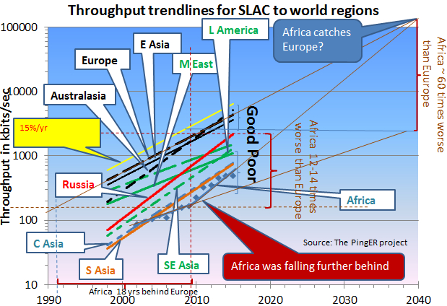
PingER Throughput Trendlines from SLAC 1998 - 2015
Top 4 Europe, N. America, East Asia & Australasia
Behind Europe
5 -9 Yrs: Russia, Latin America, Middle East, Southeast Asia
12-14 Yrs: So+Central Asia
16 Years: Africa
Derived TCP Throughput = 1460 Bytes*8bits/Byte/ (RTT * Sqrt(loss)); Matthis et al.
In 10 years: Russia and Latin America may catch up with top 4.
Africa was falling farther behind; new cables made a difference since 2010; now slowing down once again, catchup in 2013 was 2030, now 2040.
New cable down East coast with 10 times capacity in 2 years should help

Slide 2
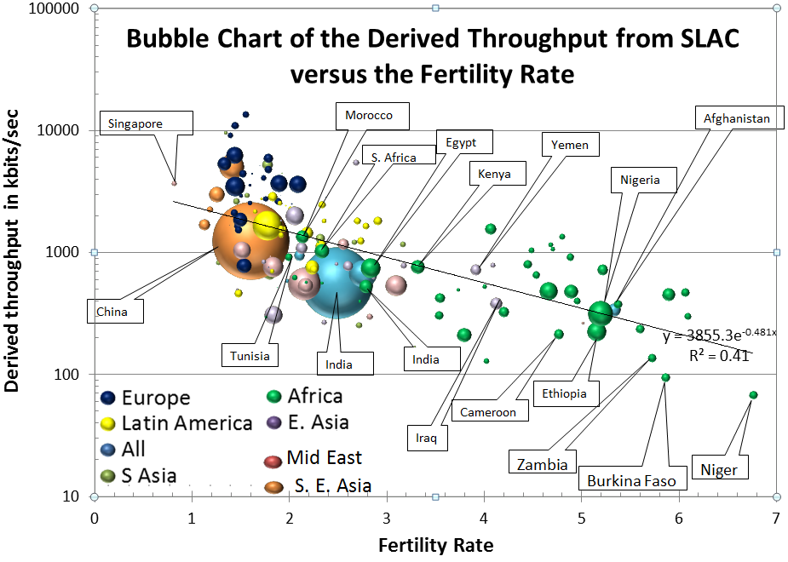
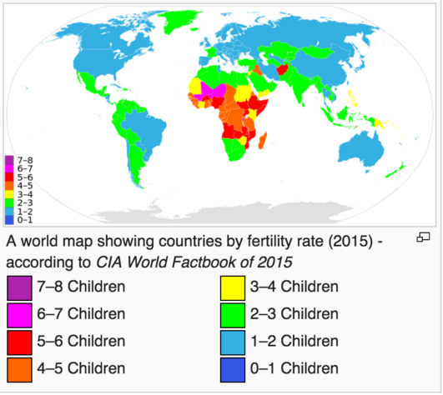
Correlation: PingER Internet Performance vs Fertility Rate
Fertility Rates drive population growth predictions indicate the world population will exceed 11 billion by 2100.
Driven by Africa for which the population could exceed 6 billion by 2100. “Six Billion in Africa, Robert Engleman, Scientific American February 2016.”
Achieving significant fertility declines requires education and easy access to information
Internet a major enabler
Africa and in particular countries such as Niger, Burkina Faso and Zambia with high Fertility Rates and low Internet performance are particularly at risk

