Slide 1
Monitoring the World’s Networks SCIC Monitoring Group (R. Cottrell et al.) Mapping the Digital Divide

Slide 2
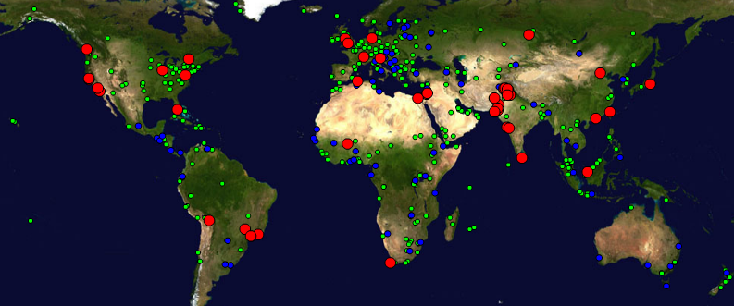
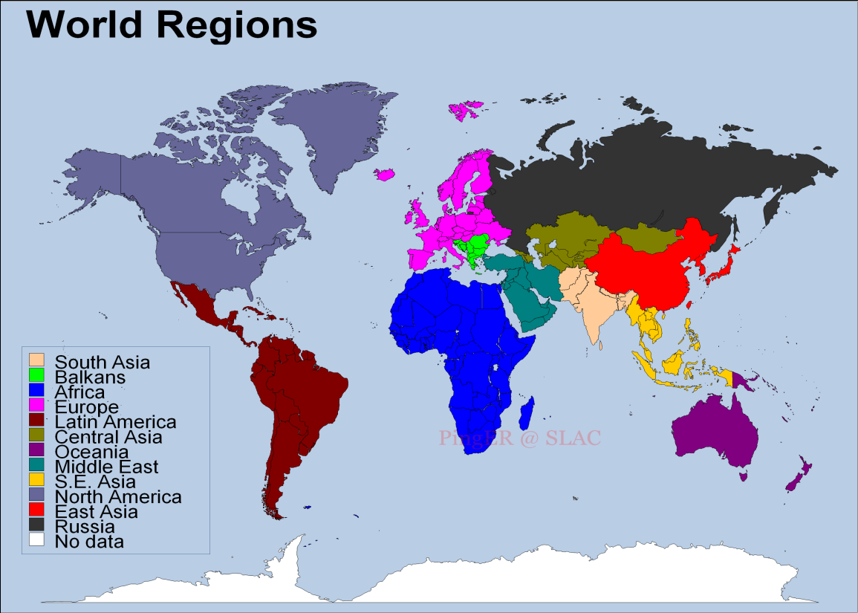
SCIC Monitoring WG PingER (Also IEPM-BW)
R. Cottrell
Monitoring & Remote Nodes Dec2013)
Measurements from 1995 On
Reports link reliability & quality
Countries monitored
Contain 99% of world pop.
99.5% of World’s Internet Users
950 remote sitesmonitored in 170 nations; 89 monitoring nodes;
Strong Collaboration with ICTP Trieste and NUST/SEECS (Pakistan) and three Malaysian universities
Excellent, Vital Work; Funding issue
Countries: N. America (3), Latin America (19), Europe (31), Balkans (10), Africa (49), Middle East (16), Central Asia (9), South Asia (8), East Asia (4),SE Asia (10), Russia (1), Oceania (5)
Notes:
Note there are some countries we should not monitor since they do not have a full Internet connection, and hence may pay dearly by byte for traffic. These include:
Code Country Conn Notes Further information
++++++++++++++++++++++++++++++++++++++++++++++++++++++++++++++++++++++++++
AF Afghanistan(Islamic St.) P C
BV Bouvet Island
CX Christmas Island C
EH Western Sahara
FX France (European Ter.) France Metropolitaine
GS South Georgia and
South Sandwich Islands C
HM Heard & McDonald Isl. C
KP Korea (North) P
MH Marshall Islands C
MM Myanmar *
MS Montserrat C
NR Nauru
PM St. Pierre & Miquelon C
PN Pitcairn C
TF French Southern Terr. C
TK Tokelau
UM US Minor outlying Isl.
VC St.Vincent & Grenadines P
WF Wallis & Futuna Islands
YT Mayotte
ZR Dem. Rep. of Congo Deleted - Replaced by Code CD

Slide 3
Key Network Monitoring WG Report Updates 2013
The addition of case studies on:
Internet disconnections: Sudan, Syria.
Study on routing an internet performance from the University of Malaysia in Sarawak (UNIMAS) to Malaysia & Identification of congestion at UNIMAS
Compared PingER and Speedtest.com throughputs to see how they correlate
Initiated collaboration with University of Malaya in Kuala Lumpur and The Technical University of Malaysia in Johor Bahru
Hosted:
PhD student from NUST (Pakistan) as visiting scientist for 1 year at SLAC
Student for UERJ Brazil for 3 months internship at SLAC
Added extra monitoring hosts in Malaysia and Pakistan.
Increased the coverage of PingER
Created prototype Linked Open Data access to PingER
Submitted paper on dynamic ping delay based Geolocation to ACM/IEEE
Started development of geolocation Visual traceroute

Slide 4
PINGER: Events and Presentations by R. Cottrell, et al. in 2013
“Africa 'leapfrogs' to wider Internet access”. Al Jazeera, Sept 2, 2013. Also appeared on SlashDot Front Page, Sept 3, 2013, referenced in SLAC Today as "SLAC expert weighs in on Internet access in Africa ", Sept 6, 2013
Two day workshop on PingER at the University of Malaya in Kuala Lumpur, June 2013
"Pinger: Measuring the Worldwide Internet's end-to-end performance”
"Navigating the PingER web site”
“PingER: Research Opportunities and Trends”,
“High Energy Physics Computing and Network Needs for Worldwide Collaborations”
“The Emergence of the Internet and Africa”, invited SLAC wide coloquium, May 6th 2013
“PingER project data on the health of Africa’s Internet networks”, in oAfrica Journal, April 15, 2013.
“Why continuous investment and improvement in African ICT infrastructure is important”, contributed by Les Cottrell to EGy Africa News, Number4, February, 2013.
“Pinging Africa: A decadelong quest aims to pinpoint the Internet bottle-necks holding Africa back”, R. Les Cottrell, IEEE Spectrum magazine Feb 2013.

Slide 5
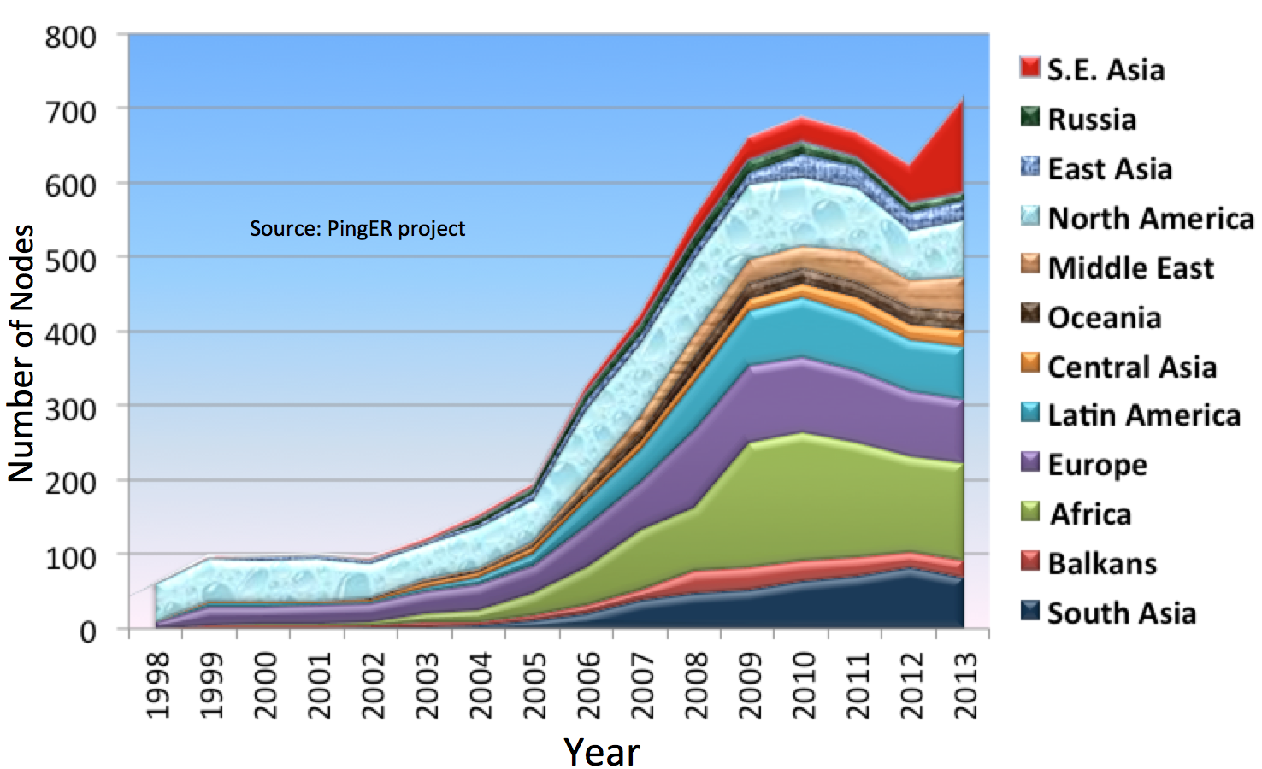
Number of Hosts Monitored By Region: 1998 - 2012
R. Cottrell
S. E. Asia
Africa
Notes:
Note there are some countries we should not monitor since they do not have a full Internet connection, and hence may pay dearly by byte for traffic. These include:
Code Country Conn Notes Further information
++++++++++++++++++++++++++++++++++++++++++++++++++++++++++++++++++++++++++
AF Afghanistan(Islamic St.) P C
BV Bouvet Island
CX Christmas Island C
EH Western Sahara
FX France (European Ter.) France Metropolitaine
GS South Georgia and
South Sandwich Islands C
HM Heard & McDonald Isl. C
KP Korea (North) P
MH Marshall Islands C
MM Myanmar *
MS Montserrat C
NR Nauru
PM St. Pierre & Miquelon C
PN Pitcairn C
TF French Southern Terr. C
TK Tokelau
UM US Minor outlying Isl.
VC St.Vincent & Grenadines P
WF Wallis & Futuna Islands
YT Mayotte
ZR Dem. Rep. of Congo Deleted - Replaced by Code CD

Slide 6
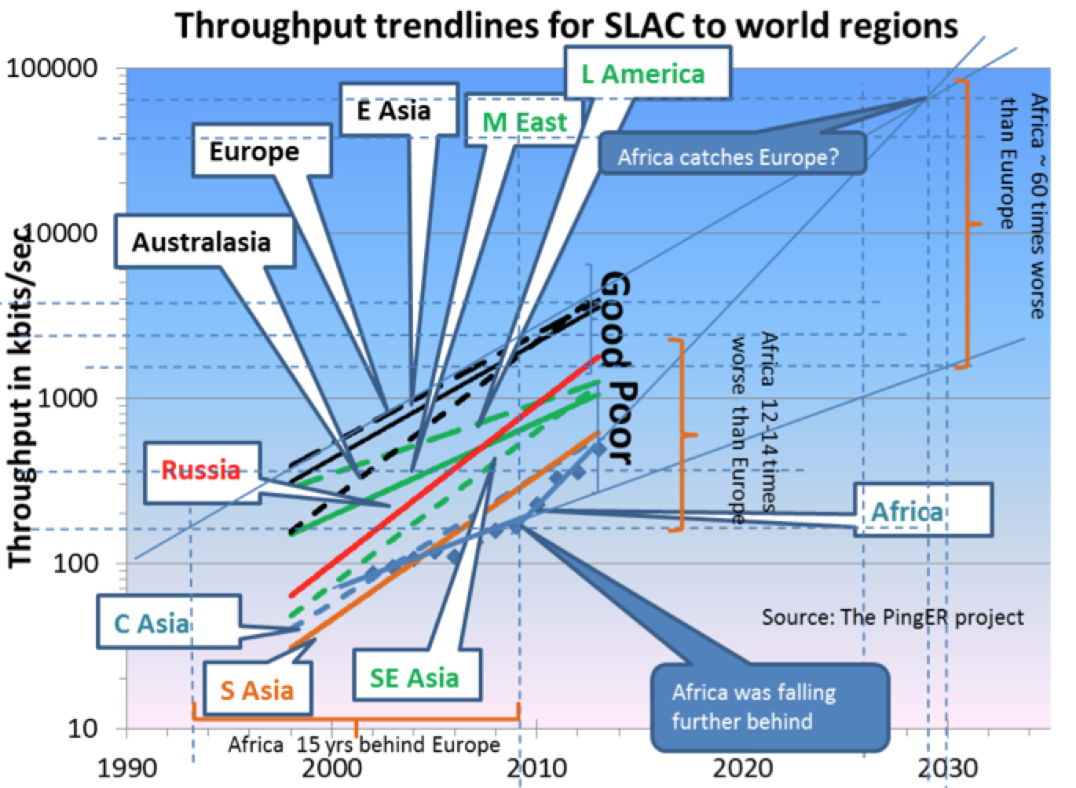
Throughput Trendlines from SLAC 1998 - 2014
Top 4 Europe, N. America, East Asia & Australasia
Behind Europe
5 Yrs: Russia, Latin America, Middle East
9 Yrs: Southeast Asia
12-14 Yrs: So+Central Asia
15 Years: Africa
Jan 2014
Derived TCP Throughput = 1460 Bytes*8bits/Byte/ (RTT * Sqrt(loss)); Matthis et al.
In 10 years: Russia and Latin America should catch up with top 4. Africa was falling farther behind; But new cables are making a difference since 2012

Slide 7
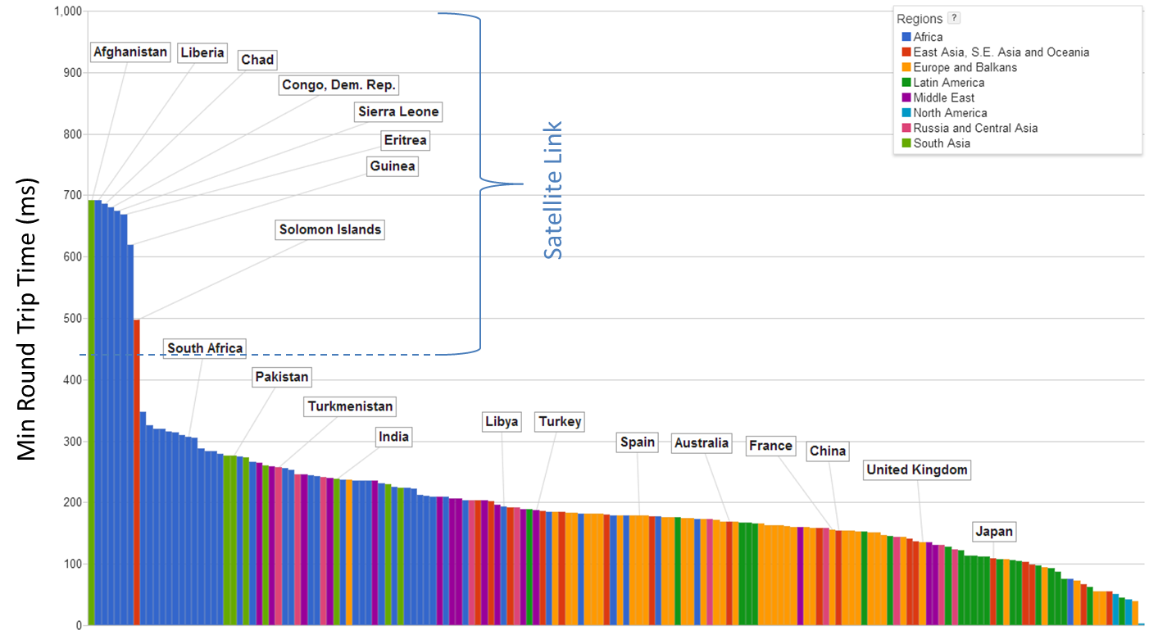
Minimum Round Trip Time (RTT) From SLAC to Countries of the World December 2013
Showing the effect of the use of Geo-stationary Satellites (270 msec and up)
Vs. Terrestrial fiber optic networks
800
Minimum Round Trip Time (ms)
600
400
200
R. Cottrell
Cuba now has terrestrial link, Africa & Afghanistan still satellite

Slide 8
World Map: Minimum RTT from SLAC
Countries Still on Geosynchronous Satellite are in Red
2008
Dec 2013
Note also the increased coverage, i.e reduced white countries, e.g
Congo-Brazzaville, Central Africa Republic, Myanmar
R. Cottrell

Slide 9
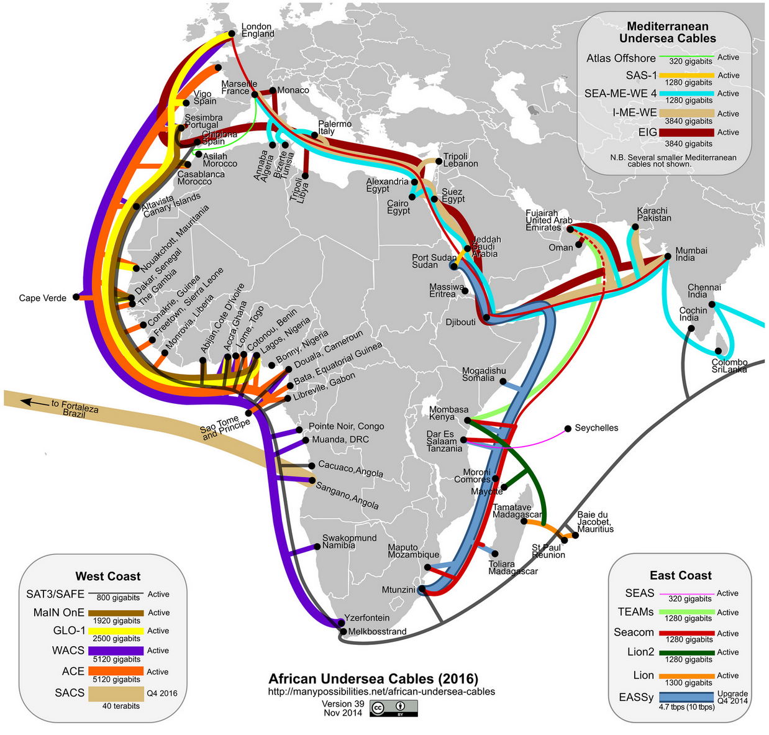
New African Undersea Cables to Europe, India, Middle East, Brazil
Update Nov. 2014
Undersea cables continue to arrive at both African coasts (since 2009); 1000X Potential capacity
To multi-Terabits/sec; 10X more by 2014
Seacom, EASSy, TEAMS, Lion, Lion2, MainOne, GLO1, WACS in production
+ ACE, BRICS, SAex, WASACE, SACS by 2014
Triggered by the 2010 World Cup.
Connections to the African interior spreading
Plus new Mediterranean Cables to Mideast+Gulf
New Cable to Fortaleza, Brazil
http://manypossibilities.net/african-undersea-cables
More comprehensive map (also with terrestrial fiber): http://events.ubuntunet.net/fibermap/
Seacom | EASSy | TEAMs | MainOne | WACS | GLO1 | ACE | SAex | WASACE | BRICS
$ 650M | $ 265M | $ 130M | $ 240 M | $ 600M | $ 800 M | $ 700M
13.7 kkm | 10 kkm | 4.5 kkm | 7 kkm | 14 kkm | 9.5 kkm | 14 kkm | 9 kkm | 9 kkm | 34 kkm
1.28 Tbps | 4.72 Tbps | 1.28 Tbps | 1.92 Tbps | 3.84 Tbps | 2.5 Tbps | 5.12 Tbps | 12.8 Tbps | 40 Tbps | 12.8 Tbps
Active 2009 | Active 2010 | Active 2009 | Active 2010 | Active 2012 | Active 2010 | 2013 | Q2 2013 | 2015 ? | 2015 ?

Slide 10
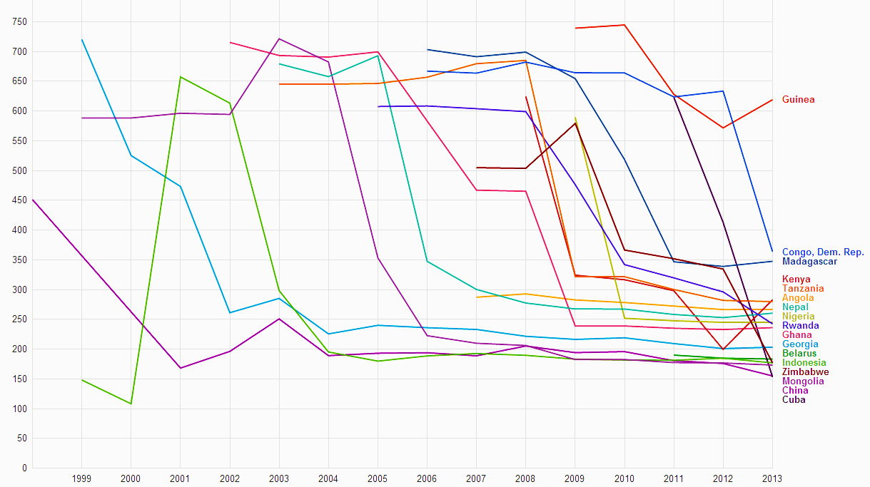
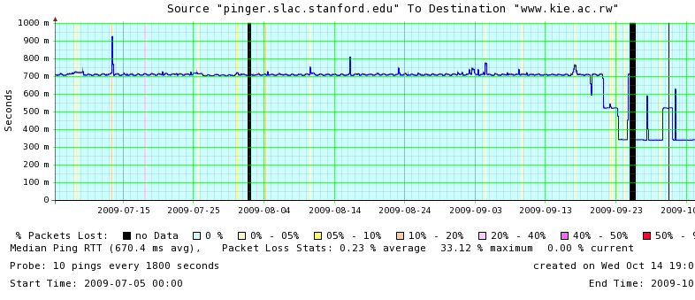
Round Trip Time (from SLAC) Drops as African Nations Move from Geostationary Satellites to the New Undersea Cables
Minimum RTT (msec)
Rwanda: RTT shift from GEOS to Fiber
Nepal
Madagascar
700 ms
Cuba
1000
DR Congo
800
500
600
300
400
200
100
China
Nigeria
Ghana
0 msec
Rwanda
Kenya
Dec 2013
R. Cottrell

Slide 11
Normalized TCP Throughput in 2011 vs. UN Human Development Index (HDI)
UNDP HDI:
A long and healthy life, as measured by life expectancy at birth
Knowledge as measured by the adult literacy rate (with 2/3 weight) and the combined primary, secondary and tertiary growth enrollment ratio (with 1/3 weight)
A decent standard of living, measured by GDP per capita
1.0
0.8
0.6
0.4
100k
1M
10M
Normalized Throughput (bps)
Clear Correlation Between the UNDP HDI and the Throughput
Notes:
Dec 2003, 27% unmeasured, 1% bad, 5% v. poor, 4% poor, 46% acceptable, 17% Good.
Note this is not for a fixed set of hosts rather it tracks the sites measured. As time goes forward we add more and more sites in countries with poorer connectivity.

Slide 12
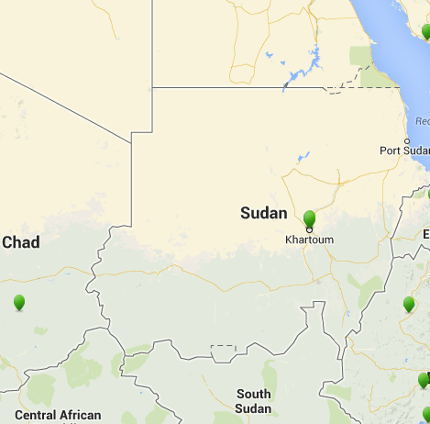
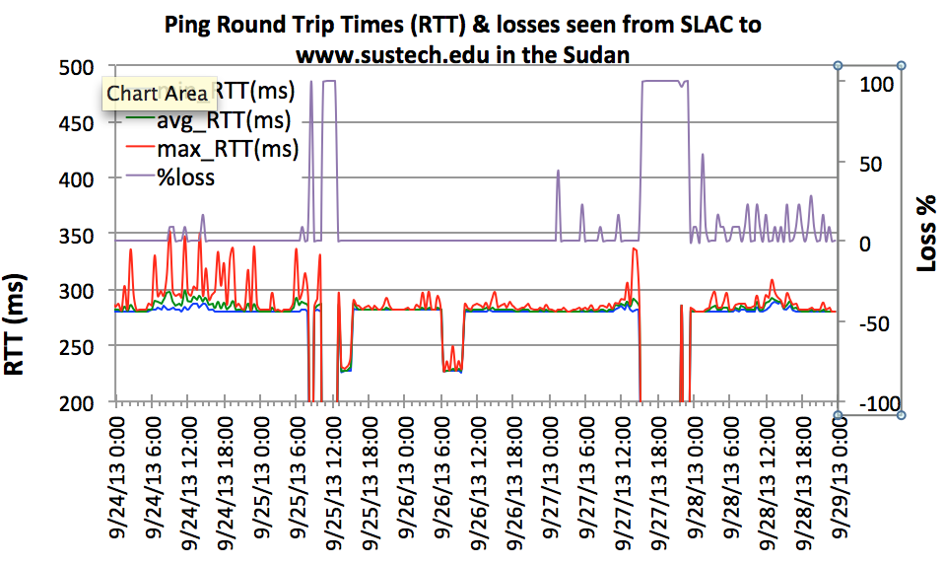
Sudan Internet Blackout
Monitored: www.sustech.edu
Loss
Sept 25 2013
Loss %
RTT (ms)
“We initially stated that Sudan’s outage began at 12:47 UTC because that was when virtually all Sudanese routed networks were withdrawn from the global routing table. However, once we plotted our active measurement data, we observed traffic into Sudan dropping off dramatically 2.5 hours earlier at 10:23 UTC” −Renesys
RTT
The initial loss of connectivity (RTT=unknown=0, loss=100%) is seen between 8:00 and 8:30am September 25th GMT, there is a recovery between 9:00 and 10:15, and then a further loss of connectivity until 13:00. The drops in minimum RTT from ~280ms to ~230ms is probably due to the use of an alternate route.
R. Cottrell

Slide 13
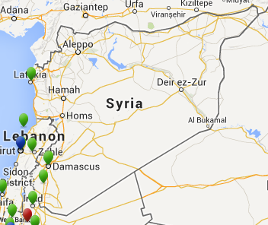
Syria went offline
Monitored: www.inet.sy, www.thawraonline.sy
PingER Measurements from SLAC to 2 hosts in Syria showed both not responding from 18:37 May 7, 2013 to 13:37 May 8, 2013
May 7-8
2013
R. Cottrell
“Internet in Syria has been restored on Wednesday at 14:13 UTC. The country went offline on Tuesday at around 18:45 UTC as Internet connectivity was completely cut across the nation.” −The Next Web
1
SLAC to www.inet.sy
RTT (s)
0
SLAC to www.thawraonline.sy
May 7
May 8
May 9
Blue line = Avg RTT, Background color = Loss
No loss
<5% loss
<10% loss
<20% loss
<20% loss
<50% loss
<100% loss, no response, disconnected

Slide 14
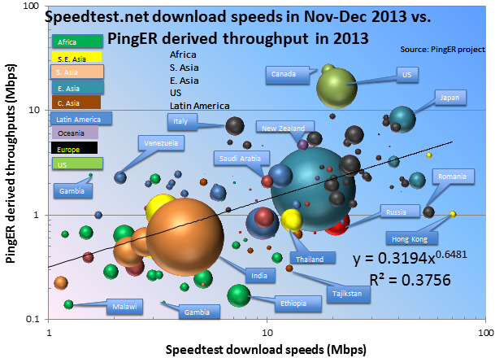
Comparison of Speedtest.net with PingER December 7 2013
The Household Download Index from Ookla is based on millions of recent test results from Speedtest.net, this index compares and ranks consumer download speeds around the globe. The value is the rolling mean throughput in Mbps over the past 30 days where the mean distance between the client and the server is less than 300 miles. We downloaded the data for ~180 countries from Ookla on December 7th, 2013.
A bubble plot comparing the measurements is shown. The X-axis is for the PingER derived throughput, the Y-axis for the Speedtest download speeds. The bubble size is proportional to the population. The trendline is a power series fit to the data.
There is a positive correlation despite the very different methods
R. Cottrell
Notes:
As might be expected the PingER values are lower than those of Speedtest since Speedtest measurements are made from within 300km (and thus lower Round Trip Times) than the PingER measurements made from SLAC with distances up to 11,000km . Thus measurements from SLAC in the US (shorter distances) to the US have better agreement,. Despite the differences in measurement time window, and measurement method there is a positive correlation (R²=0.38)between the results.

Slide 15
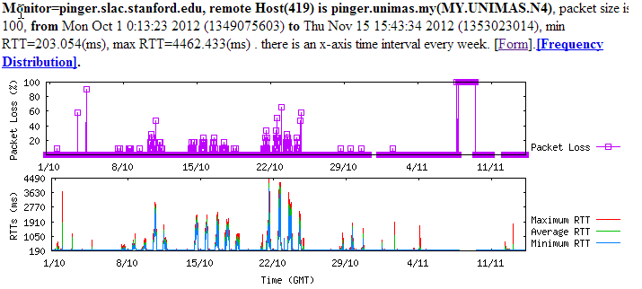
Congestion at UNIMAS Malaysia
October to November 2012
We noticed severe diurnal variations to most hosts measured from UNIMAS.
We suspected that maybe UNIMAS itself is congested. Congestion is usually an edge effect since the back-bones are well provisioned.
Traffic shaping was applied at the end of October. See the time series on right where there is seen to be a dramaticimprovement in (flat line, cyan back-ground shows no losses) November compared to October.
R. Cottrell
October ‘12
November ‘12
Notes:
The black areas

Slide 16
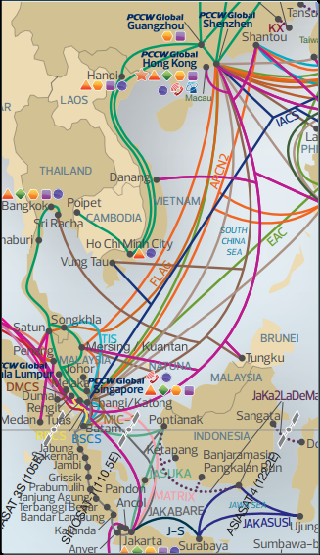
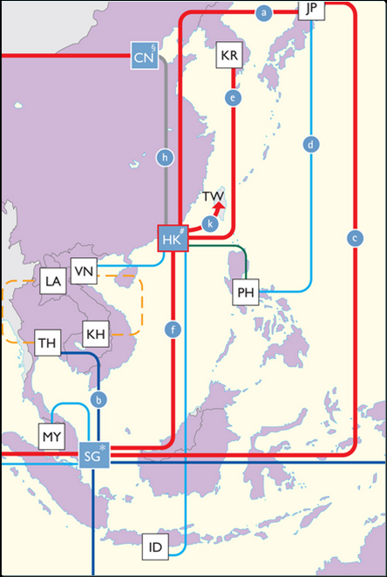
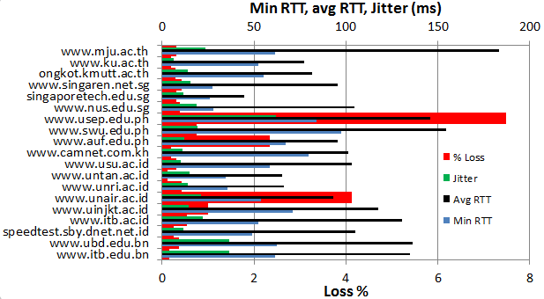
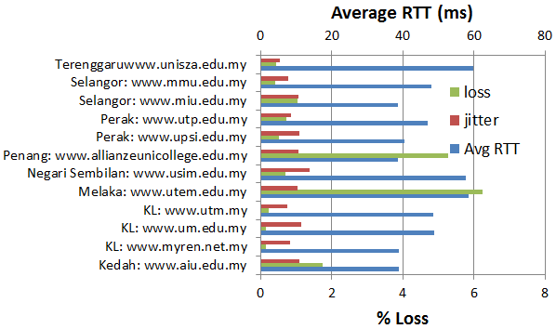
Routing from UNIMAS (Borneo/W Malaysia) Malaysia, Jan 2013
RTT & jitter (ms) from UNIMAS to S.E. Asia
To Malaysia
UNIMAS
Routes in S.E. Asia
Apart from within Western Malaysia the routes are very indirect
R. Cottrell

Slide 17
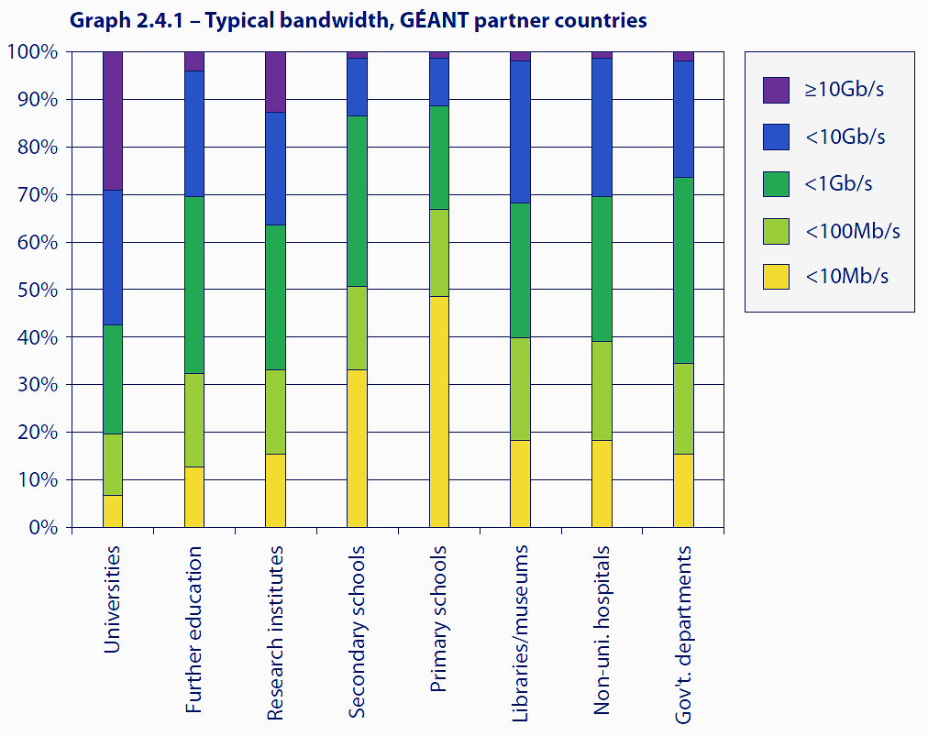
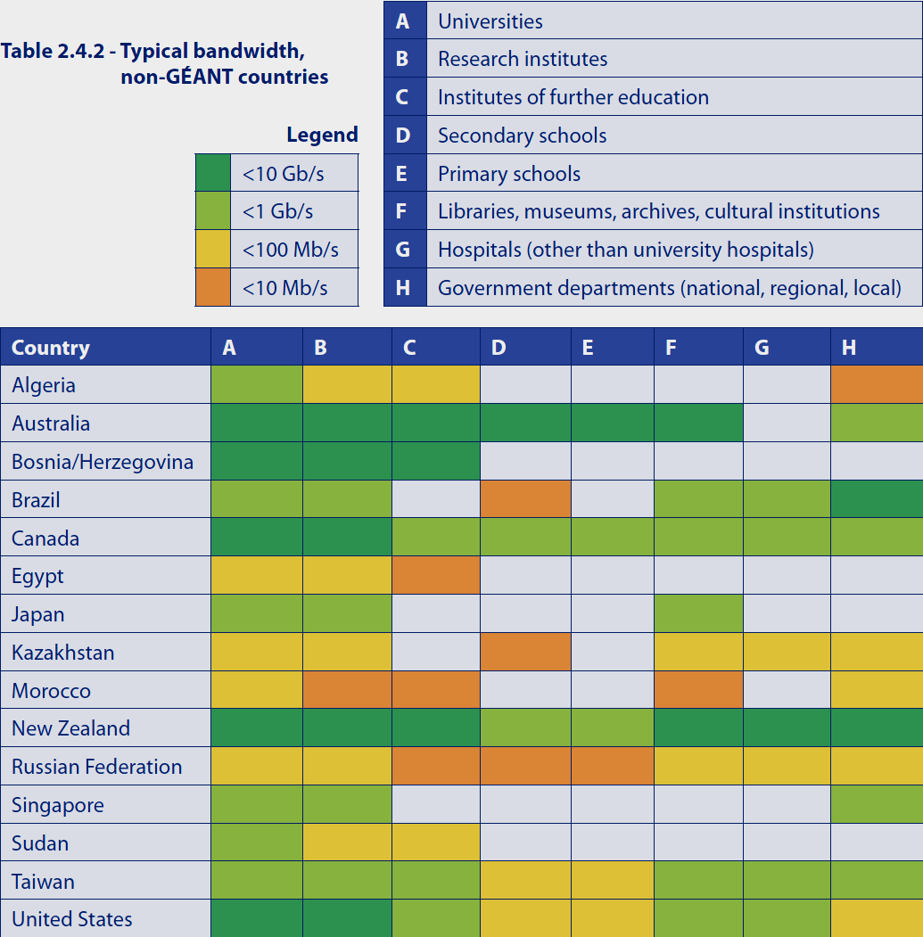
Another View of the Digital Divide
Typical BW to Institutions, by Class
GEANT Partner Countries
Non-GEANT Countries
2013 Terena Compendium

Slide 18
Erice Declaration on Principles for Cyber Stability and Cyber Peace
World Federation of Scientists (2009)
It is an unprecedented triumph of science that mankind, through the use of modern ICTs, has the means to expand economic resources for all countries, enhance the intellectual capabilities of their citizens, and develop their culture and trust in other societies.
The Internet, like science itself, is fundamentally transnational and ubiquitous in character.
The Internet, and its attendant information tools, is the indispensable channel of scientific discourse… offering to all the benefits of open science, without secrecy and without borders.
In the 21st century, the Internet and other interconnected networks (cyberspace) have become critical to human well-being and the political independence and territorial integrity of nation states.
Information and communication systems and networks underpin national and economic security for all countries and serve as a central nervous system for response capabilities, business and gov’t operations, human services, public health, and individual enrichment.

Slide 19
Erice Declaration on Principles for Cyber Stability and Cyber Peace
World Federation of Scientists (2009)
We advocate the following principles:
1. All governments should recognize that international law guarantees individuals the free flow of information and ideas; these guarantees also apply to cyberspace.
2. All countries should work together to develop a common code of cyber conduct and harmonized global legal framework.
3. All users, service providers, and governments should work to ensure that cyberspace is not used in any way that would result in the exploitation of users, particularly the young and defenseless, through violence or degradation.
4. Governments, organizations, and the private sector, including individuals, should implement and maintain comprehensive security programs based upon internationally accepted best practices and standards …

Slide 20
SCIC Montoring Group Monitoring Report Updates Key Observations Funding Issue for Managing the Effort

Slide 21
PingER Project Issue: Funding for Managing the Effort
The management and operation includes maintaining data collection and archiving, explaining needs, identifying and reopening broken connections, identifying and opening firewall blocks, finding replacement hosts, making limited special analyses and case studies, preparing and making presentations, responding to questions. The equipment performing this in this country is currently in place at SLAC . There is also an archive/analysis site in Pakistan.
Management, operation and supervision requires central funding at a level of about 20% of a Full Time Equivalent (FTE) person, plus travel. This had been provided by discretionary funding from the HEP budgets of SLAC and FNAL, until the beginning of 2008.
Google are interested in the preserving the history of the Internet implicit in the PingER data

Slide 22
PingER: Uncertainty for Managing the Future
Many agencies/organizations have expressed interest (e.g DoE, ESnet, NSF, ICFA, ICTP, IDRC, UNESCO, IHY) in this work, also Google is interested in the historical interest now and going forward, but none have so far stepped up to funding the management and operation.
Without funding, for the operational side, the future of PingER and reports such as this one is unclear, and the level of effort sustained in previous years will not be possible.

Slide 23
Mapping the Digital Divide in the HEP Community: Monitoring HEP’s Networks Seen from the Sites PerfSONAR SCIC Monitoring Group (S. McKee)

