Slide 1
Pinger Metrics ICFA Report 2011 SLAC to regions of the World

Slide 2
Europe
North America
S.E. Asia
Central Asia
Latin America
Middle East
Balkans
Africa
Russia
South Asia
Oceania
East Asia

Slide 4
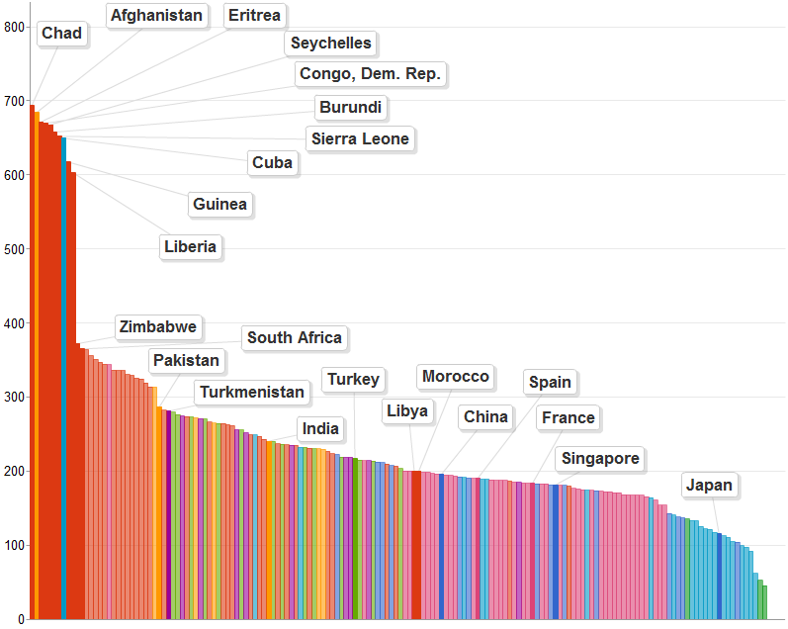
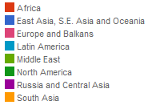
Satellite Link
Min RTT from SLAC to Regions of the World 2011

Slide 5
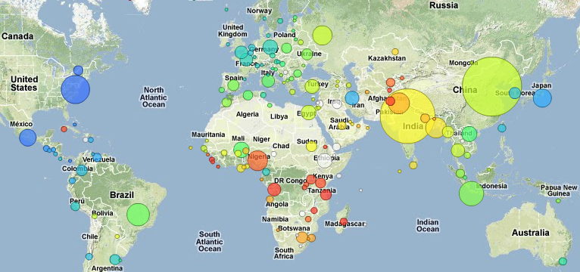
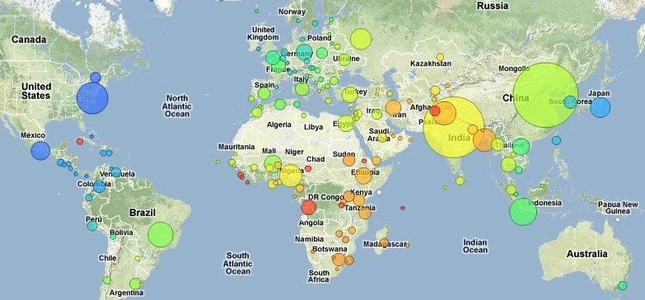
2011
2008
740.17
Min RTT SLAC to World
740.17
2011
16
16
Min RTT (ms) color scale

Slide 6
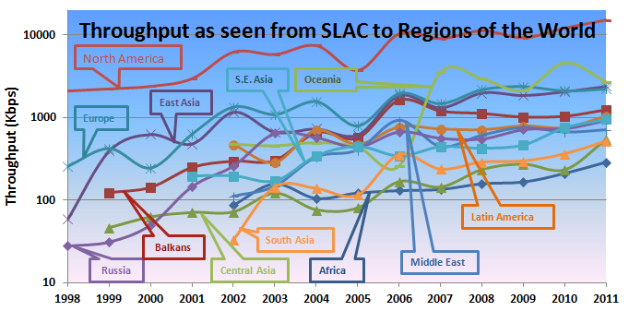
Balkans
Russia

Slide 7
PingER @ SLAC
PingER @ SLAC

Slide 8
South Asia

Slide 9
Old Nthroughput graph

Slide 10
New UpdatedNthroughput graph (Updated 12/19/2011)

Slide 11
S.E Asia throughput is high for East Asia and South Asia.
Europe to Africa throughput is higher than Africa to Africa
Europe to Russia and Africa to Russia give better throughput than from the rest of the regions. Same goes fro Middle East.
North America to Latin America throughput is better than Latin America to Latin America

Slide 12
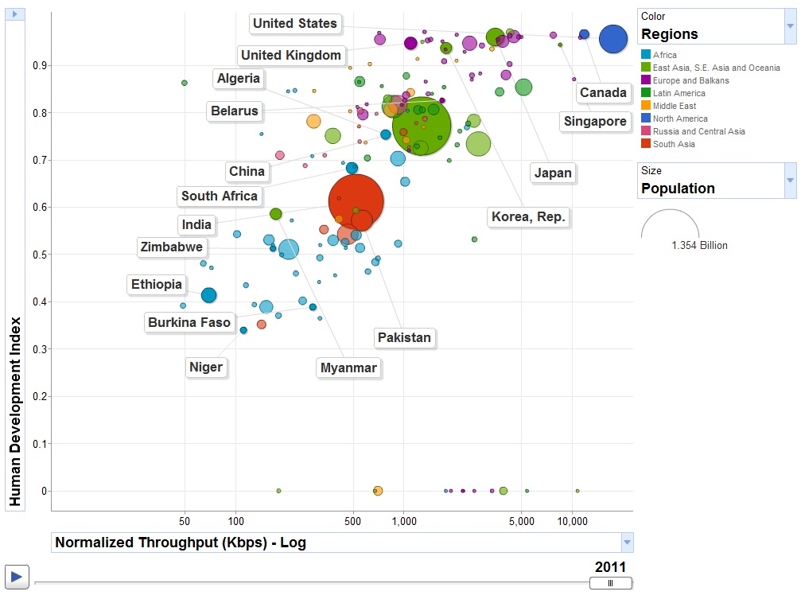
y = 0.0977 ln(x) + 0.0683
R² = 0.3258

Slide 13
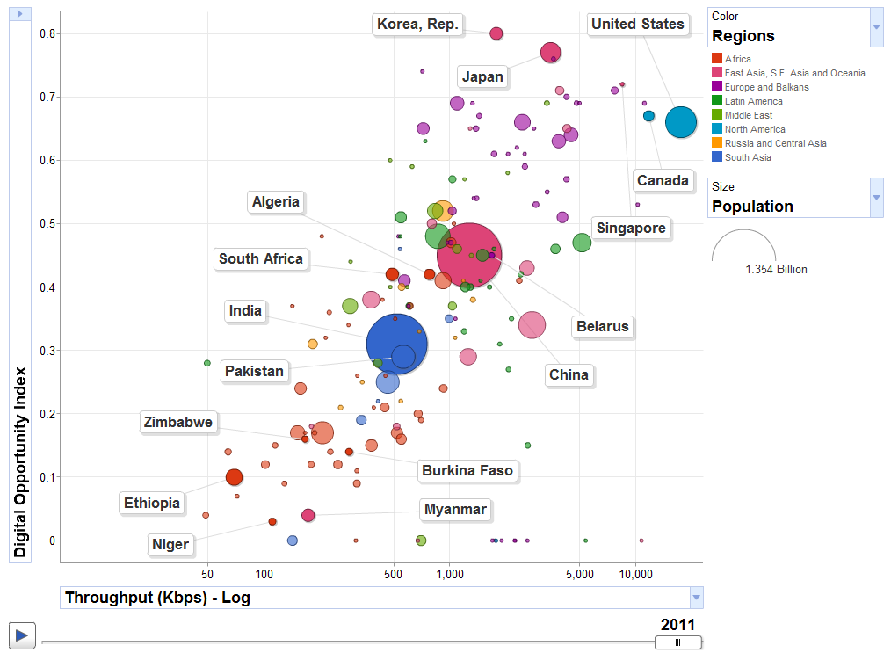
y= 0.1209ln(x) – 0.4056
R² = 0.5626

