Slide 1
The Internet: where did it come from, what are the challenges
Les Cottrell – SLAC
Ecole SIG at nouvelles Technologies en Democratic Republic Congo, 12-17 Septembre, Organisee par l’Universite de Kinshasa
Notes:
Introduce self,
Where are you from, what are you studying, degree level, knowledge of English, plans for future
Course aim to provide background for understanding some of the major bases for today’s Information Age:
Internet and communications
Mobility
Bear in mind that unlike the Industrial age, in the Information age the investment to get started is much lower: do not need canals, roads, railways, coal, steel etc; can set up in business with an Internet connection and some computers (e.g. Google, Yahoo, Facebook …). Also the business is not tied to static physical communication structures (roads, railways etc.) or access to raw materials, but can easily be moved and outsourced. Further the pace of technology is such that leapfrogging is possible, e.g. no need for a wired phone infrastructure to each house, use wireless; lifetimes of computers are 3-4 years then obsolete not worth maintaining. In the 30 years since 1980 we have been through at least 10 different copper cabling and 2 optical fibre schemes for networking. This could be good for developing nations since they can leap in with the newest technology.
I will be covering the Internet from it beginnings, its current state and usage, and the directions it is moving in
Similarly I will cover cellphones and their development into smartphones, as well as other mobility enabling devices.
I will finish up with practical information and demonstrations on debugging Internet problems, and how to measure it.
The lectures will be presented via Powerpoint. All of them are available on the Internet. The Syllabus is at: https://confluence.slac.stanford.edu/display/IEPM/Egypt+Table+of+Contents and from there you can access the presentations and follow along. The lectures are roughly 45 minutes each, so there will be 2 in each 90 minute session.
Besides the slides themselves, many of them have more information in the notes sections.
I regret I speak no Arabic and I am unsure of your strength in English so I will try and go slowly and keep to the written script most of the time. If I start going too fast or am not talking load enough or mumble please raise your and I will try harder.
Should we get finished ahead of schedule, if there is interest I could give a lecture on Geolocation.

Slide 2
Outline
Brief history
Design goals
Growth & Success
Current challenges
Internet NG
What is driving the changes

Slide 3
1961 Vision from Bell Phone System

Slide 4
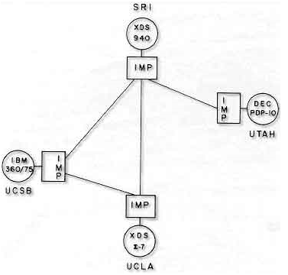
The start
1965: Larry Roberts and Thomas Marill create the first wide area connection via telephone line, turns out to be inefficient and costly. Kleinrock predicts that packet switching (developed by Baran, Davies, Kleinrock et. al.) more promising
1969: the original Internet created and had 4 nodes, UCLA, Stanford Research Institute, MIT, Utah, 50kbit backbone (today scaled up a million times)

Slide 5
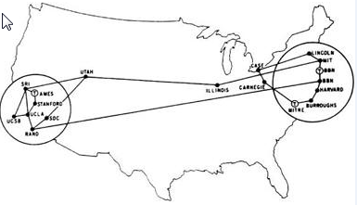
Early days
1972
1983 400 nodes,
Now 750M (many more hidden behind NATs, FW etc.)

Slide 6
Design goals
Built as a collaboration of global proportions, independent stand on own, self managed autonomous systems, decentralized (chaotic, no central control/management cf. phone system),
best effort, no guarantees, recovery from losses, pipelining (TCP), host flow control, checksums
non-proprietary (c.f. SNA, DECnet, XNS …),
little focus on security (if had focused on this it might never have happened),
simple black boxes (routers connect nets) that do not retain information about the individual flows,
packets inside envelopes, layering (independent of each other, i.e. middle layers don’t know if lower layers are wireless, satellite, copper, fibre, upper layer independent of applications cf. purpose designed TV broadcast networks, cable networks, telephone network, only end device knows what the contents mean).

Slide 7
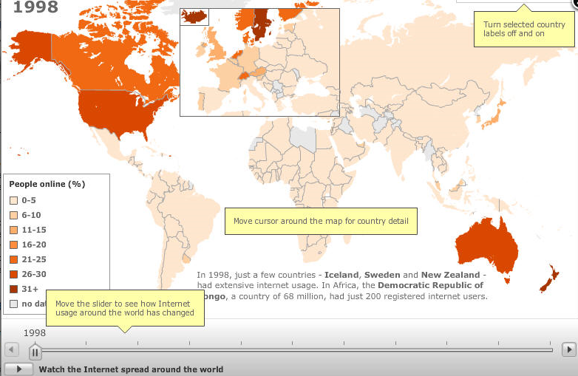
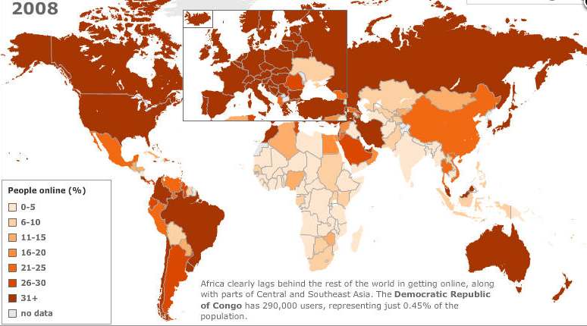
Growth: users
2.09B Mar 2011
Most future growth from developing nations
Maps from http://news.bbc.co.uk/2/hi/technology/8552410.stm

Slide 8
Growth: Devices
August 2010: 5B devices plugged in to Internet
In 10 years factor 4 growth
Driven by cell phones & other new classes of consumer electronics (eBooks, tablets, Internet TV, digital picture frames …)
Even bigger is machine to machine (smart grids for energy management, surveillance & public safety, traffic & parking control, cars, and sensor nets …).

Slide 9
Growth: bandwidth
voice long ago overtaken by data,
trunk speeds roughly double every 22months (driven by Moore's law)
moved from 75bps in 1960 to 50kbps in 1970 to 10-100Gbps singe stream today (1 billion times increase)
Dense Wave Division Multiplexing (DWDM) caused breaking point in 1998 then double every 6 months
wavelength-division multiplexing (WDM) is a technology which multiplexes multiple (up to 160) optical carrier signals on a single optical fiber by using different wavelengths (colours) of laser light to carry different signals. This allows for a multiplication in capacity, e.g 1.6Tbps each channel 10Gbps

Slide 10
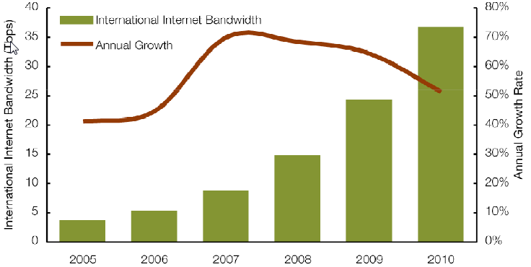
International Internet Bandwidth Growth 2005-2010
Annual growth > 50% in last few years
i.e. almost as much capacity added in 2010 as was available in 2008 (=12.5Tbps)
From Telegeography

Slide 11
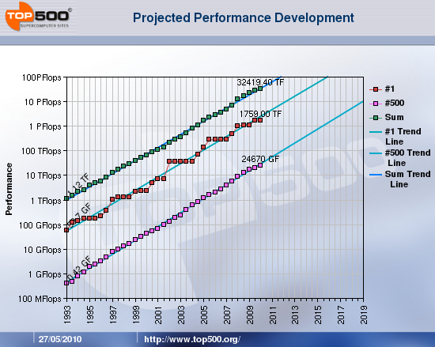
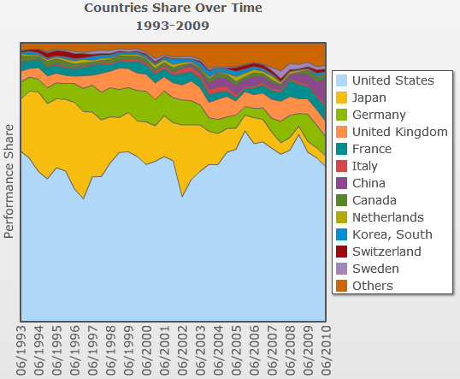
Growth: Supercomputing see http://www.top500.org/
Top machine pass 10PFlops in 2011
US still dominates, followed by China, UK and France

Slide 12
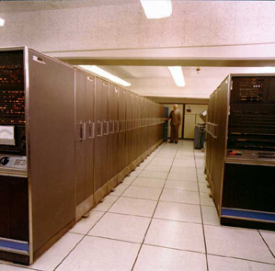
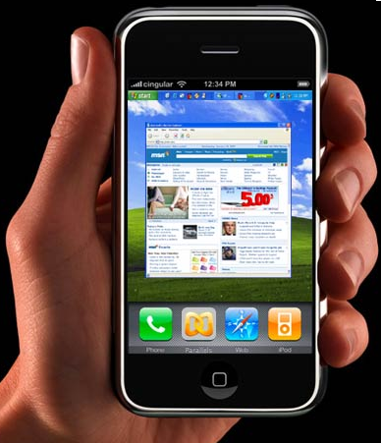
Compare today with 50 years ago
If we compare the IBM Stretch supercomputer of the early 1960’s with today’s smartphone we can see we have come a long way:
Smartphone is much smaller, i.e. it fits in the hand versus 2500 sq. feet;
Smartphone weighs 5 oz. versus 40,000lbs;
Smartphone uses 10,000 times less power;
Smartphone ~ 3000 times more compute power
Stretch $8M, smartphone $200
30 ft long

Slide 13
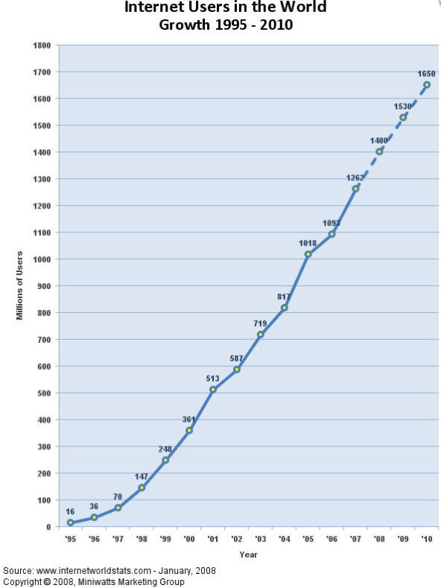
Success
The Internet has successfully scaled from a few users to over a billion and speed increases of seven orders of magnitude (56kbps=>100Gbps backbone)
From a research and education network to a commercial network used worldwide
However there are challenges…
2.09B Mar 2011

Slide 14
Challenges: Address space
IPv4 address space 32 bits ~ 4 billion addresses fine for initial usage but IANA ran out Feb 2011, APNIC Apr 2011
Recognized in 1991: By-passes evolved: private addresses (e.g. NATs), CIDR blocks etc.
Even with that will run out in next couple of years
Initially mainly a problem for later Internet deployment regions (China, India …)
Not backward compatible, not as mature as IPv4 (target for crackers), will run both for many years so added complexity,

Slide 15
Challenges: Mobility
Computers used to be big and did not move
As move need to change IP addresses
This can look like a hi-jack so need trust mechanism
Topology can change
Need persistence across links going up & down
Delay & disruption tolerance (e.g. for space flights)
No session layer in TCP/IP so left to application or just disconnect and start again
Mesh, sensor nets, self-organizing networks
Bad guy may join, e.g. military position overrun, enemy gets device, pretends to be friend
Notes:
For OSI layers see: http://en.wikipedia.org/wiki/OSI_protocols

Slide 16
Challenges: Trust
Initial trust relationship badly broken
Not everyone has everyone else’s best interest in mind
Organized crime, state sponsored intelligence gathering, cyber-warfare
Naïve OS’, unpatched systems, browsers, users
Routing mistakes (e.g. black holes), DNS needs to have trust of others (DNSSEC)
Freedom of information vs privacy (e.g. wikileaks)
Google (gmail has all your emails), Facebook have a good idea of who your friends are where you live, work, spend your free time, your health, love life, political leaning
Branching out into your realtime GPS location
Lack of tools for strong authentication needed for Grids & cloud computing
Cloud computing to generate $45.5 billion in revenue by 2015
Prevalence of spam, viruses, worms, malware, Trojan horses, DOS, DDOS
Attack traffic from 1: Russia, 2: US, 3: China, 4 Brazil …
Notes:
Computer viruses are self-executing, replicating programs written specifically to change the way a machine works, without the knowledge (or permission) of the operator/owner. Viruses are so called because they behave in a similar way to biological viruses. Just as biological viruses pass from person to person, replicating themselves as they go, computer viruses pass from computer to computer. Unlike most biological viruses, however - computer viruses are entirely man made.
The first worm released November 2, 1988 disabled most of the Internet then existing. Robert Morris, a Computer Science graduate student at Cornell University and (embarrassingly) son of the Chief Scientist at the National Computer Security Center, wrote a 99 line program in the C language designed to self-replicate and propagate itself from machine to machine across the Internet. The worm performed the trick by combining a bug in the debugging mode of the sendmail program used to control email on almost all Internet computers, a bug in the finger program, and the Unix rexec and rsh commands.
The difference between a Computer Virus, Worm and Trojan Hose, see http://www.webopedia.com/DidYouKnow/Internet/2004/virus.asp

Slide 17
Challenges SPAM
2003: an estimated 15 B spam messages were sent over the Internet daily.
45% of all e-mail messages = unsolicited pitches for things such as drugs and penny stocks.
2008: 164 B spam messages daily, =97% of email.

Slide 18
Challenges: others
Lack of effective broadcast and multicast, still mainly use unicast
How to redo a functioning production network critical to the global economy while it continues to run
Happened once before when the Internet took over from phone network, so how does it happen next time?

Slide 19
Internet NG Challenges
Deploy IPv6, start 1991, in 2008 0.4% TCP/IP traffic was IPv6
To borrow from John Lennon: "Imagine there's no latency, no spam or phishing, a community of trust. Imagine all the people, able to get online".
The goal is audacious:
To create an Internet without so many security breaches, with better trust and built-in identity management.
Researchers are trying to build an Internet that's more reliable, higher performing and better able to manage exabytes of content.
And they're hoping to build an Internet that extends connectivity to the most remote regions of the world, perhaps to other planets.
Future Internet Design (FIND) funded by NSF to get and implement a vision for 2020
Launched 50 projects ($0.5-1M) in 2006, now (2010) being narrowed down to 2-4 with up to $9M
Notes:
For IPv6 2008 see http://www.potaroo.net/ispcol/2008-04/ipv6.html
For FIND see http://www.networkworld.com/news/2010/010410-outlook-vision.html?ts

Slide 20
How have things changed (not your fathers Internet anymore):
Youth of today brought up with very different expectations:
what’s a wired phone, a payphone, a modem, typewriter, encyclopedia;
=> messaging, Google searches, Multimedia Internet, video communication (YouTube), Internet access everywhere, mobility, virtual worlds, social networking (Facebook, Twitter), video games, shared information (anyone can publish)
And they are tomorrow’s leaders.
In 1998 75% of all Internet users were Americans, now < 15%.
2014 global IP traffic will exceed 767 Exabytes (10^18, ¾ zettabyte)
CAGR 34% 2009-2014
2014 avg monthly traffic = 32M people streaming Avatar movie in 3D continuously for whole month
Web pages quintupled in size since 2003, objects/page increase by 14%/year, response time bad for low bw users, for others bw kept pace

Slide 21
Changes: Ubiquity/ Mobility
Smartphones (see other talk)
WiFi
257M mobile broadband subscriber in 2007
85% increase yearly, 2.5B by 2014
GPS and geolocation
For language, currency selection, targeted advertising
end 2010 60% of US commercial aircraft (out of 3500 total planes) will have WiFi
Universities > businesses > homes (broadband DSL, Cable, FTTH)

Slide 22
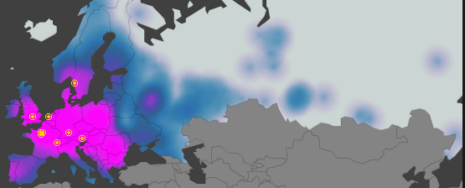
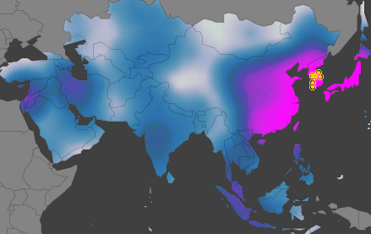
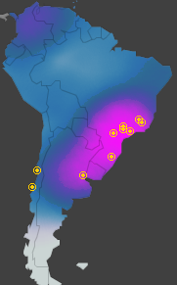
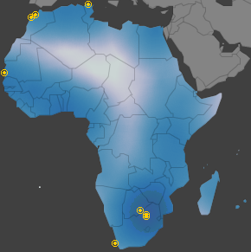
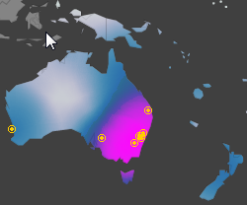
Broadband Coverage Akamai
2Mbps

Slide 23
Changes: Voice
VoIP, e.g. Skype, originally to save phone cost
40M US consumers use VoIP to communicate
Skype uses open Internet
Integration with other apps/services
Presence, GPS, RFID, Wifi

Slide 24
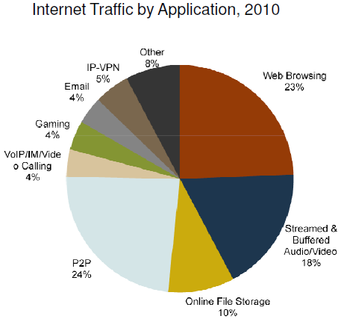
Changes: Video
Digital cameras everywhere (hit mass market in 2000), can do video
GPU’s can process video
Cost of storage dropped by factor 10,000 in 17 years
Video traffic exceeds P2P traffic by end 2010
Video community exceeds 1B by end 2010
Internet video now 1/3 of Internet consumer traffic
The sum of all forms of video (TV, video on demand, Internet, and P2P) will exceed 91 percent of global consumer traffic by 2014.
Mobile video has the highest growth rate of any application category measured within the mobile sphere
From TeleGeography
Streamed & buffered audio/video + online
File storage +P2P =52% most of which is video
Notes:
See http://www.cisco.com/en/US/solutions/collateral/ns341/ns525/ns537/ns705/ns827/white_paper_c11-481360_ns827_Networking_Solutions_White_Paper.html

Slide 25
Changes: end user I/O
Paper tape > punched cards > ASCII text terminals > desktop PCs
Cables: phone copper twisted pair, thick coax, thin coax, twisted pair, fibre
Laptops with docking stations replace desktop PCs, netbooks and OLPC cut into laptops, then:
Smartphones, Smartbooks (between cell phones and netbooks)
Aim for battery of 1 day or more (e.g. ARM processors, power mgmt)
Amazon e-Books already overtaken hardcover sales, Kindle sales tripled over last year (Jul’10)
iPAD got its timing just right:
Go introduced Penpoint in late 1980’s, 6 years later & $75M in venture capital it evaporated
Apple developed Newton in 1990’s it evaporated
Then Palm Pilot
iPAD required faster processors, lower power, lower component costs, the Internet and robust wireless networks
iPAD interface simple, characters large, appeals to elderly
Tablets predicted to outsell netbooks in US in 2013, and 20% of all PC sales in 2015

Slide 26
Net Neutrality
15 years ago internet wide-open platform unifying space, free of charge, anyone could use
Before islands: AOL, Compuserve, SNA, DecNet, Bitnet …
Internet net of nets: more that join = more benefits
What is Metcalf’s law?
C.f. computing dominated by Microsoft
Now in danger of being Balkanized by:
Governments: Blackberry, Greatwall & Google in China, blocking of child porn (Australia)
IT companies build own territories: can’t download Hulu video from Europe, Facebook & Apple control which apps can run
Network owners treat different traffic differently vs. best effort, could it lead to abuse. Being pushed by carriers.
NATs: new apps require NATs to accomodate

Slide 27
Changes: Others
Controlling smart power grid
Government to citizen communications
Banking, financing etc
Need to be greener
Energy doubled 2000-2006
Growing slower than traffic volumes
Management needs to be more automated
Increased services in cloud
Storage: $70 for 1TB in Aug ’00 would have cost $300M in ’81 (factor of 1million in 25 years)
Notes:
http://www.networkworld.com/news/2010/010410-outlook-vision-predictions.html?page=1

Slide 28
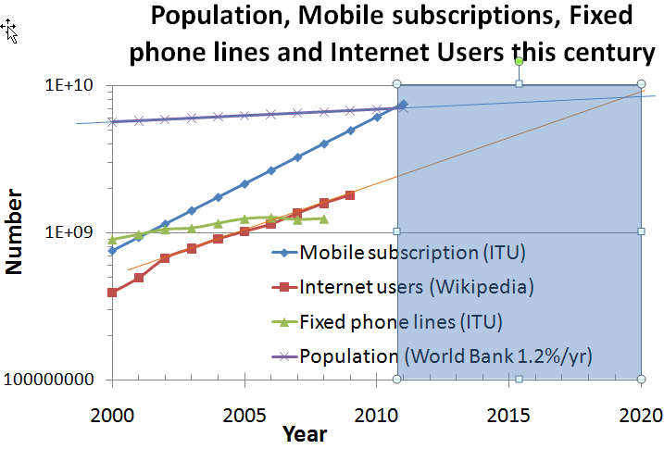
Phone/Internet convergence
Mobiles passed fixed in 2001, fixed stopped growing
Mobiles = population in 2011
Internet users = population in 2020 (slower growth)
Smartphones need Internet and at same time enable its spread

Slide 29
More Information
Video predictions from Cisco
www.cisco.com/en/US/solutions/collateral/ns341/ns525/ns537/ns705/ns827/white_paper_c11-481360_ns827_Networking_Solutions_White_Paper.html
Predictions from Network World
http://www.networkworld.com/news/2010/010410-outlook-vision-predictions.html?page=1
Future Internet
www.networkworld.com/news/2010/010410-outlook-vision.html?ts
Map of Internet penetration 1998-2010
news.bbc.co.uk/2/hi/technology/8552410.stm

