Slide 1
Geolocation
SPACE Weather School:
Basic theory & hands-on experience
Geolocation
Les Cottrell – SLAC
University of Helwan / Egypt, Sept 18 – Oct 3, 2010
Partially funded by DOE/MICS Field Work Proposal on Internet End-to-end Performance Monitoring (IEPM), also supported by IUPAP
http://www.slac.stanford.edu/grp/scs/net/talk10/diagnosis.pptx

Slide 2
Outline
Geolocation = estimating the latitude and longitude of a public (IP) network interface.
Importance
How is it done
Dynamic method
RTT => distance
Geometrical methods of finding location from circles
Method
Challenges

Slide 3
Why is it important
Overlay network construction,
Determine where customers are so can use targeted advertising and services
E.g. special offers from local stores
Direct customer to the right site
E.g. Hotmail directs clients to appropriate replicated servers based on clients location
Understand shopping or other patterns, consumer habits based on location
Applying appropriate taxes, digital and territory rights
Locate servers or suspicious hosts
Language and currency choice & translations
Applications such as Visual Traceroute need to locate nodes on a map
Notes:
http://www.getelastic.com/8-applications-of-ip-geolocation/

Slide 4
How is it done: Heuristics
Based on hostname:
Top level domain may correctly identify country
Often not true, especially developing countries use proxies in well connected locations
Name may give clue, e.g.
denvcr2-sunncr1.es.net router connecting Denver to Sunnyvale

Slide 5
How is it Done: Databases
Given an IP address lookup the Autonomous System (AS) and see where it is located
Often gives the corporate HQ of AS not location of host
Access to Internet registration databases (e.g. via whois) that may contain locations
Host locations are often not registered
Specialized location databases, e.g.
http://www.ip2location.com/
Lot of work to keep current
Maxmind is a database used by several services

Slide 6
How is it done: Dynamically
Measure Round Trip Time (RTT) from landmarks at known locations
Convert RTT to distance d
Use geometrical method (e.g. trilateration) to find intersection of circles with radius d_{i (i=1..3)}
Trilateration, multilateration, Apollonius
Apply other constraints

Slide 7
Get distance from RTT
Roughly speed of light in copper or fibre =
0.6 * c (velocity of light) or RTT = 1ms ~ 100km
However: route is not often direct
Can go through multiple routers/switches which add
delay to clock the packet onto the link
e.g. 0.5ms for 1Mbps link and 60 byte packet, i.e.
ignore for backbone (typically >= Gbps)
buffering in case link is busy
Make multiple measurements, take minimum & assume no buffering

Slide 8
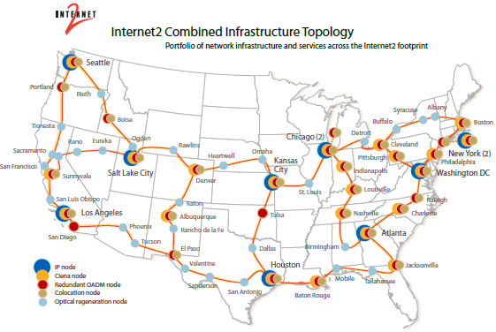
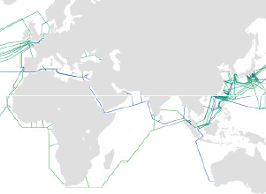
Non direct routes
Seldom does the route follow a great circle path
E.g. Europe to Japan via submarine cables going around Spain through Mediterranean, Red Sea, around Sri Lanka, Singapore, up E coast Asia to Japan
E.g. In US From LA to Salt Lake City via San Francisco

Slide 9
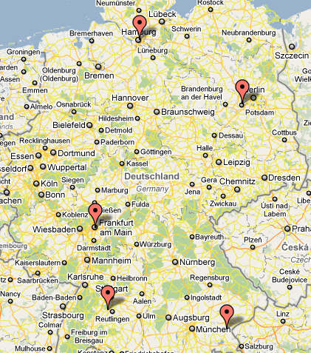
A route in Germany
The German part of the traceroute from SLAC to DESY in Hamburg goes from Frankfurt tto Potsdam to Tubingen and then to Hamburg.
This is about 1100miles compared to a direct driving distance of ~ 300miles or 4 times the distance
This indirect route is shown in red on the right.
BTW GeoIPTools placed all the routers about 30km SE of Bonn

Slide 10
Correction factor
So use d = alpha * RTT * 100 km
alpha ~ 0.4 (km/ms)
May try and optimize depending on landmark and target region

Slide 11
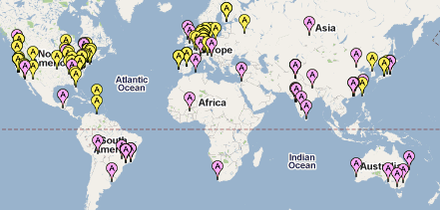
Need landmarks from which to make measurements
Landmark needs
to be at a known location
to respond to a request to make on-demand RTT measurements to a given target
~ 500 sites nominally available in:
PlanetLabs (420/81), PingER (75/50), perfSONAR
Many sites do not respond, so need to monitor and disable/enable
PingER
PlanetLabs
Locations of Enabled Landmarks

Slide 12
Method
Client/users send URL with target to a “reflector”
Reflector distributes the request to ping the target to the enabled landmarks and gets back results
Formatted results are sent to client
Client converts RTTs to distance, and uses various methods to extract the location
GUI displays results of various methods and shows some details

Slide 13
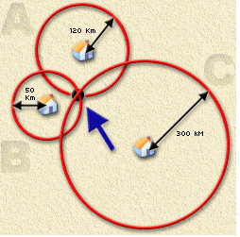
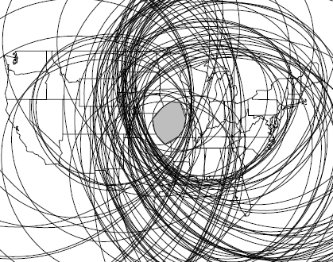
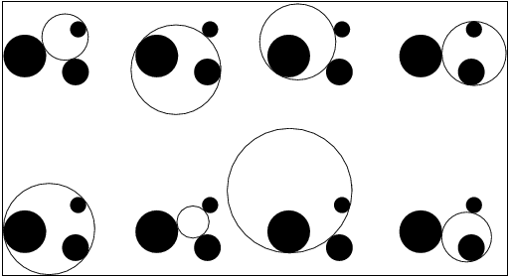
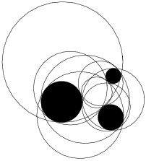
Geometrical methods
Trilateration intersection of 3 circles
Uses 3 smallest RTTs
Multilateration uses > 3 circles
Apollonius finds up to 8 circles tangential to initial 3 circles
Do not have to intersect
Chooses center of smallest circle
Or take inscription of all circles

Slide 14
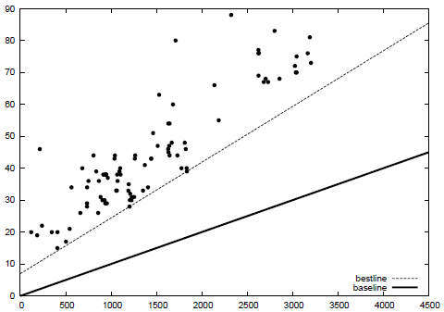
Improvements
Use maximum and minimum circles
d_{max} = 100 * RTT (ms) km
d_{min} = alpha_{min} * 100 * RTT (ms) + b km
RTT ms
km

Slide 15
Using the two sets of circles to further Constrain result
Landmark¹
d¹_{max}
d¹_{min}= alpha*d¹_{max} + b

Slide 16
Challenges
Embedded circles may have no solution
Landmarks or targets connected via satellite fail
Accuracy depends on density and distribution of landmarks
Works much better for targets in N. America and Europe
Need more landmarks but means more network traffic
Typical accuracy only as good as 250km for 80% of the targets
Today database methods generally work better
Fail for proxied hosts,
Fail often backbone routers owned by ISP
Replicated hosts, hotmail, Google, Yahoo etc
Mobile hosts
So valuable cross check

Slide 17
Problems
Amount of traffic directed at target may look like a DOS attack
Use tiering
Choose one or more landmarks representative of a region
E.g. In center of region such as Chicago for N. America or Geneva for Europe
Use such tier0 landmarks to determine region of target
The use just the landmarks in that region to locate target

