Slide 1





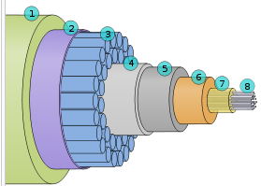
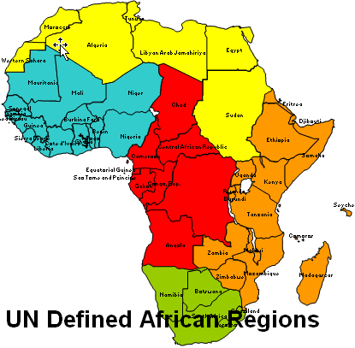
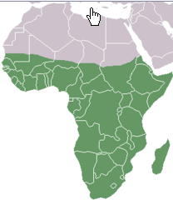
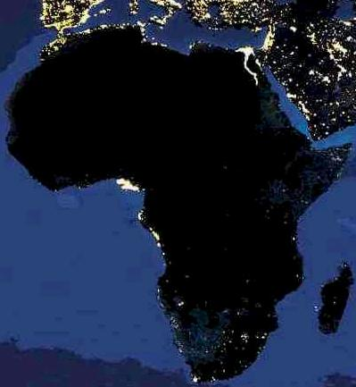

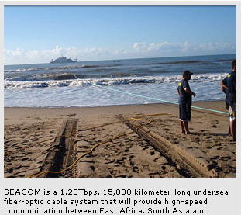
Quantifying the Worldwide Digital Divide: The Emergence of Africa
Prepared by: R. Les Cottrell SLAC,Stanford, USA
ISPA/iWeek, Pretoria, S. Africa, Sept 21, 2011
cottrell@slac.stanford.edu
Notes:
Africa is huge with over 1 billion people, speaking over 1000 languages, with huge rainforests and vast deserts. Yet as we shall show it badly lags behind the rest of the world in its Internet performance. This talk will show how we measure the Internet Performance. These measurements cover countries of the world containing over 99% of the world's Internet connected population. Using these measurements we illustrate the overall Internet performance for the world in particular for: throughput, losses, jitter, Round Trip Times, availability etc. We will demonstrate the performance trends for the last 13 years, in particular illustrating how Africa is not only behind all other regions and one to two decades behind developed regions, but worse is falling further behind. We also compare our results with the International Telecommunications Union’s ICT Development Index (IDI) that measures the performance for over 150 countries. We then focus on the promising emerging situation in Africa following the dramatic increases in performance due to submarine fibre connectivity that was driven partially by soccer’s 2010 World Cup in South Africa. We conclude that despite the many challenges in Africa, there is promising potential for a dramatic improvement in the near future, but there is still a long way to go.

Slide 2
Outline
Viewpoint from outside to Africa as a whole, focusing on R&E
Why does Africa’s Internet performance matter?
How do we measure performance?
What do we find?
What is happening and its impact
What’s next?
Conclusions

Slide 3
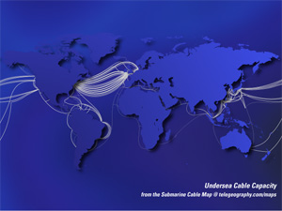
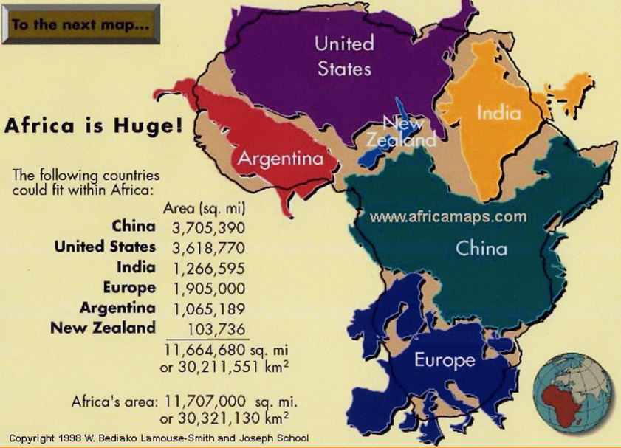
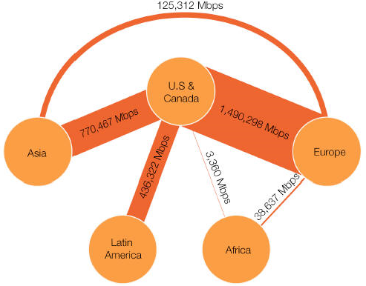
Africa is huge, diverse & dreadful access
Hard to get fibre everywhere
~ 1B people, over 1000 languages,multi climates
Fibres
Capacity
From Telegeography

Slide 4
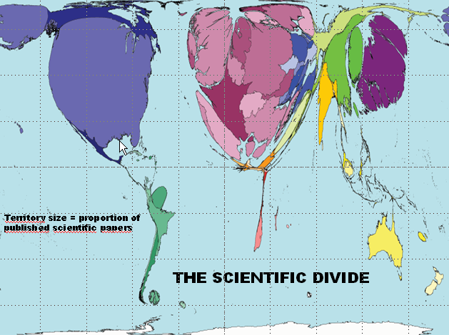
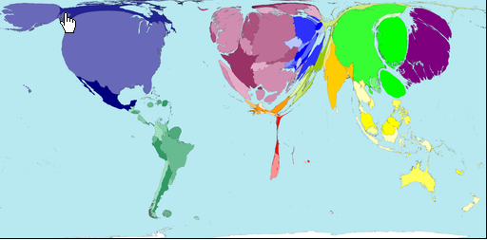
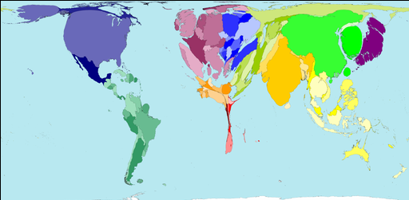
Why does it matter
African scientists isolated
Lack critical mass
Need network to collaborate but it is terrible
Brain drain
Brain gain, tap diaspora
Blend in distance learning
Provide leadership, train trainers
Internet Users 2002
Tertiary Education from
http://www.worldmapper.org/
Cartograms from:
www.geog.qmw.ac.uk/gbhgis/conference/
cartogram.html

Slide 5
How does the Internet help
A World Bank / IFC report says for every 10 percentage-point increase in high-speed Internet connections there is an increase in economic growth of 1.3 percentage points. April 2010. http://www.infodev.org/en/Article.522.html
Investment in information technology plays the role of a "facilitator" that allows other innovations to take place. http://findarticles.com/p/articles/mi_m1093/is_3_45/ai_86517828/
Notes:
ICT is an enabler (banking, global issues, digital divide, climate). Need to skip straight to broadband. Cheaper to connect up medicine instead of building hospitals everywhere. Broadband is a basic infrastructure to meet targets of reducing poverty etc. Want in place for 2015 summit. Alexander Ntoko Chef Division de la strategie Institutionnelle (CSD) ITU <alexander.ntoki@itu.int> at the APS meeting April-May 2011. Governments need to be involved, not just industry. Must be high on agenda. Has to be affordable. This has to be a key objective. Has to be in terms of % of income spent. It must have security built in else it will create many problems.
Investment in information technology plays the role of a "facilitator" that allows other innovations to take place. For information technology investment to be fully effective, it has to take advantage of "network externalities." This requires that a large enough number of people and organizations make the investment and become connected to the network.
This result, in turn, requires that users share similar levels of technical, analytical, and "problem-solving" skills. 2002, http://findarticles.com/p/articles/mi_m1093/is_3_45/ai_86517828/
There is a significant relationship between GNI per capita (in PPP international dollars) and adoption of each ICT (mobile phone, personal computer, and telephone) with the exception of Internet technology. 2009, http://iisit.org/Vol6/IISITv6p471-478Fong597.pdf
A World Bank / IFC report by says for every 10 percentage-point increase in high-speed Internet connections there is an increase in economic growth of 1.3 percentage points. April 2010. http://www.infodev.org/en/Article.522.html
The Internet and the applications riding on highspeed IP networks provide a unique and cost-effective way for economies to enhance national competitiveness and to rise above physical and geographic constraints. Countries and cities that effectively harness the power of broadband networks are treating them as basic infrastructure—key to competitiveness in the knowledge economy. http://reports.weforum.org/global-information-technology-report/
Africa suffers from numerous problems which have contributed to the poorly developed state of the Internet on that continent. Much of the population is extremely poor - meaning that, even though the Internet has resulted in many new economic growth opportunities in developed countries, relatively few Africans can afford the initial investment in technology necessary to make those opportunities possible. Africa also lacks the pre-existing networks of telephone and cable lines which broadband has been able to move over in developed countries. Moreover, despite having a high population overall, much of the African population is dispersed into smaller communities over large distances - the sort of communities which sometimes still lack full broadband connectivity even in developed countries. As in other developing countries, many regions of Africa appear ready to leapfrog the landline stage and move directly to cellular and wireless communications - eventually.
For the moment, the combination of very low income and very poor infrastructure has combined to create a very unfortunate situation: even as most potential Internet users' income is lower than in other regions, the cost of connecting to the Internet is actually much higher. According to recentpress coverage, a home DSL (broadband) connection in the country of Ghana costs about $32 a month, similar to the cost in developed countries (although DSL service in Ghana is slower and less reliable). For Internet Service Providers (ISP), the cost of purchasing a megabit-per-second connection to the global Internet was a staggering $1600-$2200 - perhaps twenty times as much as an ISP would expect to pay in a major North American or European city.
The World Economic Forum, based in Davos, Switzerland, holds that technological progress is the principal driver of innovation, productivity and efficiency.
Alberto Santoro (UERJ) at APS Apr-May 2011: proposed that connectivity/communication is a human right and has to be respected. Today most of the pressure is for improved communication by country/region. A further step is equality in access.

Slide 6
PingER Methodology very Simple
>ping remhost
Uses ubiquitous ping
Monitoring
host
Internet
Remote
Host
(typically
a server)
10 ping request packets each 30 mins
Once a Day
Ping response packets
Data Repositories@ SLAC
FNAL & NUST in Pakistan
Measure Round Trip Time & Loss
6

Slide 7

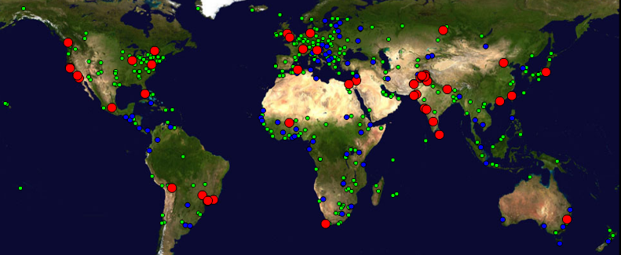
Coverage
Measurements from 1995 on reporting reliability & quality
~ 99% of world’s population in monitored countries
Collaborations with NUST, Pakistan, FNAL & ICTP Italy
  Monitors >70 in 23 countries – 4 in Africa:
    Algeria, Burkina Faso, Egypt, S. Africa
  Beacons ~ 100
  Remote sites (~740) – 50 African Countries

Slide 8
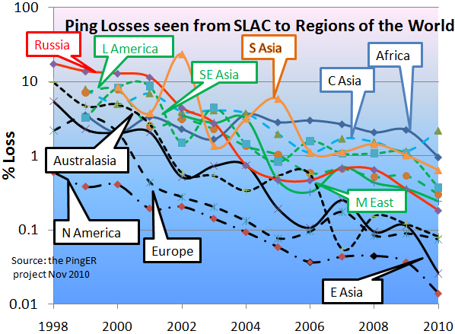
Losses
Low losses are good.
Losses are mainly at the edge, so distance independent
Losses are improving roughly exponentially, ~factor 100 in 12 years
Loss has Similar behavior to thruput:
Best <0.1%: N. America, E. Asia, Europe, Australasia
Worst> 1%:
Africa & C. Asia
Notes:
Each point represents a region for one year. Have not fitted to exponential so can see raw data.

Slide 9
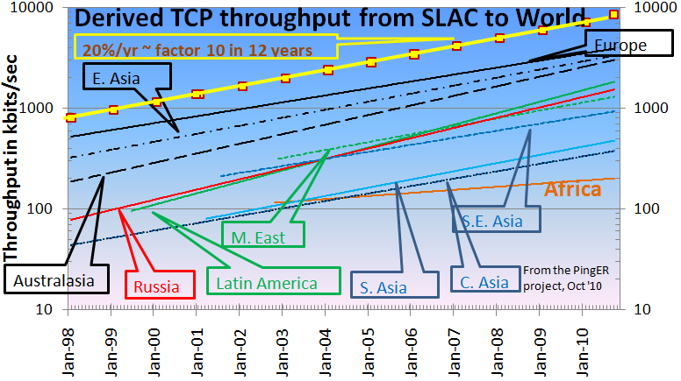
World Throughput Trends
Europe, E. Asia & Australasia merging
Behind Europe:
5-6 yrs: Russia, L America, M East
9 yrs: SE Asia
12-14 yrs: India, C. Asia
18 yrs: Africa
Derived throughput ~ 8 * 1460 /(RTT * sqrt(loss))
Mathis et. al
Feb 1992
Africa in danger of falling even further behind.
In 10 years at current rate Africa will be 70 times worse than Europe
Notes:
Using the Mathis formula for TCP/Reno throughput we can derive an estimate of the TCP throughput from our loss and RTT measurements. These estimates are only rough since the losses experienced by TCP[1] are different from those measured by ping, also PingER only sends about 14,400 pings a month between a monitoring host / remote host pair so one cannot see monthly losses of < 0.1% such as are often experienced on today’s high quality paths. In addition the RTTs on high quality paths are approaching the limits of the speed of light in a fiber, so further improvement is difficult. Finally the TCP/Reno congestion control is slowly being supplanted by more aggressive mechanisms. None-the-less, especially for poorer quality paths, combining loss and RTT into a single metric is very useful. Fig. 8 shows the derived TCP throughputs measured from SLAC to the world’s major regions, in some cases going back for the last 11 years. Similar plots (not shown here) are seen for the data measured from CERN in Geneva, Switzerland thus indicating that the effect is not just an anomaly associated with the measurements being from the U.S. The data for several of the developing countries only extends back for about five years and can vary greatly from month to month, so some care must be taken in interpreting the long term trends. With this caveat, it can be seen that links between the more developed regions including the U.S. and Canada, E. Asia and Europe are much better than elsewhere (3 - 10 times more throughput achievable). Regions such as Russia, S.E. Asia, S.E. Europe and Latin America appear to be 3-6 years behind. Russia and S.E. Asia are catching up slowly. However, Africa, S. Asia and C. Asia are 8-10 years behind and even worse appear to be falling further behind due to slow growth. Sites in many countries have less bandwidth than a residence in developed countries (typical residential DSL or cable bandwidths are of the order of a few hundred megabits/sec). Looking forward ten years to 2015, if the current rates of progress continue, then performance from N. America to Africa will be 1000 time worse than to Europe, to S. Asia and C. Asia will be 100 times worse than to Europe.
[1] TCP deliberately provokes loss as part of its congestion detection algorithm.
[2] The derivation is based on the TCP/Reno implementation of congestion control. These days more aggressive algorithms are often used. Still the formula is a useful way to combine metrics into a quality measure which is roughly based on throughput.

Slide 10
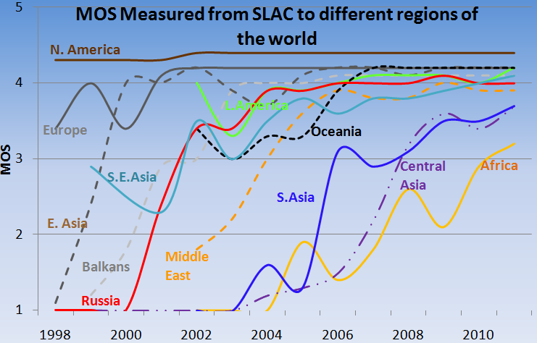
Mean Opinion Score MOS)
Used in phone industry to decide quality of call
MOS = function(loss, RTT, jitter)
5=perfect, 1= lowest perceived audible quaity
>=4 is good,
3-4 is fair,
2-3 is poor etc.
Usable
Important for VoIP
From the PingER project http://www-iepm.slac.stanford.edu/pinger

Slide 11
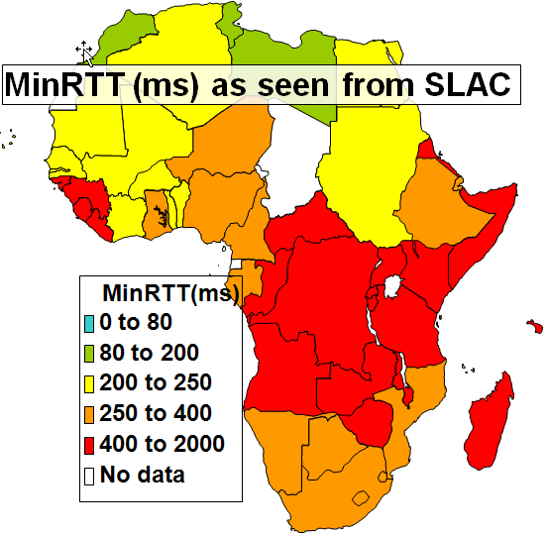
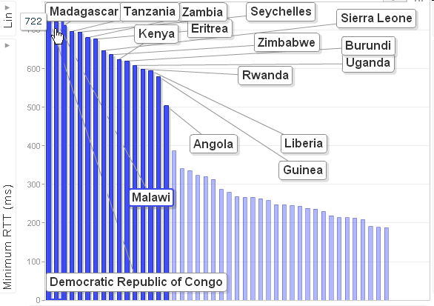
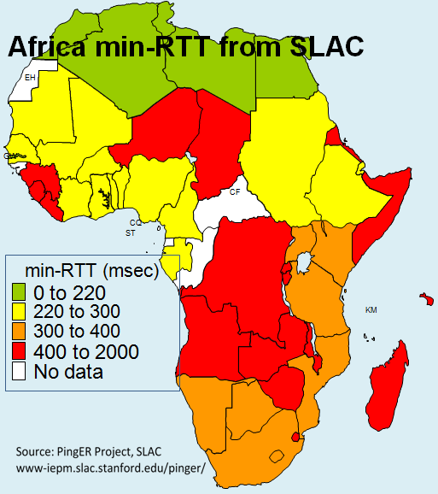
Why does fibre matter:
2008
GEOS (Geostationary Earth Orbit Satellite)
  good coverage, but expensive in $/Mbps
    broadband costs 50 times that in US,
    >800% of monthly salary c.f. 20% in US
  & long delays min RTT > 450ms easy to spot
  N.b. RTTs > 250ms v. bad for VoIP
OK to US
GEOS
500
400
300
Terrestrial
200
Minimum RTT (ms)
100
Min- RTT from SLAC to African Countries
2010
0

Slide 12
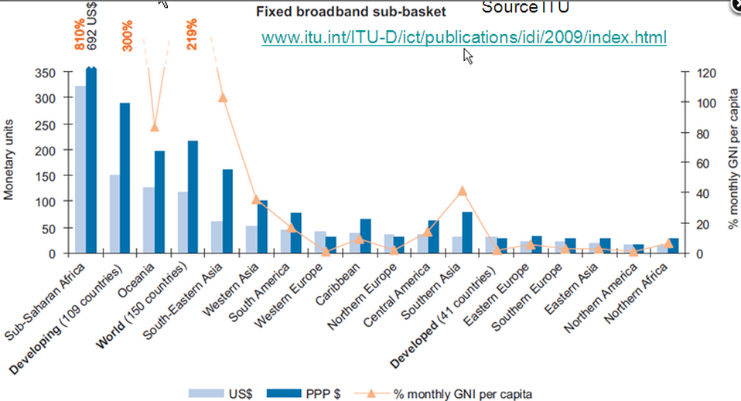
Then there is the cost

Slide 13
Demo
Throughput vs IDI, multi-dimensional
  Bubble size=population, x = IDI, y =throughput
  Color = region
  Play = time
Click to ID point, or region
Choose monitoring site, time aggregation, region
Change axes: choose metric, log vs linear
Plot sorted values, see time changes
http://www-iepm.slac.stanford.edu/pinger/pinger-metrics-motion-chart.html
Google motion chart widget:
  http://documents.google.com/support/spreadsheets/bin/answer.py?answer=91610
Data from US census bureau (population), Internet world stats (users/country), ITU (DOI), Wikipedia (CPI), UNDP (HDI)

Slide 14
Compare PingER with ICT Development Index (IDI) from ITU
IDI = ICT readiness + usage + skills
Readiness (infrastructure access)
  phone (cell & fixed) subscriptions, international BW, %households with computers, and % households with Internet access
Usage (intensity of current usage)
  % population are Internet users, %mobile, and fixed broadband users
Skills (capability)
  Literacy, secondary & tertiary education
www.itu.int/ITU-D/ict/publications/idi/2009/material/IDI2009_w5.pdf

Slide 15
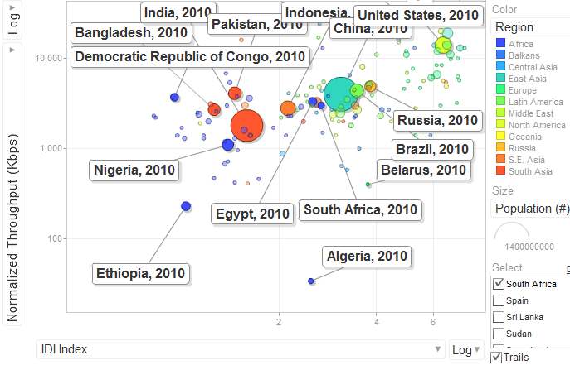
PingER throughput & IDI
Positive correlation between PingER throughput & IDI, especially for populous countries
PingER measurements automatic
No army of data gatherers & statisticians
More up to date
  IDI 2009 index for 2007 data
Good validation
Anomalies interesting
PingER Normalized Throughput
IDI index

Slide 16
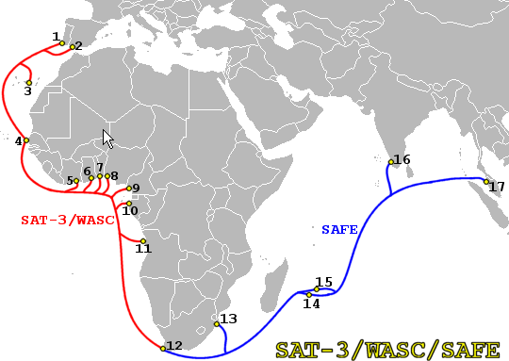
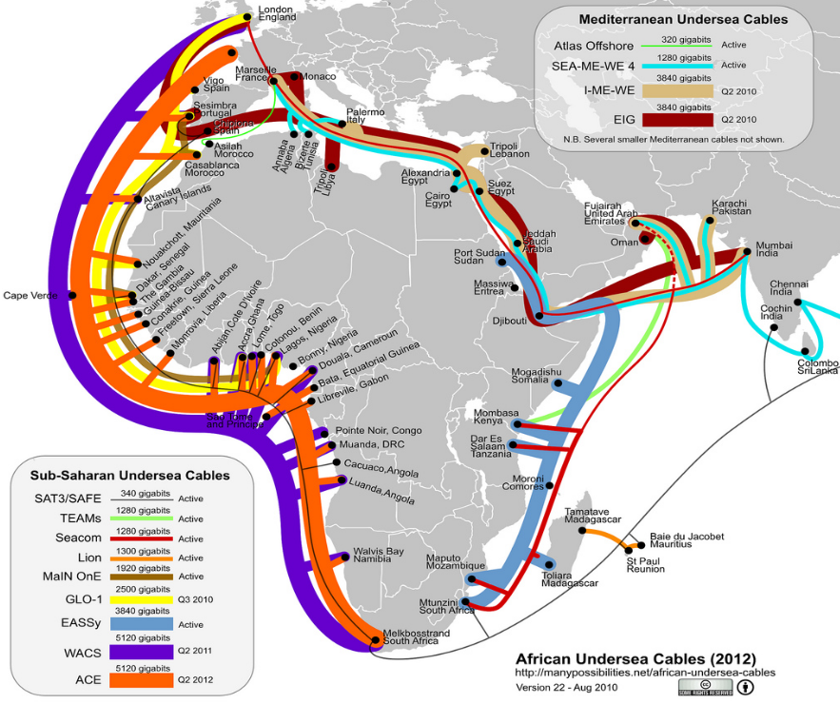
What is happening
2008
Up until July 2009 only one submarine fibre optic cable to sub-Saharan Africa (SAT3) costly (no competition) & only W. Coast
2010 Football World Cup => scramble to provide fibre optic connections to S. Africa, both E & W Coast
Multiple providers = competition
New Cables: Seacom, TEAMs, Main one, EASSy, already in production
2012
manypossibilities.net/african-undersea-cables
Notes:
Wed 2nd Feb 2011: The co-owners of the South East Asia-Middle East-Western Europe 4 (SEA-ME-WE 4) international submarine cable system have selected Alcatel-Lucent and Ciena Corporation for a network expansion project. Alcatel-Lucent was selected for an upgrade to 40Gbps (40G) transmission of all submarine segments. Ciena was selected to supply optical switching equipment for all 16 cable landing sites as well as for 100Gbps (100G) transport for an upgrade of the terrestrial link connecting Alexandria to Suez in Egypt. The deployment will commence in the first quarter of 2011, providing a substantial capacity increase to the existing cable system (ultimate capacity of 2.4Tbps per fibre pair), which supports the delivery of high speed internet and other broadband-based services along the approximately 20,000km route connecting Europe to the Middle East and South East Asia. Source: Telegeography
SEA-ME-WE 4 has a faster rate of data transmission at 1.28 Tbit/s against SEA-ME-WE 3's 0.96 Tbit/s.^{[24]} SEA-ME-WE 3 provides connectivity to a greater number of countries over a greater distance, but SEA-ME-WE 4 provides far higher data transmission speeds intended to accommodate increasing demand for high-speed internet access in developing countries. Source wikipedia
Seacom (E. Africa) & MainOne (W. Africa) connected in London so traffic can go Pan African (e.g. Nigreia to S. Africa). Eventually will also connect via S. Africa and then will have African ring. See http://www.lightwaveonline.com/networking/news/Main-One-SEACOM-link-submarine-networks-to-offer-pan-African-capacity-121248294.html?cmpid=EnlDirectMay42011

Slide 17


Plans for New Sub-Saharan
Undersea Cables to Europe and India by 2011
 | Seacom | EASSy | TEAMs | WACS | MainOne | GLO1 | ACE
Cost $M | 650 | 265 | 130 | 600 | 240 | 800 | 700
Length (km) | 13,700 | 10,000 | 4,500 | 14,000 | 7,000 | 9,500 | 14,000
Capacity | 1.28 Tb/s | 3.84 Tb/s | 1.28 Tb/s | 5.12 Tb/s | 1.92 Tb/s | >0.64 Tb/s? | 5.12 Tb/s
Completion | July 2009 | July 2010 | Sept 2009 | Q3 2011 | Q2 2010 | Q3 2010 | Q2 2012
Ownership | USA 25% SA 50% Kenya 25% | African Telecom Operators 90% | TEAMs (Kenya) 85% Etisalaat (UAE) 15% | Telkom Vodacom MTN Tata (Neotel) Infraco et al | US Nigeria, AFDB | Nigeria & UK | France Telecom et al
Main1 on YouTube: http://www.youtube.com/watch?v=pzbAS1lXW1A
Notes:
See http://www.techzim.co.zw/2011/04/5-12-terabits-wacs-undersea-cable-lands-in-cape-town/
See http://www.pccwglobal.com/network/network-map for a map of the world’s undersea cables

Slide 18
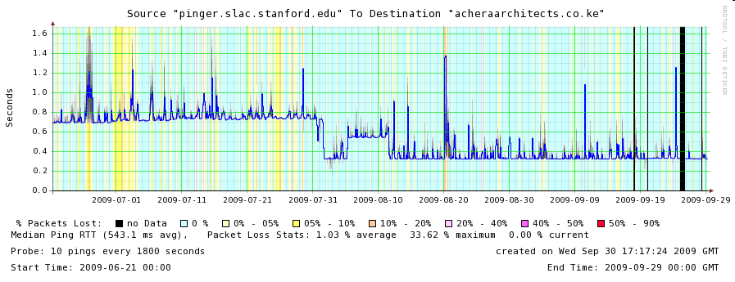
Impact: RTT etc.
As sites move their routing from GEOS to terrestrial connections, we can expect:
  Dramatically reduced Round Trip Time (RTT), e.g. from 700ms to 350ms – seen immediately
  Reduced losses and jitter due to higher bandwidth capacity and reduced contention – when routes etc. stabilized
Dramatic effects seen in leading Kenyan & Ugandan hosts
720ms
RTT improves by factor 2.2
Losses reduced
Thruput ~1/(RTT*sqrt(loss)) up factor 3
Big jump Aug 1 ’09 23:00hr
Median RTT SLAC to Kenya
325ms
Bkg color=loss Smoke=jitter

Slide 19
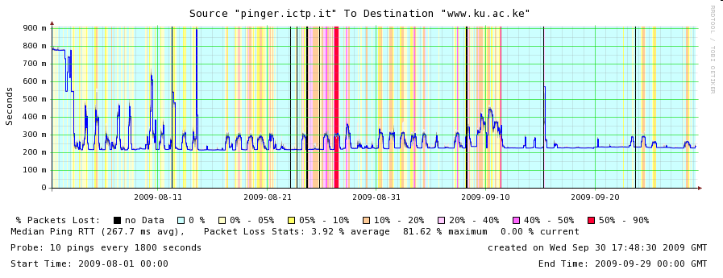
From ICTP, Trieste, Italy
Even Bigger effect since closer than SLAC
  Median RTT drops 780ms to 225ms, i.e. cut by 2/3rds (3.5 times improvement)
Still big diurnal changes
Seems to be stabilizing
Aug 2nd

Slide 20
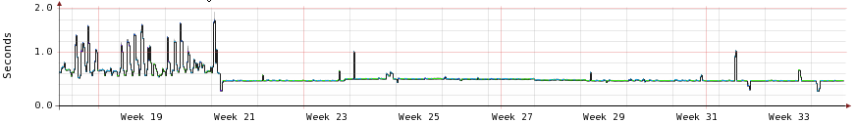
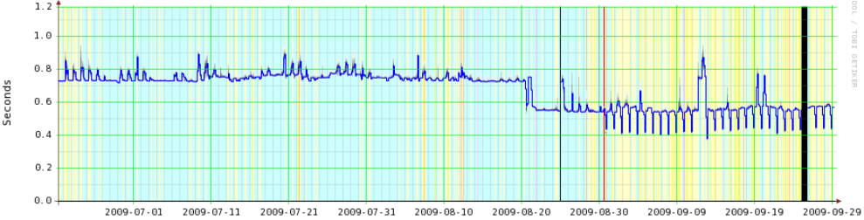
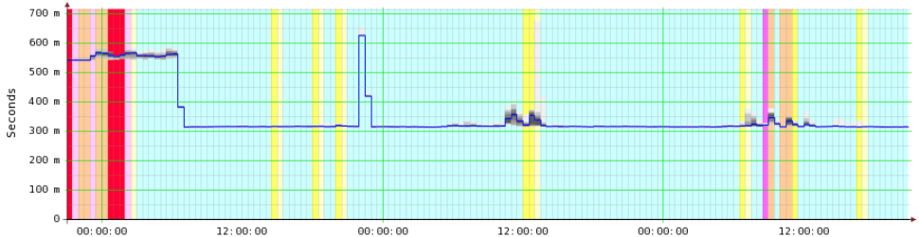
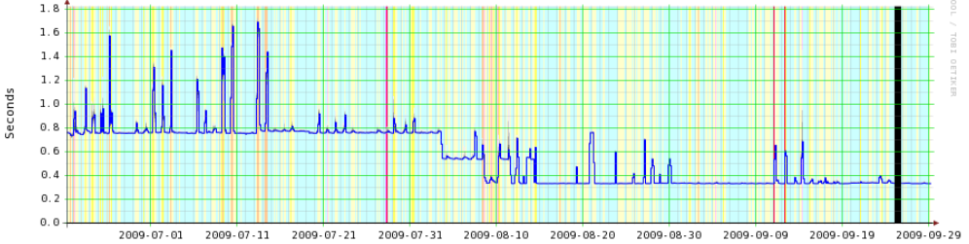
Other countries
Angola step mid-May, more stable
Zambia one direction reduce 720>550ms
  Unstable, still trying?
Tanzania, also dramatic reduction in losses
Uganda inland via Kenya, 2 step process
Rwanda Sep 25
Many sites still to connect
750ms
450ms
SLAC to Angola
Aug 20
SLAC to Zambia
1 direction
Both directions?
Sep 27
SLAC to Tanzania
SLAC to Uganda
Both directions
1 direction
Notes:
Between the 22nd and 25th of September the RTT from SLAC to The Kigali Institute of Education host www.kie.ac.rw in Kigala, Rwanda dropped by a factor of 2 from 720msec to 320msec (see below). The connection was through Kampala Uganda to Kenya.

Slide 21
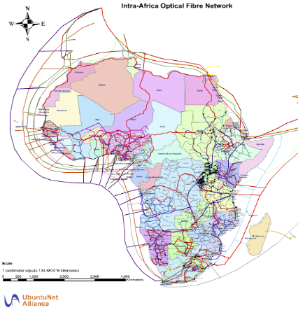
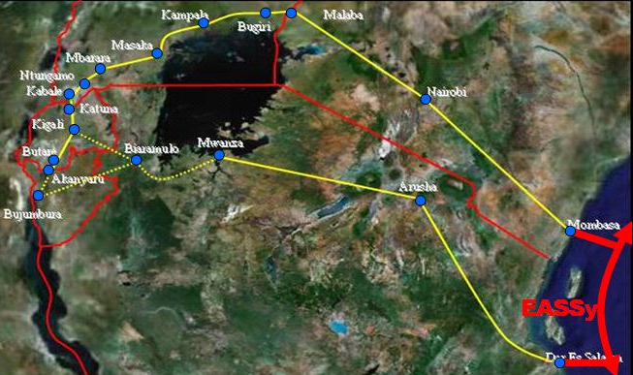
Next Steps: Going inland
Connect up the rest of the sites & countries
Extend coverage from landing points to capitals and major cites
Need fibre connections inland
They exist
Most universities located nearby
Inter Africa fibre network
www.ubuntunet.net/fibre-map
Central
Notes:
WACS Cable landed at Moanda on the coast of DRC on 19th February 2011. It is lit (is it?) to Kinshasa with 10Gbps capacity. There is a fibre under the Congo connecting Brazzaville, so they will get connectivity. Brazzaville has plans to connect a second cable to Moanda thus providing path redundancy to the coast. In Kinshasa they have plans to put a 60km ring of fibre connecting 11 (or is it 15?) universities by December of 2011. The (equipment) cost of this is under $1MUS (does this include laying and terminating the fibre?).
Today UniKin has 8 public Internet addresses, the rest of the campus is connected via a NAT(s). The campus Internet link today is 1.5Mbps download, 512kbps upload. There are 26,000 students. There are about 800 PCs. There are about 200 users of the existing Internet. The core network is 1Gbps based on Cisco equipment. They have 5km of optical cables around the campus. The edge switch/routers are typically connected at 100Mbps. The core is lightly loaded. The main applications on site are: mail, VoIP, virtual library and e-learning.
There are dark fibres running from Kinshasa to S.E. DRC to the cities of Lubumbashi and Kasumbalosa. These two cities are quite close to each other. So the possibility exists to join them & hence complete another redundant link. The Kasumbalosa path is shared with a power line. There is also dark fibre to Rwanda (nb. Rwanda is fully connected to Uganda and Kenya), Angola and Zambia

Slide 22
Next Steps: Beyond Fibre’s reach
Once one has the basic insfrastructure in place (fiber to cities) and can carry the traffic for millions of users then one need the last mile to connect up those millions of users with their cellphones etc..
In areas where fibre connections are not available (e.g. rural areas), the main contenders appear to be:
  wireless, e.g. microwave, cellphone towers, WiMax etc.,
  Low Earth Orbiting Satellites (LEOS) for example Google signed up with Liberty Global and HSBC in a bid to launch 16 LEOS satellites, to bring high-speed internet access to Africa by end 2010,
    gigaom.com/2008/09/09/google-invests-in-satellite-based-internet-startup/
  and weather balloons
    www.internetevolution.com/author.asp?section_id=694&doc_id=178131&
    http://crossedcrocodiles.wordpress.com/2009/06/26/undersea-broadband-fiber-optic-cables-to-africa/
Notes:
Safaricom and Huawei to test LTE within two months Sep 1, 2010 (From telegeography)
Safaricom, Kenya’s largest cellco by subscribers, has announced that it will begin technical trials of 4G Long Term Evolution (LTE) technology across its network within the next two months. Safaricom has selected Chinese firm Huawei Technologies to supply its core network requirements, and to facilitate the rollout itself. The two companies have signed a three-year strategic partnership worth KES12 billion (USD141.2 million). Speaking during the signing ceremony at Huawei’s headquarters in China, Safaricom's CEO Michael Joseph told the Kenyan Broadcasting Corporation: ‘We are going to do a technical LTE trial on our spectrum to see if it suits the Kenyan market and its commercial viability. This is completely a technical trial and not a commercial trial and we are going to do the trials within our spectrum in the next two months’. Joseph also said that Safaricom is keen to overhaul its billing system and core network, whilst expanding its 3G network coverage across the country. These upgrades are expected to begin within the next six months and will be completed in two phases.

Slide 23
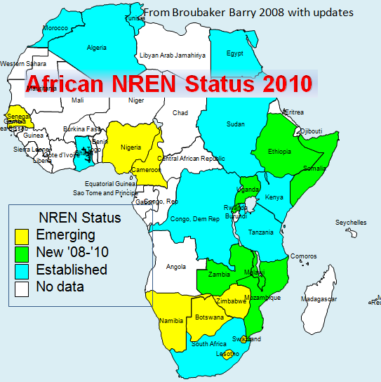
Next Steps: Let’s get together
Get leaders such as universities, academic establishments (teach the teachers) to get togeher to form NRENs for country
Bargain for cheaper rates
  BW most expensive worldwide ($4K/Mbps), dropping factor 2 in year
NRENS get together to create International eXchange Points (IXPs)
  Avoid intercountry links using expensive intercontinental links via Europe and the US
  Ubuntunet now connected to GEANT.
Notes:
See http://www.secondchurchcoventry.com/nrens-accessing-the-connectivity-revolution-for-education.html
Africa Connect for Sub-Saharan Africa GEANT-Ubuntunet-WACREN connectivity Eu14.75M over 4 years, May 11, 2011 see http://www.africaconnect.eu/MediaCentre/Pages/EC-fundedresearchinfrastructure.aspx

Slide 24
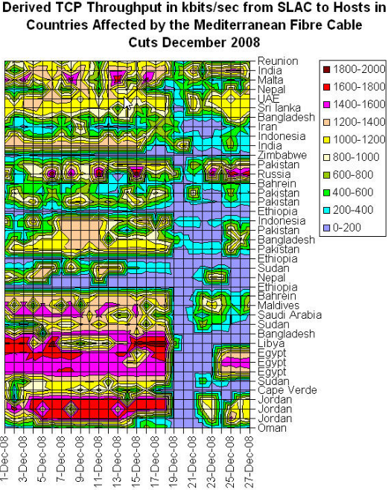
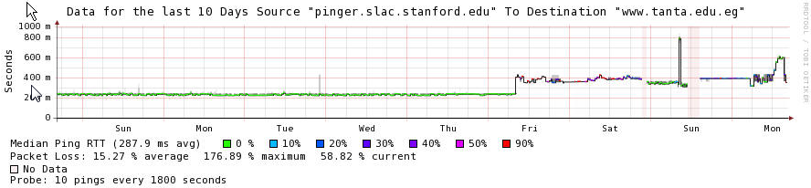
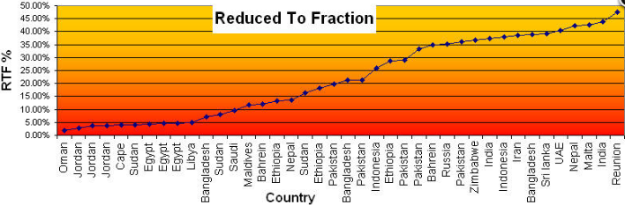
Example: Multiple routes important
Not only for competition
Need redundancy
Mediterranean Fibre cuts
  Jan 2008 and Dec 2008
  Reduced bandwidth by over 50% to over 20 countries
New cable France-Egypt Sep 1 ‘10
1000ms
Lost connection
200=>400msms
SLAC – www.tanta.edu.eg
50%
20%
0%
Notes:
For fibre cur see https://confluence.slac.stanford.edu/display/IEPM/Effects+of+Mediterranean+Fibre+Cuts+December+2008
Cyprus/France segment of Alexandros cable lit
Cyta has announced the commercial launch of the Cyprus-France segment of its new submarine cable subsystem Alexandros. The cable is the result of a strategic co-operation agreement between the Cypriot telco and Telecom Egypt (TE), under which Cyta participates on an ownership basis in ??’s submarine cable system TE NORTH (TEN), which connects Egypt with France. The TEN system has been constructed by Alcatel-Lucent and utilises eight fibre pairs with total capacity of more than 10Tbps. The system is equipped with branching units which enable it to be extended to selected countries in the Mediterranean, creating a communication bridge between Europe, Africa and Asia, as well as business opportunities in the Mediterranean and Eurasia.
Under the agreement, the TEN system has been extended to Cyprus via a direct branch and Cyta has acquired separate fibre pairs between Cyprus-Egypt and Cyprus-France, each with 96x10Gbps total capacity. The agreement also allows for an option of extending Alexandros to Greece. The Cyprus-Egypt segment of the subsystem will come into commercial operation in the coming few months, along with the rest of the TEN system.

Slide 25
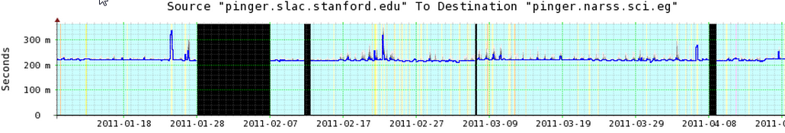
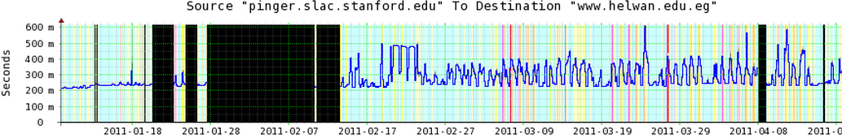
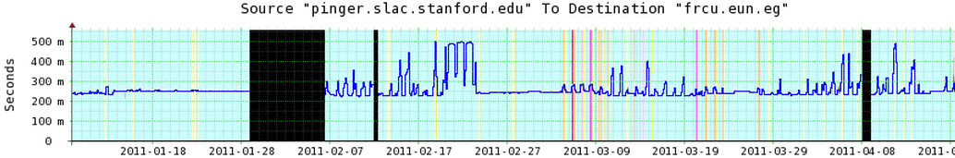
Example: N. African uprisings Jan ‘11
NARSS (Cairo)
23:59 Jan 27
Helwan (Cairo)
12:00 Jan 27
EUN (Cairo)
23:59 Jan 28
Impact varied: start time, recovery time, after effects
Egypt University Network (EUN) down least time
  NARSS via Alternet->Italy->Egypt, Helwan &EUN via PCCW Global
Libya first went dark 06:00 Feb 19 for 3 days, then again on Mar 4th more permanently
Algeria, Morocco, Tripoli not noticeable

Slide 26
Example: DRC (Democratic Republic of Congo)
WACS cable landed Moanda (DRC) & Point Noire (Congo Brazzaville) Feb ’11
Already 10Gbps fibre to capital Kinshasa (637km)
Fibre under construction to Brazzaville and
Kinshasa across R. Congo to Brazzaville
DRC NREN plan to connect 15 Kinshasa universities by fibre by Dec 2011
Today UniKin has 26K students has 8 public IP addresses 1.5Mbps download, 512kbps upload to Internet
Big changes are in store
Notes:
WACS Cable landed at Moanda on the coast of DRC on 18th February 2011 and on 19th February in Pointe Noire, on coast of Congo Brazzaville. The DRC has already built the national cable from Moanda to Kinshasa, 637 km long, a 10Gbps capacity cable, part of its national backbone. Congo Brazzaville is building its national cable from Pointe Noire to Brazzaville as well as its metropolitan ring in Brazzaville. There is a fibre between Kinshasa and Brazzaville under construction, so each of the two capitals can use the cable of the other country as redundancy if necessary. In Kinshasa, eb@le, the NREN of the DRC, has plans to put a ring of fibre connecting 15 universities by December of 2011. The cost (including optical equipment, laying and terminating the fibre) of this is under $1MUS (One Million USD).
Today UNIKIN has 8 public Internet addresses, the rest of the campus is connected via a NAT(s). The campus Internet link today is 1.5Mbps download, 512kbps upload. There are 26,000 students. There are about 800 PCs. There are about 200 users of the existing Internet. The core network is 1Gbps based on Cisco equipment. They have 5.14 km of optical cables around the campus. The University of Kinshasa is upgrading its LAN to 1 Gbps. As a member of eb@le, UNIKIN will soon receive from eb@le IP public addresses according to the number of its students. As soon as eb@le is connected to the Kinshasa-Moanda optical fibre, UNIKIN will enjoy from broadband width connection.
There are 2 dark fibres: one running from Kinshasa to Lubumbashi in the S.E. of the DRC; one other from Inga to Kasumbalesa via Lubumbashi. The Kasumbalesa path is shared with a power line. Kasumbalesa is a Congolese city at the border with Zambia. There is already a cable from the Zambian city in front of Kasumbalesa to South Africa (Powergrid cable).

Slide 27


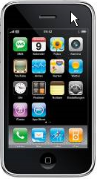
Conclusions
Many problems: electricity, skills, disease, wars, poverty, conflict, protectionist policies, corruption
  Current providers (cable and satellite) have a lot to loose
    Many of these have close links to regulators and governments (e.g. over 50% of ISPs in Africa are government controlled)
Attractions: enormous untapped, youthful market
Internet great enabler in information age
The fibre coming to Sub-Saharan Africa has
great potential to help catchup & leap forward
  Still last mile problems, and network fragility
  Leap frog: wireless replaces wired; OLPC/net computer, smart phones, tablets (iPADs) replace non mobile
Africa international bandwidth capacity increased 14 fold 2006-2010, prices are coming down, not as fast as hoped
  Yet still a long way to go: all Africa combined has less than one third as much international capacity as Austria alone.
Notes:
West Africa, for instance, now has (for the first time) a second submarine fibre-optic cable, and its bandwidth potential has now increased by six times or more. One ISP executive speculated that with new competition the ISP's megabit-per-second cost would fall from its current level, over $1600, to below $300 by next year. This would still be far more expensive than Internet connectivity in major developed countries, but it would be a fraction of the cost of last year, or even last month. http://www.helium.com/items/1941257-growth-of-the-internet-in-africa?page=2
Specifically, I covered how bandwidth has made it difficult for people to create new sites and services, but more importantly, how the uptake of those is limited by consumer use of the internet due to costs and speeds. This is changing though, as tracked and evidenced by the lowering data costs and increased bandwidth being piped into the continent each year.
I also covered the swiftly blurring lines between Mobile and web. How due to the fact that mobiles are the primary device for Africans and usually the first device that people have a meaningful interaction with the internet on, is creating a different type of user. How the entrepreneurs in Africa’s web space are thinking of it from a mobile context and how they build services to address their audience. Here I got into the argument of diffusion of internet penetration via the big international players like Facebook and Google through mobiles, which then open up infrastructure and cultural use making it more accessible to local startups. From http://whiteafrican.com/2011/02/12/ixda-and-designers-as-explorers/

Slide 28
More Information
Case Study:
  confluence.slac.stanford.edu/display/IEPM/New+E.+Coast+of+Africa+Fibre
Ubuntunet Alliance
  www.ubuntunet.net/
EU study on deploying regional backbone connecting NRENs
  http://www.feast-project.org/documents/
MANGO-NET (Made in Africa NGO NETwork)
  www.isgtw.org/?pid=1001999
Undersea fibre cables
  manypossibilities.net/african-undersea-cables
Cross country fibres
  www.cablemap.info

Slide 29
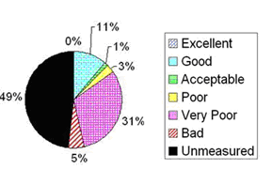
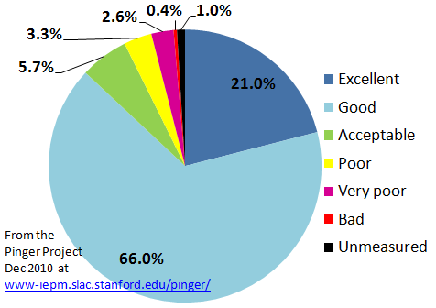
Loss Quality Vs. Population in 2008 vs. 2001
Loss Quality vs Population Jan 2010 – Dec 2010
2001
In 2001, only ~20% of the world had an Acceptable or Better Packet Loss Rate [49% unmeasured].
By 2010 this had
improved to ~93%.
What matters as much
now is throughput.

