Slide 1
SLAC Remote Access VPN over SSL
Technical Presentation with Q&A

Slide 2
When and Why Use VPN
Locations
Resources
Benefits
Visitor Wireless at SLAC
Home or Home Office
Travel
Servers or Applications Not Internet-Accessible
Network File Shares
Protects Your Network Traffic From Prying Eyes
Allows Remote Access to Off-Site Journals and Other Resources

Slide 3
Drivers And Decisions
Drivers
Decisions
IPSEC Increasingly Blocked at Hotspots/Hotels
Group-Based Security
Better Logging and Audit Trails Required
Network Infrastructure Service in Network Team (Potentially Better Aligned Than Windows Team)
Several Vendors Were Considered
Cisco is Market Leader in Government and Industry
Broad Support for Operating Systems and Mobile Devices
Established Relationship/Single Point of Contact
Lower Cost Than Equivalent Competitors

Slide 4
Cisco VPN Architecture (Overview of Features)
Modes
Fault-
Tolerance
Access
SSL With Client
SSL Clientless (Portal Site)
IPSEC (Currently not Utilized in New System)
Multiple Levels of Redundancy
Appliance Requires Less Downtime Than Servers
IPSEC (including older PPTP VPN) Often Blocked
SSL-Based VPN is Rarely Blocked Because it is Indistinguishable From Secure WWW Traffic

Slide 5
Cisco VPN Architecture (SSL Tunnel Specifics)
IP Details
Tunnels
Filters
Requires Only Port 443/TCP at Minimum
Can Use DTLS (Streaming UDP with Encryption)
Requires Only TCP/UDP Protocols (Unlike IPSEC)
Creates a Point-to-Point Tunnel
Ecryption is Transparent at Application Level
Access Control Lists Limit Access
All Traffic is Logged With Username and IP

Slide 6
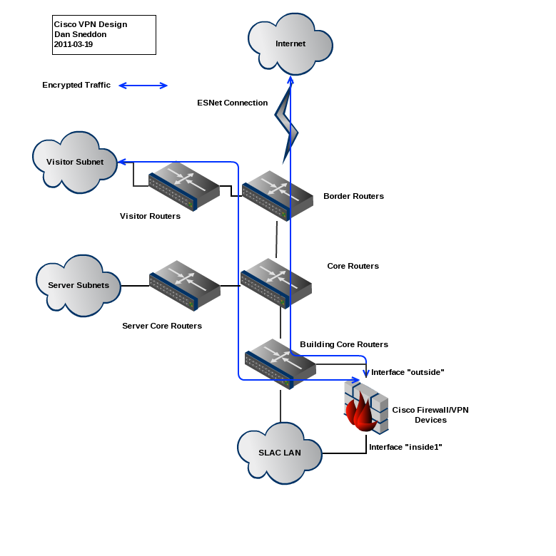
Cisco VPN Architecture (Diagram)

Slide 7
Comparison to Previous System (Microsoft PPTP)
Feature | Previous System | New System
Tunneling Protocol Used | PPTP over IPSEC | SSL with DTLS Extensions
Access Control Groups | All Users Same Security | Fine-Grained Access by Group Membership
Client Software | Included with OS | Client Required
Logging/Auditability | Minimal | Very Detailed
Locations Available | Increasingly Blocked | Anywhere Web is Available
Vendor Support for Client | Microsoft Windows Only | Windows, Mac, iOS, Linux, Solaris (Android TBA)
Diagnostic Reporting | Minimal | Extensive

Slide 8
Security Policy Discussion Q&A

Slide 9
Feedback
Forum For General Questions and Suggestions
RT Ticket or mail to net-admin@slac.stanford.edu
Confluence Documentation (Help Make it Better!)
Please Let Us Know How to Make VPN Useful for Scientific Computing and Other Specialized Users

