Slide 1
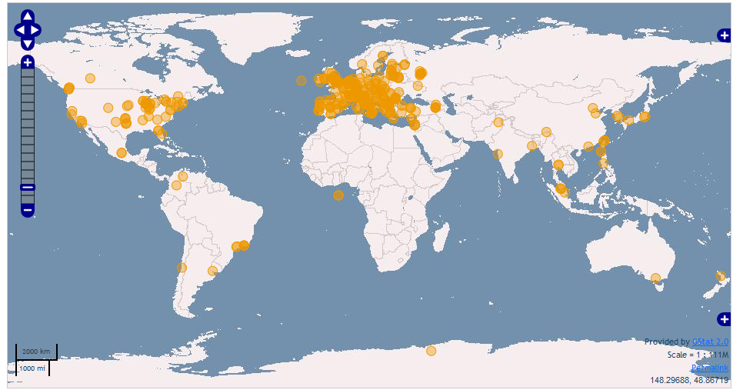
ICFA Standing Committee on Interregional Connectivity (SCIC)
Global Networks for HEP in 2010-11
Harvey B. Newman
California Institute of Technology ICFA Meeting in Beijing, February 2011
http://monalisa.caltech.edu:8080/Slides/Public/SCICReports2011Final

Slide 2
Monitoring the World’s Networks SCIC Monitoring Group (R. Cottrell et al.) Mapping the Digital Divide

Slide 3
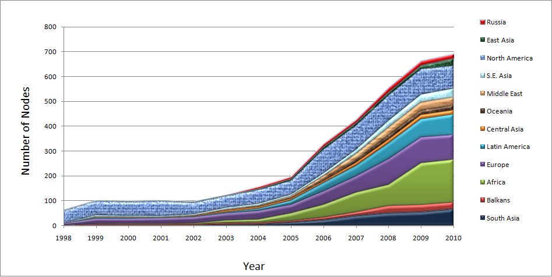
Number of Hosts Monitored By Region: 1998 - 2010
R. Cottrell
Latin America
Africa
Africa
Notes:
Note there are some countries we should not monitor since they do not have a full Internet connection, and hence may pay dearly by byte for traffic. These include:
Code Country Conn Notes Further information
++++++++++++++++++++++++++++++++++++++++++++++++++++++++++++++++++++++++++
AF Afghanistan(Islamic St.) P C
BV Bouvet Island
CX Christmas Island C
EH Western Sahara
FX France (European Ter.) France Metropolitaine
GS South Georgia and
South Sandwich Islands C
HM Heard & McDonald Isl. C
KP Korea (North) P
MH Marshall Islands C
MM Myanmar *
MS Montserrat C
NR Nauru
PM St. Pierre & Miquelon C
PN Pitcairn C
TF French Southern Terr. C
TK Tokelau
UM US Minor outlying Isl.
VC St.Vincent & Grenadines P
WF Wallis & Futuna Islands
YT Mayotte
ZR Dem. Rep. of Congo Deleted - Replaced by Code CD

Slide 4
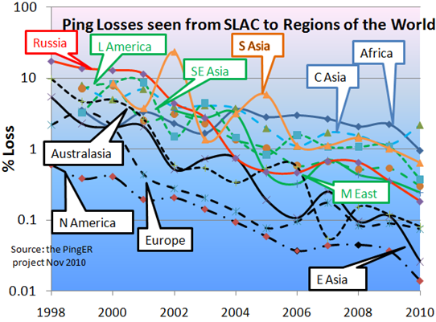
Packet Loss, from SLAC to the World 1998 - 2010

Slide 5
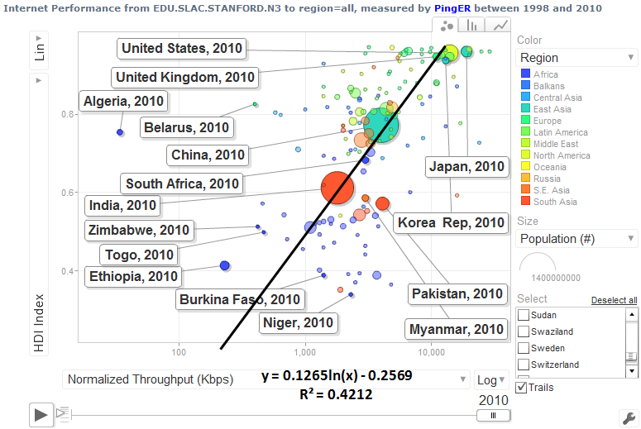
Normalized TCP Throughput in 2010 vs. UN Human Development Index (HDI)
UNDP HDI:
A long and healthy life, as measured by life expectancy at birth
Knowledge as measured by the adult literacy rate (with 2/3 weight) and the combined primary, secondary and tertiary growth enrollment ratio (with 1/3 weight)
A decent standard of living, as measured by GDP per capita
1.0
0.8
0.6
0.4
100k
1M
10M
Normalized Throughput (bps)
A Clear Correlation Between the UNDP HDI and the Throughput
Notes:
Dec 2003, 27% unmeasured, 1% bad, 5% v. poor, 4% poor, 46% acceptable, 17% Good.
Note this is not for a fixed set of hosts rather it tracks the sites measured. As time goes forward we add more and more sites in countries with poorer connectivity.

Slide 6
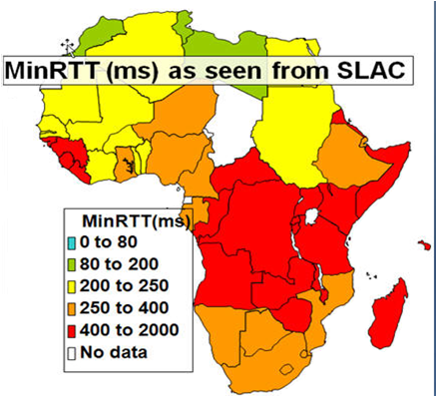
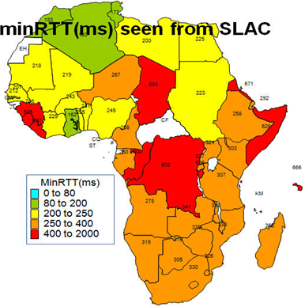
Apparent Reduction of RTT below 400ms, Impact of new Fiber / Terrestial routes
MinRTT(ms), 2009
MinRTT(ms) Sep-Nov 2010
R. Cottrell

Slide 7
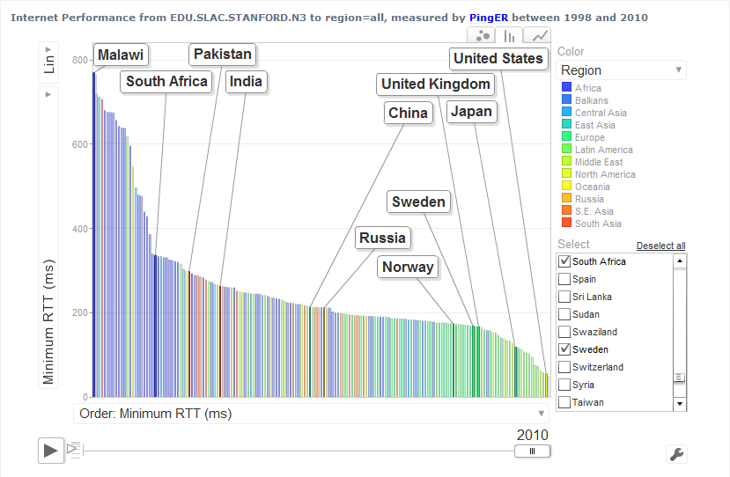
Minimum Round Trip Time (RTT) for From SLAC to Countries of the World September 2010
800 msec
Showing the effect of the use of Geo-stationary Satellites (270 msec and up)
Vs. Terrestrial fiber optic networks
600
400
200
R. Cottrell
2010

Slide 8
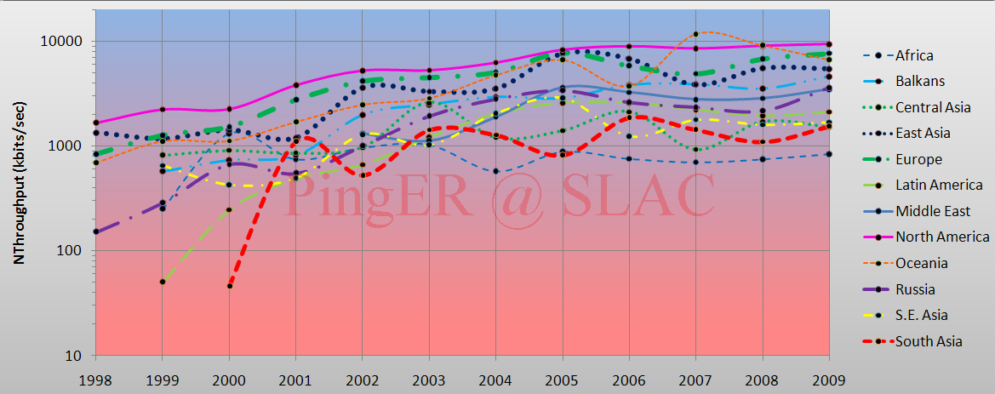
Normalized TCP Throughput Trends Seen from CERN 1998-2009
Little Improvement to Africa over the last eight years
R. Cottrell
Notes:
Dec 2003, 27% unmeasured, 1% bad, 5% v. poor, 4% poor, 46% acceptable, 17% Good.
Note this is not for a fixed set of hosts rather it tracks the sites measured. As time goes forward we add more and more sites in countries with poorer connectivity.

Slide 9
Derived Throughputs Within and Among World Regions (kbps), Nov 2010
Notes:
Dec 2003, 27% unmeasured, 1% bad, 5% v. poor, 4% poor, 46% acceptable, 17% Good.
Note this is not for a fixed set of hosts rather it tracks the sites measured. As time goes forward we add more and more sites in countries with poorer connectivity.

Slide 10
PingER Project Issue: Funding for Managing the Effort
The management and operation includes maintaining data collection and archiving, explaining needs, identifying and reopening broken connections, identifying and opening firewall blocks, finding replacement hosts, making limited special analyses and case studies, preparing and making presentations, responding to questions. The equipment performing this is currently in place at both SLAC and FNAL.
Management, operation and supervision requires central funding at a level of about 20% of a Full Time Equivalent (FTE) person, plus travel. This had been provided by discretionary funding from the HEP budgets of SLAC and FNAL, until the beginning of 2008.
Notes:
Dec 2003, 27% unmeasured, 1% bad, 5% v. poor, 4% poor, 46% acceptable, 17% Good.
Note this is not for a fixed set of hosts rather it tracks the sites measured. As time goes forward we add more and more sites in countries with poorer connectivity.

Slide 11
PingER: Uncertainty for the Future
Many agencies/organizations have expressed interest (e.g DoE, ESnet, NSF, ICFA, ICTP, IDRC, UNESCO, IHY) in this work but none have so far stepped up to funding the management and operation.
Without funding, for the operational side, the future of PingER and reports such as this one is unclear, and the level of effort sustained in previous years will not be possible.
Notes:
Dec 2003, 27% unmeasured, 1% bad, 5% v. poor, 4% poor, 46% acceptable, 17% Good.
Note this is not for a fixed set of hosts rather it tracks the sites measured. As time goes forward we add more and more sites in countries with poorer connectivity.

Slide 12
Key Network Report Updates, from 2010 to 2011
The addition of information from a new case study of the impact of newer terrestrial (sub-marine) fibres coming into production on the East and West Coasts of Africa (see Appendix A: Sub-Saharan Africa - Fibre Updates for year 2010).
Deployment of new PingER Monitoring nodes in Mexico, Nepal, Egypt and several in Pakistan. We now have ~ 70 active monitoring hosts (an increase of ~20 hosts since last year) in 22 countries. (see Appendix B: New PingER monitoring nodes in Egypt, Mexico, Nepal and Pakistan).
Deployment of PerfSONAR in Pakistan (see Appendix C: Deployment of PerfSONAR in Pakistan).
Management of TULIP active landmarks: adding and subtracting as they fail and recover (see Appendix E: Management of TULIP active landmarks).
Mention of 4 publications and 4 lectures (see 2010 Digital Divide Publications/Presentations).
Extension of the PingER archive/analysis/presentation toolkit for the host in Pakistan.

Slide 13
Accomplishments Since 2008
We have extended the measurements to cover more developing countries and to increase the number of hosts monitored in each developing country.
We have carefully evaluated the routes and minimum ping RTTs to verify that hosts are where they are identified to be in our database. As a result we have worked with contacts in relevant countries and sites to find alternatives, and about 20-30 hosts have been replaced by more appropriate hosts.
Since December of 2006, we have added a net of over 230 new remote hosts, and added 51 countries (Africa: BF, CD, CV, CI, DJ, GA, GM, GH, GW, LR, LY, MU, NA, SC, SL, SZ, TG, ZM; Balkans/S.E. Europe: BA, LV, MD; Central Asia: TM, Europe: AD, AT, BE, BG, CZ, FO, GI, LI, LU, SM, SE; Latin America: AN, BS, CO, CU, DO, NI; Middle East: AE, BH, OM, QA, SA; South East Asia: KH, LA, PH, TH; South Asia: AF, BT, MV).
While ping blocking is still a big problem as many hosts start blocking over time, no countries were lost this year.
Notes:
Dec 2003, 27% unmeasured, 1% bad, 5% v. poor, 4% poor, 46% acceptable, 17% Good.
Note this is not for a fixed set of hosts rather it tracks the sites measured. As time goes forward we add more and more sites in countries with poorer connectivity.

