Slide 1
Smartphones & other mobile computers
Les Cottrell – SLAC
University of Helwan / Egypt, Sept 18 – Oct 3, 2010
Partially funded by DOE/MICS Field Work Proposal on Internet End-to-end Performance Monitoring (IEPM), also supported by IUPAP

Slide 2
Overview
What is a smartphone, and their growth
Why are they important
How are they used
What’s coming
Other Mobile devices
Laptops, netbooks, smartbooks, tablets
WiFi
How it works
Protocols
WiFi and smartphones
Notes:
Also useful for hosts and security.

Slide 3
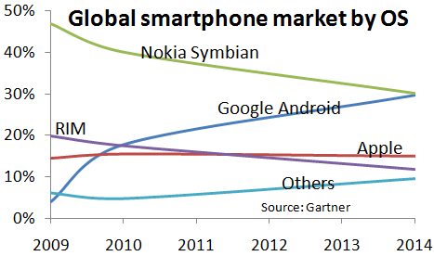
Smartphones
Smartphone is a phone that offers more advanced computing and connectivity capability than a regular feature phone
=handheld computer with a phone
First smartphone with Internet access introduced in late 1990’s by Nokia
Handsets evolving, adding email, larger screens, touch screens, qwerty keyboards, integrating cameras, voice recognition
Todays major players:
RIM, Nokia, Ericsson, Palm, Android, iPhone, Microsoft, Palm
Android catching up 200,000 sold / day (Eric Schmidt – Google 8/4/2010)

Slide 4
Smartphones and Apps
Mobile applications can not only be saleable, but that the best can become phenomena and superb revenue makers.
Market $25B by 2015
Apple claims 2.5B downloads last year

Slide 5
What’s next: Location based services
Location Based Services (LBS) is on the rise, and with iSuppli's recent forecast that 79.9% of Smartphones shipped by Q4 2011 will be GPS enabled it seems mass adoption is not far away.

Slide 6
What’s next: Mobile Payments
Mobile network operators, often in partnership with banks, card issuers and mobile payment service providers, developing platforms and apps to offer mobile payment services
The worldwide mobile payments volume – stood at USD 68.7 billion in 2009, up from USD 45.6 billion in 2008, and is set to surge nine-fold to reach USD 633.4 billion by end-2014.
In 2009, there were 81.3 million mobile payment users worldwide and this number is forecast to grow over six-fold to reach nearly 490 million by the end of 2014, i.e 8% worldwide penetration. From simple SMS-based services to advanced bar-coded tickets and beyond, mobile payment services have come a long way and yet still remain in a relatively nascent stage compared to other mobile services.

Slide 7
What’s next: Mobile payments
According to GSMA there will be 1.7M phone users by end 2012 who do not possess a formal bank account. The worldwide mobile payments market, including purchases of digital and physical goods, money transfers and NFC transactions, will grow from $170bn in 2010 to almost $630bn in 2014 according to Juniper Research.
In US AT&T, Verizon and T-Mobile teaming up with Discover Card and Barclays Bank to test system at stores in Atlanta & 3 other cities to let consumer pay with the contactless wave of a smartphone, thus replacing credit cards (1B in US consumer wallets). SJ Mercury Aug 3, 2010. Security (see later)

Slide 8
What’s next: sensory interfaces
New sensory interfaces: accelerometers, biometric sensors (fingerprints), magnetometers (digital compasses), GPS, gyroscopes, haptics, pico projectors, pressure sensors
Some key applications: augmented reality, gaming and navigation
ARCchart estimates combined shipments of these components will grow from 653 million units in 2009 to 4 billion by 2014. In terms of market value, we estimate that the revenue generated from the sale of these hardware sensors and sensory interfaces will more than triple by 2014, reaching $3.6 billion.

Slide 9
What’s next: Medical
Mobile health (mHealth) is a term used for the practice of medical and public health, supported by mobile devices. The term is most commonly used in reference to using mobile communication devices, such as mobile phones and PDAs, for health services and information.*
The Mobilizing for Healthsm grant program will fund U.S. based pilot research projects and ongoing studies in need of additional funding focused on mobile phone-based interventions for low-income patients with chronic diseases, with an immediate interest in diabetes management over the next two years. *Source: mHealth definition from Wikipedia.org, http://en.wikipedia.org/wiki/MHealth

Slide 10
What’s next: Medical
New apps to determine:
drug doses based on weight,
the size of endotracheal tube inserted down throat to help breathing (PediStat);
learn about rare conditions (Eponyms) also use Wikipedia;
to determine drug interactions (Epocrates);
learn about drug trials (Drug Trials);
breaking medical news; teaching tools
You have a whole medical library in the palm of your hand, 70% doctors use mobile phone 80% say it is essentials (the new stethoscope?)
Very important for remote areas

Slide 11
Smartphones not for everbody
Developing regions such as India have poor power, and little WiFi, or 3G
More important than smartphone capabilities are: large batteries with 5 day (30 day on standby)
Tailor to local tastes, multiple SIM cards and accounts, water resistent, FM radio, memory card pre-loaded with songs
Regular (feature) cell phone much cheaper
The dividing line between a feature phone and a smartphone is increasingly blurred

Slide 12
Other Mobile devices
Laptops
Netbooks
OLPC
Smartbooks
Tablets
iPads
Notes:
Refrigerators, washing machines, coffeemakers to communicate to repair techs,
MRI and CT machines to beam hi-res images to doctors or patients

Slide 13
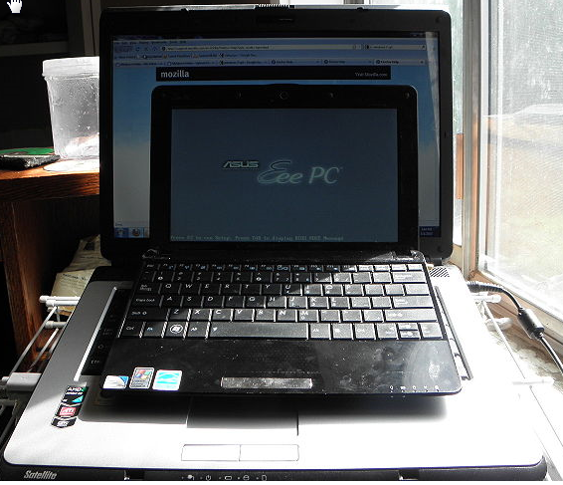
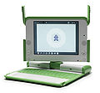
Laptops & Netbooks
Laptops: especially with docking stations displacing deskside computers
Dock for large screens
Asus Eee PC 1005HA & 15” laptop
Netbooks (kicked off 2007):
Longer battery life (ATOM & ARM chips), lighter (2-3lbs), smaller (screen 5”-10”), cheaper (<$400)
Slower, less built in peripherals
Mainly Winodws (96%), then Linux, Chrome OS, no Apple
Partially driven by OLPC,
Aimed at developing world, schools, frequent travelers
Kind of a marketing ploy
Squeezed between higher power laptops and tablets
OLPC
Notes:
Kicked off in 2007 by Asus' Eee PC 701, partly fueled by recession, consumers "were disappointed by flimsy keyboards, unfamiliar operating systems and a lack of programs that could be run on the machines." (This was most likely an allusion to many of the first-generation netbooks being Linux-powered.) "After a remarkable rise," he continued, "netbooks' popularity may already have peaked."

Slide 14
Smartbooks
Smartbooks:
mobile device falls between Cell phones and netbooks
battery life 1 day, uses lower power processor (e.g. ARM),
some have wireless or Internet access,
Amazon e-Books have already overtaken hardcover sales.
More general iPAD providing competition resulting in price slashing to under $200 (expect under $100 in 2011 for 6" model SJ Mercury 8/21/2010 page C3). Sales in 2010 expect 10 million after 4 million in 2009 (Austin research firm Display Search).

Slide 15
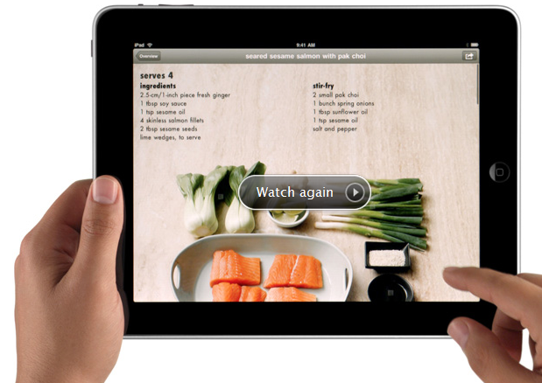
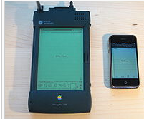
Tablets 1 of 2
iPAD timing just right:
Go introduced PenPoint pad in late 1980s with handwriting recognition (6 years and $75M in venture capital Go evaporated)
1993 Apple release the Newton, PDA, iPAD grandparent
Palm Developed Palm Pilot
Timing required faster processors, lower power, lower component costs, the Internet and robust wireless networks sports.tmcnet.com/news/2010/07/25/4918626.htm
Question what is the most popular processor in the world?
Notes:
ARM (Acorn RISC machine>Advance RISC machine, most popular processor in world with 1.5B sold annually)
Used in toasters, coffee machines, shower heads, treadmills, pens
Licensed by TI, Qualcom, Marvell, have hold on mobile market an area Intel has not pentrated
LG Electronics uses ATOM from Intel in signs that will recognize age, gender & other characteritsics of passer-by and change advertising pitch accordingly

Slide 16
Tablets 2 of 2
Forrester estimates tablets will outsell netbooks in US in 2013.
Sales expect to reach 6-9M by end 2010 (currently 3M = 5% projected netbooks sales in 2010).
iPAD designed as a media consumption, not creation, device for consumers, but also providing a unique mobile computing platform for business as well.
Some may leave the laptop at home and rely purely on the smartphone when traveling.
iPad could appeal to those who find traditional computing over complicated and daunting, e.g. kids & grand parents
iPad more closed (Apple own Appstore) than laptop/netbook.
See /www.networkworld.com/news/2010/090810-netbooks-vs-ipads----can.html for more on the relative positions
Notes:
Bloomberg reports that Wells Fargo has approved the iPad for business use, and that SAP AG, Tellabs Inc., and Daimler AG's Mercedes-Benz unit are all using the Apple iPad for various tasks ranging from e-mail access to empowering the mobile sales force with the tools to approve shipping orders or verify auto financing options. Apple has sold more than three million iPads already, and analysts estimate that it is on track to continue selling roughly two million more tablets per month. It's a lot of estimates and speculation, but if the AT&T statistic that four in ten iPhones are purchased for business use carries over to iPads, that would mean that 1.2 million of the iPads are currently being used for business purposes--and that 800k more are being added each month. A recent survey found that eight in ten business professionals rely on their smartphone as the primary business communication platform, and would rather give up coffee than surrender the smartphone. The survey also indicated that 34 percent of respondents use on the smartphone more than a PC for business
“When we were an agrarian nation, all cars were trucks because that’s what you needed on the farm.” Steve Jobs sees PCs as trucks that will be replaced by more consumer-friendly tablets that he likens to cars.

Slide 17
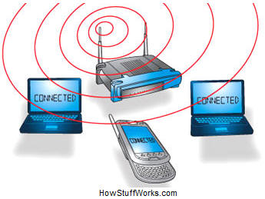
Don’ Forget WiFi
Internet
Need a wireless router, at work multiple units, in home a single unit containing:
A port to connect to your cable or DSL modem to connect to the Internet
A router
An Ethernet hub
A firewall for security
A wireless access point (AP) for wireless computers
At work AP gets Power over Ethernet (PoE)

Slide 18
WiFi how it works
Basically a 2 way radio
A computer's wireless adapter translates data into a radio signal and transmits it using an antenna.
A wireless router receives the signal and decodes it
The router sends the information to the Internet using a physical, wired Ethernet connection.
May provide power to the access point via Ethernet cable
In the home typically sends the data to the Internet via a DSL or cable connection
Frequencies
2.4Hz & 5GHz unlicensed RF spectrum ( so may interfere with uwave, cordless phones, video controllers etc).

Slide 19
WiFi protocols
Wifi becoming ubiquitous (hot spots at airports, stores such as Starbucks, starting to appear on airlines, trains in UK)
802.11a (55MHz, 5GHz, OFDM),
802.11b (11Mbps, 2.4Ghz, CCK),
802.11g (55Mbps typical 24Mbps, 2.4GHz, , OFDM)
802.11n (new standard published Oct 29 ’09 600MHz, 2.4GHz or 5Ghz) adds:
Reliability mesh networks, power adjustments, auto channel changing
Performance- uses 4 antennas, max 55Mbps => 600Mbps
Better security
What does this mean for wired connectivity?

Slide 20
WiFi & mobile phones
The number of phones shipped with Wi-Fi jumped to 139.3 million in 2009, up from 92.5 million in 2008,
ABI's research indicates that annual shipping number will surpass 500 million units by 2014, when 90 percent of all smartphones will have the technology.
At least one phone with 11n – Samsung's Wave – has been announced.
An 11n network is also more efficient, so the phone will expend less energy communicating http://www.networkworld.com/news/2010/032310-wi-fi-spreading-fast-among.html

Slide 21
Bandwidth
Bandwidth requirements for smartphones to download multimedia etc. are pushing the backhaul limits today
E.g .AT&T says listening to 2.5h/day of streamed music=2.2GB/month
Streaming a feature length film = 200MB
Providers stopping unlimited data plans, charge on volume

Slide 22
Beyond phones
Verizon looking at expanding use of 4G wireless (1.7Mbps => 10Mbps and beyond):
refrigerators, washing machines etc. to communicate with repair techs
wireless glucose, heart and other monitors for patients
MRI & CT scanners beam hi-res images to portable devices used by doctors
Autos, kids download video games and movies on back seat
Smart power meters

Slide 23
More Information
Wikipedia
http://en.wikipedia.org/wiki/Smartphone
Smartphone usage (from Nielsen)
http://blog.nielsen.com/nielsenwire/online_mobile/iphone-vs-android/

