Slide 1



Network Measurements
Les Cottrell – SLAC
University of Helwan / Egypt, Sept 18 – Oct 3, 2010
www.slac.stanford.edu/grp/scs/net/talk10/internet-measure.pptx
1

Slide 2
Overview
Why is measurement important?
LAN vs WAN
Passive
  SNMP, Netflow
  Effects of measurement interval
Active
  Tools various
    Ping, traceroute
    Available bandwidth, achievable bandwidth
PingER
Notes:
How do we measure the QoS
Introduction to PingER and active end-to-end measurement methodology
Problem areas illustrated by results from PingER:
Generally, e.g. S. America, Spain, China, Germany to .edu & .ca
How do E. Europe & Russia look?
How does performance affect applications
Validating ping measurements and impact on FTP & Web performance
Overview of impact of performance on applications including email, web, FTP, interactive apps
Detailed look at bulk data transfer expectations for HENP sites
Detailed look at critical performance metrics (RTT, loss, jitter, availability) and impact on VoIP
What can be done to improve QoS:
More bandwidth
Reserved bandwidth
Differentiated services

Slide 3
Why is measurement important?
End users & network managers need to be able to identify & track problems
Choosing an ISP, setting a realistic service level agreement, and verifying it is being met
Choosing routes when more than one is available
Setting expectations:
  Deciding which links need upgrading
  Deciding where to place collaboration components such as a regional computing center, software development
  How well will an application work (e.g. VoIP)

Slide 4
LAN vs WAN
Measuring the LAN
  Network admin has control so:
    Can read MIBs from devices
    Can within limits passively sniff traffic
    Know the routes between devices
      Manually for small networks
      Automated for large networks
Measuring the WAN
  No admin control, unless you are an ISP
    Cant read information out of routers
    May not be able to sniff/trace traffic due to privacy/security concerns
    Don’t know route details between points, may change, not under your control, may be able to deduce some of it
  So typically have to make do with what can be measured from end to end with very limited information from intermediates equipment hops.

Slide 5
Passive vs. Active Monitoring
Active injects traffic on demand, may be regular
Passive watches things as they happen
  Network device records information
    Packets, bytes, errors … kept in MIBs retrieved by SNMP
  Devices (e.g. probe) capture/watch packets as they pass
    Router, switch, sniffer, host in promiscuous (tcpdump)
Complementary to one another:
  Passive:
    does not inject extra traffic, measures real traffic
    Polling to gather data generates traffic, also gathers large amounts of data
  Active:
    provides explicit control on the generation of packets for measurement scenarios
    testing what you want, when you need it.
    Injects extra artificial traffic
Can do both, e.g. start active measurement and look at passively

Slide 6
Passive tools
SNMP
Hardware probes: e.g. Sniffer, can be stand-alone or remotely access from a central management station
Software probes: snoop, WireShark, tcpdump, require promiscous access to NIC card, i.e. root/sudo access
Flow measurement: SFlow, OCxMon/CoralReef, Cisco/Netflow

Slide 7
SNMP (Simple Network Management Protocol)
Example of a passive application, usually built on UDP
Defacto standard for network management
Created by IETF to address short term needs of TCP/IP
Consists of:
  Management Information Bases (MIBs)
    Store information about managed object (host, router, switch etc.) – system &status info, performance & configuration data
  Remote Network Monitoring (RMON) is a management tool for passively watching line traffic
  SNMP communication protocol to read out data and set parameters
    Polling protocol, manager asks questions & agent responds

Slide 8

SNMP Model
Agent
MIB
NMS contains manager software to send & receive SNMP messages to Agents
Agent is a software component residing on a managed node, responds to SNMP queries, performs updates & reports problems
MIB resides on nodes and at NMS and is a logical description of all network management data.
Agent
MIB
Agent
MIB
TCP/IP net
Agent
MIB
Agent
MIB
Agent
MIB
Network Management Station(NMS)

Slide 9
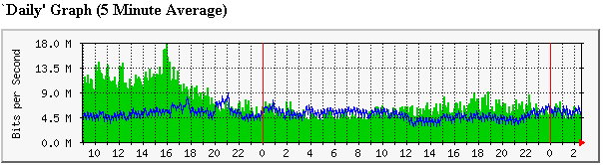
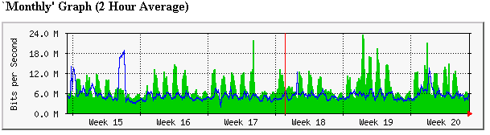
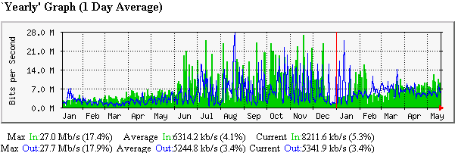
SNMP Examples
Using MRTG to display Router bits/s MIB variable
CERN
trans-
Atlantic
traffic

Slide 10
Averaging intervals
Typical measurements of utilization are made for 5 minute intervals or longer in order not to create much impact.
Interactive human interactions require second or sub-second response
So it is interesting to see the difference between measurement made with different time frames.

Slide 11
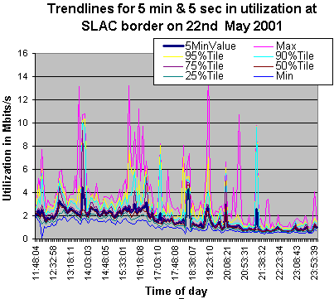
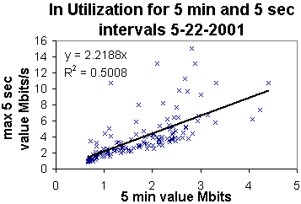
Averages vs maxima
Maximum of all 5 sec samples can be factor of 2 or more greater than the average over 5 minutes

Slide 12
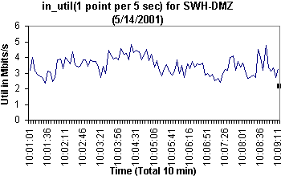
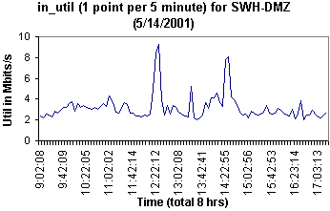
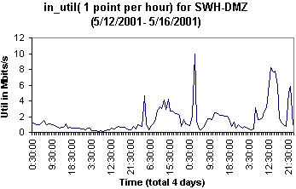
Utilization with different averaging times
5 secs
Same data, measured Mbits/s every 5 secs
Average over different time intervals
Does not get a lot smoother
May indicate multi-fractal behavior
5 mins
1 hour

Slide 13
Example: Passive site border monitoring
Use Cisco Netflow in Catalyst 6509 on SLAC border
Gather about 200MBytes/day of flow data
The raw data records include source and destination addresses and ports, the protocol, packet, octet and flow counts, and start and end times of the flows
  Much less detailed than saving headers of all packets, but good compromise
  Top talkers history and daily (from & to), tlds, vlans, protocol and application utilization
Use for network & security

Slide 14
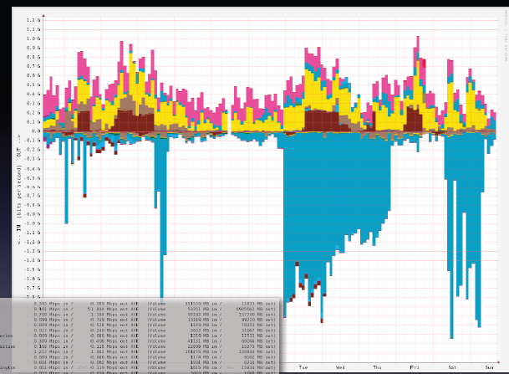
E.g.
SLAC Traffic by collaboration site
IN2P3
CNAF
1.0
0.0
1.0
MPI
OUT
IN
Gbits/s
BNL
(LHC ATLAS)
Last 2 weeks in May 2009

Slide 15
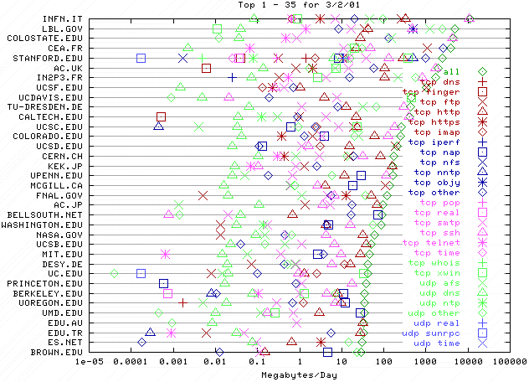
E.g. Top talkers by protocol
Hostname
Volume dominated by single
Application - bbftp
1
100
10000
MBytes/day (log scale)

Slide 16
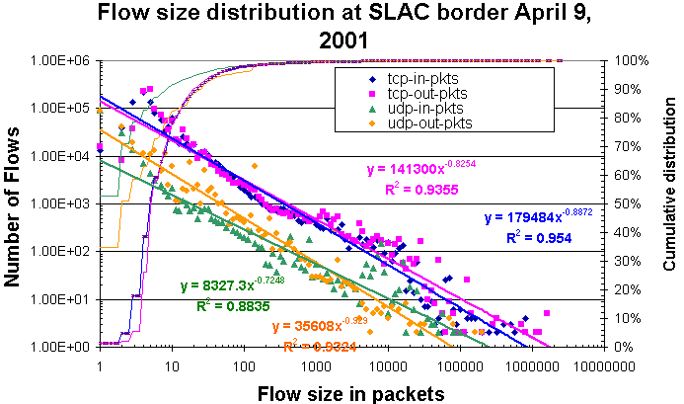
Flow sizes
SNMP
Real
A/V
AFS
file
server
Heavy tailed, in ~ out, UDP flows shorter than TCP, packet~bytes
75% TCP-in < 5kBytes, 75% TCP-out < 1.5kBytes (<10pkts)
UDP 80% < 600Bytes (75% < 3 pkts), ~10 * more TCP than UDP
Top UDP = AFS (>55%), Real(~25%), SNMP(~1.4%)
Just 2 parameters power law slope & intercept characterize traffic flows

Slide 17
Flow lengths
60% of TCP flows less than 1 second
Would expect TCP streams longer lived
  But 60% of UDP flows over 10 seconds, maybe due to heavy use of AFS

Slide 18
Some Active Measurement Tools
Ping connectivity, RTT, loss, jitter, reachability
  flavors of ping, fping
  but blocking & rate limiting
Alternative tcp ping, but can look like DoS attack
Traceroute
  How it works, what it provides
  Reverse traceroute servers
  Traceroute archives
Combining ping & traceroute,
  traceping, pingroute, mtr
Pathchar, pchar, pipechar, bprobe etc.
Iperf, netperf, ttcp, FTP …

Slide 19
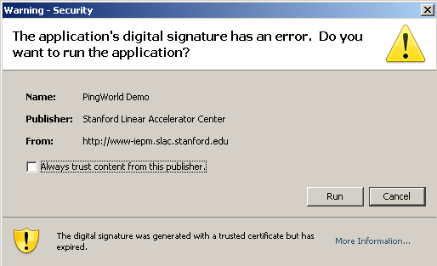
Ping from your own host to the world
www-iepm.slac.stanford.edu/tools/pingworld
  Linux:
  Windows:
Unless paranoid push Run on certificate warning

Slide 20
Traceroute technical details
Rough traceroute algorithm
ttl=1; #To 1st router
port=33434; #Starting UDP port
while we haven’t got UDP port unreachable & ttl<max {
send UDP packet to host:port with ttl
get response
if time exceeded note roundtrip time
else if UDP port unreachable
quit
print output
ttl++; port++
}
Can appear as a port scan
  SLAC about about one complaint every 2 weeks for its traceroute server, then added warning, no complaints now.

Slide 21
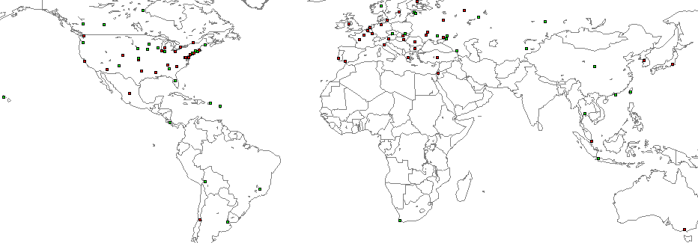
Reverse traceroute servers
Reverse traceroute server runs as CGI script in web server
Allow measurement of route from other end. Important for asymmetric routes. See e.g.
  www.slac.stanford.edu/comp/net/wan-mon/traceroute-srv.html
Also cities.lk.net/trlist.html#Lists
Visual Traceroute server: visualroute.visualware.com/
Map at www.caida.org/research/routing/reversetrace/ , however many hosts do not work

Slide 22
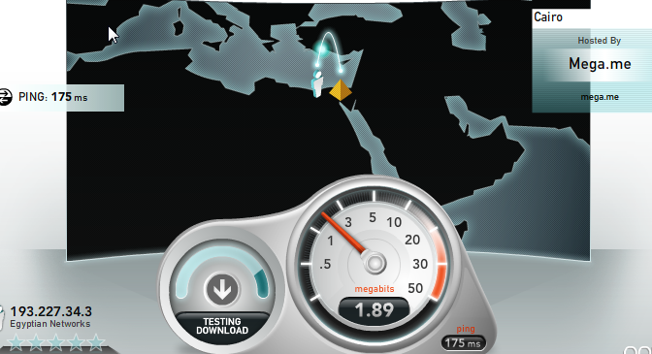
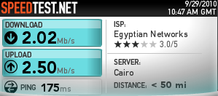
How is my host doing?
www.speedtest.net,also
www.bandwidth-test.net
For problem diagnosis also:
  netspeed.stanford.edu
    Special TCP kernel on server, Java on client
  Up & down link speeds + IDs:
    Duplex mismatch, excessive loss from faulty cables, checks for middle boxes, FWs; needs Java on client
    Also hints on setting TCP buffer sizes
SWMC Wifi

Slide 23
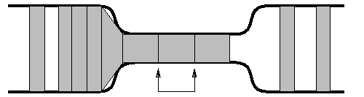
Path characterization
Pathchar
  sends multiple packets of varying sizes to each router along route
  measures minimum response time
  plot min RTT vs packet size to get bandwidth
  calculate differences to get individual hop characteristics
  measures for each hop: BW, queuing, delay/hop
  can take a long time
Pipechar (many derivatives)
  Also sends back-to-back packets and measures separation on return
  Much faster
  Finds bottleneck
Bottleneck
Min spacing
At bottleneck
Spacing preserved
On higher speed links

Slide 24
Network throughput
Iperf (& thrulay, netperf, ttcp…)
  Client generates & sends UDP or TCP packets
  Server receives receives packets
  Can select port, maximum window size, port , duration, Mbytes to send etc.
  Client/server communicate packets seen etc.
  Reports on throughput
    Requires sever to be installed at remote site, i.e. friendly administrators or logon account and password

Slide 25
Iperf example
25cottrell@flora06:~>iperf -p 5008 -w 512K -P 3 -c sunstats.cern.ch
------------------------------------------------------------
Client connecting to sunstats.cern.ch, TCP port 5008
TCP window size: 512 KByte
------------------------------------------------------------
[ 6] local 134.79.16.101 port 57582 connected with 192.65.185.20 port 5008
[ 5] local 134.79.16.101 port 57581 connected with 192.65.185.20 port 5008
[ 4] local 134.79.16.101 port 57580 connected with 192.65.185.20 port 5008
[ ID] Interval Transfer Bandwidth
[ 4] 0.0-10.3 sec 19.6 MBytes 15.3 Mbits/sec
[ 5] 0.0-10.3 sec 19.6 MBytes 15.3 Mbits/sec
[ 6] 0.0-10.3 sec 19.7 MBytes 15.3 Mbits/sec
Total throughput =3*15.3Mbits/s = 45.9Mbits/s
TCP port 5006
Max window size
3 parallel streams
Remote host

Slide 26
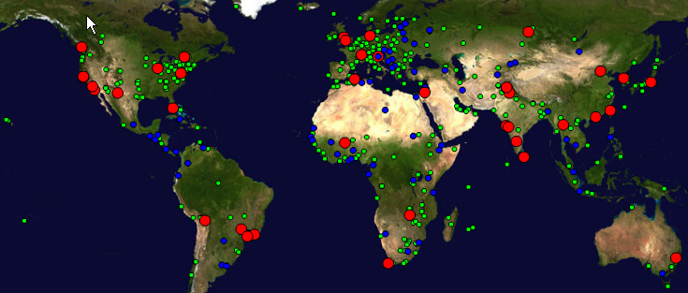
PingER
Monitors >40 in 23 countriesPI
  1 @ ICTP, 3 in Africa,
    Algeria, Burkina Faso, South Africa, (Zambia),
Beacons ~ 90
Remote sites (~740)
  50 African Countries
  ~ 99% of world’s population, >160 countries
Measurements go back to Jan-95
Reports on RTT, loss, reachability, jitter, reorders, duplicates …
Uses ubiquitous “ping”

Slide 27
PingER Methodology very Simple
>ping remhost
Uses ubiquitous ping
Internet
Monitoring
host
Remote
Host
(typically
a server)
10 ping request packets each 30 mins
Once a Day
Ping response packets
Data Repository @ SLAC
Measure Round Trip Time & Loss
27
27

Slide 28
Measures and Derivations
RTT, minimum RTT, distance dependent,
  Min RTT (no queuing), can detect satellites
jitter (ipdv), usually caused by edges
  Important for real-time predictability
Loss – big impact, mainly edges
Unreachability (all 10 pings do NOT respond),
  Host moved, name changed, unstable power , unreliable network
TCP thruput (kbps) ~ 1460*8(bits)/(RTT(ms)*sqrt(loss))
MOS = function(loss, RTT, jitter)
  Important for VoIP
See:
www-wanmon.slac.stanford.edu/cgi-wrap/pingtable.pl

Slide 29
www-wanmon.slac.stanford.edu/cgi-wrap/pingtable.pl
Choose metric, interval, size of ping, source destination
  Source & destination can be aggregates (e.g. country/region)
Table
  colored to indicate quality
  Can be sorted
  “.” Means no data
Can get to:
    Display “smokeping” graphs with details for last 6 months
  PingER map, performance maps, matrix of monitor to monitored sites, motion bubble chart

Slide 30
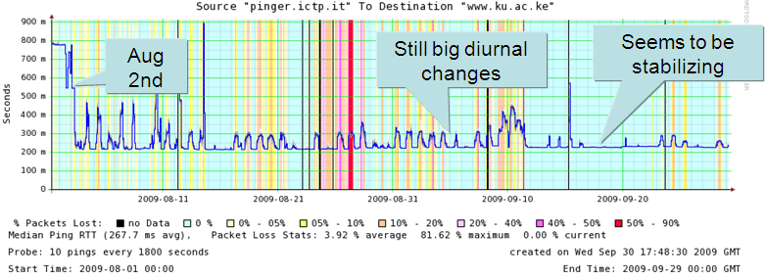
Example PingER Output ICTP>Kenya
Uses Smokeping
  Blue median RTT, background color = loss
  Smokiness = jitter
  Median RTT drops 780ms to 225ms, i.e. cut by 2/3rds (3.5 times improvement)

Slide 31
Map of PingER sites
http://www.slac.stanford.edu/comp/net/wan-mon/viper/pinger-coverage-gmap.html
Choose type of host interested in
Zoom in
Click on interesting host
  Get name, lat/long etc.

Slide 32
Maps of performance
http://www-iepm.slac.stanford.edu/pinger/intensity-maps/pinger-metrics-intensity-map.html
Choose metric
Scroll down to various regions

Slide 33
Motion Bubble charts
http://www-iepm.slac.stanford.edu/pinger/pinger-metrics-motion-chart.html
Choose metric for x & y axis and size of bubble
  RTT, min-RTT, jitter, throughput, loss, unreachability
  Internet penetration, internet users
  Population, CPI, HDI, DOI
Log/Lin axes
Playback to 1998
ID countries and trace their performance with time
Regions identified by colors
Bar and line charts too, try min-RTT

Slide 34
More Information
Tutorial on monitoring (getting a bit dusty)
  www.slac.stanford.edu/comp/net/wan-mon/tutorial.html
RFC 2151 on Internet tools
  www.freesoft.org/CIE/RFC/Orig/rfc2151.txt
Network monitoring tools
  www.slac.stanford.edu/xorg/nmtf/nmtf-tools.html
Ping
  http://www.ping127001.com/pingpage.htm
IEPM/PingER home site
  www-iepm.slac.stanford.edu/pinger
IEEE Communications, May 2000, Vol 38, No 5, pp 130-136

Slide 35
More Slides

Slide 36
How to Diagnose with Ping
to localhost (127.0.0.1),
ping to gateway (use route or traceroute (tracert on Windows) to find gateway),
ping to well known host
& to relevant remote host
  Use IP address to avoid nameserver problems
  Look for connectivity, loss, RTT, jitter, dups
  May need to run for a long time to see some pathologies (e.g. bursty loss due to DSL loss of sync)
  Try flood pings if suspect rate limited
  Use telnet- see if blocked; synack if ICMP blocked
    www-iepm.slac.stanford.edu/tools/synack/

Slide 37
Main Ping Unreachable Messages
Not ICMP but DNS not resolving name gives Unknown Host
ICMPCode Value | Message Subtype | Description
0/1 | Network/host Unreachable | The datagram could not be delivered to the network specified in the network ID portion of the IP address/specific host. Usually means a problem with routing but could also be caused by a bad address.
7 | Destination Host Unknown | The host specified is not known. This is usually generated by a router local to the destination host and usually means a bad address.
9/10 | Communication with Destination Network/Host is Administratively Prohibited | The source device is not allowed to send to the network where the destination device is located/is allowed to send to the network where the destination device is located, but not that particular device.
13 | Communication Administratively Prohibited | The datagram could not be forwarded due to filtering that blocks the message based on its contents.

Slide 38
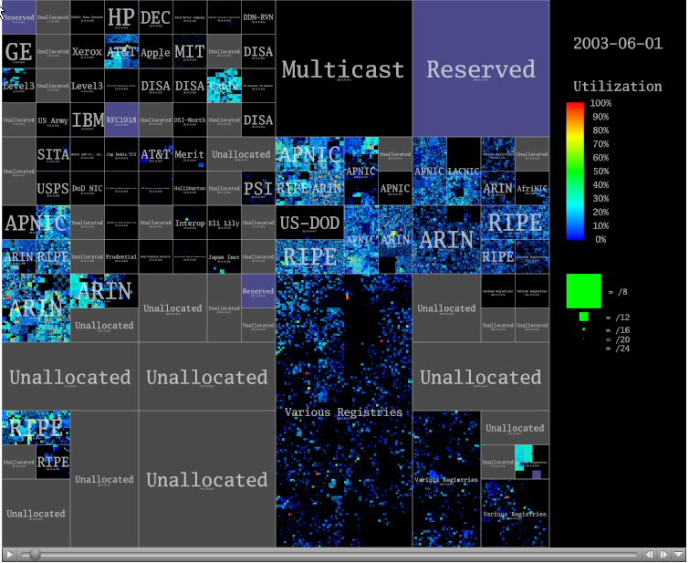
IP Addresses pingable June 2003
Grey= not allocated
Black= not pingable
Companies own class A

Slide 39
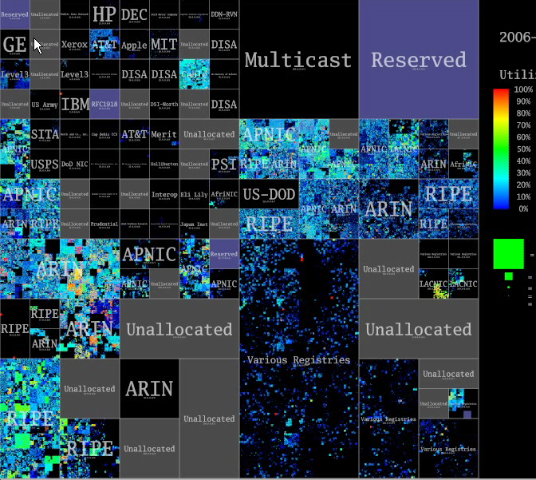
Growth 2003-2006
More areas allocated,
Existing areas more colorful
June 2003
Nov 2006

Slide 40
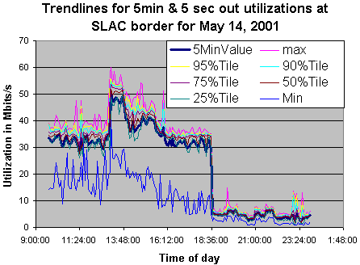
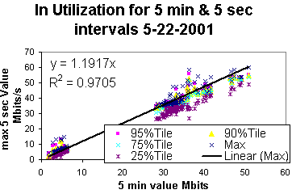
Lot of heavy FTP activity
The difference depends on traffic
Only 20% difference in max & average

Slide 41
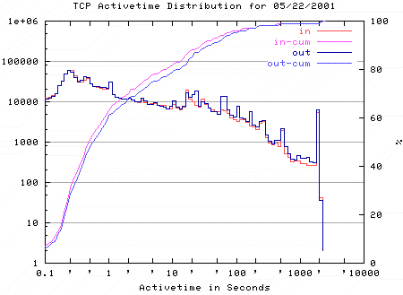
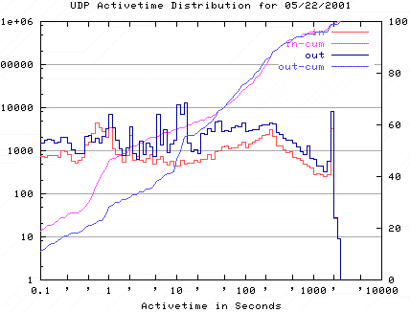
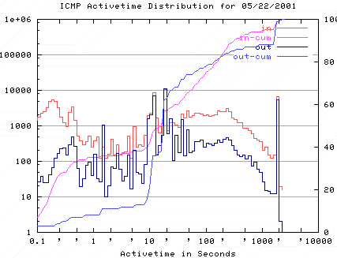
Flow lengths
Distribution of netflow lengths for SLAC border
  Log-log plots, linear trendline = power law
  Netflow ties off flows after 30 minutes
  TCP, UDP & ICMP “flows” are ~log-log linear for longer (hundreds to 1500 seconds) flows (heavy-tails)
  There are some peaks in TCP distributions, timeouts?
    Web server CGI script timeouts (300s), TCP connection establishment (default 75s), TIME_WAIT (default 240s), tcp_fin_wait (default 675s)
ICMP
TCP
UDP

Slide 42
Ping
ICMP client/server application built on IP
  Client send ICMP echo request, server sends reply
  Server usually in kernel, so reliable & fast
User can specify number of data bytes. Client puts timestamp in data bytes. Compares timestamp with time when echo comes back to get RTT
Many flavors (e.g. fping) and options
  packet length, number of tries, timeout, separation …
Ping localhost (127.0.0.1) first, then gateway IP address etc.
0
8
16
24
31
Type=8
Code
Checksum
Identifier
Sequence number
Optional data

