Slide 1
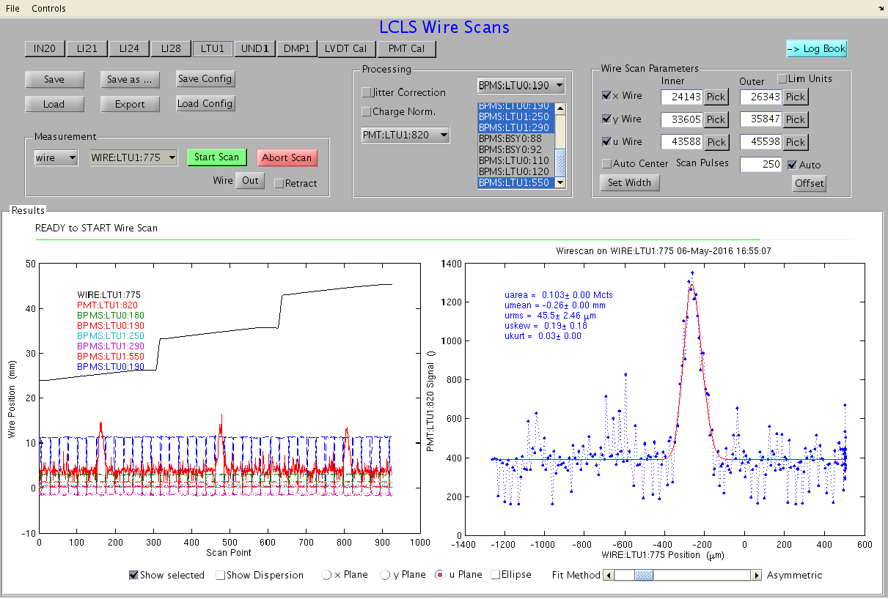
MAD & Oracle to Control System
File
Key
Process
File based w/r
User
Protocol based comms.
CVS/V drive
Poonam/
Andrea
Oracle
db
LFD/EED people typically update the Oracle db through a web interface, with device names and status.
MAD
official model deck.
MAD
output “tape” files
MAD
output “tape” files
Mark
MAD
Beampath builder
Tim/
Kristi
IOC db files define the Process Variables of the control system
IOC db files
Beampath files combine model elements and control system device names from Oracle
Beampath files
IOC db files
EPICS 7 Infrastructure Service interfaces Oracle directly to EPICS for HLA apps etc. Eg magnet polynomials, device status etc.
Beampath files
IOC db files
MAD to Matlab
Gen and X-ray match
MAD to Bmad
translator
William
Chris/Matt
Greg
Matlab Online model
Bmad Online model Service
Control System Simulation “Simulacrum” Services
Directory Service
Infrastructure Service
EPICS 7 Directory service knows the PV-device-beampath topology of accelerator
High Level Physics applications diagnose and optimize the accelerator, combining model, geometry, PV names and PV values.
IOC
IOC
IOC
LCLS Control System
Greg White

