Slide 1
ACR – Screen Sharing Zoom
Ken Brobeck
14-Jul-2020

Slide 2
ACR Screen Sharing
Overview
Network Design
Implementation
Squid Proxy
Outstanding Issues
Summary

Slide 3
Overview
COVID-19 issues (SIP)
Re-commission LCLS while keeping the number of people in the ACR to a minimum
Physicists and engineers work remotely
Operators in ACR (COVID-19 rules)
OPIs have limited access to Internet (DMZ)
Request:
Ability to share OPIs screens in ACR with the remote physicists (Zoom)
Physicists want to see what the Operators see

Slide 4
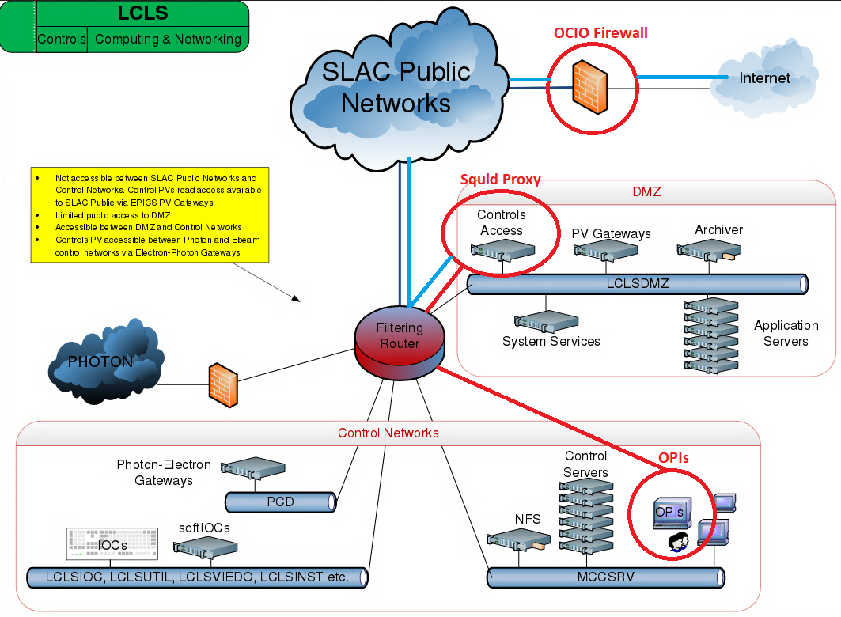
Network Design

Slide 5
Implementation
OPIs (Firefox) – Squid Proxy – OCIO Firewall – Internet
Modify the Access Control List (ACLs) on Squid Proxy to allow access to Zoom and all sites required by Zoom
Added 13 ACL changes to Squid Proxy
Work with OCIO Network and Cyber Security
Modify Firewall ACLs to allow lcls-prod03 (Squid) access to specific sites for Zoom – While still keeping us protected

Slide 6
Squid Proxy Server
Unix-based proxy server that caches Internet content
Improve the speed of the web server by caching frequently requested web pages as well as media files
Excellent access control features
Access Control Lists (ACL)
SRC, DST, File types, etc…
User account access, website or url, ip address, or DNS blocking or restriction

Slide 7
Outstanding Issues
Users must use the Zoom phone service and not computer audio
No audio configured on OPI
Our Version of Firefox does not support Zoom audio
Chat does not work (offsite)
Open ticket with Stanford.zoom.us to troubleshoot

Slide 8
Summary
OPS can open up Zoom sessions
https://stanford.zoom.us
Share desktop
Must use phone service
Chat works from within ACR – Not off site
NOTE:
Opened up https://slac.slack.com in proxy and firewall

