Slide 1
Stanford Graduate Student Orientation 2016 SLAC Session - Introduction
Ariel Schwartzman
Aaron Roodman, PPA faculty chair
David MacFarlane, Senior Associated Dean

Slide 2
The Stanford Physics Community
School of Humanities & Sciences
School of SLAC
A complex structure,
but also means
more opportunities.
You can choose faculty
advisors from
4 departments
SLAC as a national lab
and also an academic
school is unique to
Stanford/SLAC
1st year rotations may help
you steer through the maze…
Particle
Physics &
Astrophysics
(PPA)
KIPAC
Physics
Department
Accelerator
Applied
Physics
Department
Photon
Science
SLAC Dean
is Director
Chi-Chang Kao

Slide 3
Resources at SLAC
The vast resources of a national lab available to you to take advantage of for your own education
Accelerator facilities
Computing and software expertise
Engineering expertise
Schools, Workshops, Meetings, Talks
Marguerite shuttles operate 7:30am~8:30pm
between campus and SLAC ~every 20min
during week days.

Slide 4
Research at SLAC
The diverse research activities at SLAC are summarized
at https://www6.slac.stanford.edu/research
Astrophysics and cosmology
Elementary particle physics
Accelerator Research
Biology
Environmental Science
Materials, Chemistry & Energy Sciences

Slide 5
SLAC Contacts and Information
SLAC PPA faculty:
Chair: Prof. Aaron Roodman
Graduate Student Program: Prof. Ariel Schwartzman
Graduate Student Support: Judy Meo
List of Faculty: https://ppa.slac.stanford.edu/ppa-faculty
Research information:
PPA student info: http://www.slac.stanford.edu/gen/grad/
SLAC Photon Science faculty:
Senior Associate Dean: David MacFarlane
List of faculty http://home.slac.stanford.edu/photonScienceFaculty.html
Research information:
https://www6.slac.stanford.edu/about/organization/photon-science.aspx

Slide 6
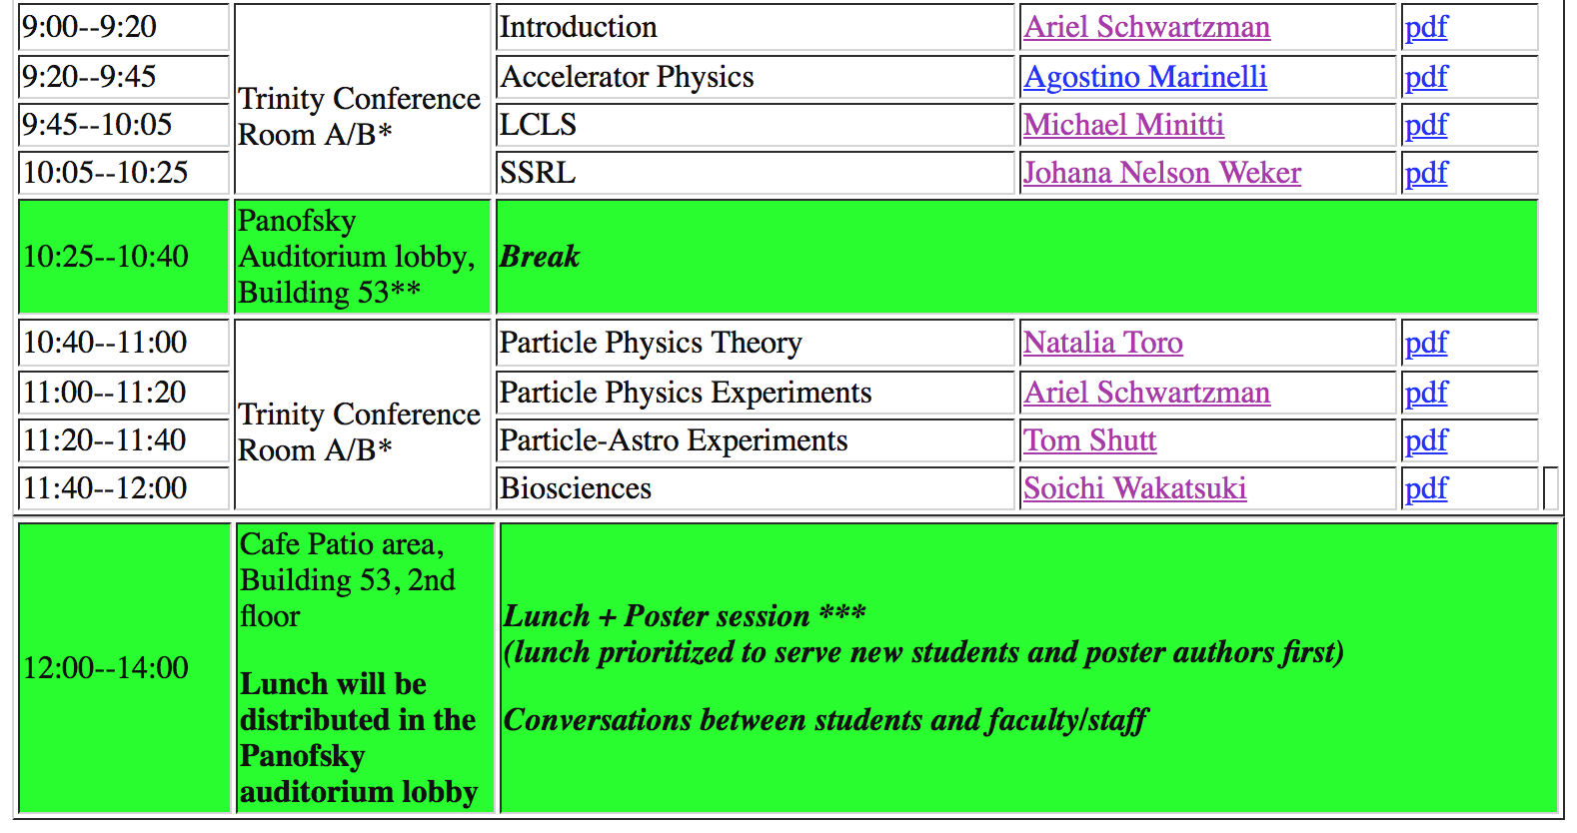
SLAC Orientation Program
2-5pm: tours and open office/lab:
http://www.slac.stanford.edu/gen/grad/orientation2016/

Slide 7
SLAC Orientation Program
Tours
LCLS X-ray Free Electron Laser facility (Alan Fry, 2-3pm)
CDMS Cryogenic Test Facility (Richard Partridge, 2-3pm)
IR2: LSST, LZ (Dan Akerib, 4-5pm)
KIPAC Visualization Lab (Risa Wechsler, 3–4pm)

