Slide 1
Recent results from the
OPERA experiment
Maximiliano Sioli (Bologna University and INFN)
on behalf of the OPERA Collaboration
SLAC Experimental Seminar - June 22, 2010

Slide 2











The OPERA Collaboration
Belgium
IIHE Brussels
Bulgaria
Sofia
Croatia
IRB Zagreb
France
LAPP Annecy, IPNL Lyon, IRES Strasbourg
Germany
Hamburg, Münster, Rostock
Israel
Technion Haifa
Italy
Bari, Bologna, LNF Frascati, L’Aquila, LNGS, Naples, Padova, Rome La Sapienza, Salerno
Japan
Aichi, Kobe, Nagoya, Toho, Utsunomiya
Korea
Jinju
Russia
INR Moscow, NPI Moscow, ITEP Moscow, SINP MSU Moscow, JINR Dubna, Obninsk
Switzerland
Bern, Zurich
Turkey
METU Ankara

Slide 3
Outline
Introduction
The OPERA experiment
  The physics case
  Detector description
Experimental results
  Oscillation physics
    → First ν_{τ} candidate event
  Non-Oscillation physics
    → Atmospheric muon charge ratio
Conclusions
Submitted to Physics Letters B
(Accepted Jun11, 2010)
arXiv:1006.1623
Published in EPJC 67 (2010) 25
arXiv:1003.1907

Slide 4
Introduction
In the last decades several experiments provided evidence for neutrino oscillations: conversion in-flight of lepton flavor
  Quantum-mechanical interference phenomenon
  Need SM extensions
  Solar, atmospheric, artificial beams: all disappearance experiments (or indirect appearance, e.g. SNO)
The OPERA experiment was mainly designed to unambiguously prove the oscillation phenomenon through direct ν_{τ} appearance
  Definitely close of the discovery phase of neutrino oscillations
The detector - although optimized for beam neutrino detection - can also be exploited for non-oscillation studies
  Cosmic ray physics at the Gran Sasso Lab.

Slide 5
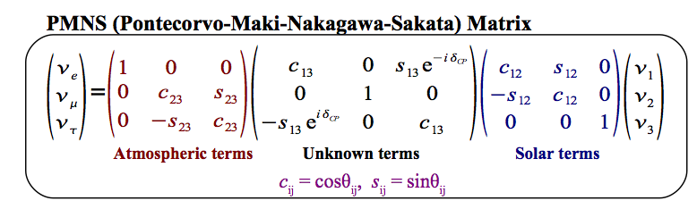
OPERA
Oscillation Project with Emulsion tRacking Apparatus
Long baseline neutrino oscillation experiment:
search for tau neutrino appearance at Gran Sasso laboratory
in a quasi-pure muon neutrino beam produced at CERN (732 km)
dominant
channel

Slide 6
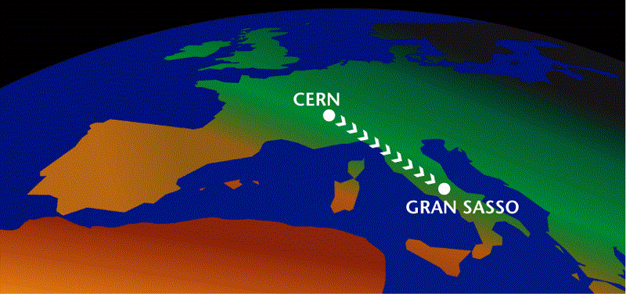


CNGS
CERN Neutrino to Gran Sasso beam
732 km
Protons from SPS: 400 GeV/c
Cycle length: 6 s
2 extractions separated by 50 ms
Pulse length: 10.5 ms
Beam intensity: 2.4 10¹³ proton/extr.

Slide 7
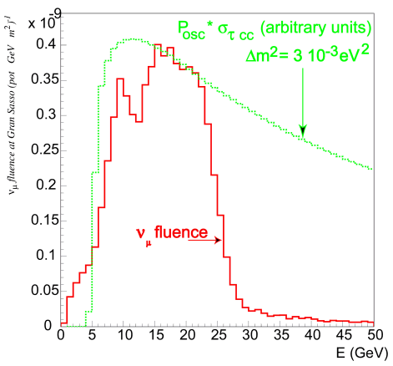
CNGS
CERN Neutrino to Gran Sasso beam
CNGS beam optimized for ν_{τ} appearance, i.e. optimized for the maximal number of ν_{τ} charged current interactions: ν_{μ} flux spectrum above τ threshold. Taken into account the ν_{τ} CC cross section → ν_{μ} flux “off peak” w.r.t the maximum oscillation probability.
Beam main features
L | 732 km
<E_{ν}> | 17 GeV
(ν_{e}+ν_{e})/ν_{μ} | 0.87%
ν_{μ} / ν_{μ} | 2.1%
ν_{τ} prompt | negligible
Limiting for ν_{μ} ◊ ν_{e} searches
“off peak”
(ν_{μ}^{CC})

Slide 8
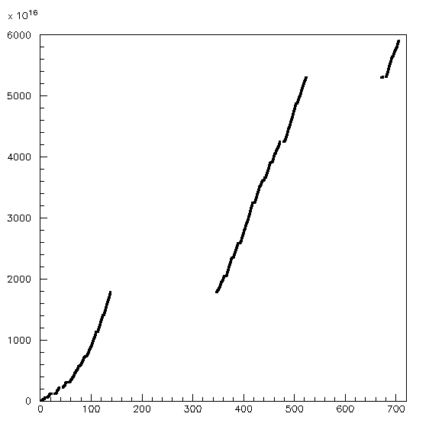
CNGS PERFORMANCE
2006 | 0.076x10¹⁹ pot | no bricks | Commissioning
2007 | 0.082x10¹⁹ pot | 38 ev. | Commissioning
2008 | 1.78x10¹⁹ pot | 1698 ev. | First physics run
2009 | 3.52x10¹⁹ pot | 3693 ev. | Physics run
2010 | 0.60x10¹⁹ pot (23 May) | 579 ev. | Physics run
2010
5970 events collected until 23 May 2010 (within 1σ in agreement with what expected on the basis of pots)
Improving features, high CNGS efficiency (97% in 2008-2009)
2010: close to nominal year
Aim at high-intensity runs in 2011 and 2012
2009
2008
Days
Notes:
MTE

Slide 9
Detection of ν_{τ}’s
Decay “kink”
ν
The challenge is to discriminate ν_{τ} interactions
from ν_{μ} interactions:
identify τ leptons via their decay topology
ν_{μ}
oscillation
μ⁻
τ⁻
ν_{τ}
~1 mm
μ⁻ ν_{τ} ν_{μ}
h⁻ ν_{τ} n(π^{ο})
e⁻ ν_{τ} ν_{e}
π⁺ π⁻ π⁻ ν_{τ} n(π^{ο})
B. R. ~ 17%
μ⁻
ν_{μ}
B. R. ~ 50%
ν_{μ}
B. R. ~ 18%
B. R. ~ 14%
Two conflicting requirements:
➔ Large mass ~O(kton)
signal selection background rejection ➔ High granularity ~1μm resolution
ECC concept adopted

Slide 10
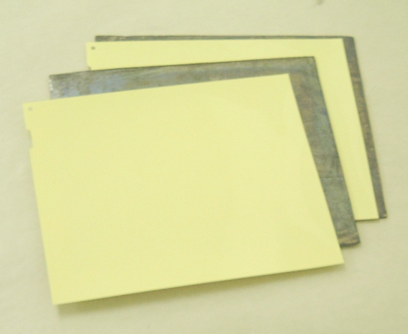
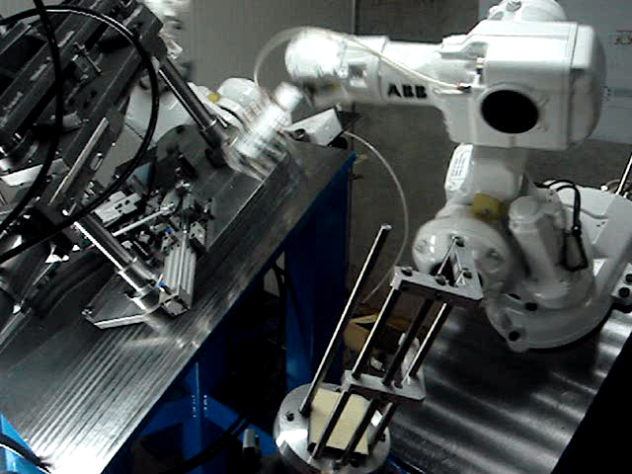
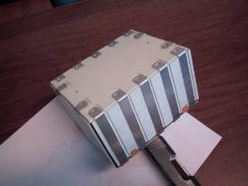
Emulsion Cloud Chambers
ECC = sequence of emulsion-lead layers
  High resolution and large mass in a modular way
The brick is the target basic component
  57 nuclear emulsion films interleaved with 1 mm thick lead plates
~150000 bricks (1.25 ktons)
99.0 mm
124.6 mm
Emulsion resolution:
δx = 1 µm
δθ = 2 mrad
8.3 Kg

Slide 11

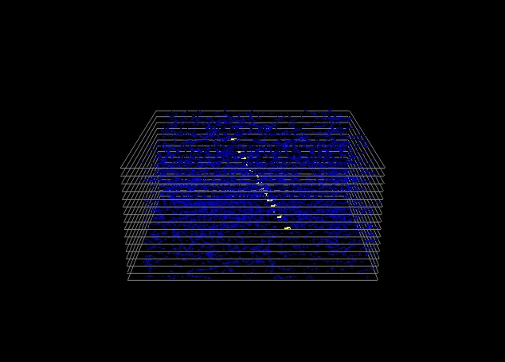
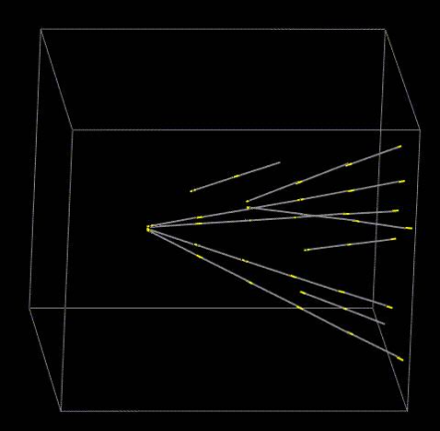
ECC event reconstruction
Automated emulsion scanning: based on the tomographic acquisition of emulsion layers.
15 tomographic views
Field of view
44 μm
44 μm
390 μm × 310 μm
Scanning speed: 20 cm²/h
Track segment: aligned clusters
Passing-through tracks rejection
Track segments found in 8 consecutive plates
Vertex reconstruction in the brick

Slide 12
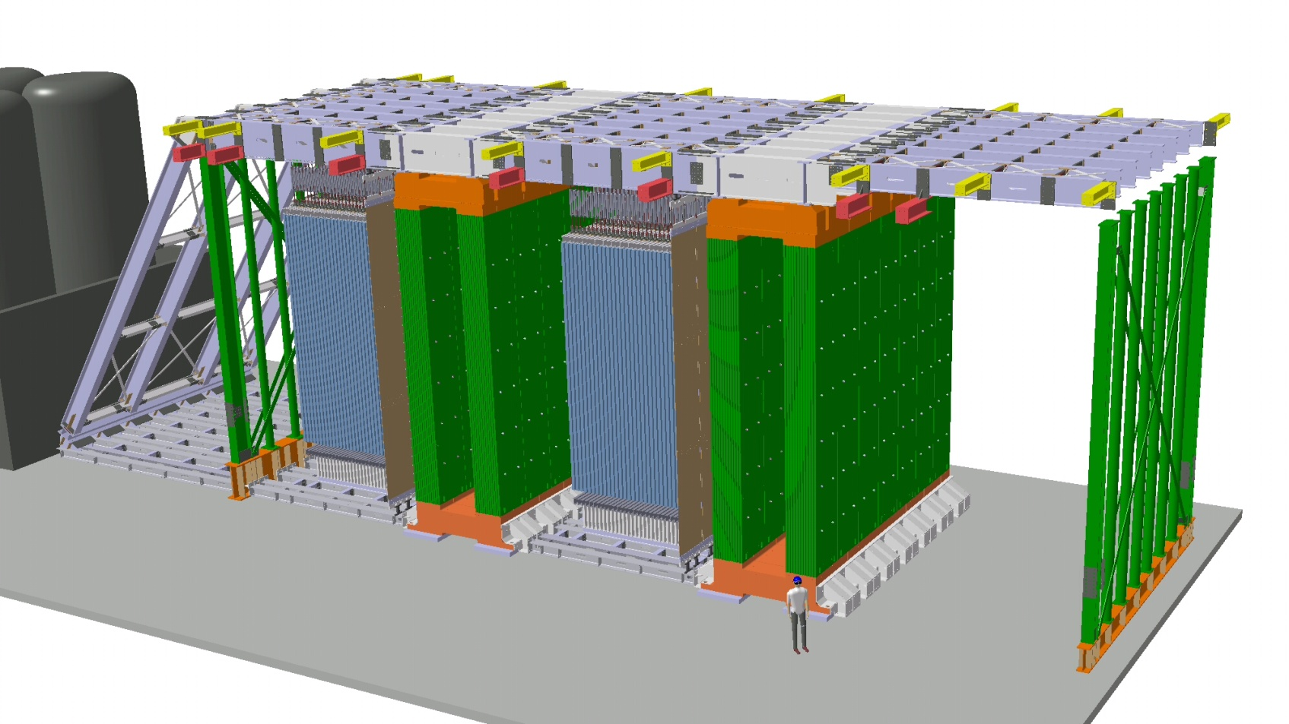
OPERA general structure
Target SuperModule
(side view)
Target sections (6.7 m²):
75000 bricks/SM
31 Target Tracker walls (TT)
ν
Brick selection
Calorimetry
10m
Magnetic spectrometers
(6×10 m²):
22 RPC planes
6 drift tube planes
B = 1.53 T
10m
20m
Total target mass = 1.25 ktons

Slide 13
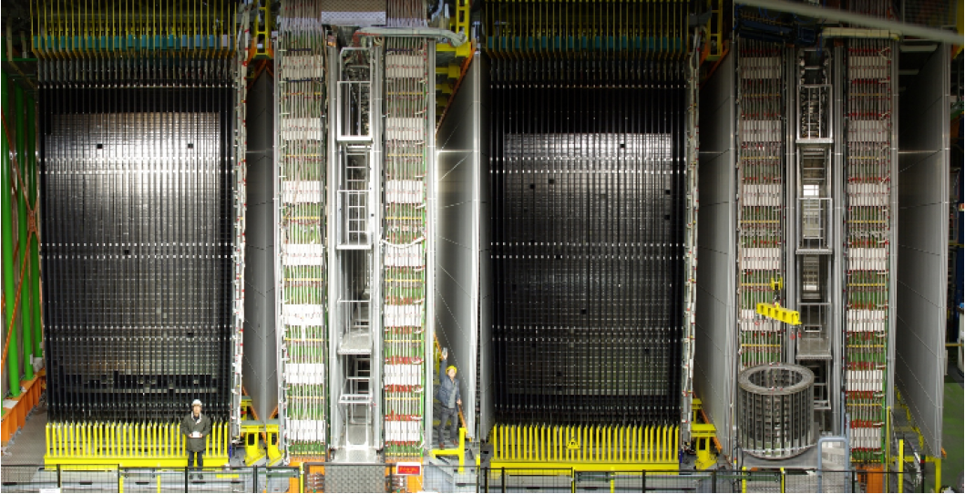
The OPERA detector
SM2
High Precision Tracker
(6 drift tube stations)
Instrumented dipole magnet
(22 RPC planes in total)
Bricks (lead + emulsions) and Target Tracker (plastic scintillators)
Veto plane (RPC)

Slide 14
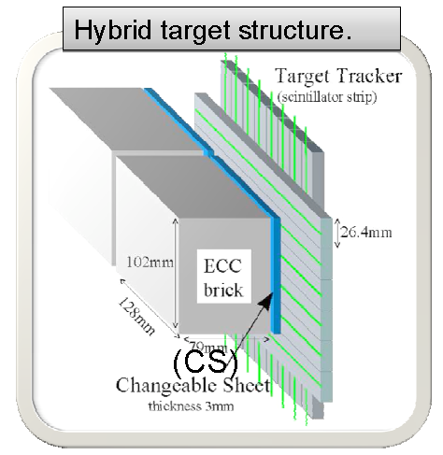
Detector working principle
Electronic detectors
  Trigger for a neutrino interaction
  Locate the most probable brick
Changeable Sheets
  Connection between the cm world
  of electronic detectors and the μm world of nuclear emulsions
ECC treatment after confirmation
  Exposure to GeV CR muons for alignment
  Emulsion development
  Emulsion shipping to scanning labs
  Vertex location
  Kinematical measurements
  Decay search

Slide 15
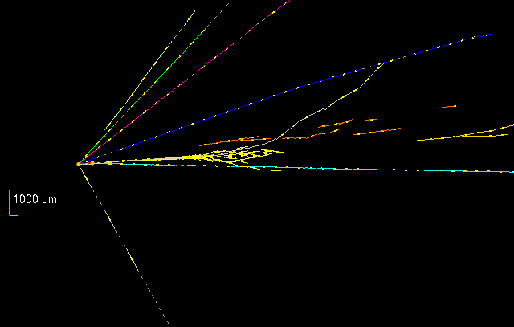
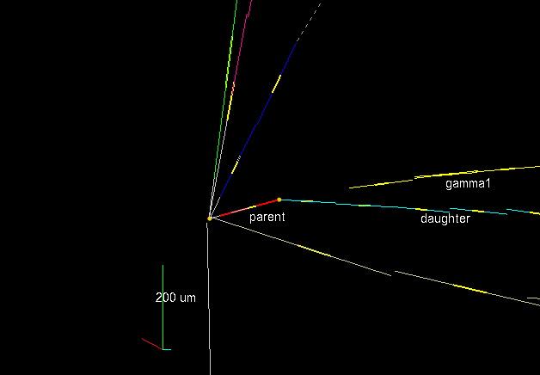
The first ν_{τ} candidate
ZOOM

Slide 16
Kinematical variables
VARIABLE | AVERAGE
kink (mrad) | 41 ± 2
decay length (μm) | 1335 ± 35
P daughter (GeV/c) | 12 ⁺⁶₋₃
Pt daughter (MeV/c) | 470 ⁺²³⁰₋₁₂₀
missing Pt (MeV/c) | 570 ⁺³²⁰₋₁₇₀
ϕ (deg) | 173 ± 2
The kinematical variables are computed by averaging the two sets of track parameter measurements
We assume that:
γ1 and γ2 are both attached to 2^{ry} vertex
The average values are used in the following kinematical analysis
The uncertainty on Pt due to the alternative γ2 attachment is < 50 MeV

Slide 17
Event nature and
invariant mass reconstruction
The event passes all cuts, with the presence of at least 1 gamma pointing to the secondary vertex, and is therefore a candidate to the τ ➔ 1-prong hadron decay mode.
The invariant mass of the two detected gammas is consistent with the π⁰ mass value (see table below).
The invariant mass of the π⁻ γ γ system has a value (see below) compatible with that of the ρ (770). The ρ appears in about 25% of the τ decays: τ ➔ ρ (π⁻ π⁰) ν_{τ}.
πº mass | ρ mass
120 ± 20 ± 35 MeV | 640 ⁺¹²⁵₋₈₀ ⁺¹⁰⁰₋₉₀ MeV

Slide 18
We observe 1 event in the 1-prong hadron τ decay channel,
with a background expectation (~ 50% error for each component) of:
0.011 events (reinteractions)
0.007 events (charm)
0.018 ± 0.007 (syst) events 1-prong hadron
all decay modes: 1-prong hadron, 3-prongs + 1-prong μ + 1-prong e :
0.045 ± 0.020 (syst) events total BG
(here we add up the errors linearly)
By considering the 1-prong hadron channel only, the probability to observe 1 event
due to a background fluctuation is 1.8%, for a statistical significance of 2.36 σ on the
measurement of a first ν_{τ} candidate event in OPERA.
If one considers all τ decay modes which were included in the search, the probability
to observe 1 event for a background fluctuation is 4.5%.
This corresponds to a significance of 2.01 σ.

Slide 19
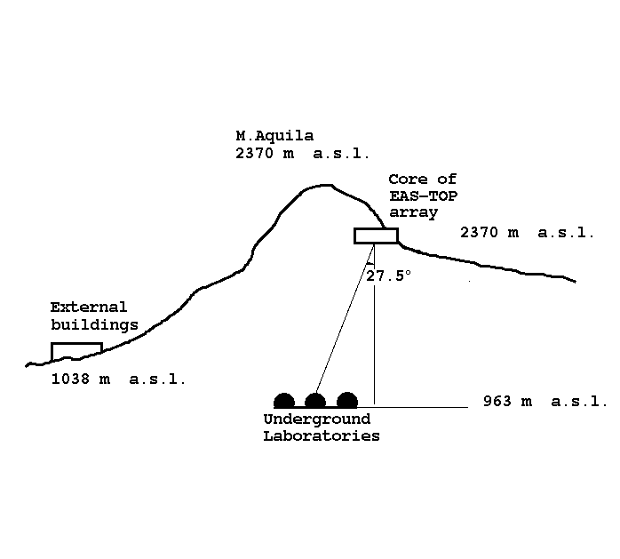
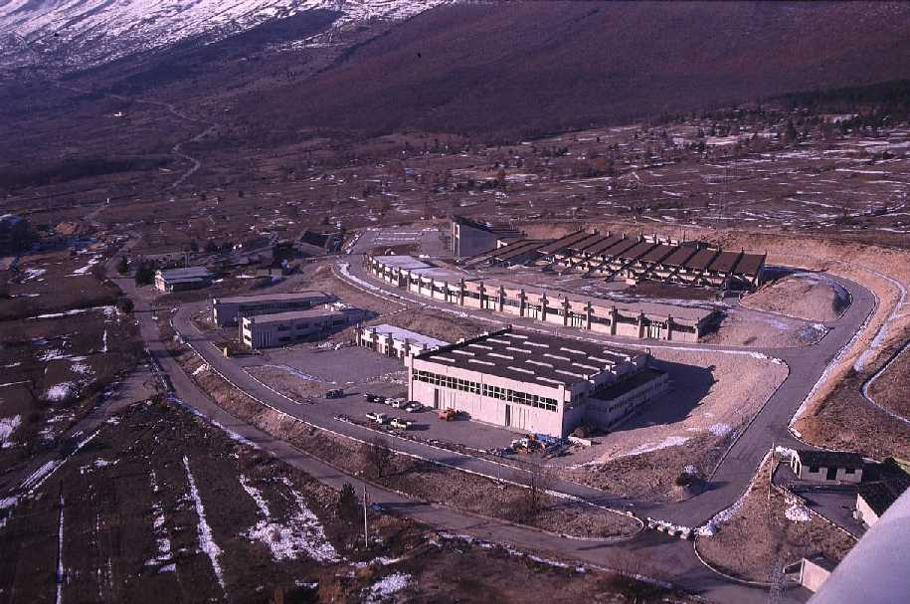
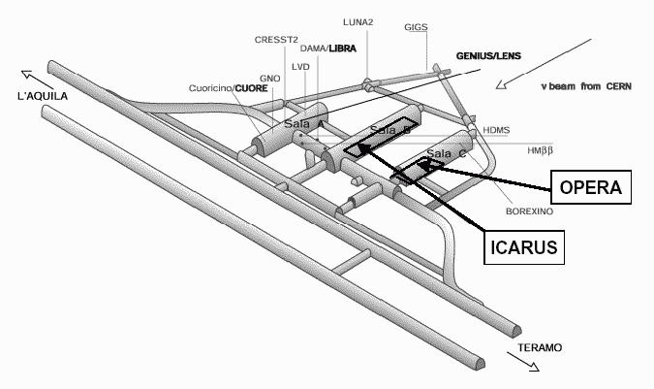
OPERA as a cosmic ray detector
Gran Sasso underground lab: 1400 m of rock (3800 m.w.e) shielding, cosmic ray flux reduced by a factor 10⁶ w.r.t. surface, very reduced environmental radioactivity.
1400 m
OPERA vs previous and current underground experiments:
a deep underground detector with charge and momentum reconstruction and excellent timing capabilities (~10 ns).
Analyses under way:
  Atmospheric neutrino induced muons
  Coincidences among experiments (OPERA/LVD)
  Atmospheric muon charge ratio → this talk

Slide 20
Atmospheric muon charge ratio
The atmospheric muon charge ratio R_{μ} ≡ N_{μ+}/N_{μ-}
is being studied and measured since many decades
  Depends on the chemical composition and energy spectrum of the primary cosmic rays
  Depends on the hadronic interaction feautures
  At high energy, depends on the prompt component
It provides the possibility to check HE hadronic interaction models (E>1TeV) in the fragmentation region, where no data exists
Since atmospheric muons are kinematically related to atmospheric neutrinos (same sources), R_{μ} provides a benchmark for atmospheric ν flux computations (e.g. background for neutrino telescopes)

Slide 21
The physics of CR TeV muons
hadronic interaction: multiparticle production
σ(A,E), dN/dx(A,E) → extensive air shower
Primary C.R.
proton/nucleus:
A, E, isotropic
Κ
(ordinary) meson decay: dN_{μ}/d cosθ ~ 1/ cosθ
π
μ
short-lifetime
meson production
and prompt decay
(e.g. charmed mesons)
Isotropic angular
distribution
transverse size of bundle
∝ P_{T}(A,E)
μ
μ
TeV muon propagation
in the rock: radiative
processes and
fluctuations
detection: N_{μ}(A,E), dN_{μ}/dr

Slide 22
Analytic predictions
Naive prediction:
  Since charged multiplicity grows with the energy, the extra-charge of the primary proton is diluited and R_{μ} → 1 in the HE limit (WRONG!)
A more elaborate model:
  Suppose only primary protons with a spectrum dN/dE = N₀E^{-(1+γ)}
  Suppose only pions and neglect muon decays (HE limit)
  Consider the inclusive cross-section for pions
  The pion spectrum is then
p (primary)
air
nucleus
π

Slide 23
Analytic predictions (cont’d)
  This expression can be simplified under the assumption
  and becomes
  Finally we have
Feynman
scaling
Spectrum
Weighted
Moments

Slide 24
Interpretation of the result
Interpretation of the result
  The result is valid only in the fragmentation region, since
  in the central region Feynman scaling is strongly violated
  But the steeply falling primary spectrum (γ ∼ 1.7) in the SWM suppresses the contribution of the central region in the
  secondary production → scaling holds (at least for E < 1 TeV);
  In other words: each pion is likely to have an energy close to
  the one of the projectile (primary CR proton) and comes from
  its fragmentation (valence quarks) → positive charge
  R_{μ} does not depend on E_{π} (or E_{μ}) nor on the target nature
  R_{μ} depends on the primary spectrum γ

Slide 25
Neutrons in the primary flux
Further refinements
  Introducing the neutron component in the primary flux (in heavy nuclei) and considering the isospin symmetries:
  one obtains:
p₀, n₀ = proton and neutrons in the primary flux

Slide 26
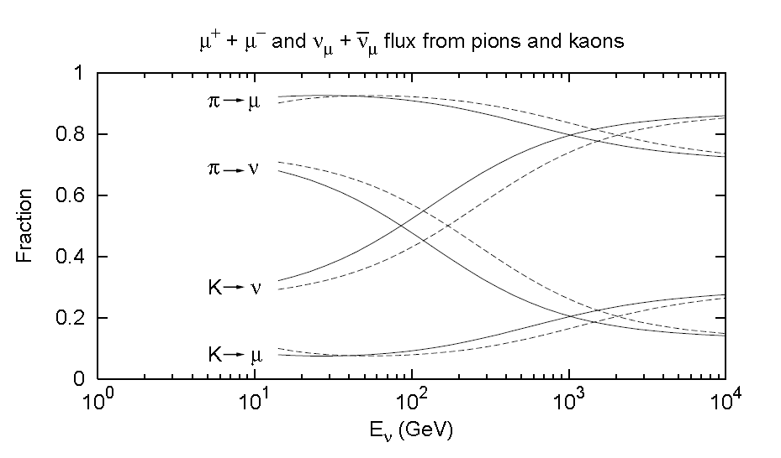
Kaon contribution
At higher energy (>100 GeV) the
contribution of K becomes important
In general, the contribution of each
component to the muon flux
N_{par} = (π, K, charmed, etc.)
depends on the relative contribution
of decays and interaction probabilities:
where
θ = 0º
ε_{π}
ε_{Κ}
θ = 60º
ε_{i} = ε_{i}(θ) is the “critical energy”, i.e. the energy above which interactions dominate over decays. Along the vertical (θ = 0º)
ε_{i}(0)= m_{i}ch/τ_{i} (h = 6.5 km)
ε_{π} = 115 GeV
ε_{K} = 850 GeV
ε_{X} > 10⁷ GeV

Slide 27
Kaon contribution to R_{μ}
However, for kaons:
Because of their strangeness (S = +1),
K⁺ and K⁰ can be yielded in association
with a leading baryon Λ o Σ. On the other
hand, the production of K⁻,K⁰ requires
the creation of a sea-quark pair s − s
together with the leading nucleon and
this is a superior order process.
This leads to a larger R_{μ} ratio at high energy
−
−

Slide 28
General form for R_{μ}
Let us consider again the general form for the muon flux
where we have explicited the ε_{i}(θ) dependence on θ
where θ* is the zenith angle at the production point
The correct variable to describe the evolution of R_{μ} is
therefore E_{μ}cosθ∗
The R_{μ} evolution as a function of E_{μ}cosθ∗ spans over the different sources
R_{μ} = w_{π}R_{μ}^{π} + w_{K}R_{μ}^{K} + w_{charm}R_{μ}^{charm} +…
θ
θ∗
Earth
POWERFUL HANDLE TO
DISCRIMINATE MODELS
OPERA: ⟨E_{μ}cosθ∗⟩ ≈ 2000 GeV
The (magnetized) experiment with
the largest E_{μ}cosθ

Slide 29
Cosmic-event reconstruction in OPERA
Cosmic-event tagging:
  Outside the CNGS spill window
Dedicated pattern recognition and track finding/fitting:
  Cosmic events are passing-through
  Cosmic events comes from all directions
  Cosmic events may have multiple parallel tracks (in OPERA 5% of the events are muon bundles)
  Different reconstruction philosophy

Slide 30
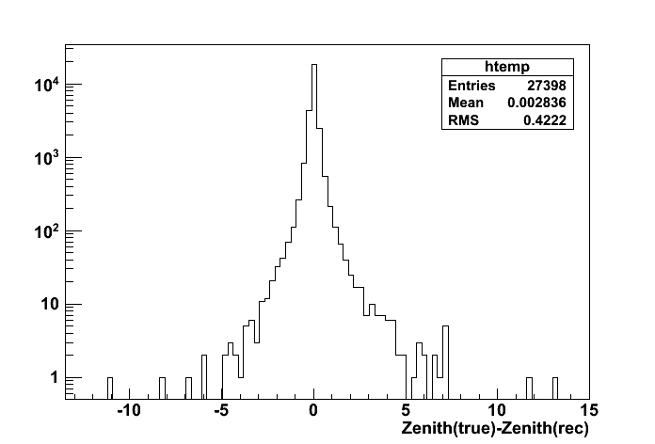
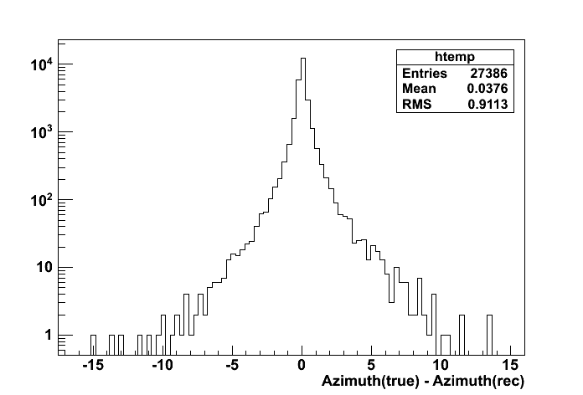
Pattern recognition
Tracking philosophy
  we know a priori which is the target: single tracks or bundle of tracks almost parallel (RMS is ~1 deg, mainly due to MCS in the overburden)
Hybrid strategy
  global method (Hough Transform) to individuate the event direction
  scan the Hough Space and select the slope corresponding to the maximum → used to set the θ_{slice} of the slice
  local method (pivot points) on slices around the direction
  Merge tracks in the XZ and YZ views → 3D track
    “resolutions” < 1 deg
    both for zenith and
    azimuth direction
    reconstruction
θ
φ

Slide 31
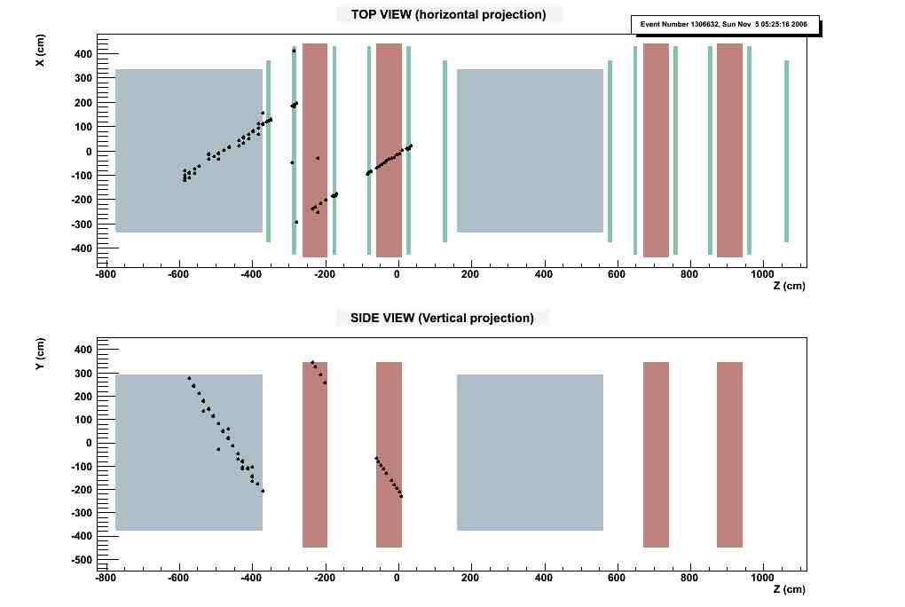
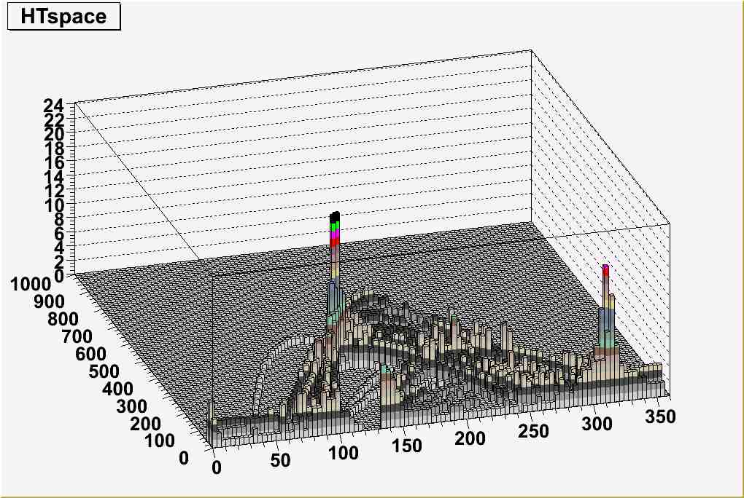
Pattern recognition (cont’d)
Real double muon event
Y
original coordinate plane
1
ρ
ρ
2
3
ψ
ψ_{peak}
θ
Z

Slide 32
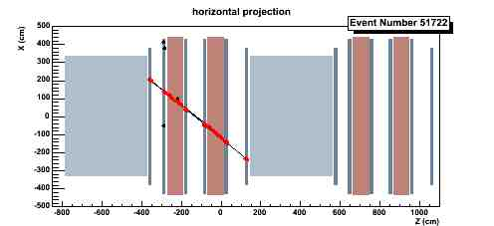
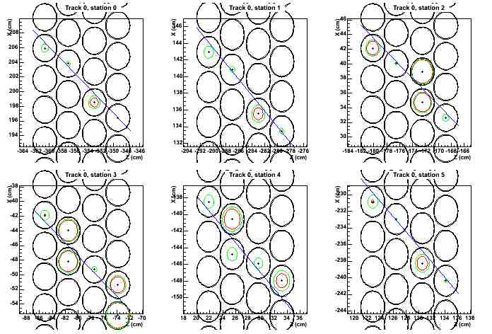
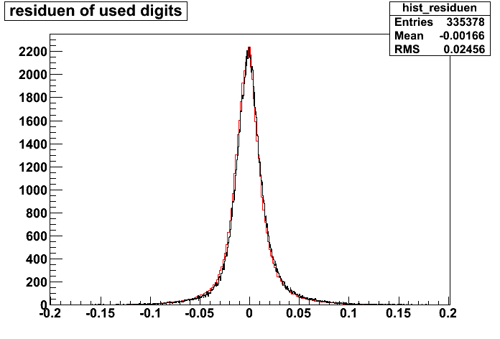
PT track reconstruction
3D tracks are used to “guide”
track finding and fitting in the PT
system:
Find the line tangent to the
drift circles with the best χ²
250 μm position resolution
0.15 (1) mrad angular resolution
for doublets (singlets) for φ = 0
(improve for φ > 0)
Residuals ~250 μm

Slide 33
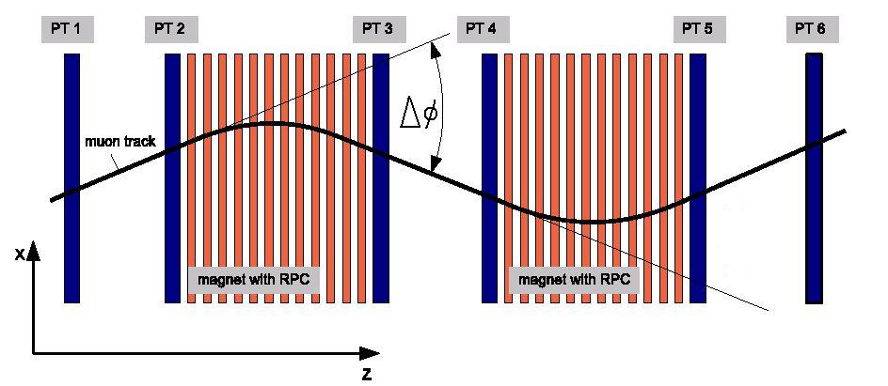
Momentum reconstruction
l
In each side of the magnet arm we can reconstruct an independent angle φ_{j}, j=1,...,6.
Each φ_{j} can be reconstructed with one station (singlets) or two stations (doublets)
We compute Δφ_{k} = φ_{i} – φ_{j} , k=1,...,4, angle differences between adjacent station-pairs
  55% of Δφ’s comes from doublets
  9% from singlets
  36% are mixed
B ≡ Bd/l =
effective magnetic field

Slide 34
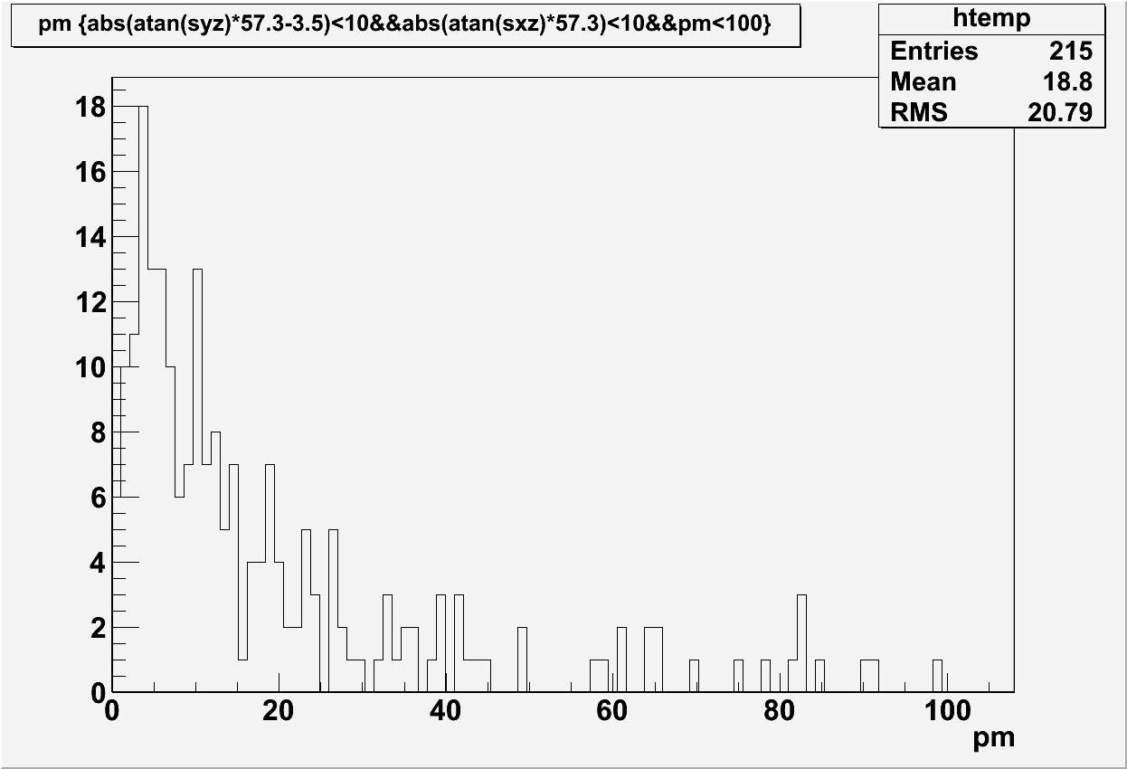
Charge reconstruction
Charge is reconstructed according to the Δφ sign
If each track contributes to multiple Δφ angles, a weighted average is computed
  weights = experimental errors on Δφ
Cross-check with beam data
R_{μ} = (1.9 ± 0.9) %
where
p_{μ}

Slide 35
Maximum Detectable Momentum
Consider the magnetic field bending and the total deflection spoiling (detector + MCS)
Requiring Δφ_{Β}/σ_{Δφ} > 1 we obtain (for φ=0):
  p_{max}(doublets) = 1.25 TeV
  p_{max}(singlets) = 190 TeV
  p_{max}(mixed) = 260 TeV
Exact computation at all angles (MC)
~500 GeV/c

Slide 36
Charge mis-identification
η ≡ fraction of tracks reconstructed with wrong charge sign
Used to correct data (unfold)
In the LE limit (only MCS) the estimate is ~10⁻³
Real η is larger due to spurious effects:
  Secondary particles
  Timing errors

Slide 37
Monte Carlo simulation
MC simulation used for different purposes:
  Calibrate and correct (unfold) experimental data
  Estimate surface muon energy and
  primary-cosmic-ray related quantities
Two MCs used:
  Parametrized generator
    - Fast but approximate
  Full Monte Carlo simulation
    - Slow but reliable

Slide 38
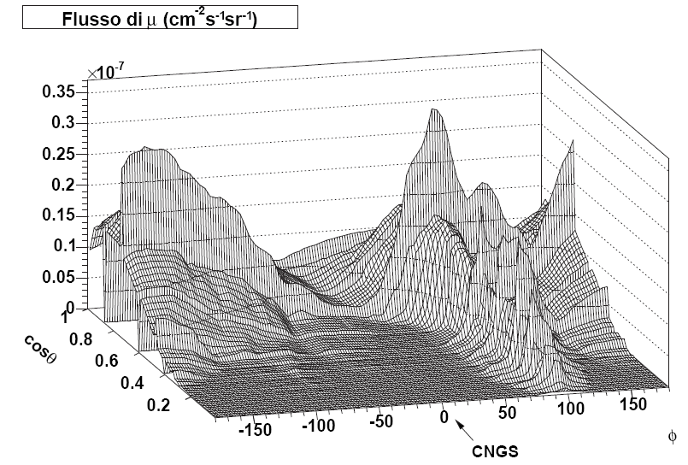
Monte Carlo simulation (MC1)
Generates multiple muon events at the
level of the Underground Halls of the
LNGS Laboratory
  each primary type and its energy are sampled according to the composition model (MACRO-fit model)
  the direction is sampled isotropically and the corresponding amount of rock overburden is computed (from Gran Sasso map)
  given the primary type, its energy, the direction and the rock, the probability to have n_{μ} muons at underground level is computed
  using tables obtained from a full MC simulation, the same used to derive the primary composition model → SELF-CONSISTENCY
  Then the residual energy for each muon is computed from a parameterized function [PRD 44 (1991) 3543]
  The lateral dispersion R_{μ} of each muon w.r.t. the shower axis is again parameterized according to a full MC simulation
  The muon charge ratio is introduced by hand (R_{μ} = 1.4)
Muon flux

Slide 39
Monte Carlo simulation (MC2)
Based on the FLUKA code
Full simulation chain:
  Detailed geometry description (atmosphere, mountain)
  HE hadronic interactions (h-N and N-N) handled by DPMJET
  Primary composition model from APP 19 (2003) 193
  Predictive of the atmosperic muon charge ratio
Usage:
  Surface muon energy estimation
  Link between underground variables and primary cosmic ray parameter
γ~2.7÷3
E_{cut}~3000 TeV
E_{cut}
E

Slide 40
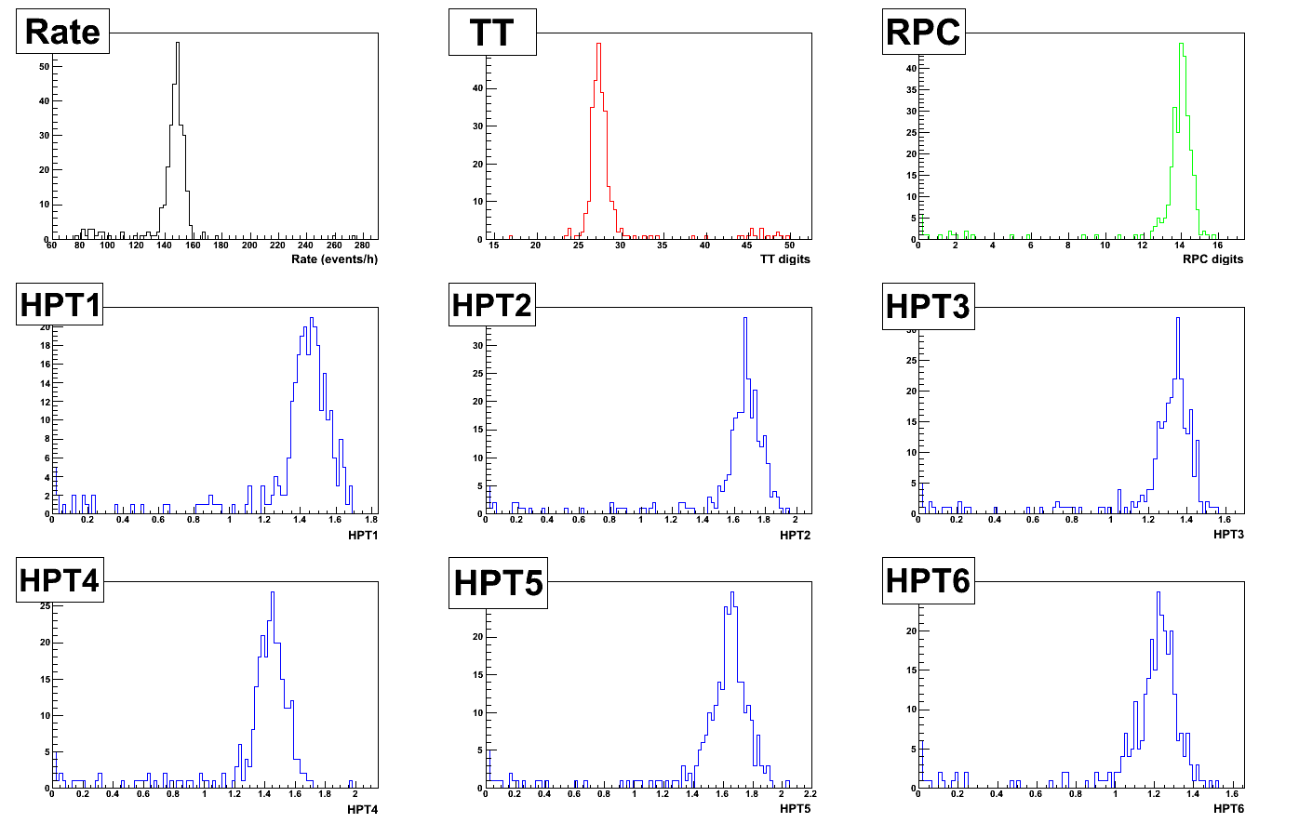
Data pre-selection
Data taken during 2008 CNGS physics run:
  from June 18th until November 10th 2008
The data acquisition was segmented in “extraction periods”
of ~12 hours each.
Each “extraction” was
selected or rejected on the basis of:
  Run stability
  Global distributions (see figure)
Livetime: 113.4 days
Total number of events: 403069

Slide 41
Data reduction
A set of progressive cuts applied in order to isolate a clean data sample:
  at least one reconstructed Δφ angle
  (acceptance cut)
  Remove events with large number of PT hits (clean PT cut)
  Remove events with bendings smaller than the experimental resolution (deflection cut)
  c’) Remove events with very large bendings
  (effective for p_{μ}<5 GeV/c)

Slide 42
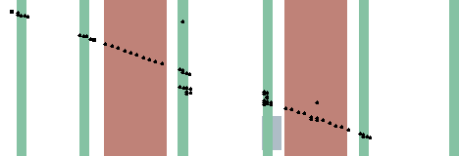
Clean PT cut
Remove events with a large number of PT tubes fired (δ-rays, secondary interactions, electronic noise etc) → can induce wrong matching
M = M(φ)
N’ = N - M(φ)

Slide 43
Deflection cut
Tracks with a bending below the experimental resolution are removed:
Δφ/σ_{Δφ} > n, n=3
The robustness of the cut with respect to n was checked, i.e. the results do not depend on n, when n>2

Slide 44
Deflection cut: effects on Δφ and η
The charge mis-identification η is strongly
reduced.
Possible differences between MC and
real η is a source of systematic uncertainty
on R_{μ} → will be reported later
μ⁻
μ⁺
μ⁻
μ⁺
w/o deflection cut
w/ deflection cut
μ⁻
μ⁺
η ~ 3%

Slide 45
Data reduction - statistics
 | DATA |  |  | MC
 | evt/day | f₁ | f₂ | evt/day | f₁ | f₂
Acceptance | 992 | 100.0% | - | 1222 | 100.0% | -
Clean PT | 515 | 51.9% | - | 959 | 78.5% | -
Deflection | 391 | 39.4% | 76.0% | 708 | 58.0% | 73.8%
Single μ | 379 | 38.2% | 96.9% | 673 | 55.1% | 95.1%
Multiple μ | 12 | 1.2% | 3.1% | 35 | 2.9% | 4.9%

Slide 46
Quality cuts vs reconstructed p_{μ}
No cuts
Clean PT
Δφ<100 mrad
Δφ/σ_{Δφ} > 3

Slide 47
Alignment of the PT system
R_{μ} strongly depends on the alignment precision of the PT system
Two stages of correction:
  Mechanical: gross corrections using a theodolite
  Cosmic rays: finer corrections using HE muons
  (w/ and w/o magnetic field)
Mis-alignment may have different contributions:
  Global: each PT station can be roto-translated as a whole w.r.t. the master reference frame
    Accounted for with the present statistics
  Local: each PT station may have distortions which vary from point-to-point
    Not yet accounted for with the present statistics

Slide 48
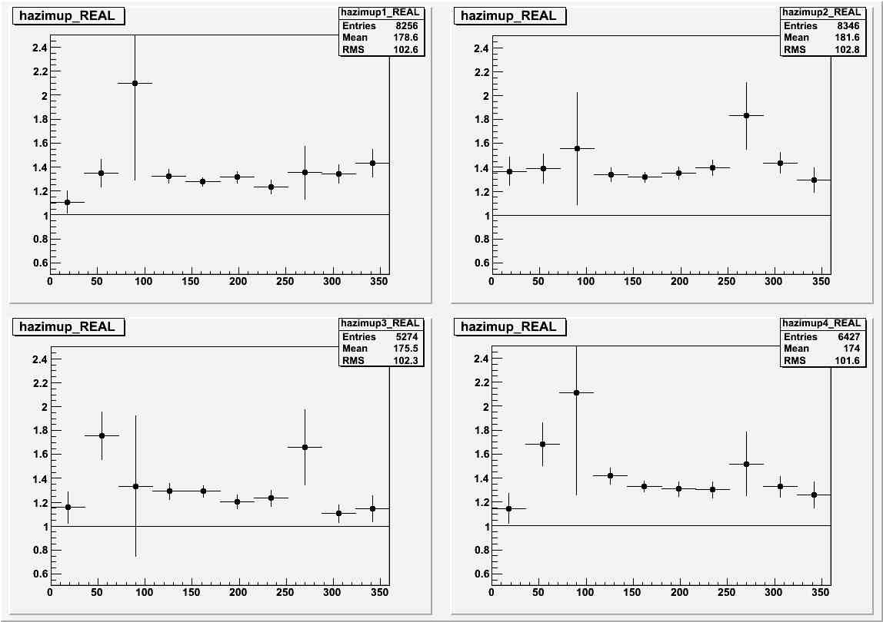
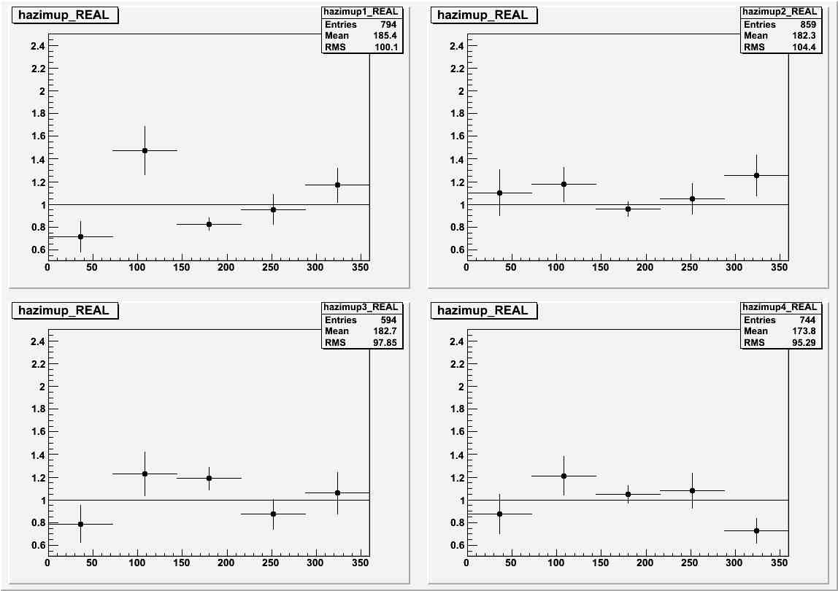
Alignment of the PT system
Phase 1: Align two stations of a doublet treating them as rigid bodies
- first shifts, in x, y and z
- then rotation, in x, y and z
Phase 2: Align two doublets on both sides of an iron arm using CR data w/o magnetic field
Phase 3: Estimate bending effects
Magnets ON
Magnets OFF

Slide 49
Underground muon charge ratio
R_{μ} computed separately for the three categories and then unfolded:
Finally compute R_{μ}^{unf} as the weighted average of the 3 samples:
 | N_{μ+} | N_{μ-} | R_{μ}^{meas} | η | R_{μ}^{unf}
Doublets | 13595 | 9993 | 1.360 ± 0.018 | 0.0165 ± 0.0012 | 1.375 ± 0.019
Mixed | 8951 | 6603 | 1.355 ± 0.022 | 0.0403 ± 0.0022 | 1.393 ± 0.025
Singlets | 2181 | 1704 | 1.28 ± 0.06 | 0.064 ± 0.005 | 1.33 ± 0.05
R_{μ} = 1.377 ± 0.014

Slide 50
Underground muon charge ratio
R_{μ} computed separately for single and multiple muon events
  check of the hypotheis of “dilution” of R_{μ} when proton-Air and neutron-Air interactions change their relative contributions
  in practice: compute R_{μ} when the 3D
  multiplicity is > 1, independently on the
  number of measured charges in the event
OK,
n_{μ}=3
N_{μ} | ‹A› | ‹E/A›_{primary} [TeV] | H fraction | N_{p}/N_{n} | R_{μ}^{unf} (2008)
= 1 | 3.35 ± 0.09 | 19.4 ± 0.1 | 0.667 ± 0.007 | 4.99 ± 0.05 | 1.377 ± 0.014
> 1 | 8.5 ± 0.3 | 77 ± 1 | 0.352 ± 0.012 | 2.09 ± 0.07 | 1.23 ± 0.06
Different at 2.4σ level: first indication of a “dilution” effect

Slide 51
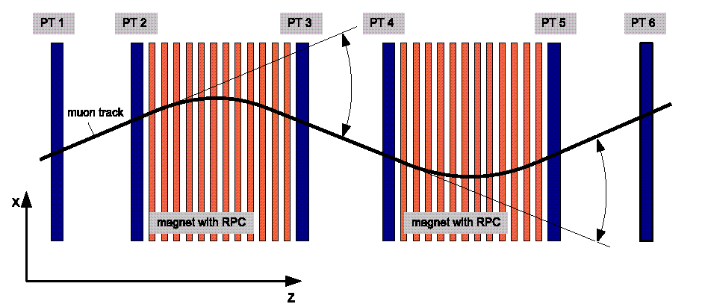
Systematic uncertainty on R_{μ}
a) Mis-alignment of the PT system
  can be estimated with the “2-arm” test: consider tracks which cross
  both arms of a spectrometer. Neglecting energy losses, the two deflections should be the same:
δ(Δφ) = Δφ₁ - Δφ₂ = 0
δ(Δφ) = 0.08 mrad
δR_{μ} = 0.015

Slide 52
Systematic uncertainty on R_{μ}
→ Consistency checks:
  The 4 R_{μ} values, computed separately for each magnet arm, fluctuate around the average of 0.017, which is below their statistical accuracy (0.03)
  Run with inverted polarity (9 days): R_{μ}^{inverted} = 1.39 ± 0.04
Charge mis-identification η
  estimate δη = η_{data} – η_{MC} for a subsample of events again with
  the “2-arm” test, then extrapolate to the whole sample
  the probability that Δφ₁ and Δφ₂ have opposite sign is related to η
  through a function η = η(p), computed via MC
  δη = 0.007 → δR_{μ} = 0.007
The total systematic uncertainty is δR_{μ}^{unf}(syst) = +0.017, -0.015

Slide 53
R_{μ} as a function of p_{μ}
R_{μ} was computed in bins of p_{μ} (underground momentum) and unfolded (bin migrations taken into account with the Bayes method)
Evolution with p_{μ} is compatible with a constant
R_{μ} = a₀ + a₁ log₁₀ p_{μ}
→a₀ = 1.29 ± 0.06
→a₁ = 0.05 ± 0.03
R_{μ} = c₀
→ c₀ = 1.379 ± 0.015
Δχ²/dof = 2.47/1
(compatible with a constant)

Slide 54
R_{μ} as a function of E_{μ}cosθ∗
The resolution on E_{μ} is dominated by fluctuations in the stochastic of the energy loss
Different attempts to retrieve E_{μ}
  Use of the standard (approximate) formula:
  Back-propagation algorithm
    Start from p_{μ} and back-propagate the track up to the surface, up
  Use of “crude” MC2
    Build a table ⟨E_{μ}⟩ = f(h,p_{μ})
= α(Ε)
β = β(Ε)
BEST PERFORMANCE

Slide 55
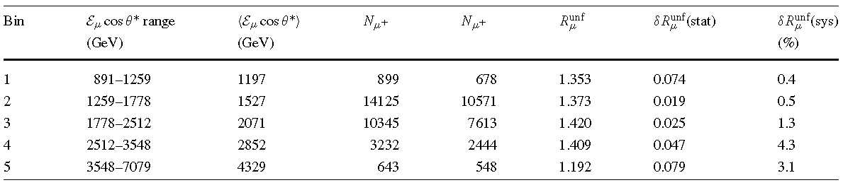
R_{μ} as a function of E_{μ}cosθ∗
Fixing R_{Κπ} = 0.149 (Gaisser):
R_{π} = Z_{Nπ+}/Z_{Nπ-}= 1.229 ± 0.001
R_{Κ} = Z_{NΚ+}/Z_{NΚ-}= 2.12 ± 0.03

Slide 56
Analysis update
Further investigation on the HE point:
  Inclusion of 2009 run data
  New estimation of the “surface muon energy”
  New estimation of charge mis-identification η

Slide 57
Update with 2009 data (preliminary)
  From June 1st until November 23rd 2009: livetime 2009 = 123.2 days
2008 data
2009 data
n_{μ} | ‹A› | ‹E/A›_{primary} [TeV] | H fraction | N_{p}/N_{n} | R_{μ}^{unf} (2008) | R_{μ}^{unf} (2009) | R_{μ}^{unf} (2008+2009)
= 1 | 3.35 ± 0.09 | 19.4 ± 0.1 | 0.667 ± 0.007 | 4.99 ± 0.05 | 1.377 ± 0.014 | 1.402 ± 0.014 | 1.392 ± 0.010
> 1 | 8.5 ± 0.3 | 77 ± 1 | 0.352 ± 0.012 | 2.09 ± 0.07 | 1.23 ± 0.06 | 1.20 ± 0.05 | 1.22 ± 0.04
Discrepancy now at 4.2σ level

Slide 58
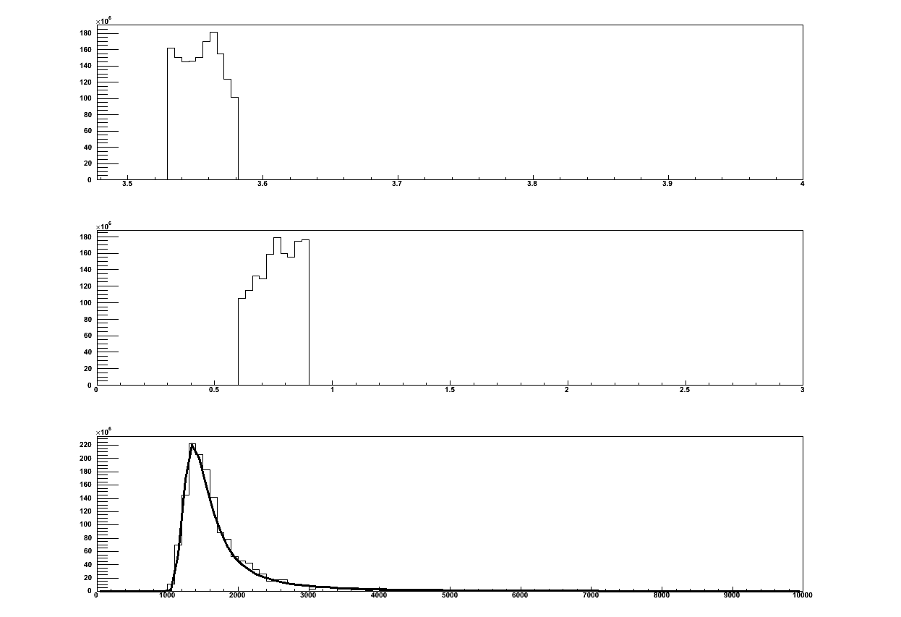
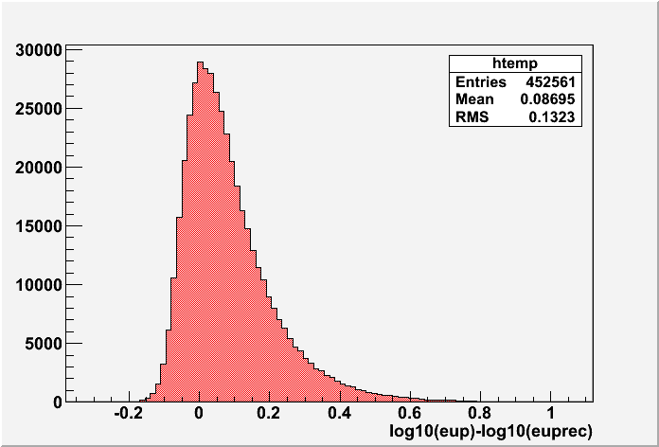
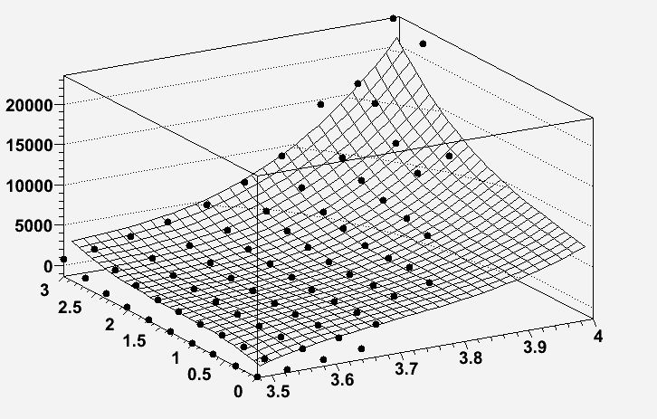
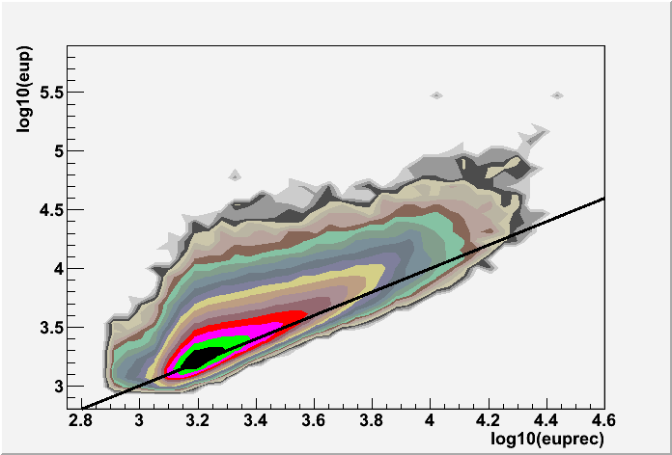
New estimation of the “surface muon energy”
Same as before, but take the MPV of the Landau distribution instead of the mean → better resolution and residuals well centered
h (bin 2)
p_{μ} (bin 3)
E_{μ}^{surface}
MPV
E_{μ}^{surface}(GeV)
Log₁₀(p_{m}/GeV)
Log₁₀(h)

Slide 59
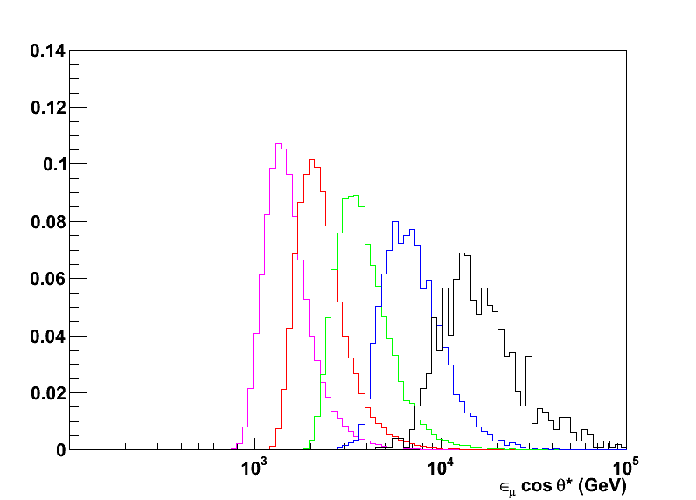
New estimation of the “surface muon energy”
Using MC2 the proper binning was computed:
5 bin in log10(E_{μ}cosθ∗): 2.9 – 4.2
(bin width = 2*RMS = 0.26)

Slide 60
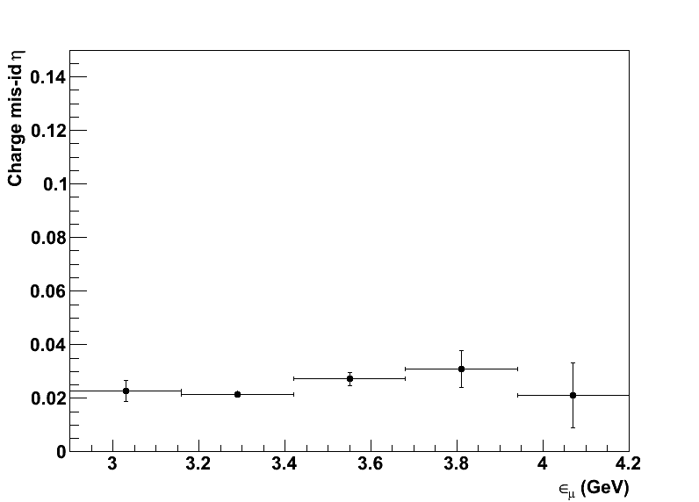
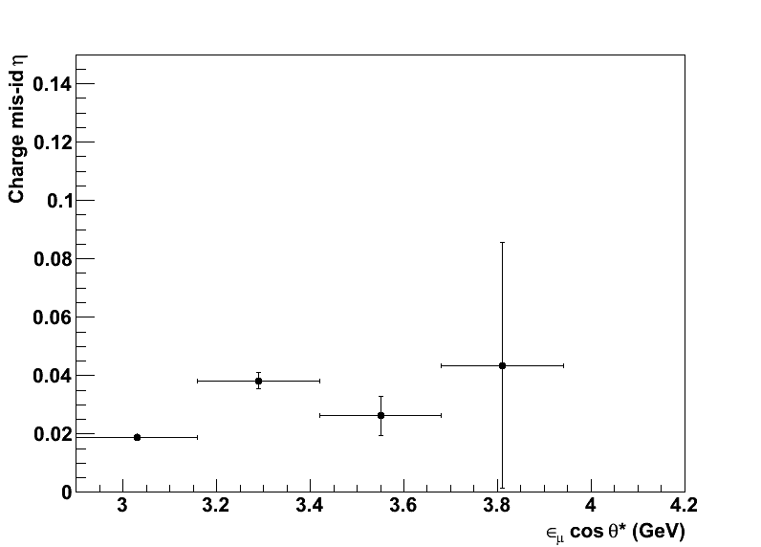
New estimation of charge mis-identification η
Due to the increased statistics, it is now possible to use only doublet data, for which the charge mis-identification can be extracted directly from data (→2-arm test)

Slide 61
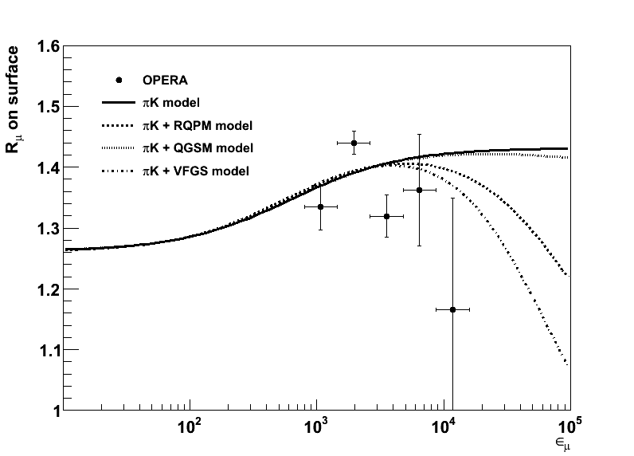
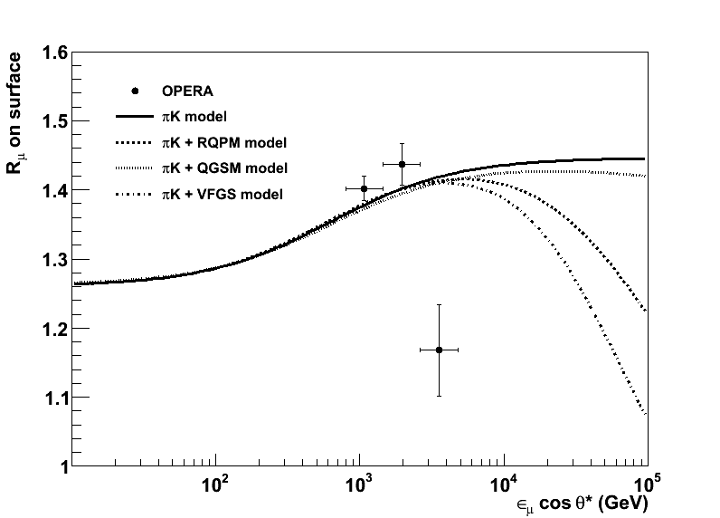
Re-evaluation of muon R_{μ} vs E_{μ}cosθ∗
The anomaly in the HE point is still there
Independent
on p_{μ}^{max}!

Slide 62
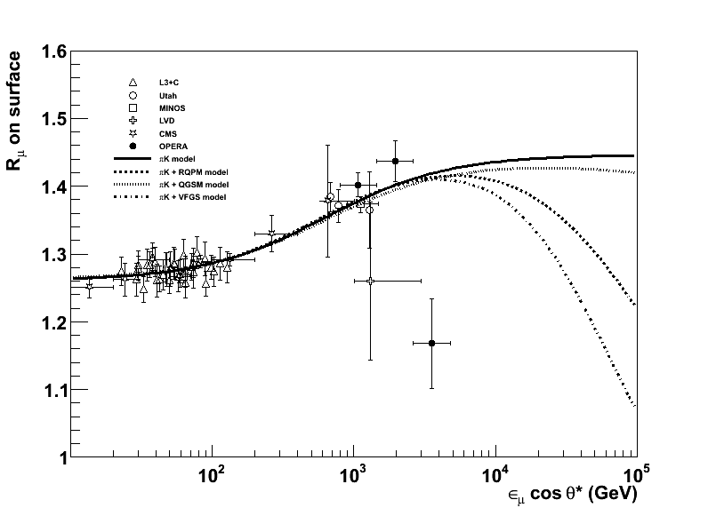
New fit with world survey
Fixing R_{Κπ} = 0.149 (Gaisser):
R_{π} = Z_{Nπ+}/Z_{Nπ-}= 1.219 ± 0.001
R_{Κ} = Z_{NΚ+}/Z_{NΚ-}= 2.43 ± 0.04

Slide 63
Conclusions
OPERA is the first experiment searching for direct ν appearance in the framework of ν oscillation
  First ν_{τ} candidate found in a subsample of 2008-2009 data
The detector was also exploited for cosmic ray studies
  The atmospheric muon charge ratio was measured in the highest energy region
  The integral value is compatible with expectation from a simple π-K model
  The SWM ratios were measured
  Found a significant reduced charge ratio for multiple muon events
  Unexpected behavior in the last HE points of the energy distribution: detector effect or physical origin?
  Need for further data and independent cross-checks

Slide 64
Spares

Slide 65
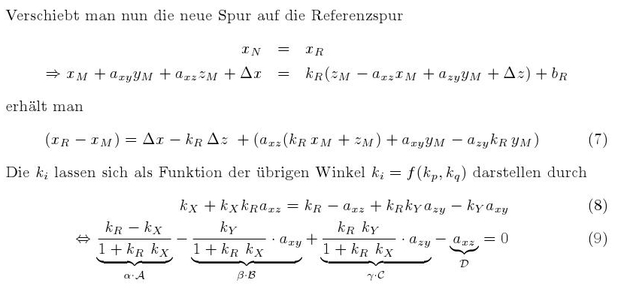
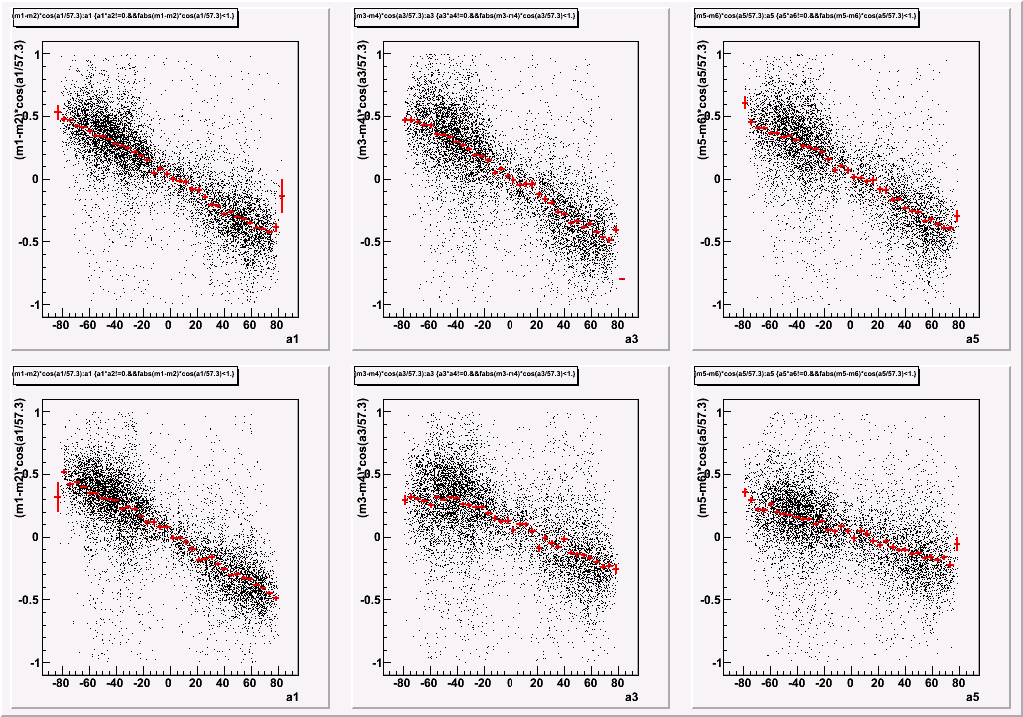
Alignment: phase 1

Slide 66
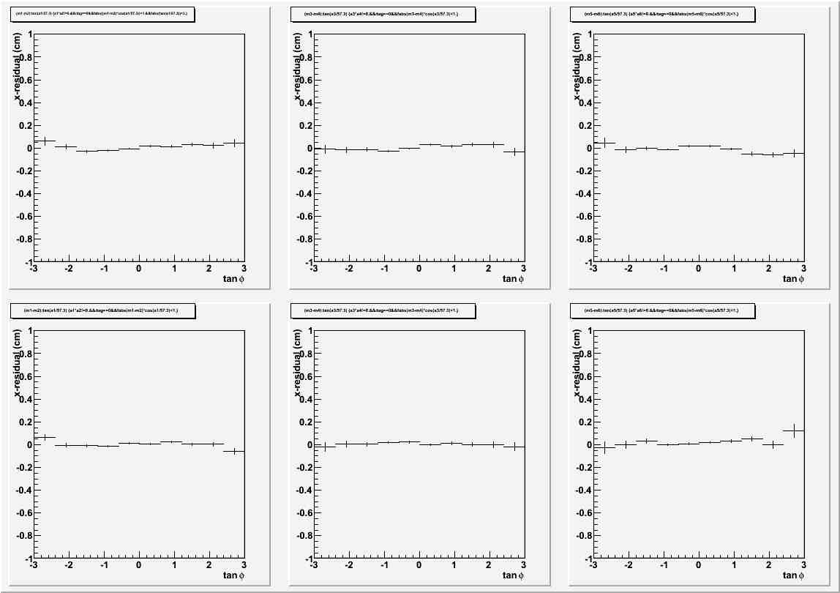
Alignment: phase 1, results

Slide 67
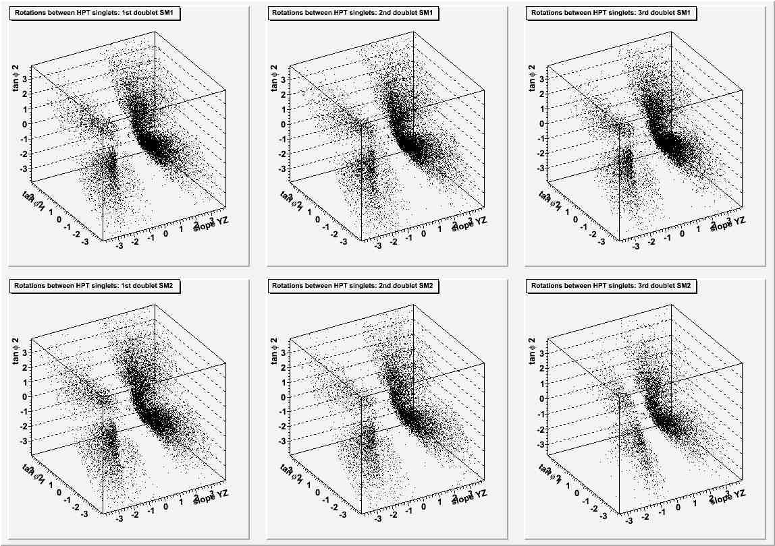
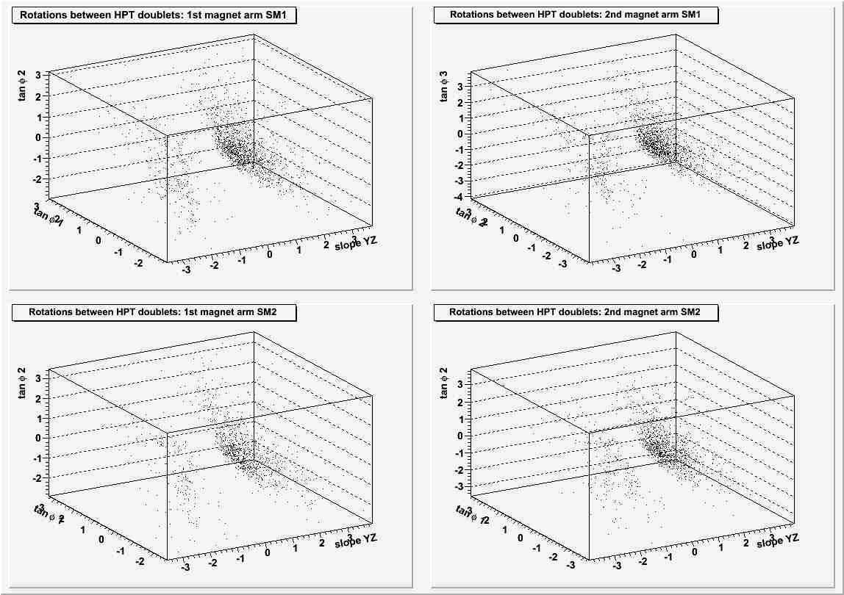
Alignment: phase 2 (rotations)

Slide 68
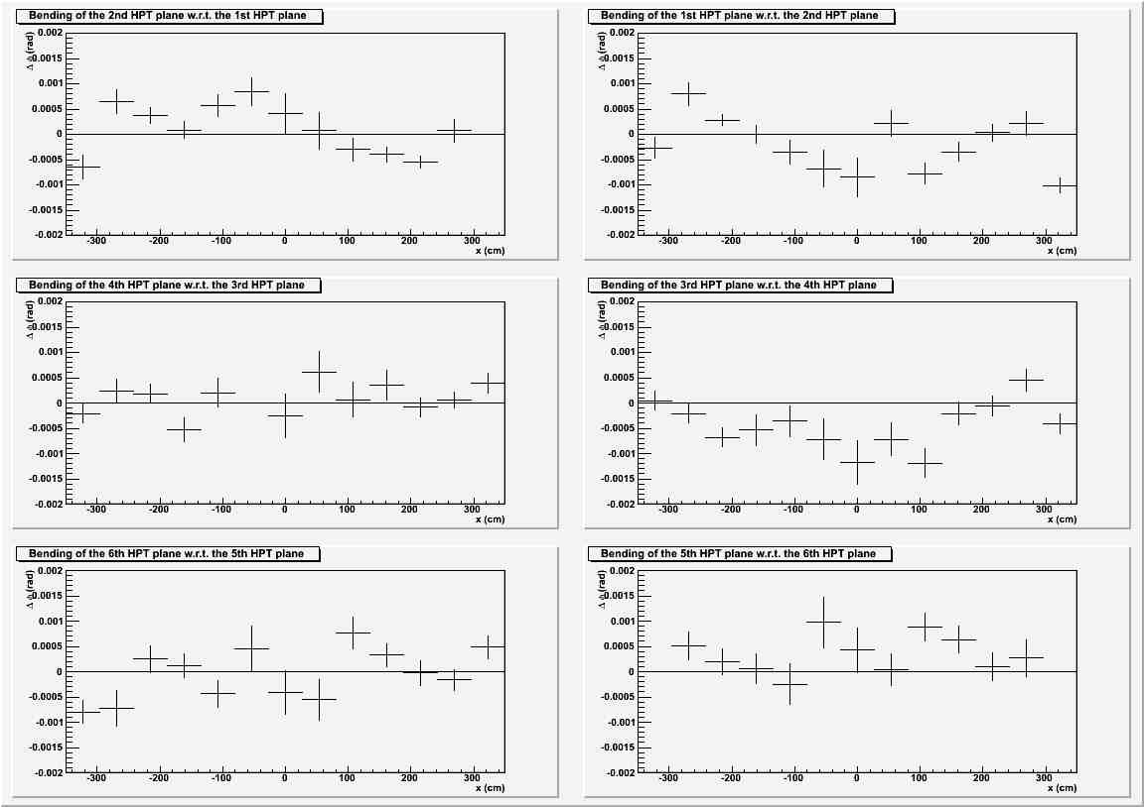

Alignment: bendings

Slide 69

CR stability as a function of data taking
Event number

