Slide 1
Xogenesis
LR
With Matthew Buckley
(current work with Cui, Kahawala,Shuve)

Slide 2
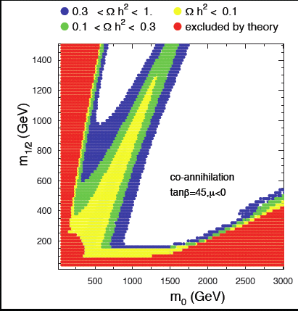
WIMP Miracle Too Good to be True?
Weak masses and cross sections lead to about right dark matter density
But: Narrow parameter ranges
Almost always some tuning or coincidence needed
Coannihilation, resonance enhancement
Tuned parameters to get bino, higgsino mixture
Current bounds testing much of parameter range for large class of weak scale models—should see something soon
Is WIMP miracle right?
Definitely keep pushing direct detection to exptally test
Meanwhile, theorists consider alternatives
mir·a·cle
/ˈmɪrəkəl/ Show Spelled[mir-uh-kuhl] Show IPA
–noun 1. an effect or extraordinary event in the physical world that surpasses all known human or natural powers and is ascribed to a supernatural cause.
2. such an effect or event manifesting or considered as a work of god.
3. a wonder; marvel.

Slide 3
Is WIMP the right Miracle?
ρ_{X}~6ρ_{B}
Why should dark matter and ordinary matter energy densities be at all comparable?
Could just be independently generated—baryogesis somehow and weak miracle
Could be related: Asymmetric Dark Matter
n_{B}~6n_{X}
Could be more generally related; naturalness not quite so inflexible
Weak scale dark matter still natural
Thermal suppression
Bleeding excess number density through in eqm lepton violation below sphaeleron scale
Generate lower number density

Slide 4
Asymmetric Dark Matter
See Zurek talk
As with matter—baryons—generate dark matter excess over anti-dark-matter
Dark matter density not from simple thermal decoupling
Need mechanism to create asymmetry
Original ADM Models
Create net B-L
Transfer asymmetry through equilibrium processes to dark matter—net asymmetry preserved but requilibrated
Transfers decouple, freezing in asymmetries in B and X
Symmetric component annihilates
Correct ADM dark matter density favors light dark matter—5-10 GeV
Light Dark Matter also Tantalizing Experimentally

Slide 5
All Sorts of Miracles Possible
Asymmetric Dark Matter
Make B (L), Transfer B to X, n_{B}~n_{X}, light DM
Zurek,Luty,Kaplan,…
Hylogenesis, Aidnogensis, Cladogenesis
Make B, X together (asymmetric or nonthermal)
n_{B}~n_{X}, light DM
Davoudiasl, Morrissey, Sigurdson, Tulin, Hall,
March-Russell, West, Chun, Blennow,Allahverdi…
Darkogenesis, Dark Genesis
Make X, Transfer X to B n_{B}~n_{X}, light DM
Shelton, Zurek, Haba, Matsumoto
Xogenesis
Make X, Transfer X to B, n_{B}<n_{X}, weak scale DM
Buckley, LR
Xogenesis’, Cladogenesis
Make X, B, n_{B}<n_{X}, weak scale DM
Cui, Kahawala,LR, Shuve
Light Dark Matter
Weak Scale Dark Matter
Theory options: not necessarily motivated by experiment

Slide 6
Xogenesis: like…
Main Entry: exogenesis
Part of Speech: n
Definition: origin from external causes, as a disease
Etymology: Greek exo- 'outside' + genesis 'origin'

Slide 7
Weak Scale ADM Dark Matter
Three Mechanisms
Thermal suppression of number density
Nonrelativistic at decoupling
Bleeding exceess dark matter
Transfer to leptons still inequilibrium below sphaeleron temperature at which B established
Suppressed dark matter production
Eg sphaeleron with left and right handed doublet with small admixtures of singlet
Sphaeleron production of dark matter decouples with singlet mass

Slide 8
Light Dark Matter: “Relativistic Solution”
Chemical equilibrium between B or L and X
Net asymmetry
Ratio chemical potential~ratio number density~ratio energy density

Slide 9
Weak Scale (or Heavy) Dark Matter “Nonrelativistic Solution”
More generally
Number density suppressed for m>>T

Slide 10
Nonrelativistic Solution
Need to solve
Number density of X less than B
Chemical, but no longer thermal equilibrium
Allows for different masses

Slide 11
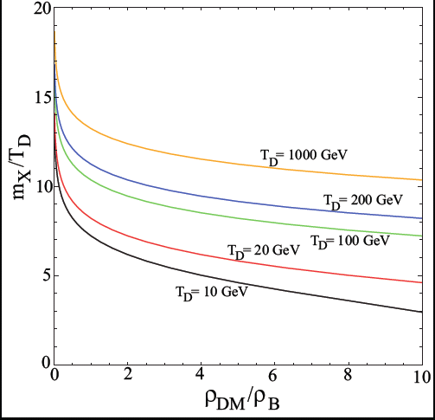
Naturalness allows hierarchy of order ten
Right ratio of densities found for wide range of m/T
Usually need m/T~10, which is quite reasonable
Expect comparable densities over the whole range

Slide 12
Requirements for Workable Scenario
Sakharov Conditions in Dark Sector:
Create X: X violation,…
Or B and X:B and X violation,…
In first case, need XB violating operators to transfer asymmetry
Need symmetric component to be eliminated
This might be best bet for detection.

Slide 13
Example: XB-Violation
X pairs annihilate to 3 squarks decay to 3 quarks and 3 neutralinos
Freezeout:
T_{D} depends linearly on Δm=3m_{q}-m_{X}
M~TeV, m_{q}>400 GeV
L_{eff} from

Slide 14
Scales and Other Considerations
Δm~45T_{D}, m_{X}~10T_{D}; m_{q}~20T_{d}
T_{d}>20GeV; m_{X}>200GeV
Rest of model relies on eliminating symmetric component, neutralinos
Neutralino: winolike
AnnihilatIon:
(Pseudo) Scalars or Vector Bosons

Slide 15
Detection
Pseudoscalar exchange NMSSM:
with >pb cross section
Vector: annihilate to dark (eg W’s)
Bad for detection: invisible
Mix with photon
See everyone else

Slide 16
Example: XL-Violation
X pairs annihilate to sneutrino->neutrino,neutralino
Decouples:
Need sneutrino mass about 30 times decoupling temperature
If decoupling above Tsphaeleron~100-200GeV
Very high SUSY scale

Slide 17
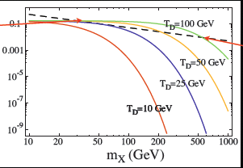
Bleeding X into L
Suppose T_{D}<m_{X}<T_{sphaeleron}
At high temperature, n_{X}~n_{L}
Sphaelerons: n_{B}~n_{L}
Below T_{sphaeleron}, X ↓ and L ↑
n_{X}<n_{B} at end

Slide 18
Observability
Symmetric component must annihilate
UV completion for L-violating operator can involve new doublet, low scale
Direct detection:
Very likely challenging—especially for heavier dark matter

Slide 19
Discussion
Do we believe this?
Chief nonobvious assumptions :
Symmetry-transferring, breaking operators
Sphaelerons might be most obvious-just need doublets—but hard to meet detection bounds
Detectability not guaranteed
Symmetric component can annihilate into dark sector
Heavy dark matter gives weaker signal
On the other hand: natural, and explains weird near-coincidence of matter densities
And can still be connected to weak scale
Relativistic (light) and Nonrelativistic (heavy or weak scale)

Slide 20
How will we know?
Indirect signals rule it out
Measure direct detection signal?
Combined with collider data?
Measure mass?
Properties of LSP?
Don’t see anything?
Very model-dependent signal
Need to work out examples

