Slide 1
Particle Physics and Detectors
Su Dong

Slide 2
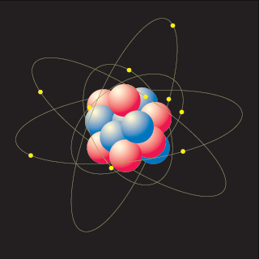
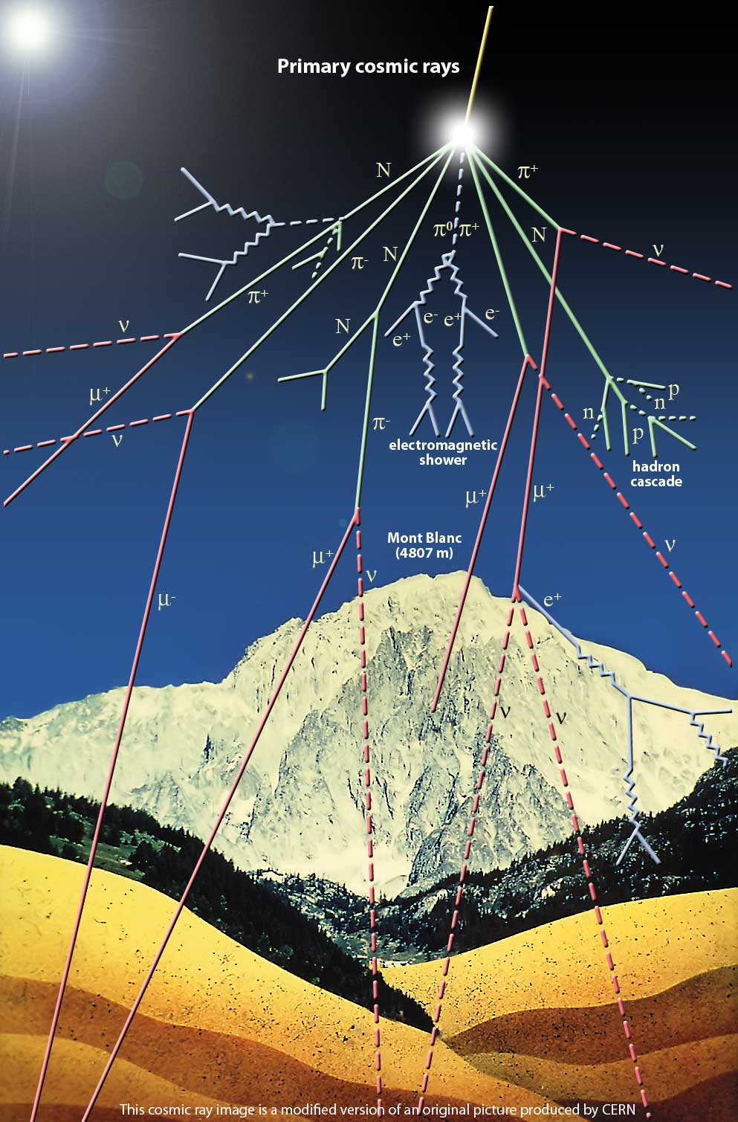
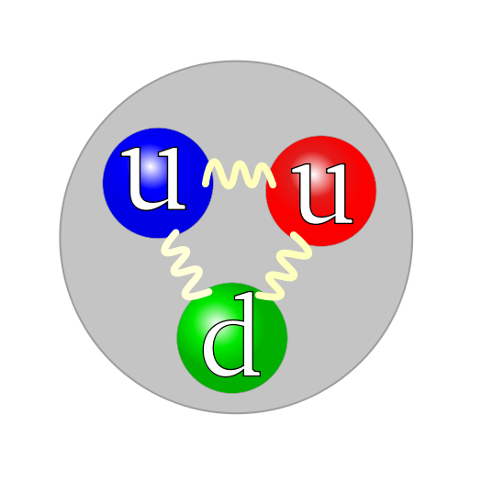
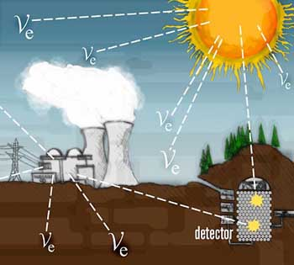
Fundamental Building Blocks
proton
e⁻
p
n
Proton and neutrons
are composite objects
made of quarks (u,d)
Q_{u}= +2/3 Q_{d}= -1/3
Can also form mesons
π⁺
Muon ~ “heavy electron”
Cosmic μ flux ~70/m²/s/sr
Solar ν flux ~6x10¹⁴/m²/s

Slide 3
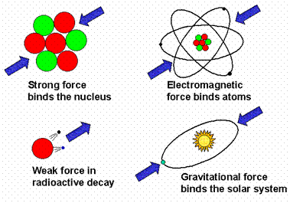
Fundamental Forces
Strong
Interaction:
Gluon g
m=0 Q=0
Spin=1
Electro-magnestism:
Photon γ
m=0 Q=0
Spin=1
Weak
Interaction:
W⁺, Z⁰
m=80, 91GeV
Spin=1
Gravity:
Graviton G
m=0 Q=0
Spin=2
Forces/interactions can be described as exchange
of mediating gauge bosons

Slide 4
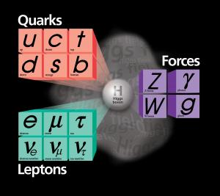
The Standard Model
Very successful in describing nearly all measurements so far, but we know we are missing something…
Large number of free parameters
Origin of the mass scales ?
Neutrino mass <1 eV
top quark mass 174 GeV
M_{plank} ~10¹⁵ GeV
Why 3 generations ?
None of the existing particles could explain dark matter.
How does gravity fit in ?
We finally got our hands on the
the mysterious Higgs boson
responsible for generating the
Masses ?

Slide 5
Beyond the SM ?
There are many interesting ideas on the market:
Super symmetry; extra dimensions…
SUSY particles, KK gravitons, Z’, mini black holes…
Many ideas support the notion that something ought to happen at the TeV energy scale (if we don’t find Higgs <1 TeV, then we also know we are fundamentally on the wrong track)
but there is a huge chasm between what looks so nice and might be true, and what is actually true.
The only way to really move forward is to do experiment at the TeV scale.

Slide 6
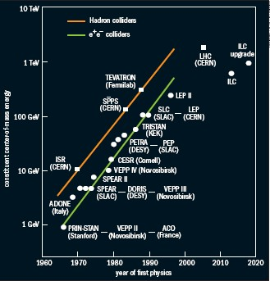
Colliders
e⁺e⁻ colliders
Well known, initial state for simpler kinematics.
Beam energy fully engaged in interaction.
Hadron Colliders
Higher energy reach but only part of the proton energy making interesting interactions.
Interesting events sitting on top of mountain of uninteresting background interactions

Slide 7
The Large Hadron Collider
The next major facility at energy frontier. Located at CERN, Geneva, Switzerland.
Proton Proton collisions @ 7+7 TeV
Two general purpose large experiments: ATLAS and CMS.
First collision Dec/09
4+4 TeV run ended in Feb/13. Restart 2015 for 6.5+6.5TeV

Slide 8
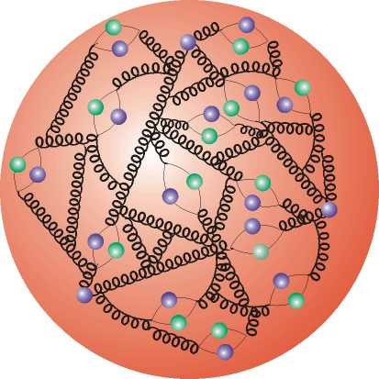
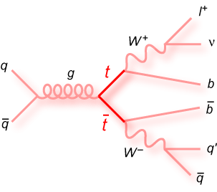
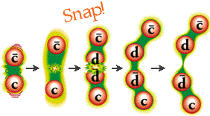
PP Collisions
A closer look at the proton
reveals a sea of partons.
qq,gg,gq interactions
and remaining proton debris.
Quarks fragment into jets of hadrons

Slide 9
Physics Processes at LHC
7 TeV
Cross sections for heavy objects such as top, Higgs or possible new particles grew substantially compared to Tevatron
but they are still under a huge mountain of QCD background.
Multiple interactions in each beam crossing at LHC luminosity also gets much worse.
Very challenging environment to pull out the interesting physics.

Slide 10
Physics Signatures
The overwhelming background at LHC is jet production, primarily gluons and light quark which all fragment into jet of light hadrons.
The more interesting objects typically decay more democratically to other particles:
__ __
Z⁰ -> bb~15%; cc~12%; e⁺e⁻:μ⁺μ⁻:τ⁺τ⁻ ~3.3% each
W -> eν,μν, τν ~11% each
top quark -> b~100%; eν+X,μν+X each ~9%
Devise experiment to detect the distinctive signatures:
e, μ, τ leptons
b quarks
Missing energy

Slide 11
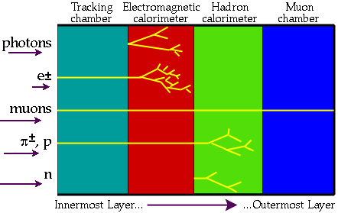
Particle Signatures
ν and other non-interacting dark matter candidates => Missing Energy

Slide 12
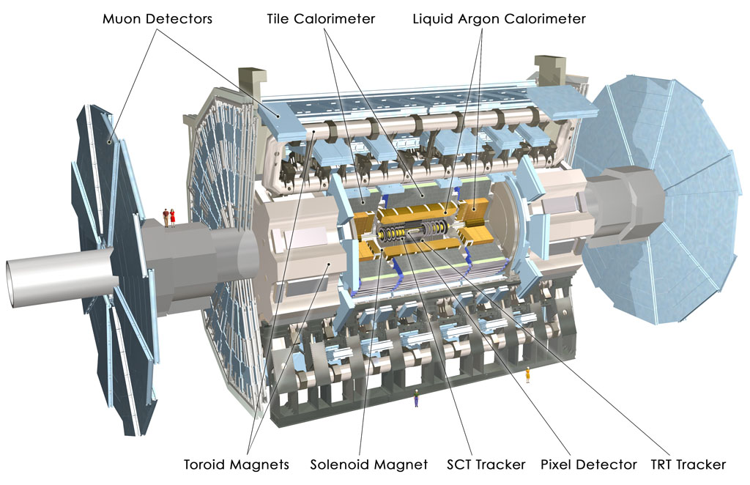
The ATLAS Experiment

Slide 13
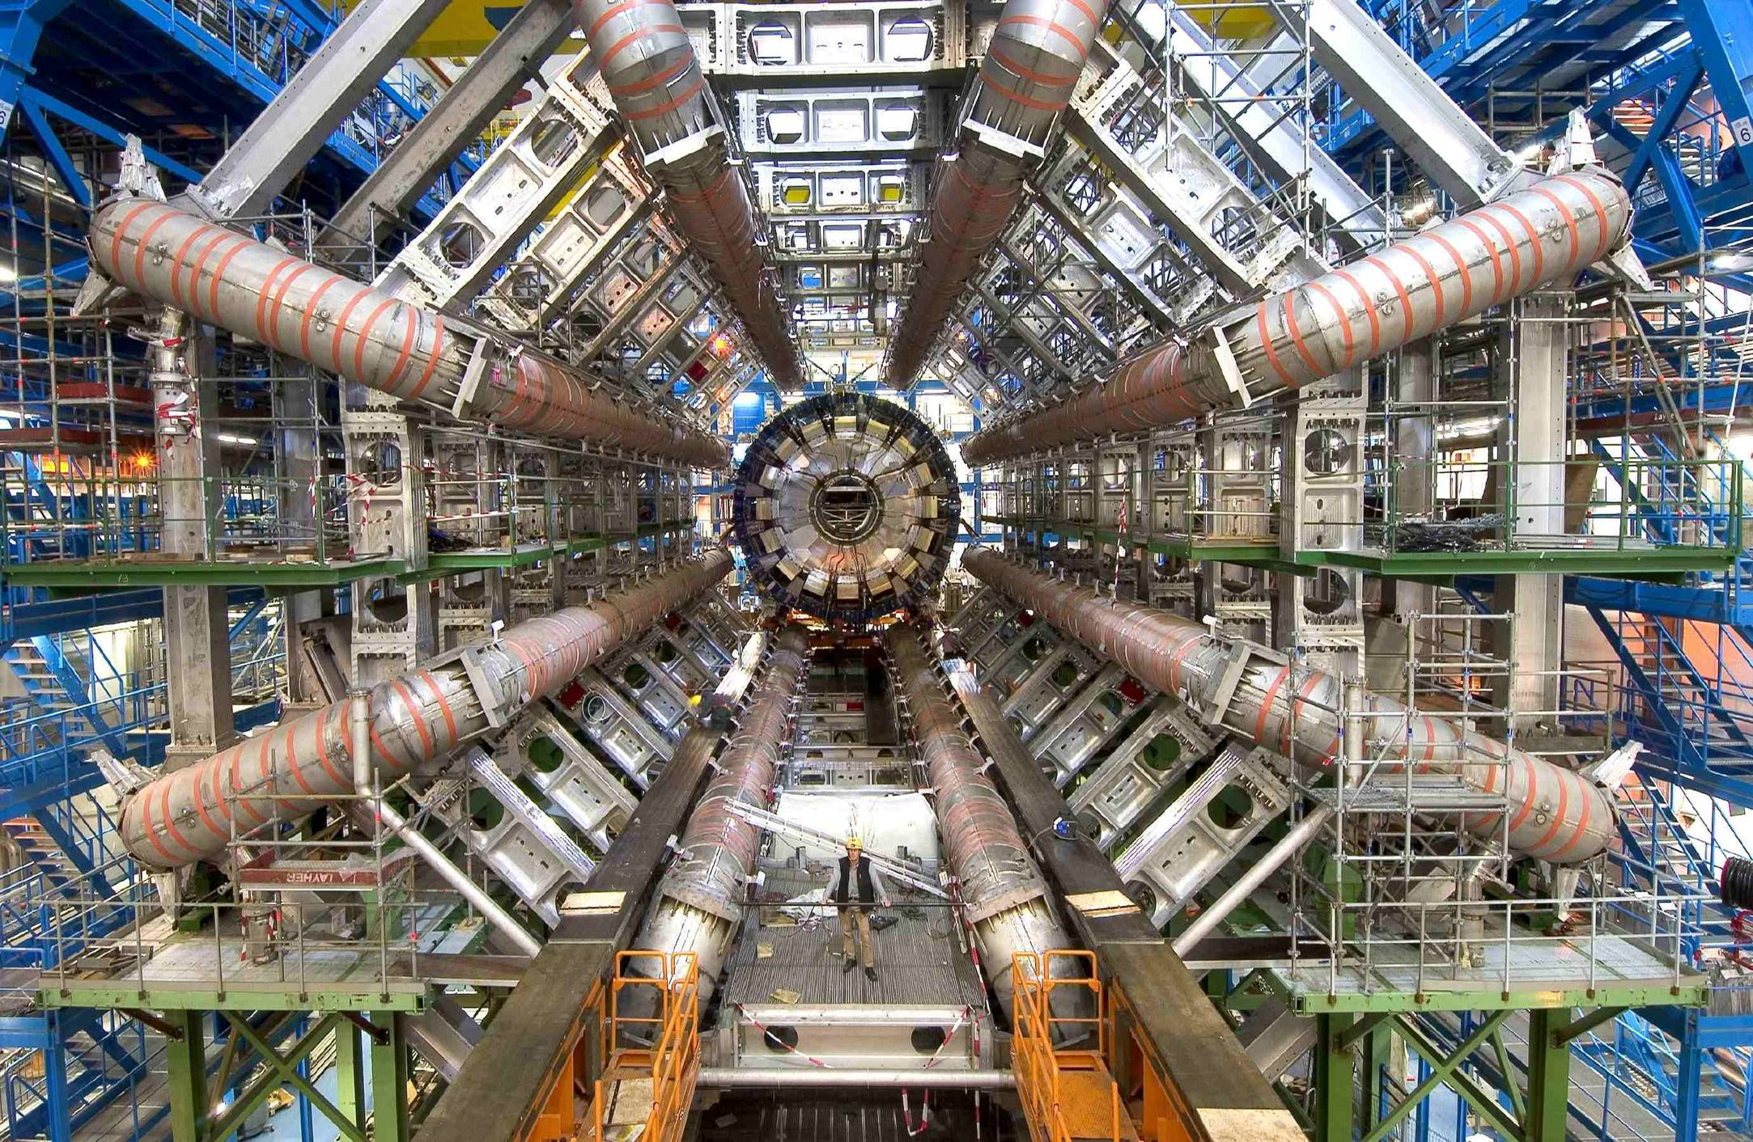

Slide 14
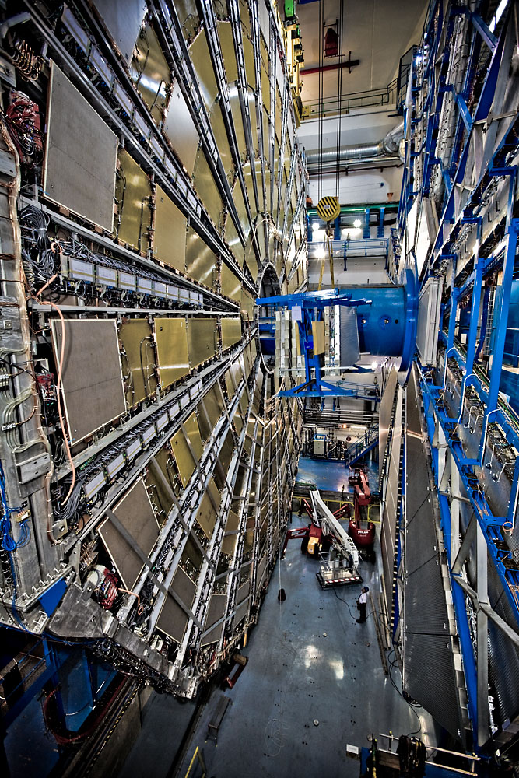
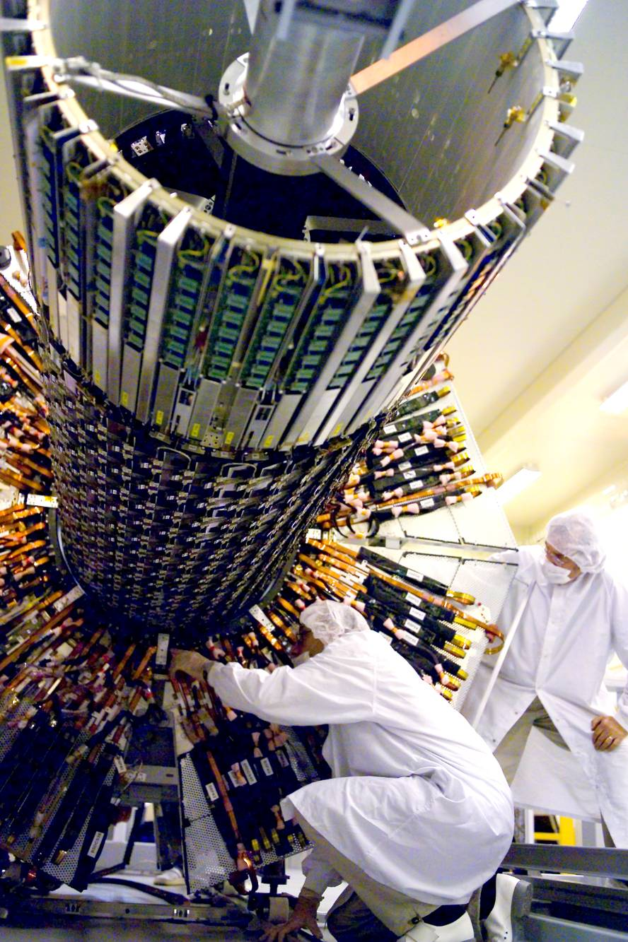

Slide 15
How Does ATLAS Detector Particles ?
See ATLAS movie Episode-2 on how detectors work:
ATLAS - Episode 2: The Particles Strike Back (part-1)
ATLAS - Episode 2: The Particles Strike Back (part-2)
Many other general ATLAS info for the public:
https://atlas.cern/

Slide 16
Trigger & DAQ
500 CPUs
1600 CPUs

Slide 17
Challenge of Detecting Interesting Physics
Simulation
~23 interactions
per beam crossing
at 10³⁴ luminosity
Higgs → ZZ → 2e+2μ
Pile up background

Slide 18
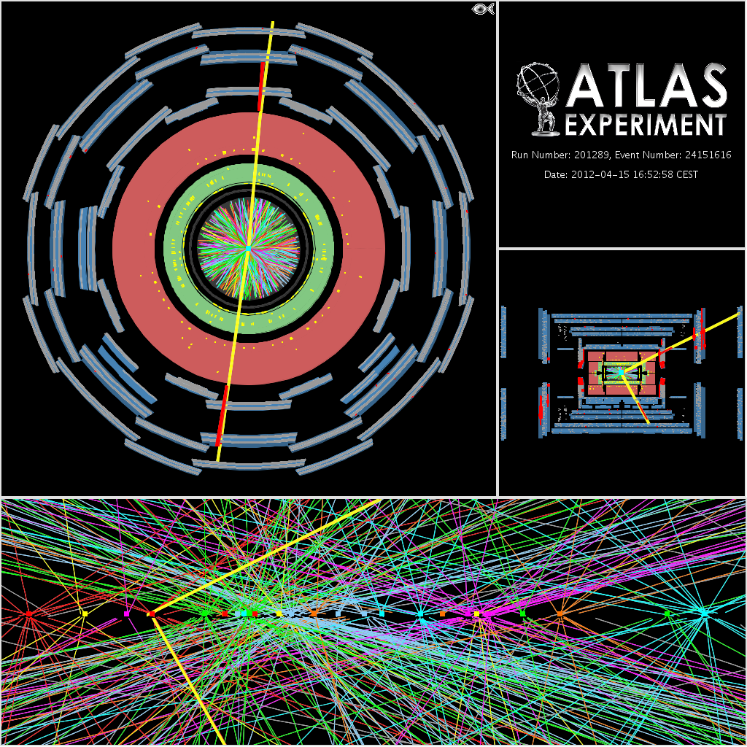
Z⁰->μμ event
on top of 25 other pileup interactions.
Challenge to experimentalists
with constant battle to suppress background.

Slide 19
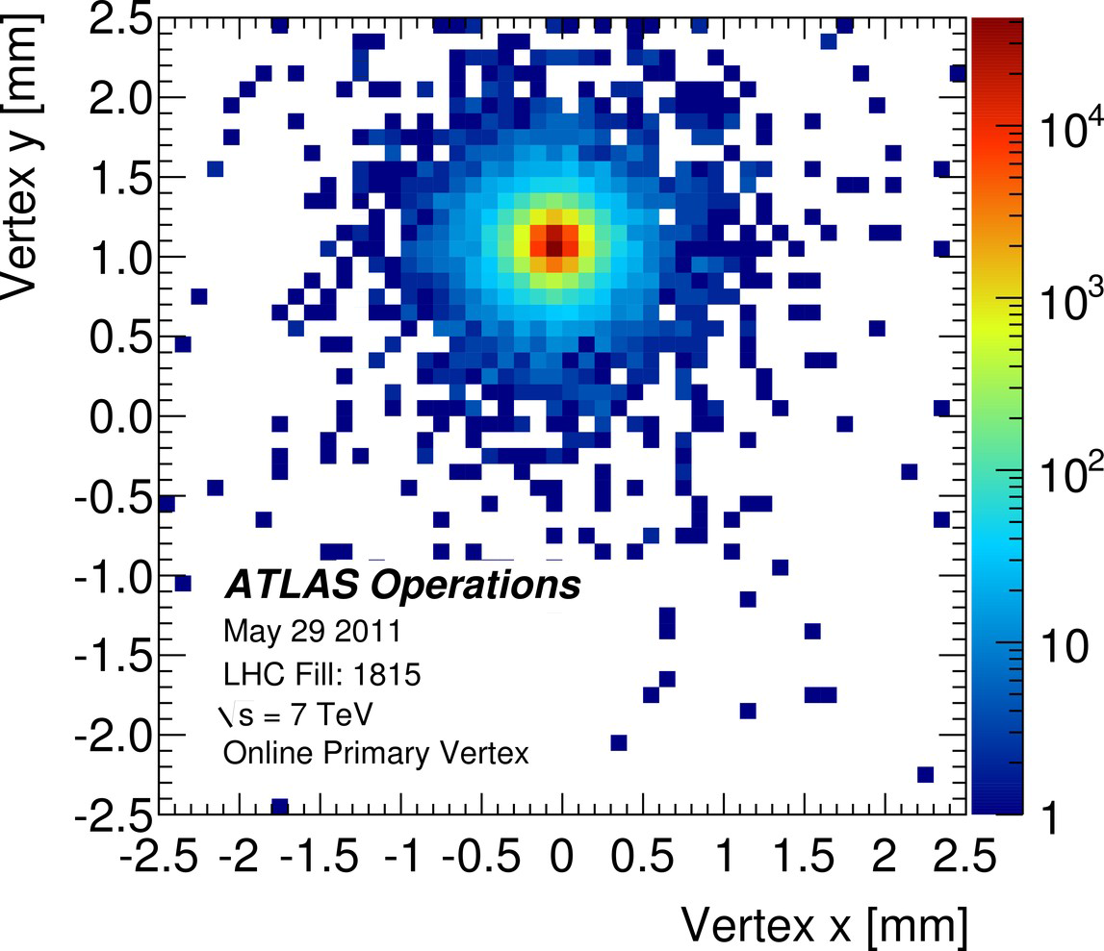
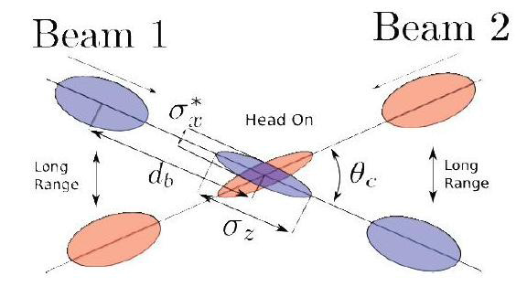
ATLAS Online Beam Spot
2μm

Slide 20
Conflictory Desires in Tracker Design
Would like t have infinitesimal granularity for best resolution
Should only consume minimal power
Should be extremely light in material to reduce multiple scattering
It should be very radiation hard
Has infinite bandwidth for shipping data
There should be just a few cables
It’s better to only cost pocket change

Slide 22
Radiation Hard Silicon Pixel Detector

Slide 23
ATLAS Insertable B-Layer (IBL) Pixel Detector for 2015
Enhance capability to identify b quarks – for e.g. Higgs->bb

Slide 24
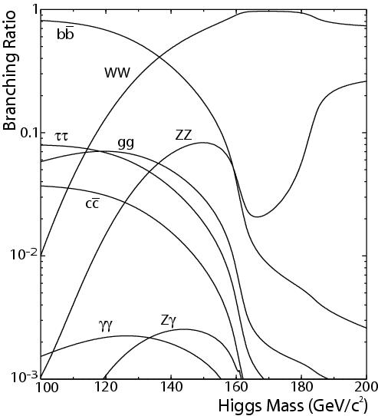
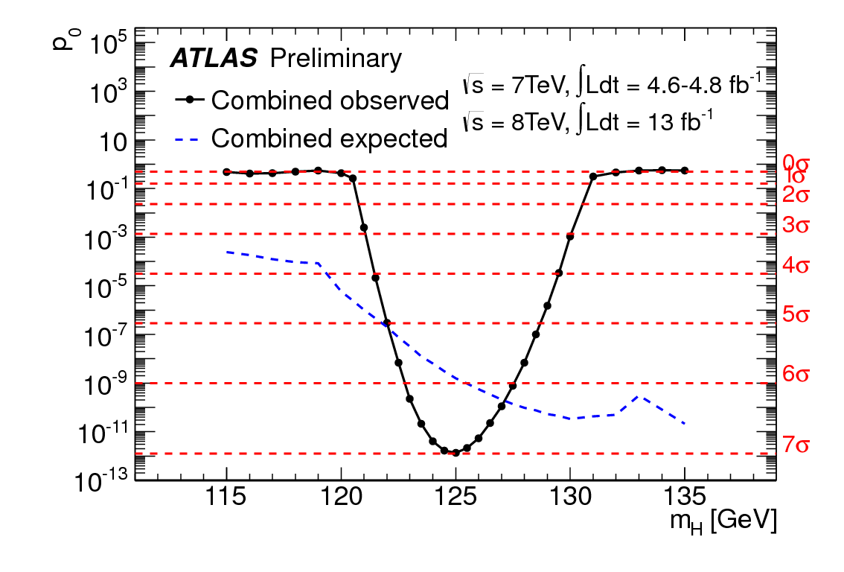
Searching for Standard Model Higgs
So far observed γγ,ZZ,WW decay modes
Getting close on bb, ττ modes
Trying to determine the spin
Really the SM Higgs ?
Is this the only Higgs ?

Slide 25
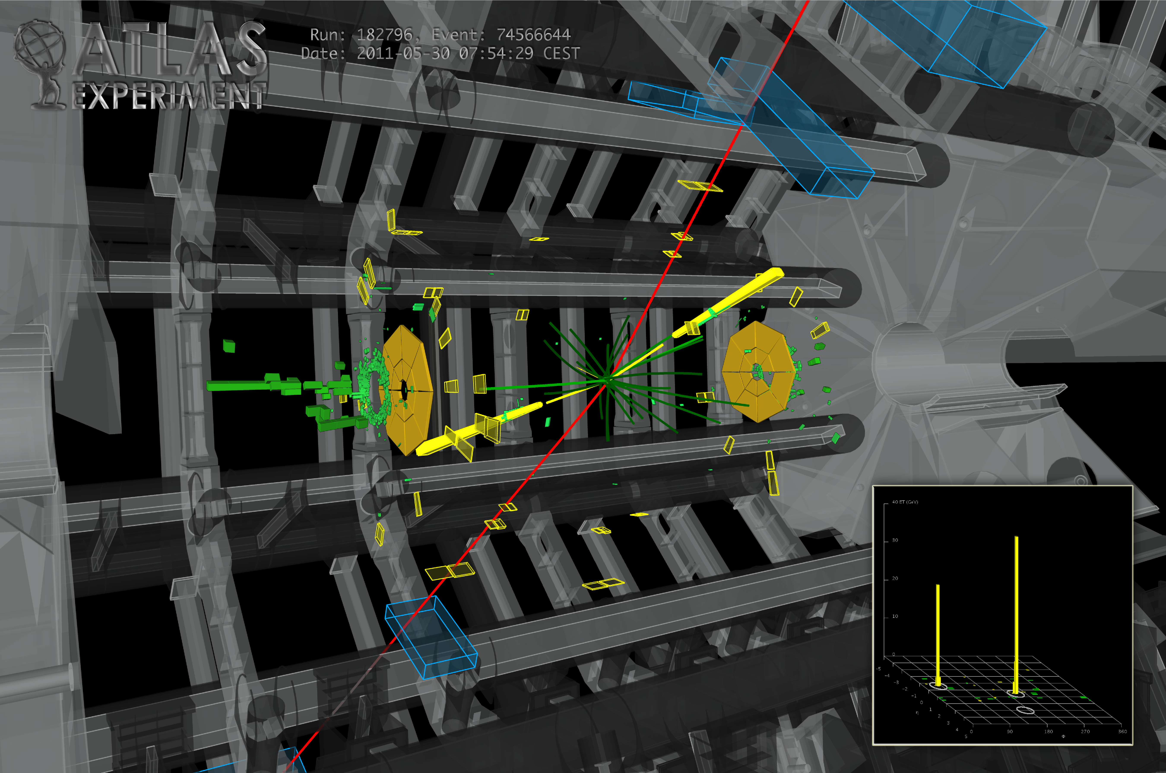
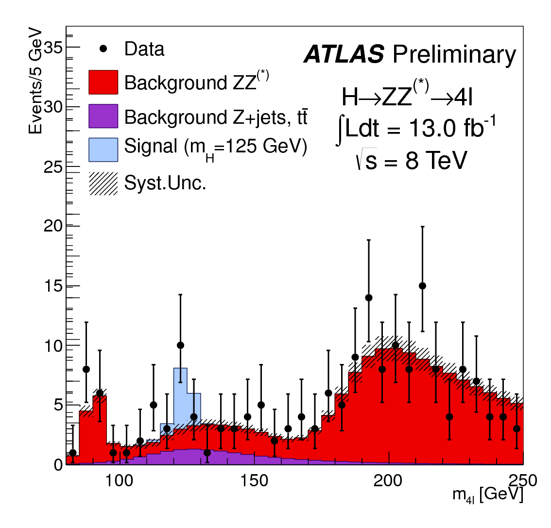
h->ZZ->μμee candidate

Slide 26
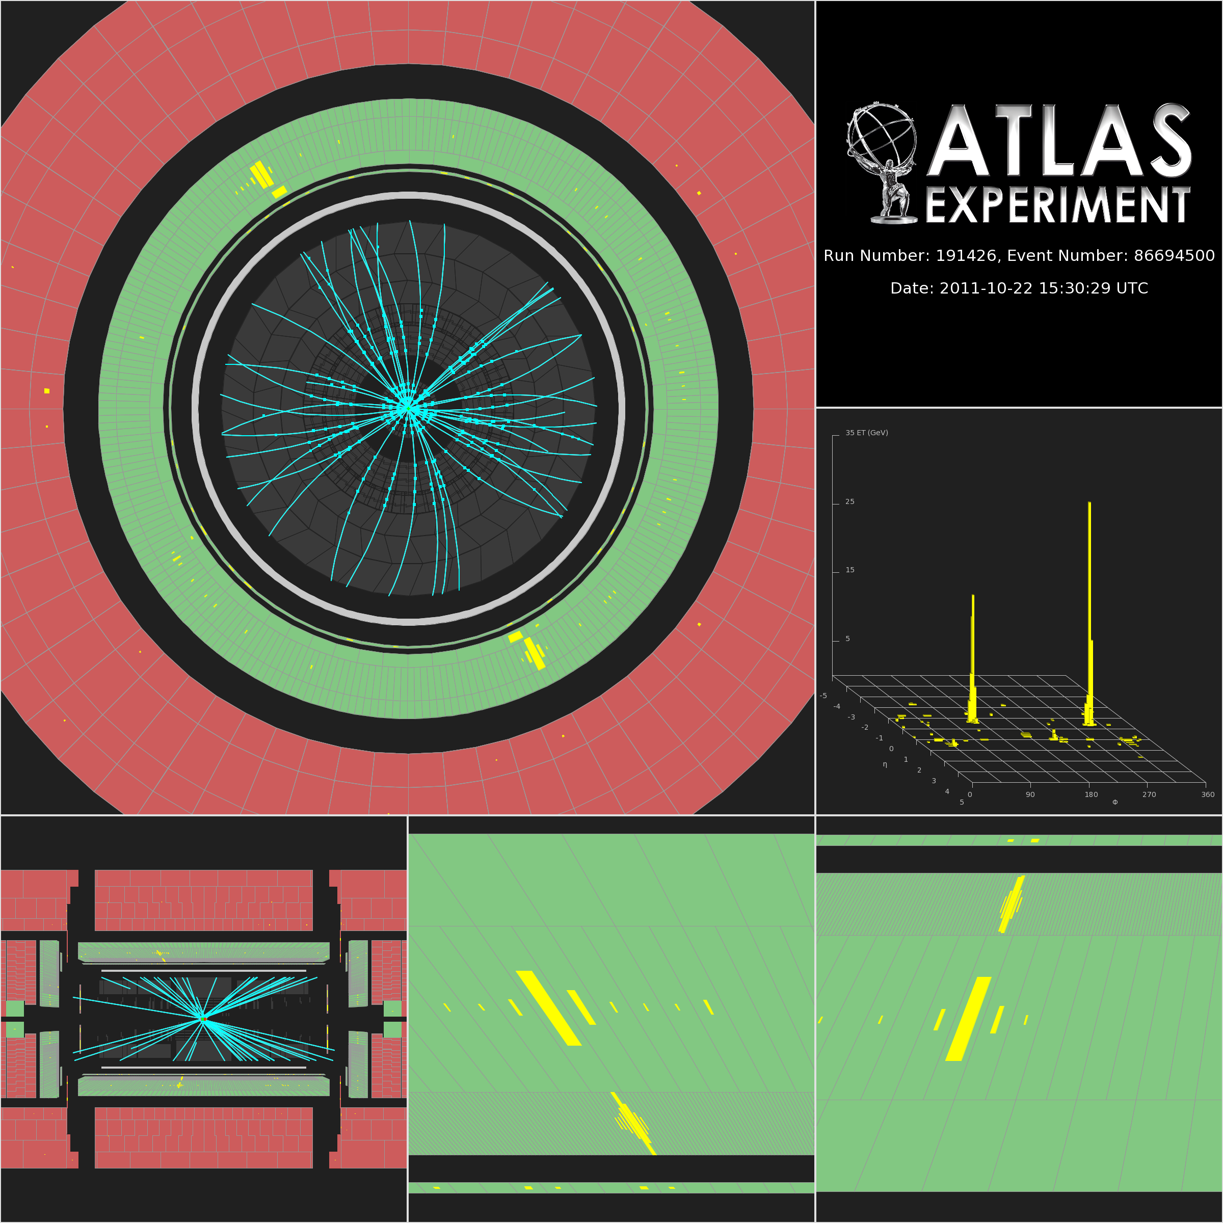
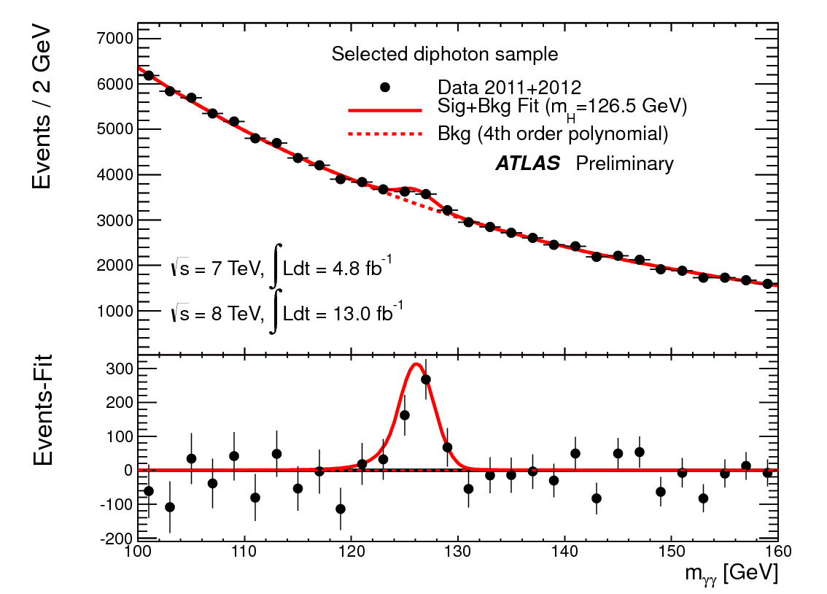
h->γγ candidate

Slide 27
LHC Road map

Slide 28
Summary
Collider detectors and computing are major technical challenges.
LHC accelerator and detectors represent a monumental peak of HEP achievements.
Already one major discovery at LHC and hopefully more are on the way.
The high luminosity LHC challenge require upgrades to detectors that are underway.

Slide 29
Online Resource and Contacts
Large Hadron Collider:
Wikipedia: https://en.wikipedia.org/wiki/Large_Hadron_Collider
LHC: https://home.cern/science/accelerators/large-hadron-collider
ATLAS experiment public info:
https://atlas.cern
SLAC ATLAS Activities
https://atlas.slac.stanford.edu/
Contact me:
sudong@slac.stanford.edu
(650)-926-2284

