Slide 1
Thursday Announcements
Workshop group photo to be taken just before Thursday afternoon break (~3:30pm) on the lawn in front of CEMEX Auditorium.
Campus self-guided tour (6-7pm)
See Social Event page for walk route recommendation for Main Quad then Rodin Garden + Cantor museum. (Reg desk has Stanford map with main landmarks).
People with cars can drive to tour spots (free parking after 4pm) and depart to dinner from there.
Dinner at University Club 7:45pm, drinks start 7:15pm
(bring your ticket)
People with rental cars should give rides and drive to dinner (no bus return to campus). Driving directions at reg desk/social page.
Bus to dinner depart from Cantor Museum at 7:00pm.
Bus to hotel after dinner departs 10:00pm.
Signup to Friday afternoon Stanford NanoFab Facility tours now open on Social event page.

Slide 2
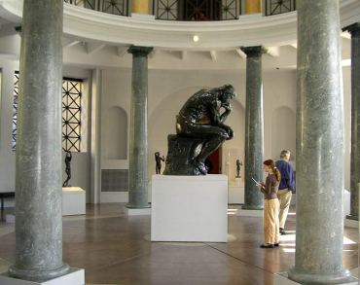
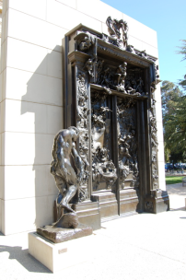
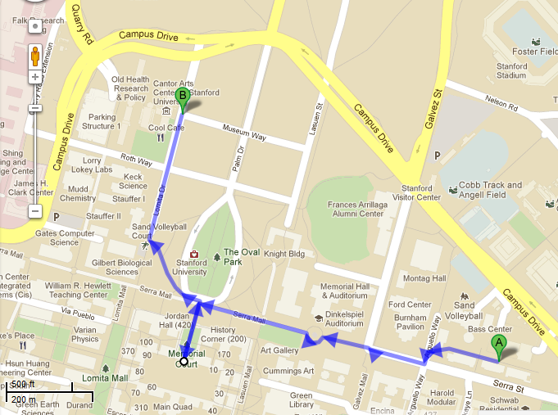
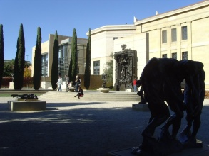
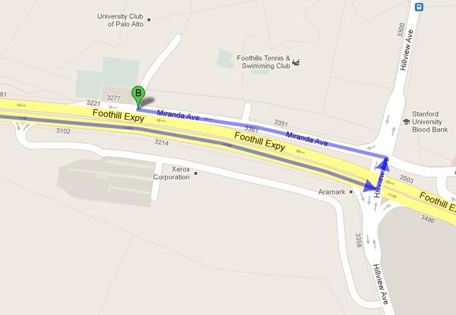
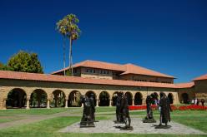
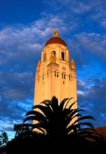
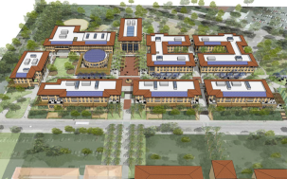
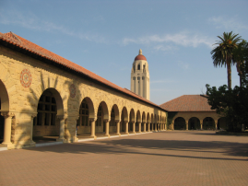
Stanford Campus Self-tour
Dinner Driving Directions
To University Club
Cantor Museum & Rodin Garden
U-turn at Hillview into
Miranda Ave

