Slide 1
IDENTIFICATION OF THE IDEAL SITES FOR MARINE TURBINE IN MADAGASCAR
Nirilalaina RANDRIATEFISON¹, Yvon ANDRIANAHARISON²
1: Ecole Normale Supérieure
2: Ecole Supérieure Polytechnique
Université d’Antananarivo, Madagascar

Slide 2
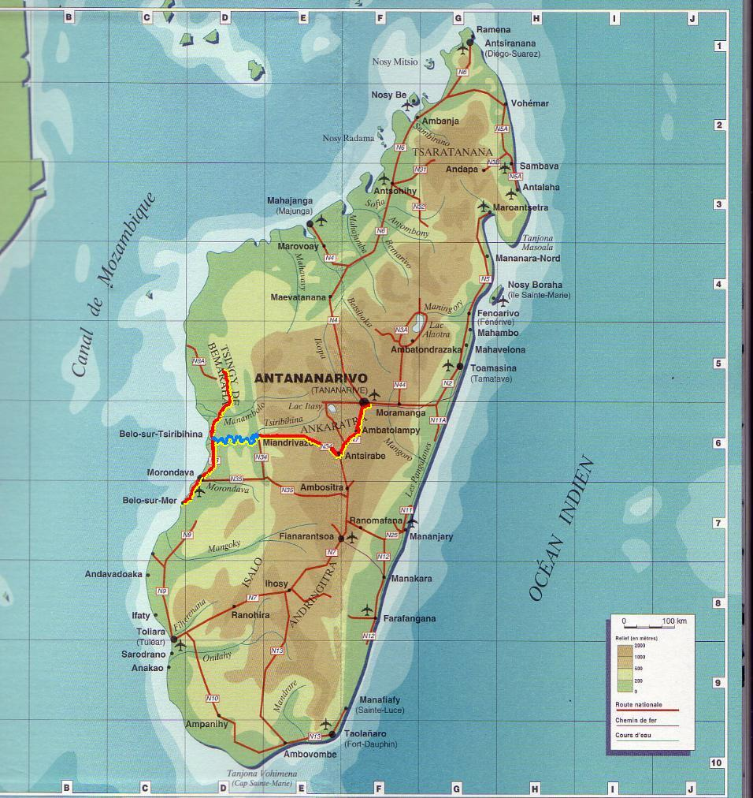
Diego Suarez (Antsiranana), located in the Far North
Majunga(Mahajanga) in the northwest
Tulear(Toliara) in the southwest
Morondava in the west
And Nosy Be, the coastal island of Madagascar located in the Mozambique Channel
Map of Madagascar
Source: http://gasykarajia2008.skyrock.com

Slide 3
Source : Les hydroliennes , Jacques Ruer, SAIPEM , Conférence mer et littoral de Bretagne, Hydrolien Fromveur, 3 juin 2013

Slide 4
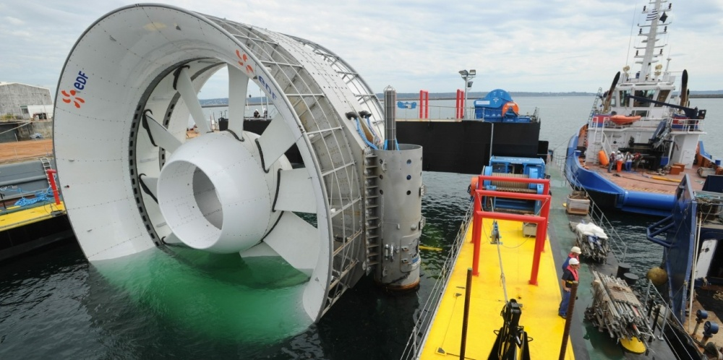
In France, in 2017, the company OpenHydro / Naval Group installed 2 tidal turbines (with a diameter of 16m and a cumulative power of 1 MW), bay of Saint Brieuc,
Source: Photos d’archives Le Télégramme
" Marine Energy Action Plan 2010" aims:
to save 17 million tons of CO₂ by 2030 and 60 million tons by 2050,
creating 16,000 jobs
The United
Kingdom

Slide 5
Main forms of capturing this energy :
transformation of the kinetic energy of marine currents, including tidal currents encountered near the coast in the case of the marine turbine here treaty;
use of potential energy related to tidal range (it is the difference of level between full and low tide) by tidal power plants of the Rance type;
use of wave energy from the wind on the surface of the sea (also-called "wave energy")

Slide 6
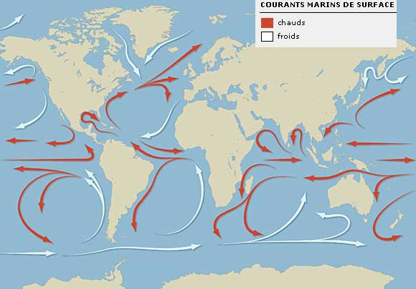
The warm currents (in red)
The cold currents (in white)
Source :
- www.kolpex.servhome.org
- Razouls C., de Bovée F., Kouwenberg J. et Desreumaux N., 2005-2017. - Diversity and Geographic Distribution of Marine Planktonic Copepods, CNRS, UPMC

Slide 7
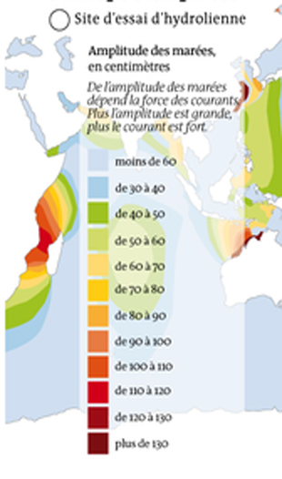
Source : MEDDE, Dossier de presse, 2013 ;
Conférence Institut Coriolis, 2010
C : the coefficient of the tide
hm : the time of the tide
V_{me}(hm) et V_{ve}(hm) : speeds

Slide 8
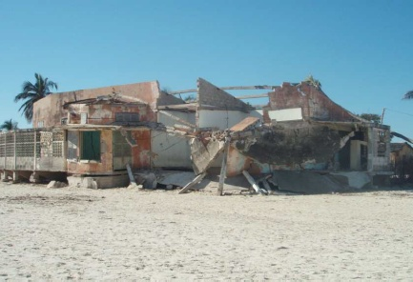
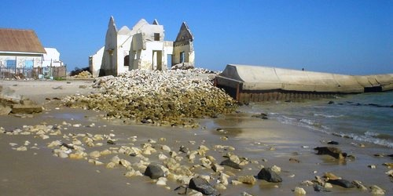
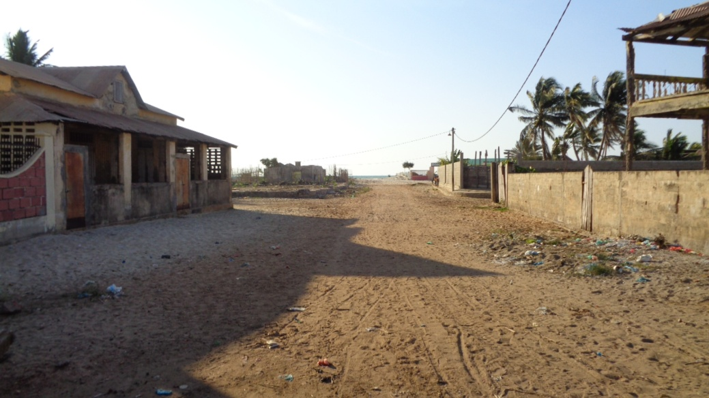
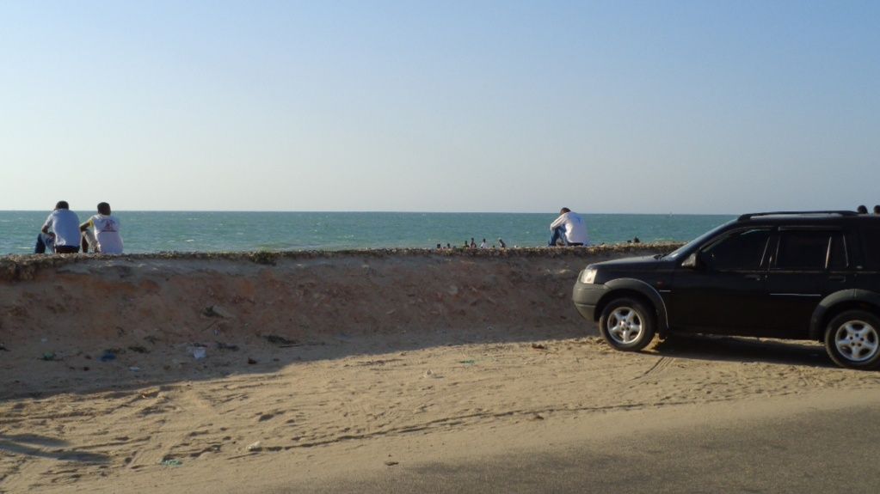
Mischief of marine erosion on the coast
Source: Razafimbelo M.R.
Source: http://www.morondava-autrement.com
Abandoned village near to the beach
Protective dam

Slide 9
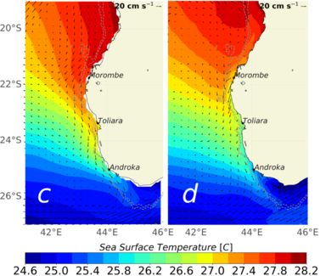
A new marine current along Madagascar
Source: Ramanantsoa, J. H. D., P. Penven, M. Krug, J. Gula, and M. Rouault, Uncovering a new current: the South-west MAdagascar Coastal Current (SMACC), 2018, Geophys. Res. Lett., 45, 2017GL075900

Slide 10
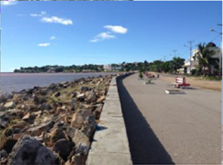
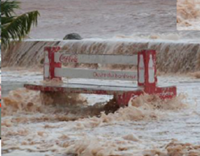
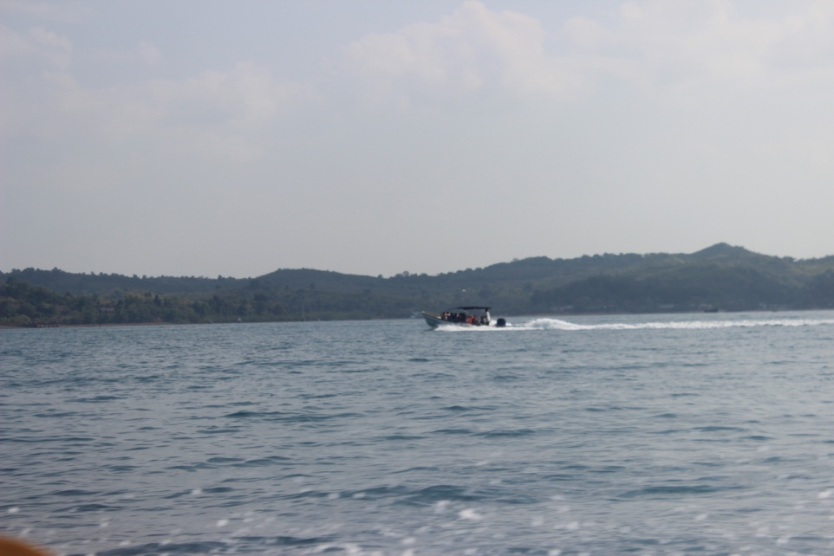
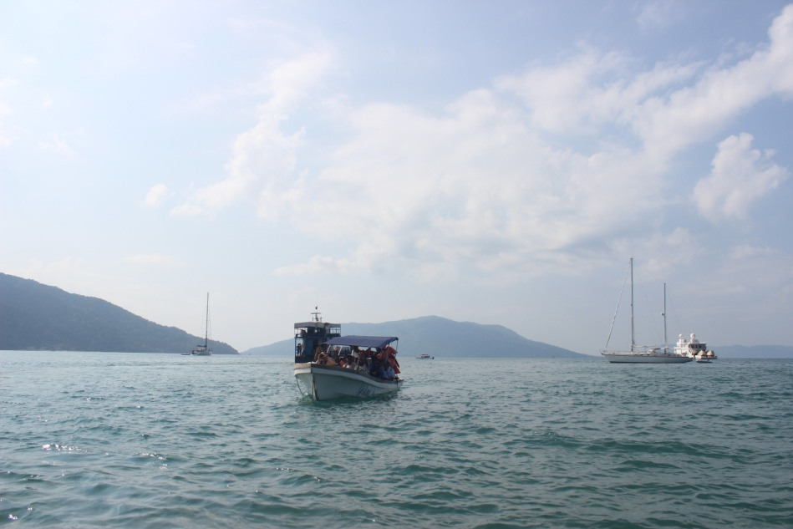
The "Edge of Mahajanga “:
the most stable zone in normal times
during the passage of cyclone Hellen in 2014
Source: Mandimbiharison Aurélien
Waves of Nosy Be Island

Slide 11
To be favorable for the installation of this tidal energy equipment, the sites must meet the following criteria:
current greater than 4 or 5 knots;
depth of about 40 meters;
proximity to the coast to pull a submarine cable
=>These criteria met by the cities of the west coast of Madagascar, therefore, the projects of installation of tidal turbines are favorable.

Slide 12
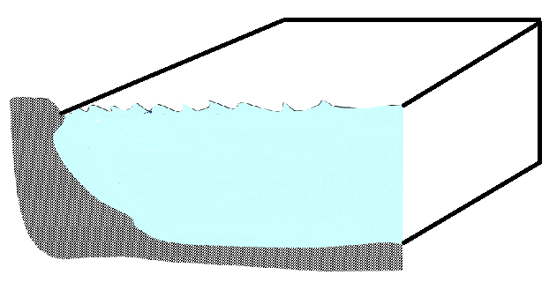
The equation of continuity
The Navier-Stokes equations
H: Height of total water of it (m)
d : Rating of the bathymetry in relation to the middle level
η : Variations of the free surface
S_{n}
Wind
η
S_{m}
S_{l}
H
d
Tidal database:
the height,
the period,
the pressure,
wave direction, in addition to measuring currents.
Bathymetry
Geometry of the study area

Slide 13
Honorable audience,
Thank you for your attention

