Slide 1


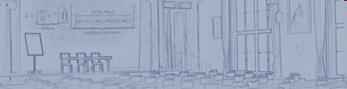
Hadron Physics at KLOE and KLOE-2
Camilla Di Donato
Sez. INFN Napoli
On Behalf of KLOE and KLOE-2 Collaborations

Slide 2
Hadron Physics at KLOE and KLOE-2
KLOE performed several precision measurement this talk ⇒Results on hadron physics:
  η decays and FF
  γγ → η and γγ → π⁰ π⁰
KLOE and DAFNE upgrade
Perspective for KLOE-2 on Hadron Physics
  Rich program: see Eur. Phys. J. C 68 (2010), 619

Slide 3
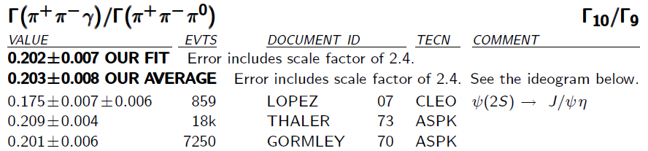
Box Anomaly:
Box Anomaly: in the η⁽′⁾→π⁺π⁻γ decay a significant contribution from the chiral anomaly responsible for π⁰/η⁽′⁾ →γγ decay is expected.
Studies of the two pion system → M_{ππ} allow for tests of ChPT and its unitarized extensions, e.g. VMD or chiral unitary approach.
[Holstein, Phys. Scripta, T99 55 (2002); Benayoun, Eur. Phys. J., C31 525 (2003); Borasoy, Nissler, Nucl. Phys., A740 362 (2004)]
Existing data are low in statistic and not acceptance corrected; not sufficient for unambiguous theoretical interpretation [Gormley, Phys.Rev. D2 501 (1970); Layter, Phys.Rev. D7 2565 (1973)]
CLEO latest result differ from old measurement > 3σ

Slide 4
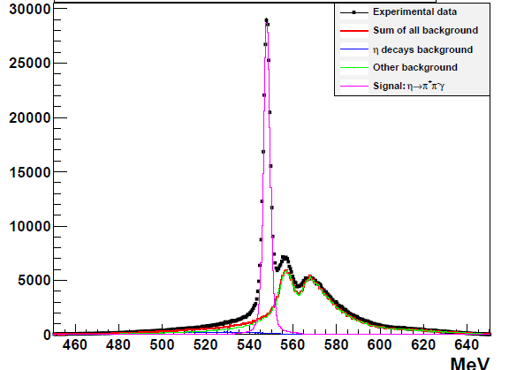
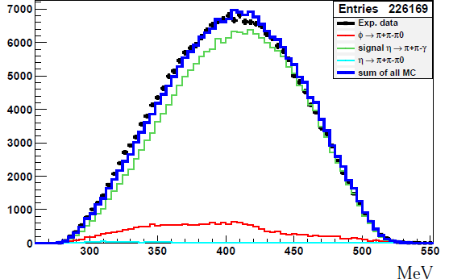
Box Anomaly:
Mππγ (MeV)
Mππ (MeV)
L = 558 pb⁻¹; N _{η→π+π−γ} = 204 950;
ε=(21.31±0.04)%; B/S=10%;
δ(Γ(η→π⁺π⁻γ)/ Γ(η→π⁺π⁻π⁰)) = 0,3% _{stat} ; 1% _{syst}
Fit to the Mππ shape with VDM in progress
preliminary
@KLOE-2: η′→π⁺π⁻γ 120'000 for one year run

Slide 5
Branching ratio:
Sub. To PLB
arXiv : 1105.6067
Data Sample: 1.7 fb⁻¹
MC (J. Bijnens and F.Persson, arXiv:0106130)
And FSR
Fit to the M_{eeee} with MC shapes for signal and events from the continuum
First observation!

Slide 6
Form Factor Measurement:
Existing measurements on transition FF involving η meson:
Notes:
Aggiungi importante per light by light

Slide 7
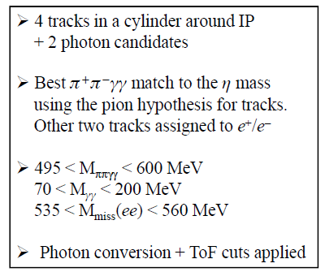
Form Factor Measurement:
Sample: 739 pb⁻¹
η→π⁺π⁻ π⁰ ⇒ BR=22.7%
BR(φ→ηe⁺e⁻)=1.15×10⁻⁴

Slide 8
Data MC Comparison: Preliminary
7×10³ φ→ηe⁺e⁻ →π⁺π⁻ π⁰ e⁺e⁻
MC M_{ee} shape from VDM with FF slope from SND (213 events)
  next⇒ Extract directly from our data

Slide 9
Fit to the M_{ee} Shape
Using decay parametrization
from Landsberg85 and F(q2)
approx. from Achasov,
Kozhevnikov, Sov. J. Nucl.
Phys. 55 (1992) 449

Slide 10
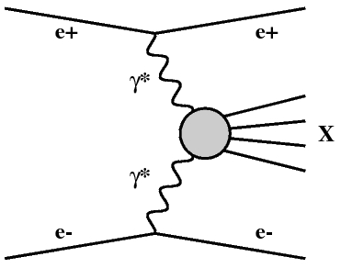
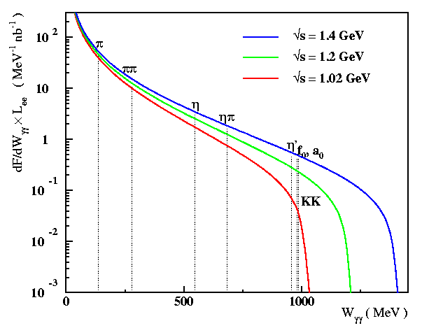
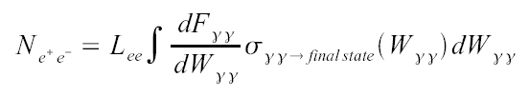


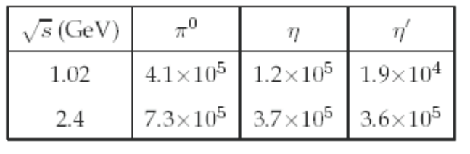
γγ Physics:
Weizsäcker-Williams approx, |q_{γ}²| << W²
Tagger is essential to reduce bckg
from φ and to close kinematics → KLOE-2
L_{int} = 1 fb⁻¹
X

Slide 11
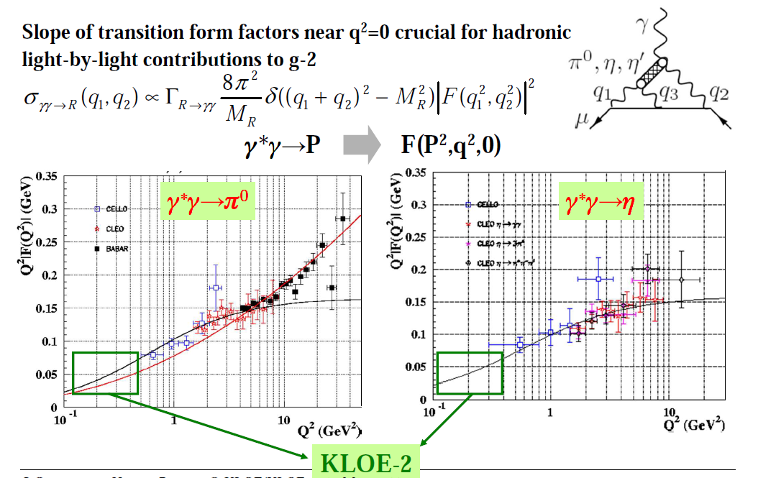
γγ Physics: Meson Transition Form Factor

Slide 12
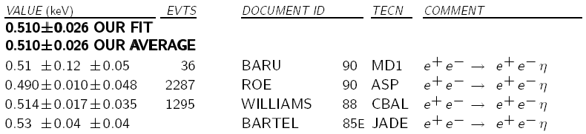
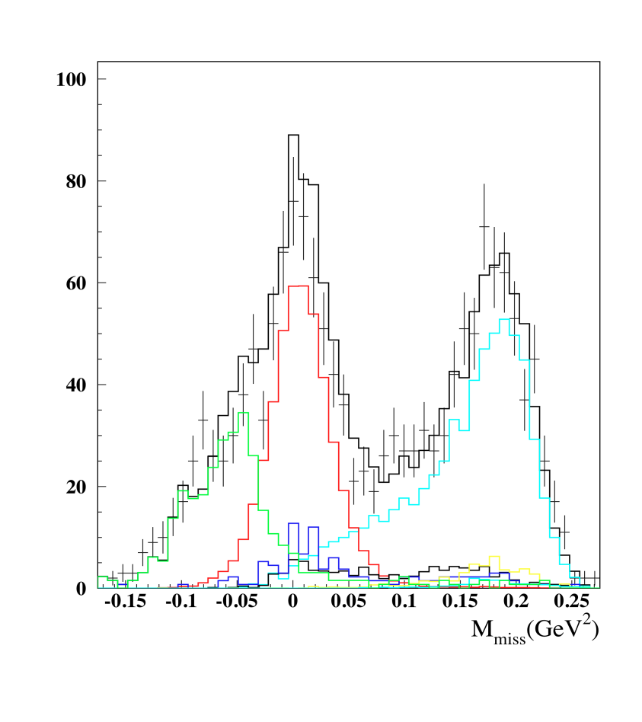

γγ Fusion:
@KLOE without tagger
√s (GeV)
7.2-10.4
29
9.4-10.6
34.6
γγ→η studied at KLOE
Data sample: 240 pb⁻¹ @ √s = 1 GeV
(reduced bckg contamination from φ)
Selected channel: η→π⁺π⁻π⁰
Main background: φ→ηγ with
undetected photon
Extraction of σ(e⁺e⁻→e⁺e⁻η) and Γ_{γγ} in progress
Statistical accuracy on Γ_{γγ} comparable with existing measurements

Slide 13
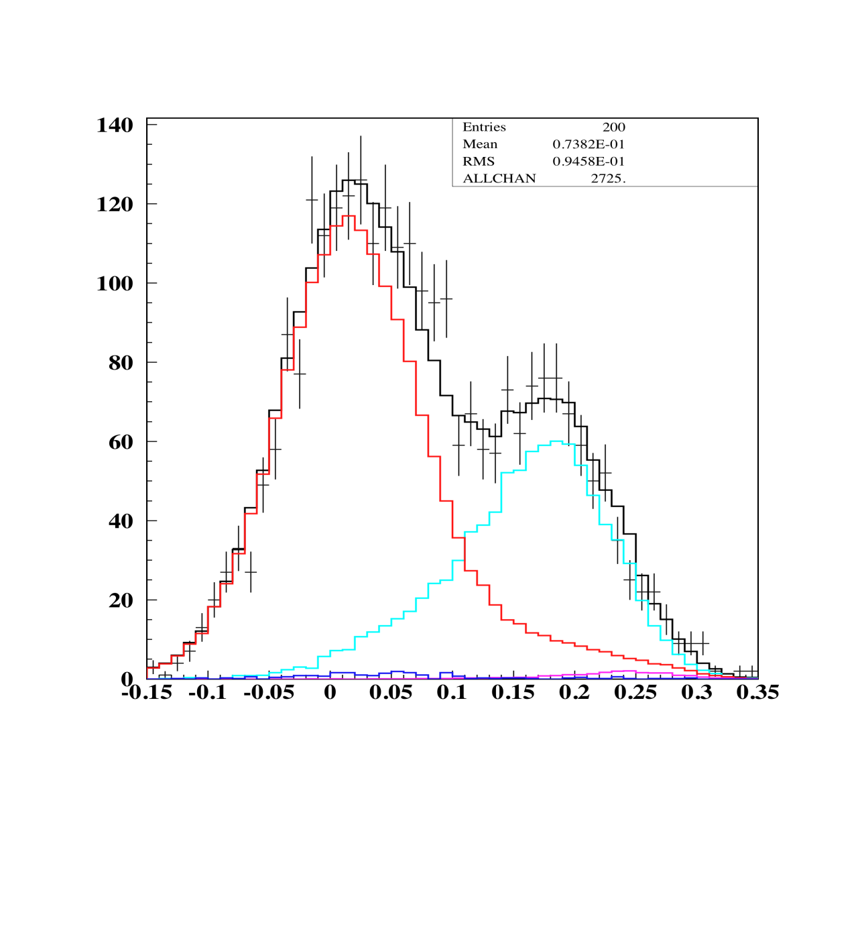
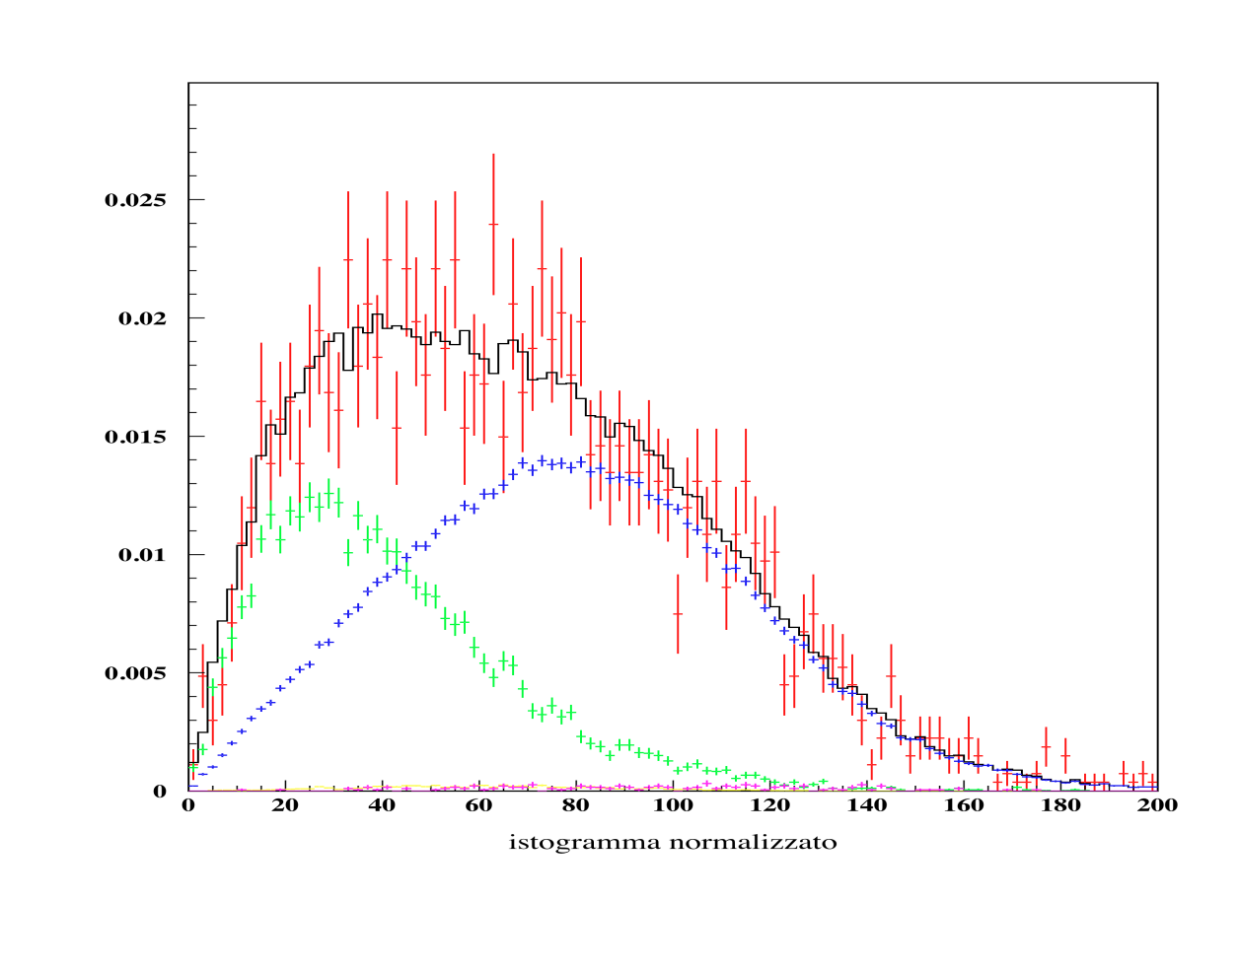

γγ Fusion:
@KLOE without tagger
e+e- → ωπ⁰ fixed, other backgrounds left free
contribution mainly
from γγ → η and e⁺e⁻ → ηγ
2725 events after selections
χ²_{fit} /d.o.f.= 56.9/46
MC all contr.
Signal
ηγ
ηγ
Signal
data*
p_{T} (MeV)
From the fit:
N(γγ→η→π⁰π⁰π⁰) = 921 ± 35
Preliminary

Slide 14
γγ Fusion:

Slide 15
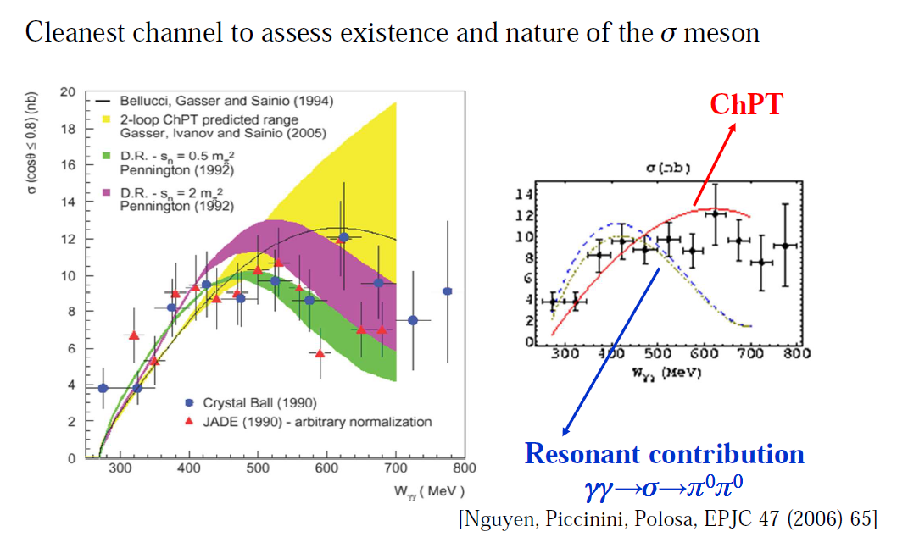
γγ Fusion:

Slide 16
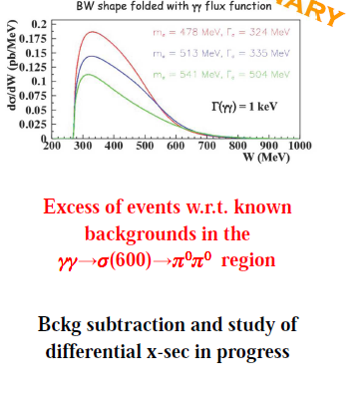
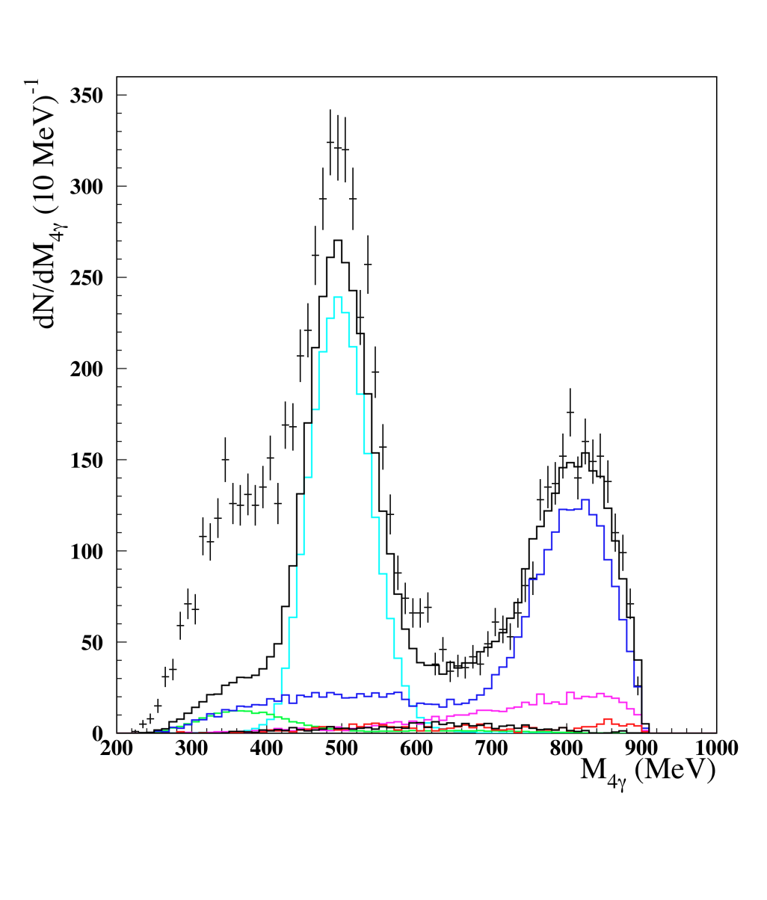
@KLOE without tagger
γγ Fusion:
PRELIMINARY
240 pb⁻¹ @ √s = 1 GeV
8090 events after selections
Bkg normalized using x-sections
K_{S}K_{L}
ωπ⁰
f₀γ

Slide 17
Conclusions and Outlooks
High statistic samples of light mesons produced @KLOE allowed to perform precision measurement and to look for very rare decays
New data taking @KLOE-2:
  Run started on November 2010: first collisions @DAφNE, mainly for data quality and background study
  Detector ready to take data
  Several machine hardware failures: we will restart in September 2011
  Rich physics program: Eur. Phys. J. C 68 (2010), 619
Upgrade: from KLOE to KLOE-2, completion expected in spring 2012
Notes:
One year @ φ peak to get O(5 fb⁻¹)

Slide 18
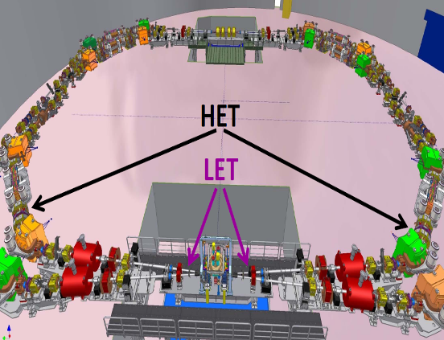
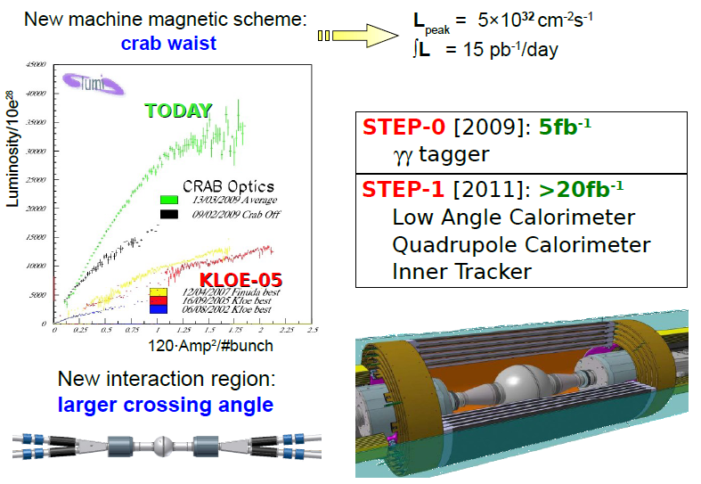
DAφNE & KLOE UPGRADE
DAΦNE upgrade
New interaction scheme:
large beam crossing angle + sextupoles for crab waist
Luminosity increase:
factor ~ 3; ∫ Ldt ≈ 1 pb⁻¹/hour
KLOE2: two step upgrade
  0.taggers for γγ physics: to detect off-momentum e± (LET/HET)
  1.IT+ small angle calorimeters
IT
New scheme
Old scheme
QCALT
CCALT
18

Slide 19
From KLOE to KLOE-2: IP detector
Minimal detector upgrade for first KLOE-2 run (≈5 fb⁻¹ in 1 year):
taggers to detect momentum of leptons in e⁺e⁻→e⁺e⁻γ∗γ∗→e⁺e⁻X
LET: E=160-230 MeV
Inside KLOE detector
LYSO+SiPM
σ_{E}<10% for E>150 MeV
HET: E > 400 MeV
11 m from IP
Scintillators + PMTs
σ_{Ε} ∼ 2.5 MeV
σ_{T} ~ 200 ps

Slide 20
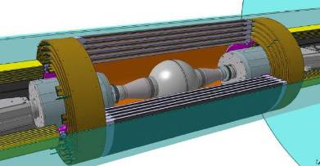
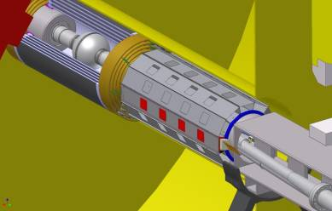
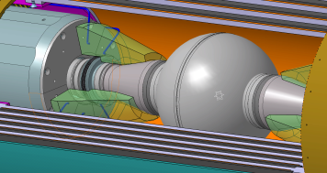
From KLOE to KLOE-2: IP detectors
INNER TRACKER
4 layers of cylindrical triple GEM
Better vertex reconstruction near IP
Larger acceptance for low p_{t} tracks
QCALT
W + scintillator tiles + SiPM/WLS
QUADS coverage for K_{L} decays
CCAL
LYSO + APD
Increase acceptance for γ’s from IP (21°→10°)
Major detector upgrades (late 2011) for second KLOE-2 run:
Notes:
20

Slide 22
SPARE

Slide 23
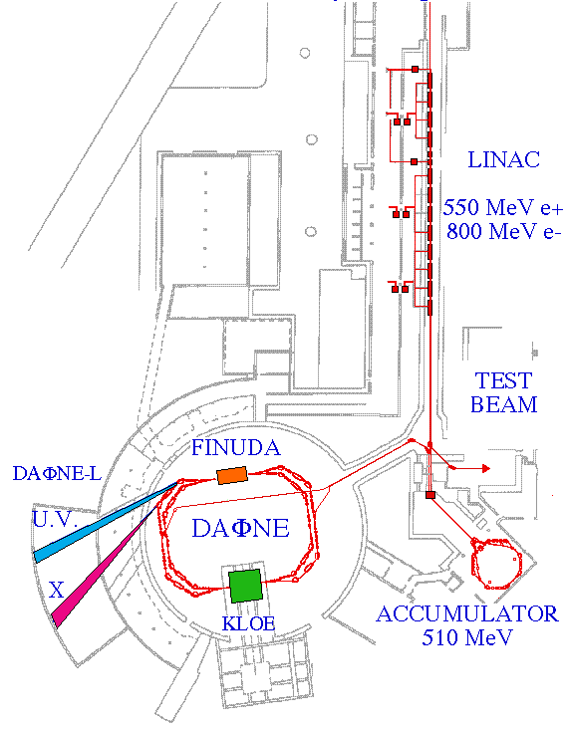
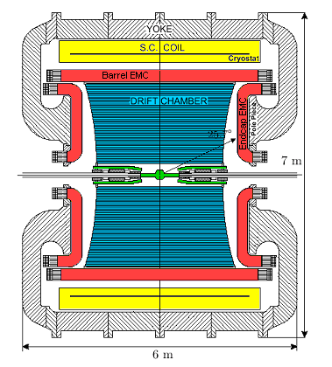
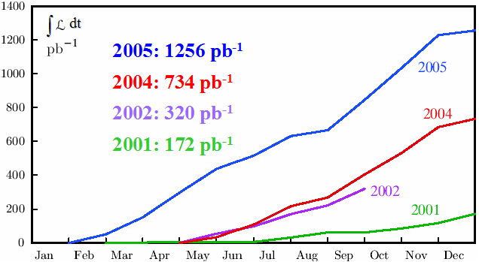
KLOE and DAFNE upgrade
Data taking ended on March 2006
2.5 fb⁻¹ on tape @ √s = M_{φ}
8×10⁹ φ ⇒ ~ 10⁸ η ⇒ ~ 5 ×10⁵ η´
10 pb⁻¹ @ 1010, 1018, 1023, 1030 MeV
250 pb⁻¹ @ 1000 MeV
Frascati φ-factory: e⁺e⁻ collider
@ √s ≈1020 MeV ; σ_{peak}≈3.1 μb
Best performances in 2005:
  L_{peak} = 1.4 × 10³² cm⁻¹s⁻¹
  ∫ Ldt = 8.5 pb⁻¹/day

Slide 24
KLOE-2 Physics Program
Goal: ~20 fb⁻¹ in the next 3-4 years to extend the KLOE physics program
at DAΦNE upgraded in luminosity (approved):
[G.Amelino-Camelia et al., Eur. Phys. J. C 68 (2010), 619-681
γγ physics
Light meson spectroscopy
Kaon physics
Dark matter searches
Hadronic cross section
  Existence (and properties) of σ/f₀(600)
  Study of Γ(S/PS→γγ)
  PS transition form factor
  Properties of scalar/vector mesons
  Rare η decays
  η′ physics
  Test of CPT (and QM) in correlated kaon decays
  Test of CPT in K_{S} semileptonic decays
  Test of SM (CKM unitarity, lepton universality)
  Test of ChPT (K_{S} decays)
  Light bosons @ O(1 GeV)
  α_{em}(M_{Z}) and (g-2)
Notes:
Metti ref e dai dettagli su gamma gamma programma e adronica

