Slide 1


Studies of open heavy flavour production
at LHCb
Artur Ukleja
(The Andrzej Sołtan Institute for Nuclear Studies, Warsaw)
on behalf of the LHCb Collaboration
XIV International Conference on Hadron Spectroscopy
München, 13-17 June 2011

Slide 2
Outlook
Motivation
Inclusive cross-section to produce b-flavoured hadrons
(two measurements):
  semileptonic:
  inclusive J/ψ (μμ):
      also measured open charm cross-section
        ≈ 20 times higher than b cross-section
Fragmentation fractions:
  f_{s} / (f_{u}+f_{d})
    using semileptonic modes:
  f_{Λb} / (f_{u}+f_{d})
    using semileptonic modes:
  f_{s} / f_{d}
    using hadronic modes:
Summary

Slide 3
Motivation
Knowledge of b-yield is critical in ascertaining sensitivity of experiments
in B flavour sector (searching of new sources of CPV)
b-flavour hadrons cross-section can be compared to QCD predictions
  also needed to estimate sensitivity to NP in B decays
Fragmentation fractions f_{s} / f_{d}
input to inclusive b cross-section measurement
f_{s} needed for all B⁰_{s} branching ratios measurement
In particular for precise measurements
Fragmentation fraction f_{Λb}:
CDF’s value is substantially larger then LEP’s
explained by CDF: it’s because of difference of <p_{T}(B)>

Slide 4
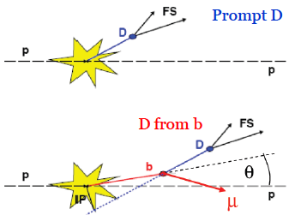
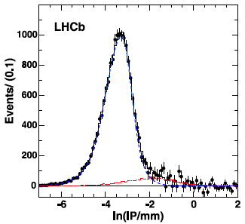
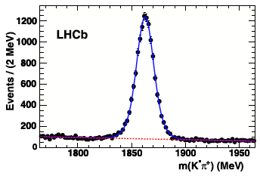

b or anti-b hadrons cross-section: using b→D⁰Xμ⁻ ν
−
D⁰→K⁻ π⁺
Prompt D: IP ≈ 0
D from b: large IP (the smallest distance between D reconstr. trajectory and PV)
Prompt D and Dfb components can be separated using IP with respect to the closest PV
PV
D from b: IP > 0
PV
IP of D⁰
NO μ requirement
3 nb⁻¹
Prompt D
(Back-
ground)
Prompt D
3 nb⁻¹
D from b
(Signal)
Background >> Signal
Notes:
Blue dashed line – Prompt component
Red dotted line – D from b (signal)
Histogram – the sum of the two

Slide 5
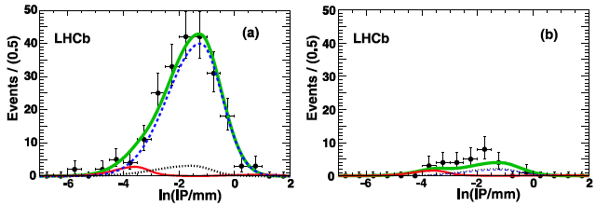

b or anti-b hadrons cross-section: using b→D⁰Xμ⁻ ν
−
D⁰→K⁻ π⁺
To select decay chain we match D⁰ candidates with tracks identified as muons:
  RS combinations: μ sign of charge the same as K in D decay
  WS combinations: opposite signs of charges of K and μ
IP of D⁰ ; Now μ required
RS
WS
12 nb⁻¹
D from b
(Signal)
12 nb⁻¹
Prompt D
(Background)
Prompt D
(Background)
sidebands
Now: Background (solid) << Signal (dashed)
As expected: prompt yields are consistent between RS and WS
Notes:
Black dotted line – D sideband backgrounds
Red solid line – Prompt yields
Blue dashed line – D from b signal
Thick solid curves the totals

Slide 6
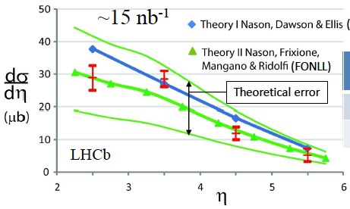
b or anti-b hadrons cross-section: using b→D⁰Xμ⁻ ν
−
D⁰→K⁻ π⁺
[Phys.Lett.B694,209 (2010)]
Dominant systematics:
Tracking efficiency | 10 %
Luminosity | 10 %
 | 5 %
(MCFM)
Summing over η (2<η<6)
[using LEP frag. fractions]:
σ(pp→H_{b}X) = (75.3 ± 5.4 ± 13.0) μb
(stat) (syst)
consistent with predictions
The measured value changes if the b-hadron fractions differ
If Tevatron frag. fractions are used: σ(pp→H_{b}X) = (89.6 ± 6.4 ± 15.5) μb
Total b anti-b cross-sections (extrapolate using Pythia):
σ(pp→H_{b}X) = (284 ± 20 ± 49) μb
Using Tevatron frag. fractions result increases by 19%
Notes:
MCFM – predicts the cross-sections for b anti-b quark production in NLO
FONLL uses CTEQ 6.5 Parton Distribution Functions (PDF) and improves NLO result with resummation of pT logarithms up to next-to-leading order
Measured cross-section is consistent with theoretical predictions (both)

Slide 7
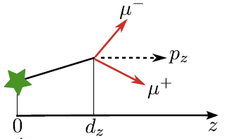
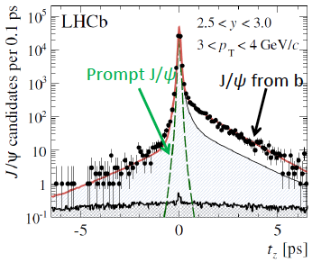
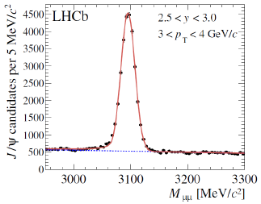
b or anti-b hadrons cross-section: using b→J/ψX
Prompt J/ψ:
t_{z} ≈ 0
J/ψ from b:
t_{z} > 0
J/ψ→μ⁻ μ⁺
Pseudo lifetime used to separate prompt and J/ψ from b:
PV
PV
b
J/ψ from b:

Slide 8
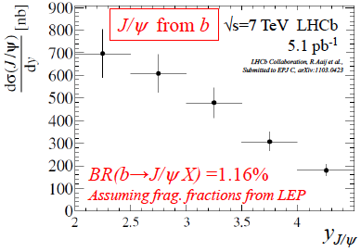
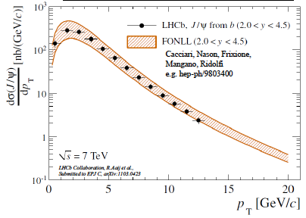
b or anti-b hadrons cross-section: using b→J/ψX
[Submitted to Eur.Phys.J C: hep-ex/1103.0423]
J/ψ→μ⁻ μ⁺
Measured cross-sections depend on y and p_{T}
Total – extrapolate using Pythia (using LEP frag. frac.):
σ(pp→H_{b}X) = (288 ± 4^{stat} ± 48^{syst}) μb
(2% change when using Tevatron fractions
is included in systematic error)
Good agreement among both measurements
from : σ(pp→H_{b}X) = (284 ± 20 ± 49) μb
Good agreement with QCD predictions
Dominant systematics:
Tracking efficiency | 8 %
Luminosity | 10 %
BR(b→J/ψX) | 9 %

Slide 9
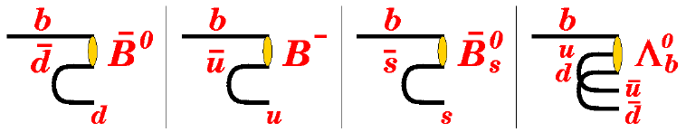
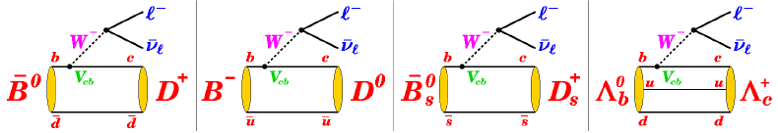
Fragmentation fractions
Probability of b quark hadronizing with an antiquark (anti-d,u,s)
or a di-quark pair (ud)
Input to inclusive b cross-section measurement
f_{s} needed for all B⁰_{s} branching ratios measurement
  in particular for precise measurements
Two methods:
semileptonic modes:
hadronic modes:

Slide 10
Ratio of fragmentation fractions f_{s} / (f_{u}+f_{d})
semileptonic modes
n_{corr} – efficiency, branching fractions and cross-feed corrected yields
Cross-feed between channels is taken into account
(C.Weiser, DELPHI 99-162 TALK 6, 1999)

Slide 11



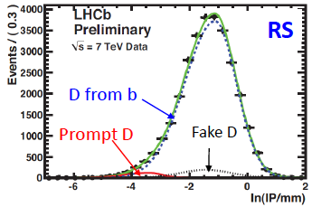
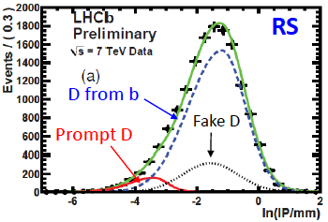
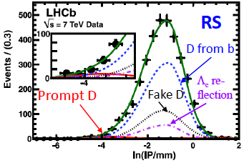
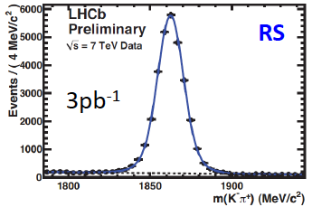
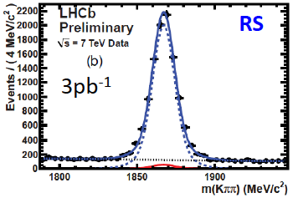
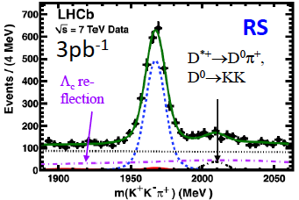
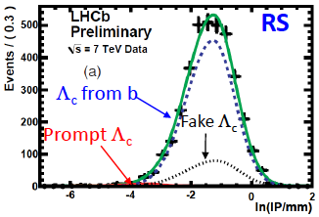
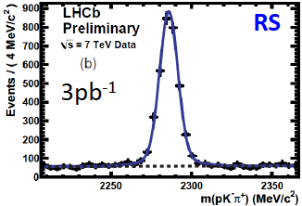

Semileptonic modes

Slide 12
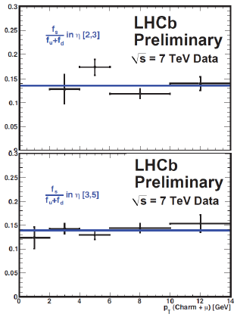
Ratio of fragmentation fractions f_{s} / (f_{u}+f_{d})
semileptonic modes
LHCb: 3 pb⁻¹
Dominant systematics:
f_{s} / (f_{u}+f_{d})
Branching fractions of charm hadrons | ±5.5 %
Subtraction of B_{s}→D⁰KXμν background | +4.1 % −1.1 %
η [2,3]
LEP: 0.128 ± 0.012
CDF: 0.135 ± 0.016
No evidence for dependence on η or p_{T}(charm+μ)
Good agreement with LEP and Tevatron values
η [3,5]
p_{T}(charm+μ) [GeV]

Slide 13
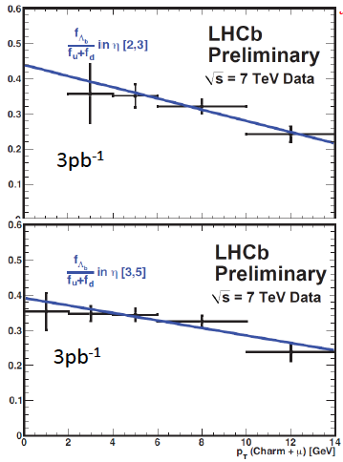
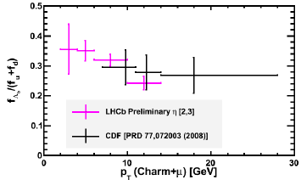
Ratio of fragmentation fractions f_{Λb} / (f_{u}+f_{d})
semileptonic modes
LHCb: 3 pb⁻¹
Slope with p_{T} not consistent with zero
Parameterising with straight line gives (for p_{T} < 14 GeV):
f_{Λb} / (f_{u}+f_{d})
η [2,3]
Systematic error dominates
26% uncertainty on BR(Λ_{c}→pΚπ)
η [3,5]
p_{T}(charm+μ) [GeV]

Slide 14
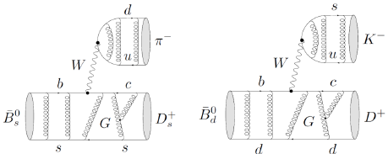
Ratio of fragmentation fractions f_{s} / f_{d}
hadronic modes
The ratio: B⁰_{s}→D⁻_{s}π⁺ / B⁰_{d}→D⁻K⁺
only tree diagrams are involved
theoretically well understood, branching ratios calculable
suffers from reconstructed yield
of B⁰_{d}→D⁻K⁺
π⁺
K⁺
D⁻_{s}
D⁻
B⁰_{s}
B⁰_{d}
World average for B⁰_{s}-to-B⁰_{d} lifetime ratio:
ε_{X} – total detector efficiency
N_{X} – observed number of decays
N_{a}=1.00±0.02 – non factorizable U-spin breaking effects
N_{F}=1.24±0.08 – ratio of form factors
(R.Fleisher, N.Serra, N.Tuning, Phys.Rev.D83:014017,2011)

Slide 15
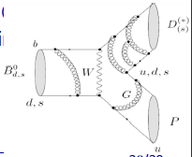
Ratio of fragmentation fractions f_{s} / f_{d}
hadronic modes
The ratio: B⁰_{s}→D⁻_{s}π⁺ / B⁰_{d}→D⁻π⁺
suffers from theoretical uncertainties due to contribution from W exchange diagram
π⁺
π⁺
D⁻_{s}
D⁻
B⁰_{s}
B⁰_{d}
W
ε_{X} – total detector efficiency
N_{X} – observed number of decays
N_{a}=1.00±0.02 – non factorizable U-spin breaking effects
N_{F}=1.24±0.08 – ratio of form factors
N_{E}=0.966±0.075 – additional correction term for the W exchange
in B⁰_{d}→D⁻π⁺ decay

Slide 16
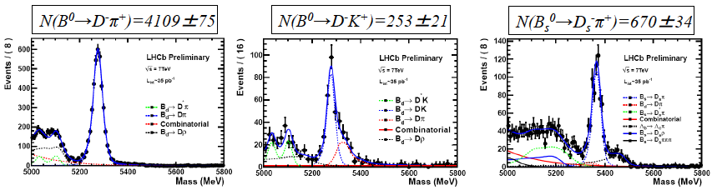
Ratio of fragmentation fractions f_{s} / f_{d}
hadronic modes
Modes topologically identical and using identical selection criteria to minimizing efficiency differences between modes
LHCb
35 pb⁻¹
From B⁰_{s}→D⁻_{s}π+ and B⁰_{d}→D⁻K⁺: f_{s} / f_{d} = 0.242 ± 0.024^{stat} ± 0.018^{syst} ± 0.016^{theor}
From B⁰_{s}→D⁻_{s}π+ and B⁰_{d}→D⁻π⁺ : f_{s} / f_{d} = 0.249 ± 0.013^{stat} ± 0.020^{syst} ± 0.025^{theor}
Combined: f_{s} / f_{d} = 0.245 ± 0.017^{stat} ± 0.018^{syst} ± 0.018^{theor}
Theoretical uncertainty dominated by uncertainty on form factor ratio
Agrees well with semileptonic result and LEP and Tevatron
Extra result: extract world best BR(B⁰_{d}→D⁻K⁺)=(2.02 ± 0.17 ± 0.12) × 10⁻⁴
(LHCb-CONF-2011-013)

Slide 17
Summary
LHCb has measured the b or anti-b hadrons cross-section in √s=7 TeV pp collisions (total):
  in agreement with (and more precise than) QCD predictions
  measured open charm cross-section (≈20 times higher)
LHCb has measured the ratios of fragmentation fractions
  f_{s} / f_{d} in good agreement with LEP and Tevatron
  f_{Λb} / (f_{u}+f_{d}) partially for different p_{T} (p_{T}<14GeV) than Tevatron (〈p_{T}〉≈14GeV), in common region of p_{T} good agreement

Slide 18
Backup

Slide 19
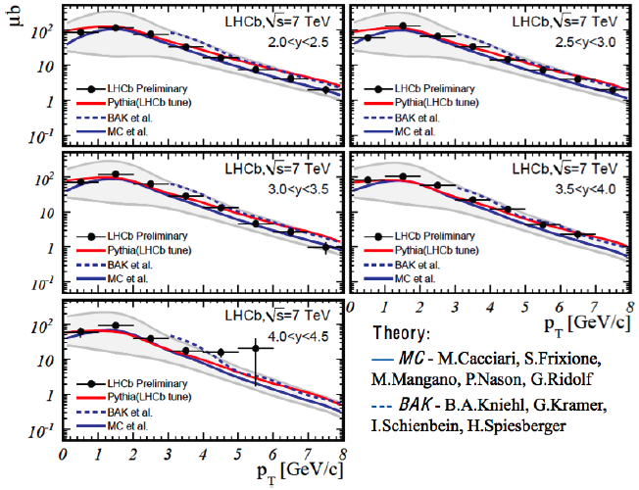
D⁰ cross section – example
LHCb: 2 nb⁻¹
Also measured for:
D⁺ , D*⁺ , D⁺_{s}
The shape and absolute normalization are in good agreement with theoretical predictions
20 times higher than σ(b anti-b)
(LHCb-CONF-2010-013)
Combining all (p_{T}<8 GeV , 2<y<4.5):
Full p_{T} and y using Pythia extrapolation:

Slide 20
(C.Weiser, DELPHI 99-162 TALK 6, 1999)

Slide 21
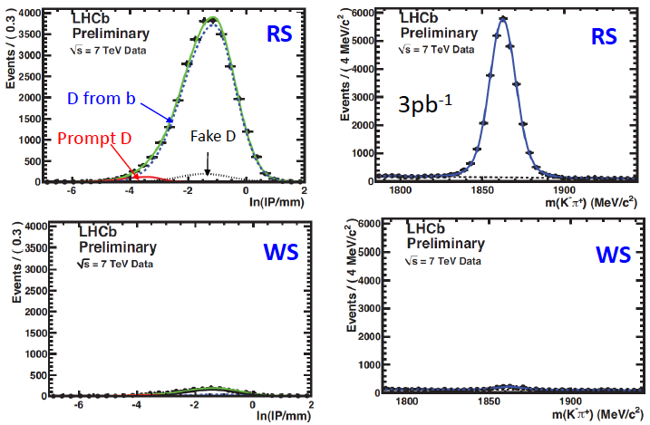

Slide 22
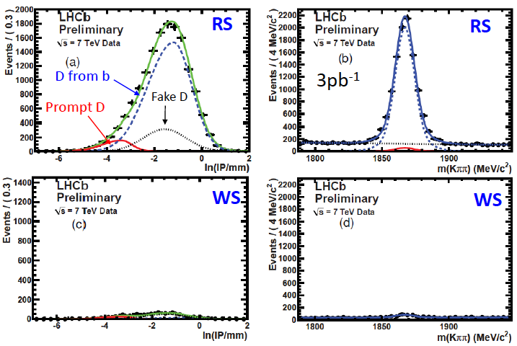

Slide 23
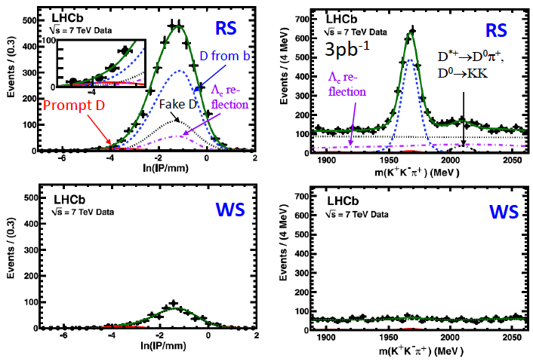

Slide 24
