Slide 1
η−η′ Mixing-From Electromagnetic Transitions to Weak Decays of Charm and Beauty Hadrons
Camilla Di Donato
Sez. INFN Napoli, Italy
Work in collab. with
G. Ricciardi, Università di Napoli “Federico II”, Italy
and I.Bigi, University of Notre Dame du Lac, USA
e-Print: arXiv:1105.3557 [hep-ph]
Munich, June 13th, 2011

Slide 2
Outline
Review on theoretical and experimental progresses in η−η′ mixing—probing their gluonic content
Analysis one by one of relevant processes at different energy scales
electromagnetic and strong decays
electroweak D and B decays
Conclusions and future prospects

Slide 3
Motivations
Knowing the η−η′ wave functions probes our understanding of non-perturbative QCD dynamics --- Showing there is a purely gluonic component would establish for the first time that gluons play an independent role also in hadronic spectroscopy.
Also essential to disentangle SM hadronic uncertainties vs. New Physics
Great effort has been given to this challenge { yet no clear picture has emerged }
We point out which measurements and theoretical analysis would be most helpful for a more definite conclusion.

Slide 4
η-η′ Mixing
Just for orientation:
quadratic (linear) Gell-Mann-Okubo
mass formula θ_{P}≈-10º (θ_{P}≈-23º)
quark-flavor basis:
θ_{P} = φ_{P} –arctan √2 = φ_{P} – 54.7º φ_{P} ≈45º (φ_{P} ≈32º)

Slide 5
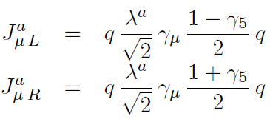
Two Mixing Angles Scenario: Octet-Singlet Basis
From the late 90’s (Leutwyler , Kraiser , Kroll, Stech , Feldmann etc. ) been shown the mixing cannot be adequately described by a single angle; the fact that the decay constants follow the pattern of state mixing is an a-priori assumption
Due to SU(3) breaking (f _{K} ≠ f _{π}), mixing of decay constants does not follow the
same pattern of state mixing
<0 | Jª_{μ5}(0)| P(q)> = i f_{p}ª q _{μ}
The estimated difference θ₈-θ₀ can be large [-12º-19º]

Slide 6
Quark Flavor Basis
The smallness of the mixing angles is consistent with the OZI-rule, i.e. amplitudes that involve quark-antiquark annihilation into gluons are suppressed
vector meson sector: mixing angle ≈ 3◦
ω ≈ ϕ ≈
In the pseudoscalar sector, U(1)_{A} anomaly induces a significant mixing between the fields η_{NS} and η_{S .}

Slide 7
Two Mixing Angle scenario: Flavor Basis
_{In principle we have}
However, while the mixing is large (≈ 40º ), the difference between the two mixing angles is determined by OZI-rule violating contribution
OZI-rules rigorous when Nc→∞ or α →0
φ_{q} and φ_{s} nearly coincide

Slide 8
Mix with Gluonium
The η′ meson is a good candidate to have a sizeable gluonic content, (while the η meson is well understood as an SU(3)-flavor octet with a small singlet admixture)
gluonic content ⇒
Mixing with heavier pseudoscalar mesons is ignored

Slide 9
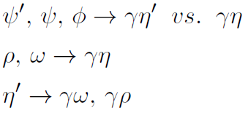
Electromagnetic and Strong Transitions
Radiative vector and pseudoscalar meson decays
Decays into two photons or production in collisions:
Decays of ψ into PV final states with the vector meson acting as a `flavor filter':

Slide 10
Radiative ρ/ω/ϕ Decays: first modern analyses
allowing for gluonium
no gluonium hyphotesis
KLOE 07:
KLOE09
Escribano,
Nadal 07
Thomas 07:
no form factors
with form factors

Slide 11
η̍ Decays
In lowest order all possible η′ strong decays are forbidden by C, CP invariance and G-parity conservation.
First order electromagnetic decays are forbidden as well, or occur at a suppressed rate because involving an anomaly.
The first allowed decay is therefore the second-order electromagnetic transition
key role in the mixing parameters determination
MD-1@Novosibirsk (1985), ASP@SLAC 85
can be exploited also looking at the inverse processes, namely
Crystal Ball Collab@DESY (1988)
NEW Results BaBar (2011) disagree with theoretical prediction: (Bakulev et al 2001): admixture of the two-gluon component?
Significantly below previous results

Slide 12
Weak Decays of Charm and Beauty Hadrons
η/η′ wave functions important input for several weak D and B decays
CP asymmetries involving η/η′ in the final states
Control NP vs SM hadronic uncertainties
Phenomenological approach (while waiting for lattice)
pioneering lattice calculation RBC-UKQCD of η/η′ masses and mixing using Nf = 2+1 (2010)

Slide 13
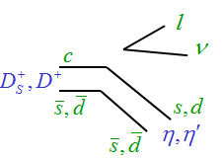
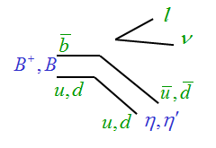
Light Flavour Spectroscopy in Semileptonic Decays
Spectator diagram dominance
Cabibbo allowed c →s, suppressed c →d and CKM suppressed b →u
If η/η′ without gluonic content and pole ansatz for form factors
Feldmann, Kroll, Stech 98
CLEO-c

Slide 14
Light Flavour Spectroscopy in Semileptonic Decays
Allowing gluonic content
Using (Anisovic al. 97)
new (compatible) CLEO-c 09 data
BESIII expects errors on φ_{P} going down to 2%

Slide 15
Weak annihilation (WA) diagrams
Spectator
WA (gluonic)

Slide 16
WA for Precision Studies
WA no more than a nonleading contribution to inclusive rates, BUT could affect exclusive modes considerably
Strength depends on:
size of the gg component in the wave functions
how much gg radiation one can expect in each semileptonic channel
might come from the interference with the spectator amplitude, it can a priori enhance or reduce those
A recent analysis based on inclusive semileptonic D decays, which considers both the widths and the lepton energy moments, shows no clear evidence of WA effects
No extensive exclusive theoretical analysis yet
Gambino, Kamenik 2010

Slide 17
B± semileptonic decays
Same than D ± only large q ² and CKM suppressed by | Vub | ²
First evidence of by CLEO in 2008
Newest BaBar results (2011) (with a significance of 3.0 σ).
an order of magnitude smaller than the CLEO result
Seems to allow a large gluonic singlet contribution
potentially informative on the gluonic content, exp challenging. In SM BR 10⁻⁷-10⁻⁸ (Super-flavour factories)
Notes:
In B+ to eta(prime) l nu decays the situation is analogous to that of D+ to eta(prime) l nu except that their rates are suppressed by |Vub/Vcb|^2 rather than |Vcd/Vcs|^” and that the range in q^2 is much larger.

Slide 18
CP Violation
Charmless hadronic B decays provide valuable tests for the pattern of CP violation in the CKM framework
Decays dominated by single b→ s penguin amplitude
In the SM
Corrections for suppressed diagrams
Estimates in the ranges (-0.03, 0.03) (QCDF and SCET) and in the range (-0.05, 0.09) from SU(3) symmetry bounds
Compatible with SM and (Babar 11) from
Beneke 05, Williamson,Zupan 06, Cheng,Chia,Soni 05, Gronau, Rosner, Zupan, 06
Belle 11

Slide 19
Experimental Puzzle
>>
>>
SU(3)fl singlet penguin, including gluonic contributions
Anomaly effects, large charm content, NP?

Slide 20
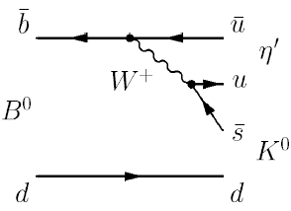
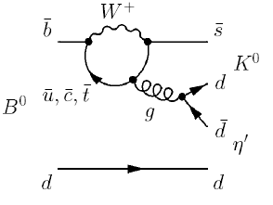
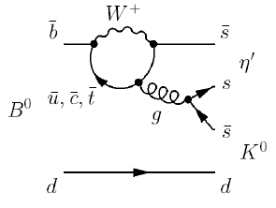
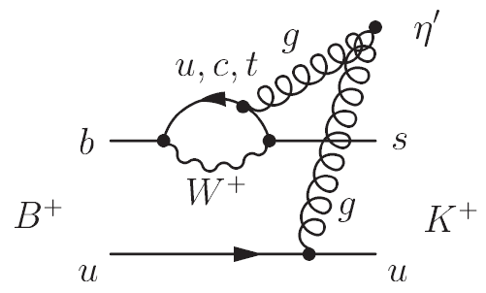
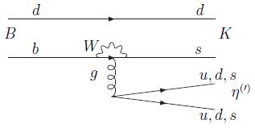
Penguin dominated decays
Tree level CKM and color suppressed
Penguins CKM not suppressed
Additional contribution to the SU(3) singlet contribution: fusion of gluons, one gluon from b →sg process and another one from spectator.
λ ≈ 0.22
|Vub Vus| ≈ λ⁴
|Vtb Vts| ≈ λ²
20
Notes:
A sizeable gluonium contribution to the η′ meson could play an important role: the contribution of the diagram in which two gluons are directly attached to gluonium in η′ in principle important

Slide 21
Theoretical Approaches
Within large errors BR compatible with interference among different contributions
QCDF and SCET : sizable gluonic contributions to the B → η′ form factor
pQCD : impact of the gluonic component numerically very small
Major analyses prior to 06, relying on old experimental data
Beneke, Neubert 03; Williamson, Zupan 06
Y.-Y. Charng, T. Kurimoto, H.-n. Li 06

Slide 22
More Recent Data
2008-2010 CLEO/BaBar
B semileptonic <
2010 BaBar
2007 CLEO
≈
<

Slide 23
Conclusions
The different determinations of η−η′ mixing angle are generally consistent, but show relevant model and mode dependence
The message concerning η′ gluonium content remains ambivalent
More dedicated studies are necessary (including theoretical updates with new data) while waiting for lattice
Also D⁺, D_{S}⁺ and B⁺ decays must be included in traditional investigations to check η′ gluonium role

Slide 24
Conclusion II
Radiative ρωφ
KLOE (+η′→γγ) | (39.7±0.7)° | 0.14±0.04
Escribano | (41.4±1.3)° | 0.04±0.09
Thomas | (41.7±0.5)° | 0. 04±0.04
Thomas F.F. | (41.9±0.7)° | 0.10±0.04
J/ψ→VP
Thomas | (45±4)° | 0.30±0.21
Thomas F.F. | (46+4/-5)° | 0.48 ±0.16
Escribano | (44.6±4.4)° | 0.29+0.28/-0.26
Semileptonic decay
 | (37.7±2.6)° | 0.12

Slide 26
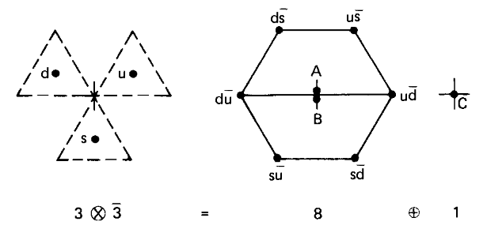
SU(3)_{flavor}
η-η' physical states originated by the mixing of neutral I = 0 octet η₈ and singlet η₀ states

Slide 27
Radiative Decays
KLOE vs. th analyses:
KLOE: VP-overlap parameters without gluonium, (from Bramon, Escribano and Scadron 01)
Theory: VP-overlap parameters determined allowing for gluonium ⇒new values
OZI-rule reduces considerably possible
transitions and their respective VP
wave-functions overlaps (P →V γ, V→P γ)
Differently from the th analyses, Kloe use also constraints from η′→γγ, where no VP-overlap parameters enter in the analysis: this guarantee “independence” from the parameters in a reasonable range.
KLOE
Escribano,Nadal
no VP
overlap

Slide 28
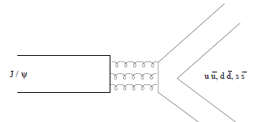
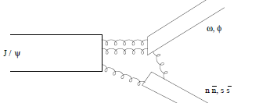
ψ→PV: also ambivalent results
Mark III (1985) : (35±18)% of the η′ wave function can be attribute to gluonium or radial excitation
analysis is based on the assumption that decays proceed via singly disconnected diagram (SOZI), omitting the doubly disconnected (DOZI) diagram
Mark III (1988) : any gluonium contribution to the η′ wave function is ruled out
including DOZI diagrams
SOZI DOZI
More recent re-analyses of the hadronic J/ψ and ψ′ decays (including DOZI) furnish a consistent description in terms of one mixing angle with a suggestion of some gluonic component of the η′. F.i.
no form factors
form factors (Thomas 2007)

Slide 29
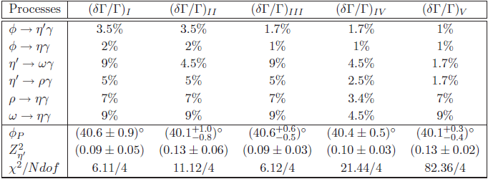
Possible future experimental scenarios
"I" :actual uncertainties in the exp input values (PDG 2010)
"II" :improvement by studying η’→ωγ using 1) 20 fb⁻¹ (KLOE2) 2) selection efficiency 20% 3) neglecting background subtraction—
limiting factor : uncertainty in the total η’ width
"III" :improvement in determination of the partial widths for ϕ→η^{(‘)}γ
"IV" : improvement in determination of the partial widths for η^{(‘)} →ργ
"V" : un uncertainty of 1% on the measure of branching ratios for η’ decays and of 1.4% for the η’ full width.

Slide 30
Experimental status and prospects
Conclusions from previous table :
both BR(η^{(’)} →ργ ) and Γ _{η’} to be measured more accurately.
η’→ωγ partial width with relative error 9% (PDG 2010 ) Relevant experiment (ANL-E-397, 1977) bases on 68 events.
ϕ→η^{(‘)}γ partial width mainly due to KLOE07; error dominated by systematics due to the secondary η’ branching ratio
η’ →ργ partial width with relative error 5% (PDG 2010 ) Relevant experiment (1969) bases on 298 events
Γ _{η’} = 0.194 ±0.009 (PDG 2010); Γ _{η’} = 0.30 ±0.09 direct meas.(1996,1979)
Crystal Ball@MAMI (started 2009)
New insight could come from production in γγ fusion (KLOE)

Slide 31
Charmless Hadronic B Decays
Charmless hadronic B decays provide valuable tests for the pattern of CP violation in the CKM framework
CP asymmetries
in the SM, if one single dominant amplitude

Slide 32
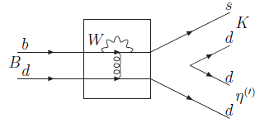
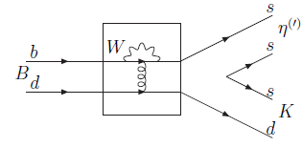
Other Contributing Penguins
Annihilation penguin contribution
SU(3)fl singlet penguin (B_{i} meson triplet, M^{l}_{j} meson nonet)

