Slide 1
The Quest for the Spin of the proton
Results from RHIC

Slide 2



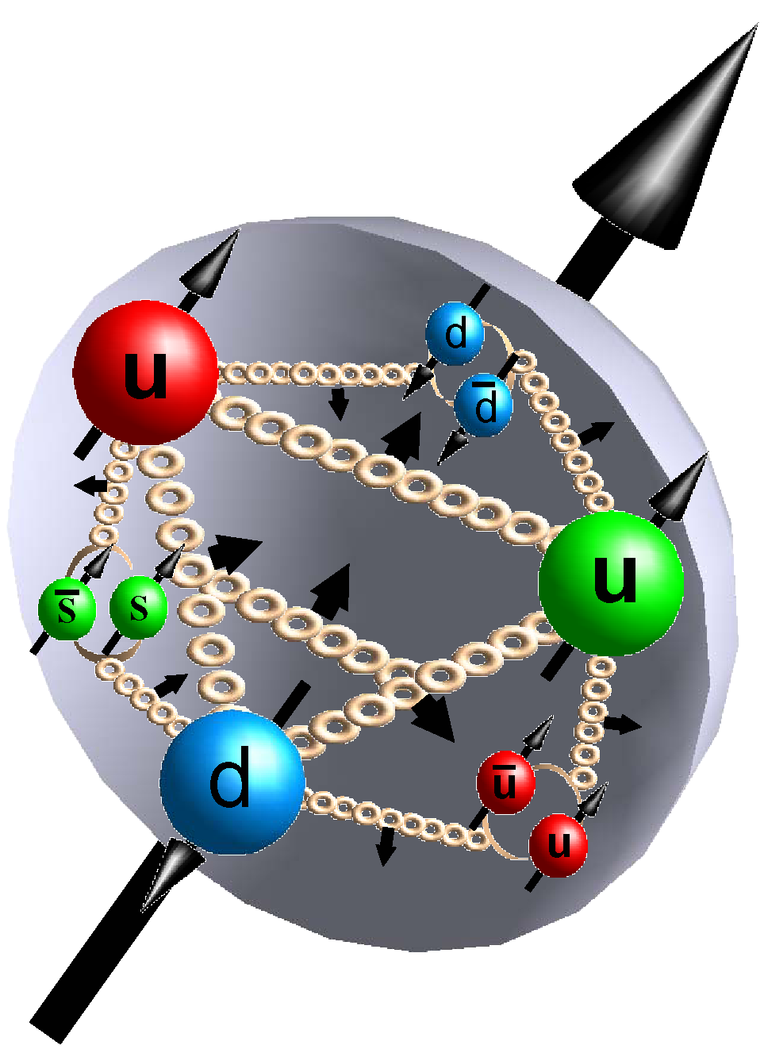



How do the partons form the spin of protons
Is the proton looking like this?
ΔG
Σ_{q}L_{q}
L_{g}
Σ_{q}Δq
Σ_{q}L_{q}
δq
δq
Σ_{q}Δq
ΔG
L_{g}
“Helicity sum rule”
gluon
spin
Where do we stand
solving the “spin puzzle” ?
total u+d+s
quark spin
angular
momentum

Slide 3
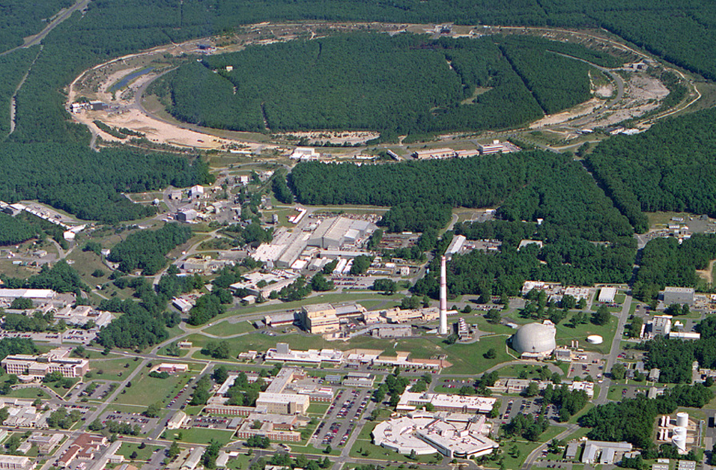
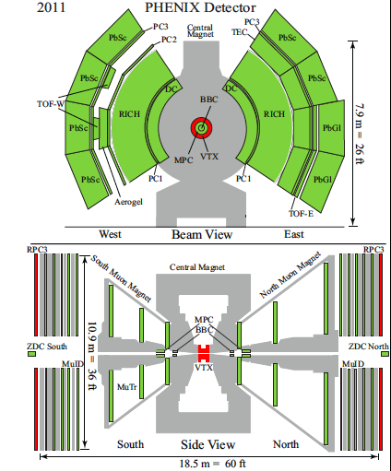
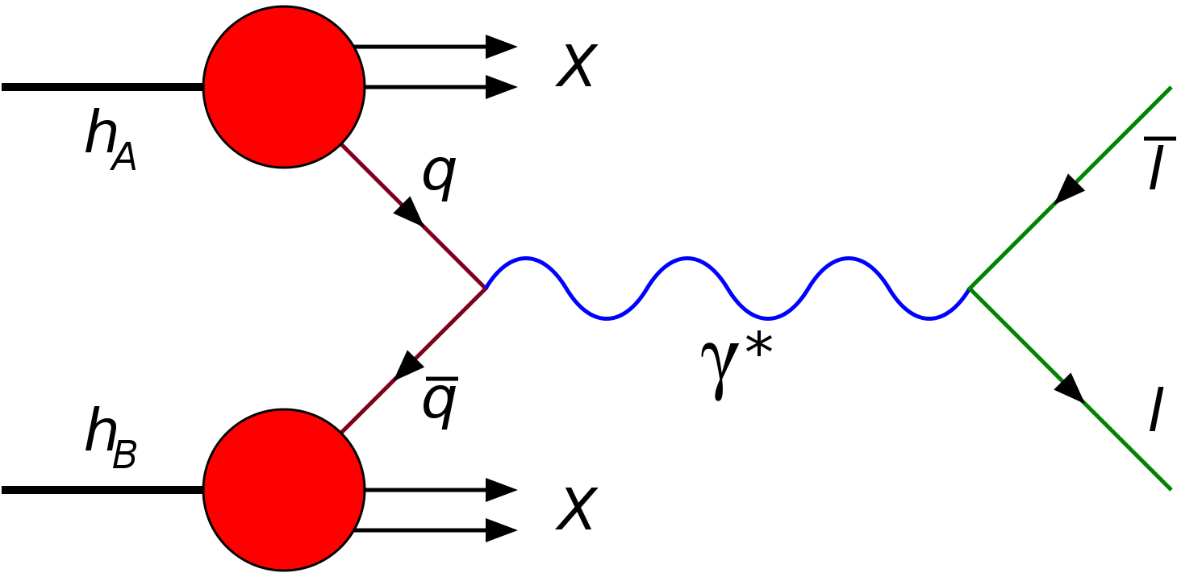
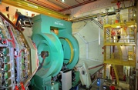
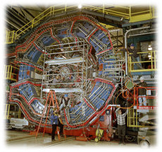
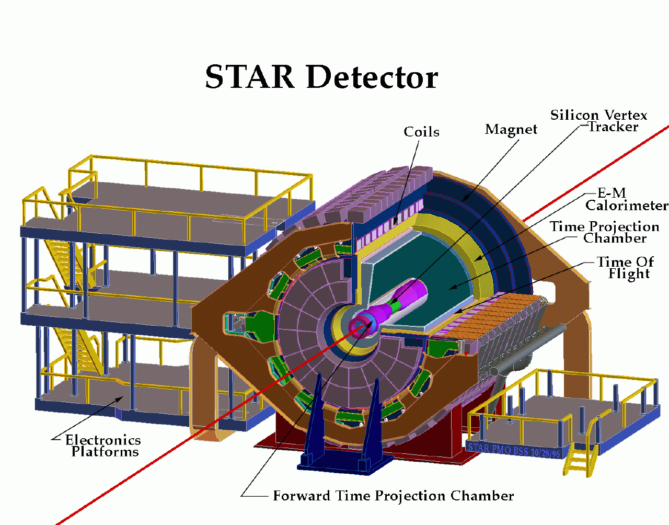

RHIC@BNL Today
Jet/C-Polarimeters
12:00 o’clock
RHIC
A_{N}DY
2:00 o’clock
PHENIX
8:00 o’clock
RF
4:00 o’clock
Beams: √s=<500 GeV pp; 50-60% polarization
Lumi: ~10 pb⁻¹/week
STAR
6:00 o’clock
LINAC
NSRL
EBIS
Booster
STAR
ERL Test Facility
AGS
Tandems

Slide 4
Predictive power of pQCD
q(x₁)
Hard Scattering Process
X
g(x₂)
“Hard” (high-energy) probes have predictable rates given:
    Partonic hard scattering rates (calculable in pQCD)
    Parton distribution functions (need experimental input)
    Fragmentation functions (need experimental input)
Universal non-perturbative functions

Slide 5
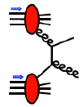
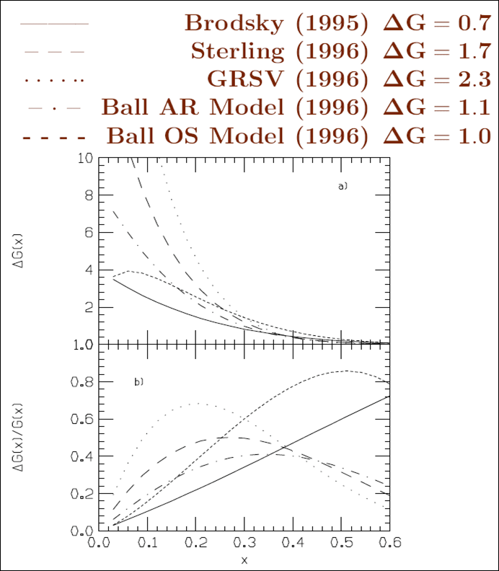
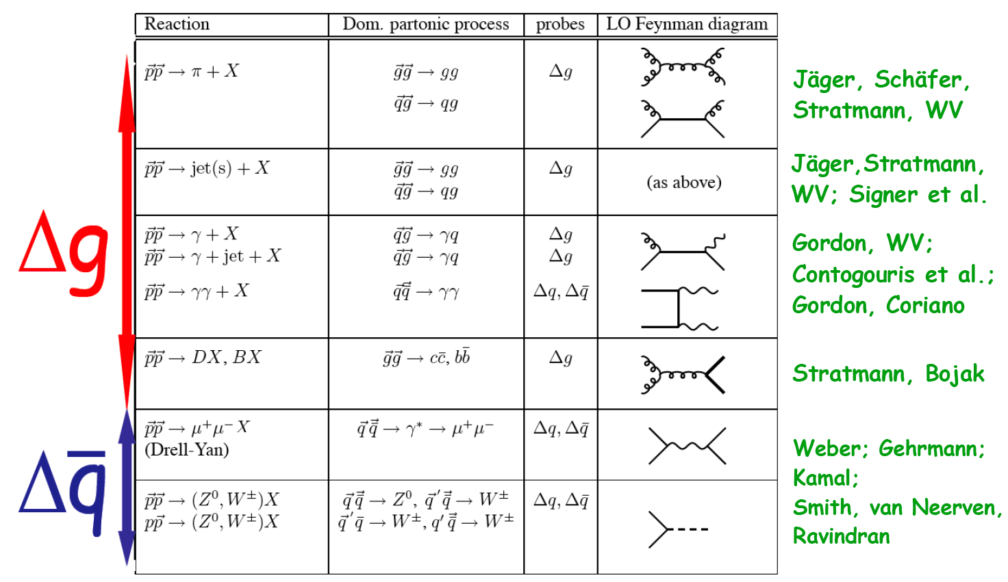
The Gluon Polarization
RHIC: many sub-processes with a
dominant gluon contribution
high-p_{T} jet, pion, heavy quark, …
Theoretical Predictions
in NLO
unpolarised cross sections nicely reproduced in NLO pQCD

Slide 6
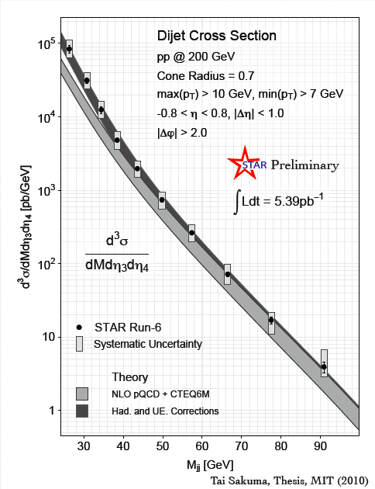
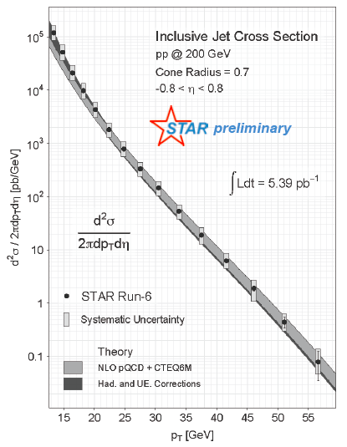
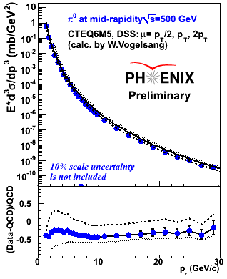

Does QCD work: Cross Sections
√s=62 GeV (PRD79, 012003)
√s=200 GeV (PRD76, 051106)
√s=500 GeV (Preliminary)
Data compared to NLO pQCD calculations:
√s=62 GeV calculations may need inclusion of NLL (effects of threshold logarithms)
√s=200 and 500 GeV: NLO agrees with data within ~30%
Input to qcd fits of gluon fragmentation functions → DSS
√s=200 GeV Jet Cross Sections agree with data in ~20%

Slide 7
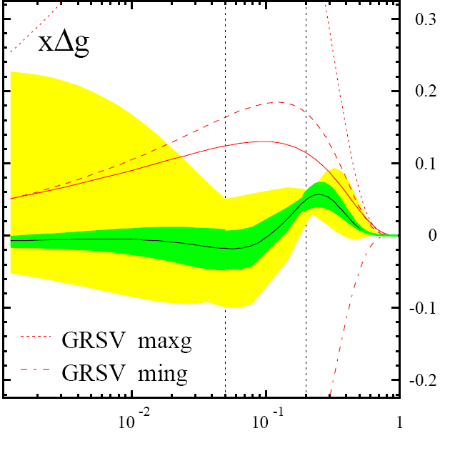
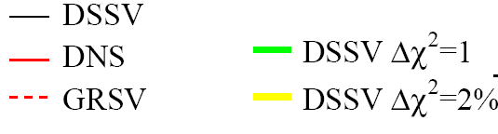
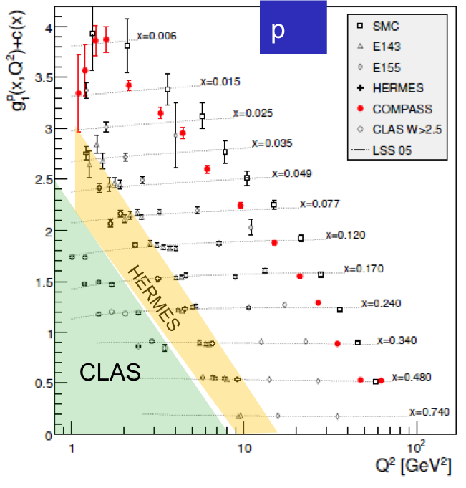
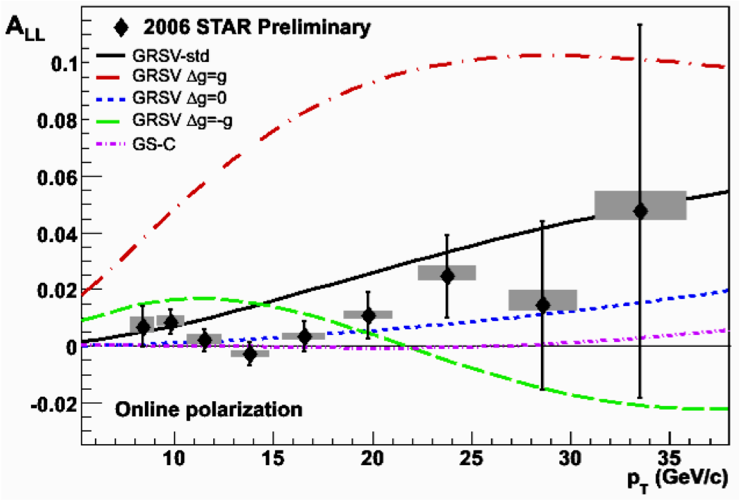
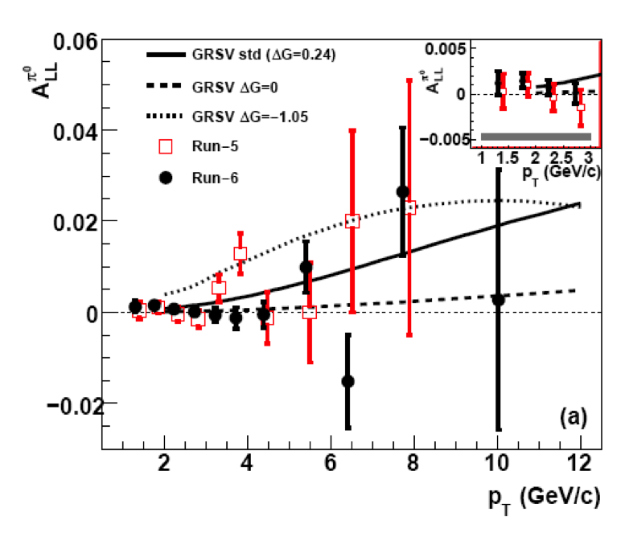

Δg from inclusive DIS and polarized pp
Current knowledge on Δg
Scaling violations of g₁
(Q²-dependence) give indirect access to the gluon distribution via DGLAP evolution.
DIS
EIC
RHIC polarized pp collisions at midrapidity directly involve gluons
Rule out large ΔG for 0.05 < x < 0.2
DIS
RHIC
constrained x-range still very limited

Slide 8
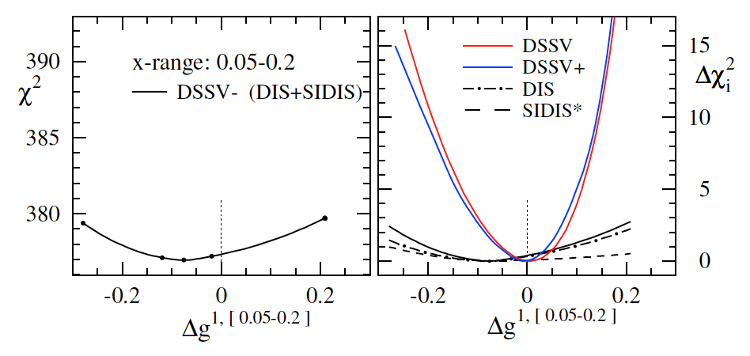
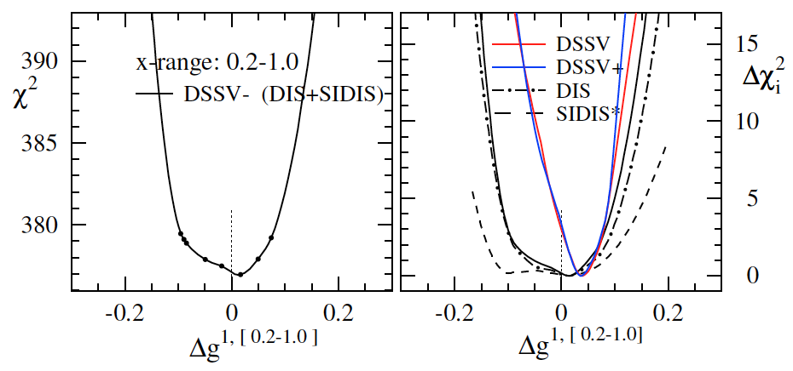
Δg and the relevance of RHIC data
truncated moment
(“RHIC pp region”)
truncated moment
(“high x”)
bottom line:
RHIC pp data clearly needed (current DIS+SIDIS data alone do not constrain Δg)
new (SI)DIS data do not change much for Δg
trend for positive Δg at large x (as before)

Slide 9

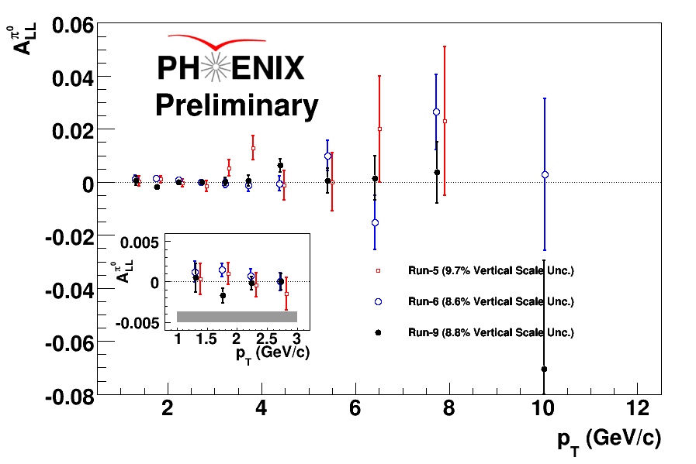
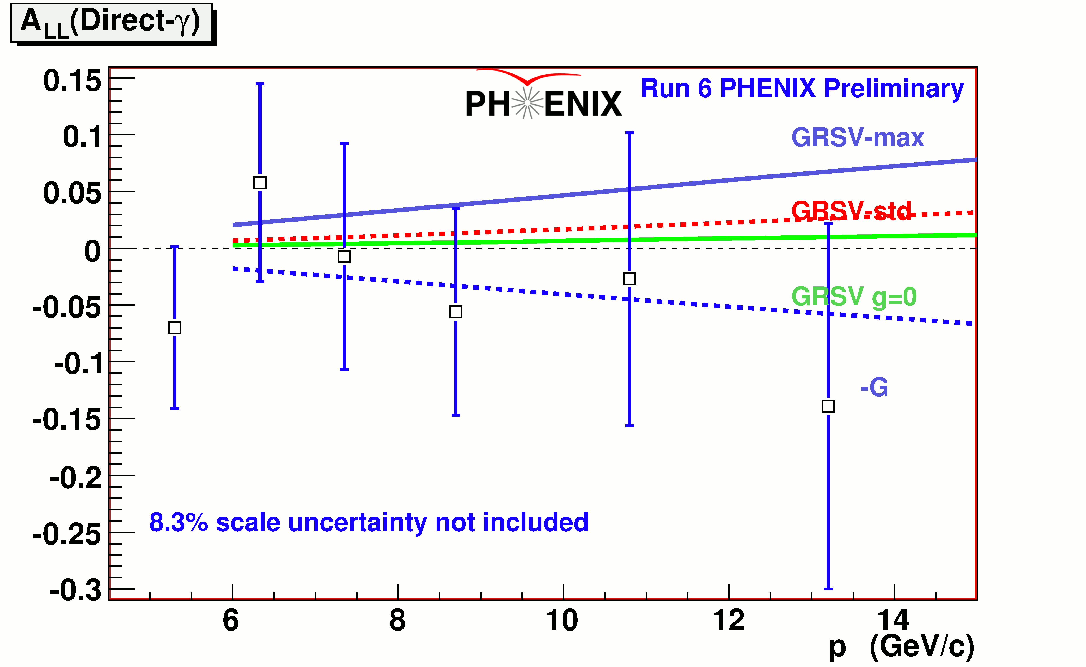
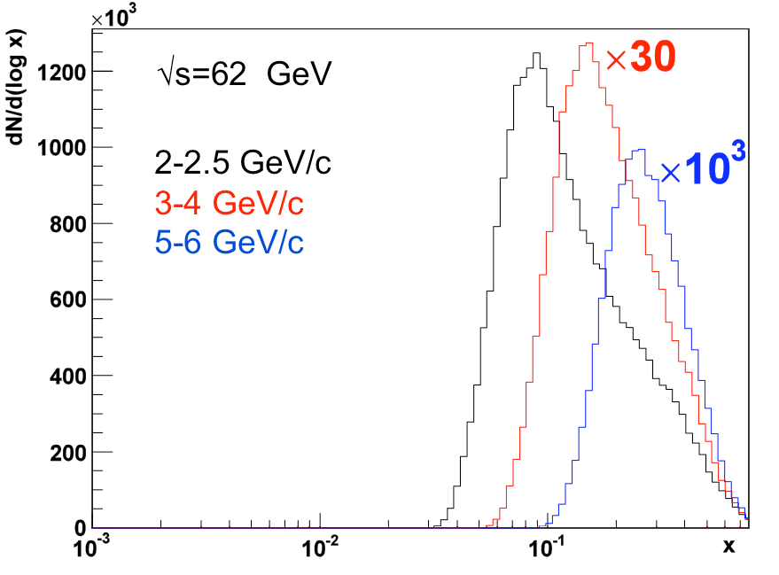
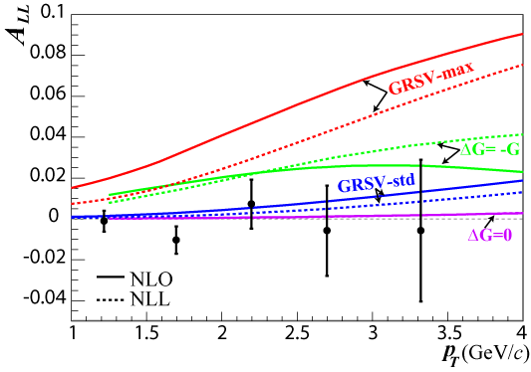
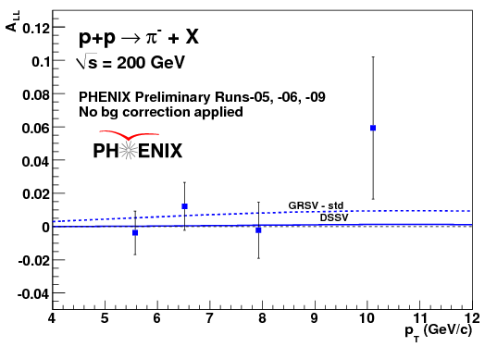
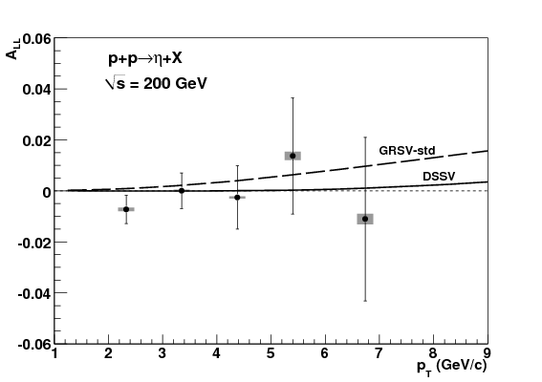
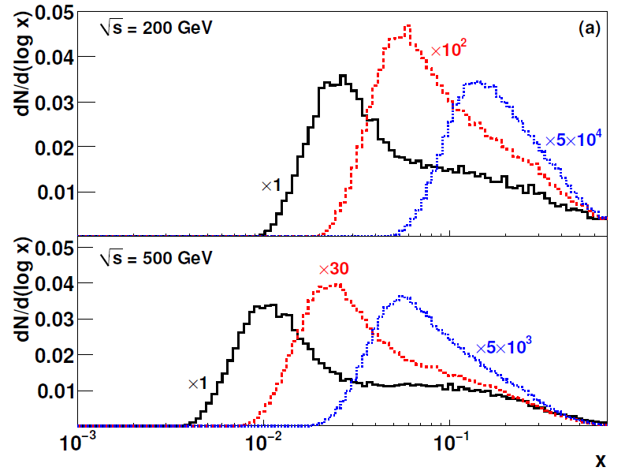
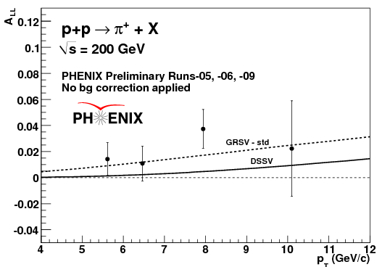
Much more data
Direct photon
Phys. Rev. D 79, 012003 : √s = 62.4 GeV
Increased √s allows to go to lower x
Different final states select between
gg and qg scattering
➔ sign of Δg
Future measurements will include
di-hadron at forward rapidity
→ constrain x and to go to lower x
η A_{LL} : Phys. Rev. D 83, 032001
2-2.5 GeV/c
4-5 GeV/c
9-12 GeV/c
2-2.5 GeV/c
4-5 GeV/c
9-12 GeV/c

Slide 10
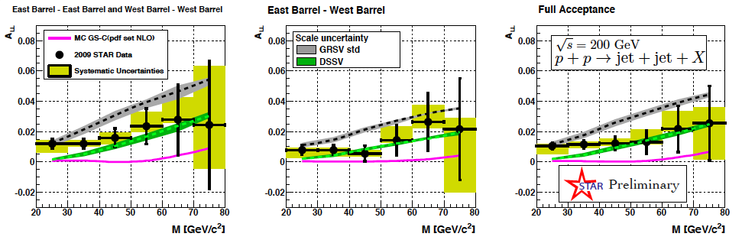
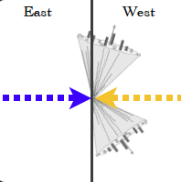
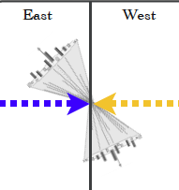
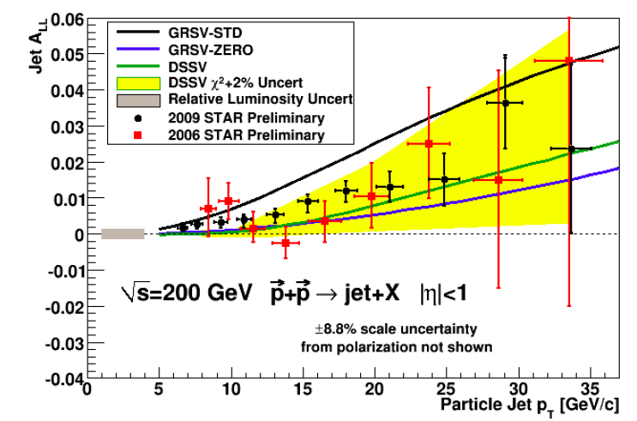
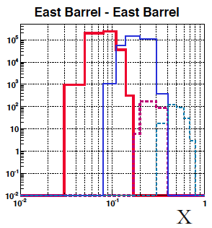
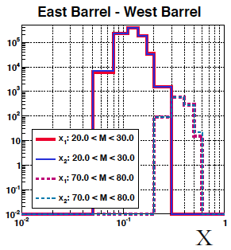
Much more data
STAR

Slide 11
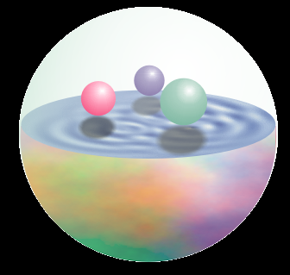
Δq: W Production Basics
Since W is maximally parity violating
→ W’s couple only to one parton helicity
large Δu and Δd result in large asymmetries.
u
No Fragmentation !
d
Similar expression for W⁻ to get Δ and Δd…

Slide 12
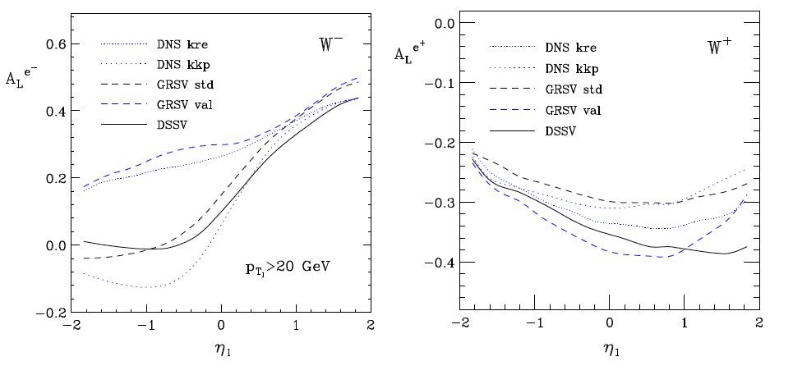
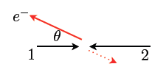
expectations for A_{L}^{e} in pp collisions
de Florian, Vogelsang
t large
u large
t large
u large
strong sensitivity to
limited sensitivity to

Slide 13
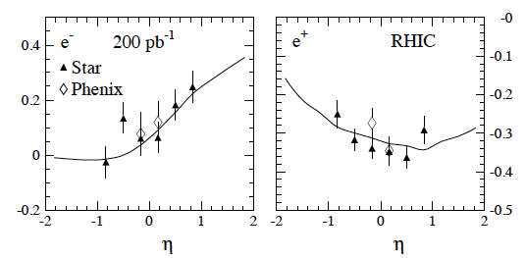
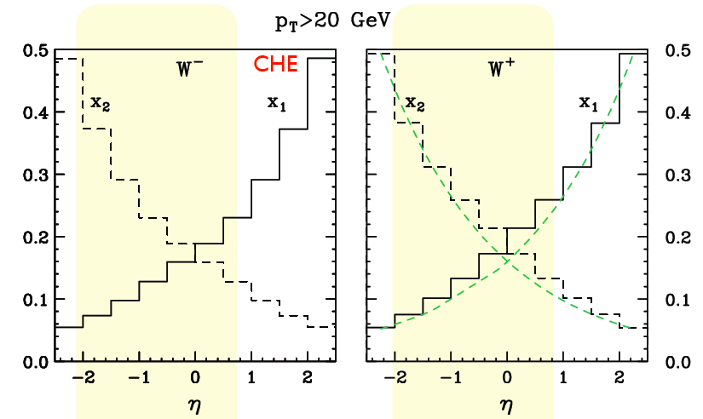
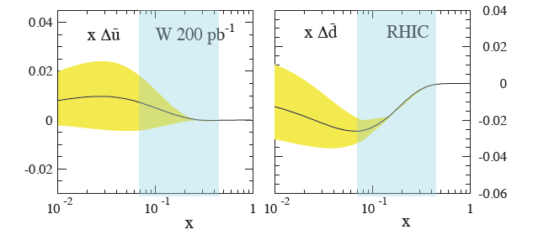
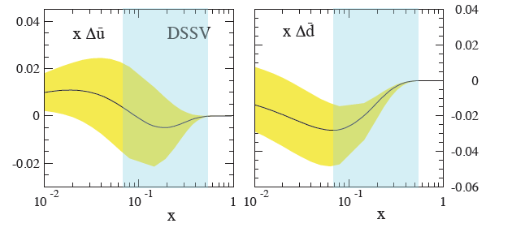
RHIC: A_{L} for W bosons
RHIC: can detect only decay leptons;
lepton rapidity most suited observable
de Florian, Vogelsang, arXiv:1003.4533
strong correlation with x_{1,2}
<x>
will extend rapidity from
-1<η<1 to -2<η<2
allows for flavor separation for 0.07 < x < 0.04
Δχ² = 2% uncertainty bands
of DSSV analysis
Δχ² = 2% uncertainty bands
with RHIC data

Slide 14
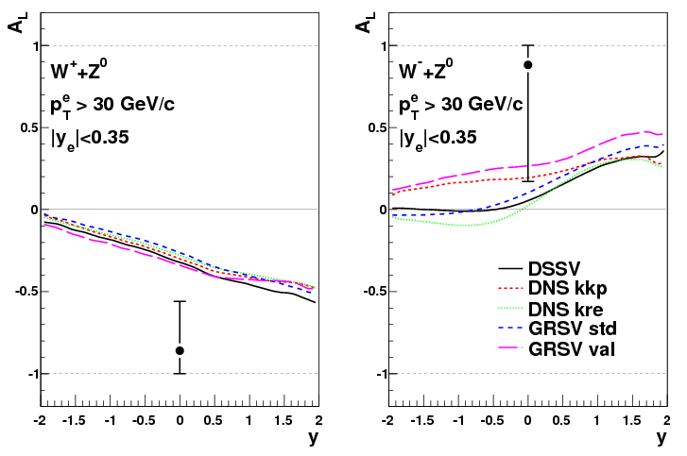
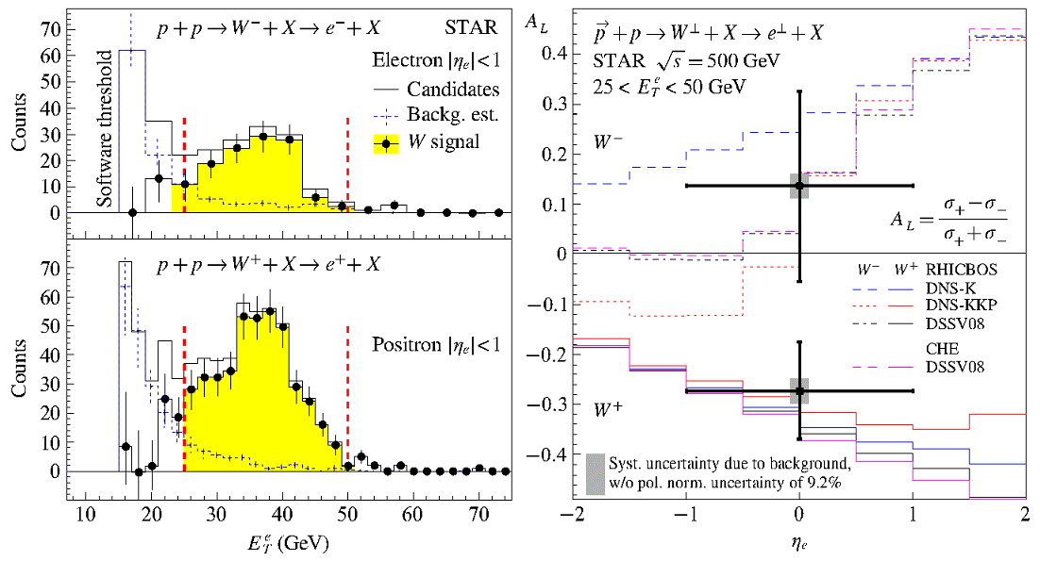
First proof of principle
STAR
Need much more statistics to compete with SIDIS
doubled statistics in 2011

Slide 15
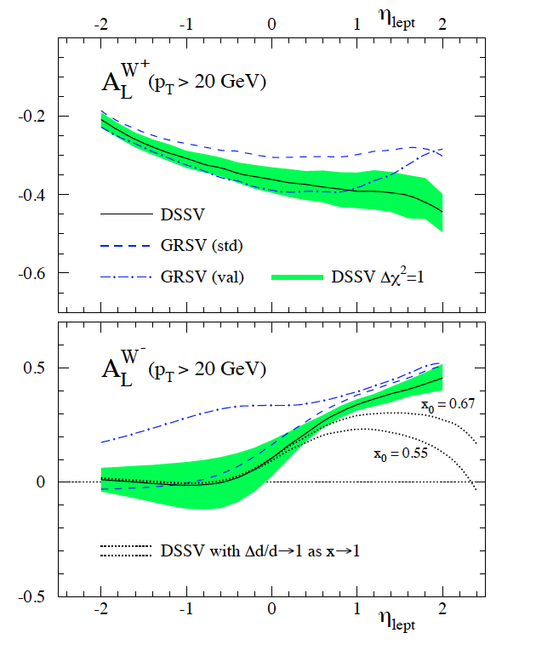
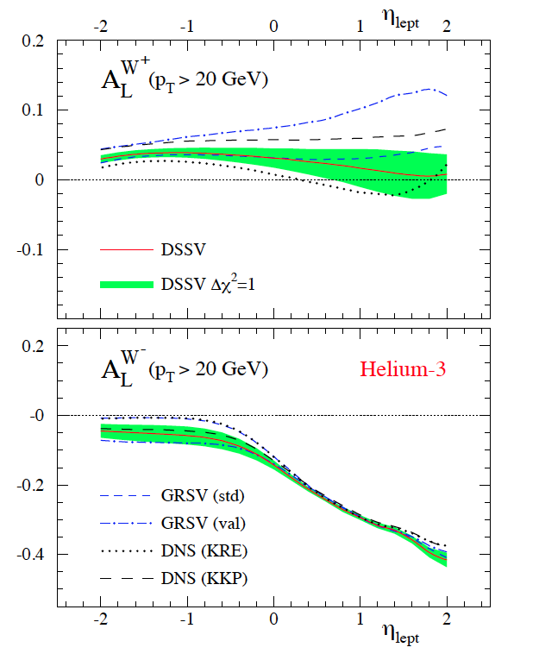
Future Possibilities
Increase p-beam energy to 325 GeV →
  factor 2 in σ_{W}
  access to lower x for Δg(x)
Get a polarized He-3 beam → flavor separation
A_{L}^{W}: pp @ 500 GeV
A_{L}^{W}: He3-p @ 432 GeV

Slide 16
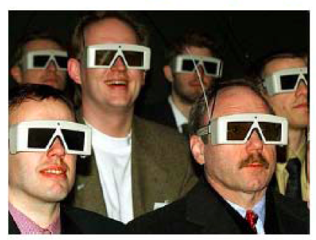
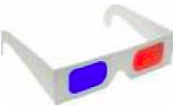
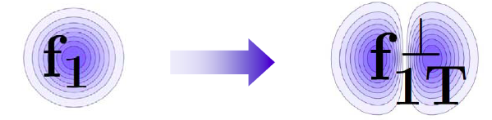
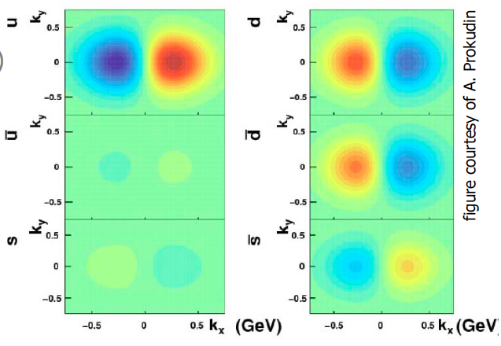
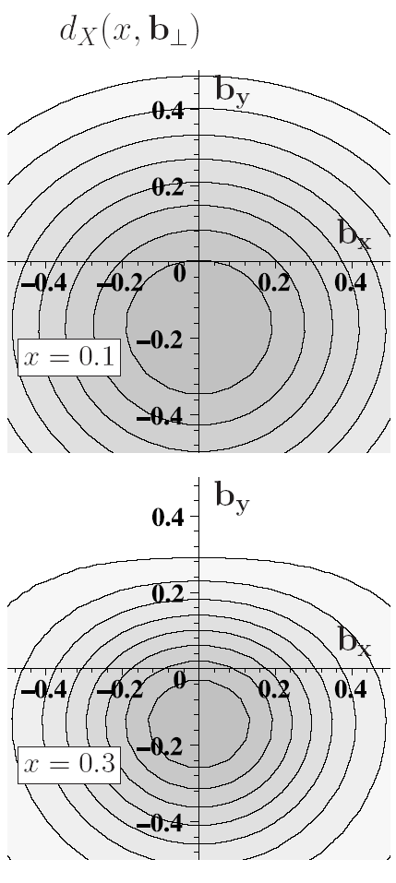



Quantum phase-space tomography of the nucleon
Wigner Distribution
W(x,r,k_{t})
Join the real
3D experience !!
TMDs
GPDs
d³r
d²k_{t}dz
3D picture in momentum space 3D picture in coordinate space
  transverse momentum generalized parton distributions
  dependent distributions → exclusive reaction like DVCS
u-quark
Polarized p
d-quark
Polarized p

Slide 17
More insights to the proton - TMDs
Transversity distribution function δq(x)
Correlation between and
Single Spin Asymmetries
Unpolarized distribution function q(x), G(x)
beyond collinear picture
Explore spin orbit correlations
Helicity distribution function Δq(x), ΔG(x)
Boer-Mulders distribution function
Correlation between and
peculiarities of f⊥_{1T}
chiral even naïve T-odd DF
related to parton orbital angular momentum
violates naïve universality of PDFs
QCD-prediction: f⊥_{1T,DY} = -f⊥_{1T,DIS}
Sivers distribution function
Correlation between and

Slide 18
Processes to study Single Spin Asymmetries
π,K,γ
jet
γ*
π,K
u,d,s,g
u,d,s
u,d,s,g
polarized SIDIS
δq_{f}, f⊥_{1T}
polarized pp scattering
? δq_{f}, f⊥_{1T}?
e⁺/μ⁺
e⁻/μ⁻
γ∗
u,d,s
polarized DY
f⊥_{1T}

Slide 19

Transverse single-spin asymmetries
ANL ZGS
√s=4.9 GeV
BNL AGS
√s=6.6 GeV
FNAL
√s=19.4 GeV
BRAHMS@RHIC
√s=62.4 GeV
π⁰
Big single spin asymmetries in pp !!
Naive pQCD (in a collinear picture)
predicts A_{N} ~ α_{s}m_{q}/sqrt(s) ~ 0
What is the underlying process?
Sivers or Twist-3 or Collins or ..
Do they survive at high √s?
left
right

Slide 20




Transverse Polarization Effects @ RHIC
Left
Right

Slide 21






Transverse Polarization Effects @ RHIC
Left
PRL 97, 152302
-Right
A_{N}f(γ)
Phys. Rev. Lett. 101 (2008) 222001
archiv:1012.0221

Slide 22


What is seen at RHIC
No strong dependence on s from 19.4 to 200 GeV
Spread probably due to different acceptance in pseudorapidity and/or p_{T}
x_{F} ~ <z>P_{jet}/P_{L} ~ x : shape induced by shape of Collins/Sivers
Sign also consistent with Sivers and/or Transversity x Collins
need other observables to disentangle underlying processes
Do we understand the theory

Slide 23

Test of Theory underlying TMDs
QCD:
DIS: attractive
FSI
Drell-Yan: repulsive
ISI
Sivers_{DIS} = - Sivers_{DY}
Processes Universality vs non-universality:
  Semi-Inclusive deep inelastic scattering ✔
  Drell-Yan ✔
  e+/e- annihilation ✔
  p + p → h1 + h2 + X ! !
  arXiv:1102.4569
✔
Watch out for sign flips !
TMD PDF is not just non-universal,
it is ill-defined at the operator level !
→ work has started to fix this problems

Slide 24

Twist-3 vs. TMD
Intermediate Q_{T}
Q>>Q_{T}/p_{T}>>Λ_{QCD}
Transverse
momentum
dependent
Q>>Q_{T}>=Λ_{QCD}
Q>>p_{T}
Collinear/
twist-3
Q,Q_{T}>>Λ_{QCD}
p_{T}~Q
Q_{T}/P_{T}
Λ_{QCD}
<<
Q_{T}/P_{T}
<<
Q
Clear sign mismatch !!
Kang, Qiu, Vogelsang, Yuan
arXiv:1103.1591
Solution ??

Slide 25




Twist-3 vs. TMD
Different functional form for SIDIS Sivers-fct.
  node in k_{T}
  node in x
Prokudin, Z.-B. Kang
in preparation
Current
Sidis: p_{t}<1GeV
A_{N} for jets and/or direct photon will resolve things
arXiv:1103.1591
There are two major contributions to the SSAs of the single inclusive
hadron production in pp collisions
still very unknown
The current available global fittings are based on the assumptions that the SSAs
mainly come from the twist-3 correlation functions, which might not be the case
If the contribution from the twist-3 fragmentation functions dominates, one
might even reverse the sign of the ETQS function?
A_{N} = A_{N}|^{PDFs} + A_{N}|^{FFs}
If A_{N}|^{FF}>A_{N}, sign of is A_{N}|^{PDFs} is opposite to A_{N}

Slide 26



New Global Fit
Parameterization:
shape ala DSSV node if η_{q}>0
Data-Input: HERMES and COMPASS SIDIS & STAR π⁰
A. Prokudin, Z.-B. Kang
Anselmino et al. 2009
Impact on DY A_{N}
need to measure DY
x_{f} < 0.3

Slide 27

A_{N}DY @ IP-2
Final configuration 2013
Idea: have DY feasibility test
at IP-2
  staged measurements over
  3 years
  re-use as much detector
  equipment as possible to
  finish till summer 2014
Measurement:
  why IP-2
    transverse polarization
    measure parallel to
    √s = 500 GeV W-program
  η > 3, M>4 GeV
  0.1<x_{f}<0.3
  optimizes
  Signal / Background & DY rate
  measure dA_{N}^{DY} ~0.015 for
  Σ L~100 pb⁻¹
Proposal approved June 2011

Slide 28


Detector Developments: PHENIX
Move from a 4 arm
detector to a more
standard high energy
detector

Slide 29

Detector Developments: STAR
Forward instrumentation optimized for p+A and transverse spin physics
  Charged-particle tracking
  e/h and γ/π⁰ discrimination
  Baryon/meson separation
Discussions on a bigger forward upgrade ongoing → eSTAR

Slide 30


What is eRHIC
RHIC
existing
Electron accelerator
to be build
p
Polarized protons
50-325 GeV
Unpolarized and
polarized leptons
5-20 (30) GeV
e⁻
Light ions (d,Si,Cu)
Heavy ions (Au,U)
50-130 GeV/u
e⁻
e⁺
70% e⁻ beam polarization goal
polarized positrons?
Polarized light ions He³ 215 GeV/u
Center mass energy range: √s=30-200 GeV; L~100-1000xHera
longitudinal and transverse polarization for p/He³ possible
eRHIC is one of the pillars of BNL’s strategic and priority plan

Slide 31

From RHIC to eRHIC
(PHOBOS)
10:00 o’clock
Jet/C-Polarimeters
12:00 o’clock
eRHIC-Detector
& Polarimeters
12:00 o’clock
(BRAHMS)
2:00 o’clock
RHIC
eRHIC
e
PHENIX
8:00 o’clock
RF
4:00 o’clock
e
STAR
6:00 o’clock
LINAC
NSRL
EBIS
Booster
ERL Test Facility
AGS
Tandems

Slide 32
The Physics we want to study
What is the role of gluons and gluon self-interactions in nucleons and nuclei?
  Observables in eA / ep:
    diffractive events: rapidity gap events, elastic VM production, DVCS
    structure functions F₂^{A}, F_{L}^{A}, F_{2c}^{A}, F_{Lc}^{A}, F₂^{p}, F_{L}^{p},………
What is the internal landscape of the nucleons?
  What is the nature of the spin of the proton?
    Observables in ep
      inclusive, semi-inclusive Asymmetries
      electroweak Asymmetries (g-Z interference, W+/-)
  What is the three-dimensional spatial landscape of nucleons?
    Observables in ep/eA
      semi-inclusive single spin asymmetries (TMDs)
      cross sections, SSA of exclusive VM, PS and DVCS (GPDs)
What governs the transition of quarks and gluons into pions and nucleons?
  Observables in ep / eA
    semi-inclusive c.s., ReA, azimuthal distributions, jets
The key to the questions
The Gluon
It represents the difference between QED and QCD
Dominates structure of QCD vacuum
Responsible for > 98% of the visible mass in universe

Slide 33

EIC: what can be achieved for Δg?
recall:
low x behavior unconstrained
no reliable error estimate
for 1st moment
(entering spin sum rule)
find
DSSV global fit
DIS
&
pp
RHIC
pp
x
pQCD scaling violations
positive Δg

Slide 34


polarized DIS and impact on Δg(x,Q2)
strategy to quantify impact: global QCD fit with realistic toy data
current
data
W² > 10GeV²
ECA+M. Stratmann
DIS data sets produced for stage-1 [5x50, 5x100, 5x250, 5x325] and 20x250, 30x325
DIS statistics “insane” after 1 month of running (errors MUCH smaller than points in plots)

Slide 35




what can be achieved for Δg? – cont’d
how effective are scaling violations at the EIC…
Sassot, Stratmann
χ² profile slims down
significantly already
for EIC stage-1
(one month of running)
DSSV+ includes also latest
COMPASS (SI)DIS data
(no impact on DSSV Δg)
with 30x325 one can reach down to x ≈ 3×10⁻⁵ (impact needs to be studied)

Slide 36



what can be achieved for Δg? – cont’d
what about the uncertainties on the x-shape …
golden measurement
unique
feasible
relevant
Sassot,
Stratmann
expect to determine at about 10% level (or better – more studies needed)
kinematic reach down to x = 10⁻⁴ essential to determine integral

Slide 37

Conclusions
we have just explored the
tip of the iceberg
you are here
Δu_{tot}, Δd_{tot}
Many new avenues for
further important
measurements
and theoretical developments
eRHIC
is the ultimate machine
to understand the spin
structure of the proton
Δg
Δu, Δd
Δs
TMDs
L_{q,g}
spin sum rule
  Thank you for your attention

Slide 38
BACKUP

Slide 39

W program @ RHIC: what can we learn?
key measurement at RHIC: parity violating single spin asymmetry
Δχ² = 2% uncertainty bands
of DSSV analysis
new versatile NLO MC code
de Florian, Vogelsang, arXiv:1003.4533
simulated impact of RHIC
W boson data on global fit
reduction of uncertainties
for 0.07 < x < 0.4
can test consistency of
low Q² SIDIS data in
that x regime
Δχ² = 2% uncertainty bands
with RHIC data
1st PHENIX & STAR data
no impact on fit yet
“proof of principle”

Slide 40

Probing the Helicity Structure of the Nucleon with p+p Collisions
Study difference in particle production rates for same-helicity vs. opposite-helicity proton collisions
DIS
?
pQCD
e+e-
Leading-order access to gluons → ΔG
Notes:
Let me now show you some highlights from the helicity program at RHIC.

Slide 41

Azimuthal angles and asymmetries
angle of hadron relative to final quark spin (Collins)
Collins
angle of hadron relative to initial quark spin (Sivers)
Sivers
SIDIS allows to study subprocesses individually

Slide 42



Inclusive Neutral Pion Asymmetry at √s=200 GeV
PRL 103, 012003 (2009)
PHENIX: Limited acceptance and fast EMCal trigger → Neutral pions have been primary probe
- Subject to fragmentation function uncertainties, but easy to reconstruct
New results from 2009 data released at SPIN 2010.
Still no evidence for a non-zero asymmetry!
Helicity asymmetry measurement
Notes:
“Quality of data fits versus gluon spin in measured region”
How do we know that we can trust pqcd in extracting gluon spin?
“pQCD works well at RHIC energies”

Slide 43


Inclusive Jet Asymmetry at √s=200 GeV
A_{LL} systematics | (x 10 ⁻³)
Reconstruction + Trigger Bias | [-1,+3] (p_{T} dep)
Non-longitudinal Polarization | ~ 0.03 (p_{T} dep)
Relative Luminosity | 0.94
Backgrounds | 1st bin ~ 0.5 Else ~ 0.1
STAR: Large acceptance
Jets have been primary probe
Not subject to uncertainties on fragmentation functions, but need to handle complexities of jet reconstruction
π⁺
e⁺
π⁰
π⁻
Κ⁰
p_{T} systematic | ±6.7%
Helicity asymmetry measurement
GRSV curves and data with cone radius R= 0.7 and -0.7 < η < 0.9
STAR
43
Notes:
43

Slide 44

Additional info on Jets
Di-jet Kinematics:

Slide 45


Measuring TMDs
Measure A_{N} for identified hadrons in pp and pHe³
  flavor separation
  test of current extractions of u and d PDFs
planed upgrade of pp2pp @ STAR can tag the scattering occurred on the p or n

