Slide 1
First observation of the heavy hyper-hydrogen isotope ⁶_{Λ}H
Elena Botta
INFN – Sezione di Torino & Universita’ di Torino
for the FINUDA Collaboration
XIV International Conference on Hadron Spectroscopy
Notes:
outcome

Slide 2
Talk outline
n-rich hypernuclei
FINUDA @ DAΦNE LNF-INFN
n-rich hypernuclei search with FINUDA
Previous results (partial statistics)
Present results (global statistics): preliminary
production rate and binding energy determination
(preliminary)
XIV International Conference on Hadron Spectroscopy

Slide 3
n-rich hypernuclei: physics motivations
Λ-hypernuclei:
nuclear core compression (⁷_{Λ}Li vs ⁶Li: H.Tamura et al., Phys.Rev.Lett. 84 (2000) 5963
Λ extra binding energy
good candidates to show n excess and n halo
tool to obtain infos on b-b interaction in low-density nuclear matter
ΛNN force rôle (increasing with N/Z)
connections with nuclear astrophysics
extension of the Strange Nuclei chart
directly produced
hyperfragments
S. Ajimura et al. Proposal for P10 – J-PARC
SCX
DCX
XIV International Conference on Hadron Spectroscopy
Notes:
SCX: mirror hypernuclei, DCX n-rich

Slide 4
n-rich hypernuclei (Λnp⁻² states): production
(K⁻_{stop}, π⁺)
K⁻ + p → Λ+π⁰ π⁰ + p → n + π⁺ (2-step)
K⁻ + p → Σ⁻+π⁺ Σ⁻ + p n + Λ (1-step)
K.Kubota et al, NPA 602 (1996) 327.
⁹_{Λ}He (⁹Be) U.L.=2.3 10⁻⁴/K⁻_{stop}; ¹²_{Λ}Be(¹²C) U.L.=6.1 10⁻⁵/K⁻_{stop};
¹⁶_{Λ}C(¹⁶O) U.L.=6.2 10⁻⁵/K⁻_{stop}
T.Y.Tretyakova et al., Nucl. Phys. A 691 (2001) 51c
(π⁻, K⁺)
π⁻ + p → π⁰ + n π⁰ + p → Λ + K⁺ (2-step)
π⁻ + p → K⁰ + Λ K⁰ + p → n + K⁺ (2-step)
π⁻ + p → K⁺ + Σ⁻ Σ⁻ + p n + Λ (1-step)
P.K.Saha et al., PRL 94 (2005) 052502: ¹⁰_{Λ}Li (¹⁰B) dσ/dΩ = 11.3±1.9 nb/sr
T.Y.Tretyakova et al., Phys. At. Nucl. 66 (2003) 1651
XIV International Conference on Hadron Spectroscopy

Slide 5
n-rich hypernuclei: ⁶_{Λ}H
L. Majling, NPA 585 (1995) 211c
binding energy
prod. rate ~ 10⁻² * hyp. prod. rate in (K⁻_{stop}, π⁻)
4.2 MeV
5.8 MeV
Y. Akaishi et al., AIP Conf. Proc. 1011 (2008) 277
K.S. Myint, et al., Few Body Sys. Suppl. 12 (2000) 383
Y. Akaishi et al., Frascati Phys. Series XVI (1999) 16
“coherent” Λ−Σ coupling in 0+ states
→ ΛNN three body force
XIV International Conference on Hadron Spectroscopy

Slide 6
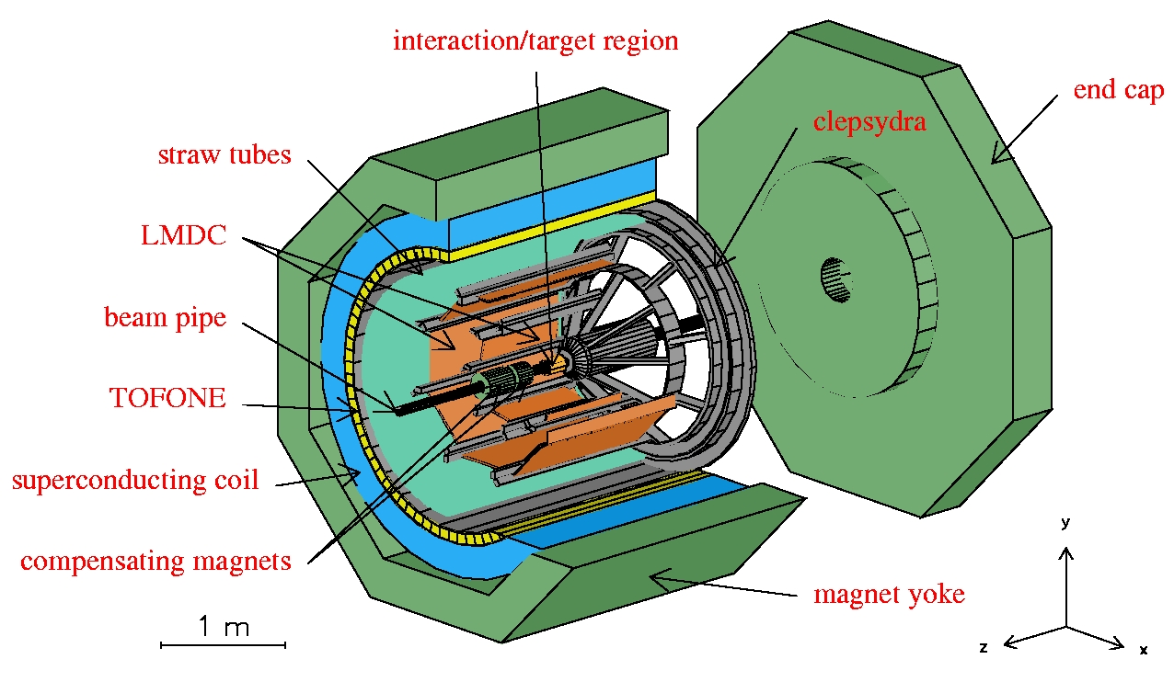
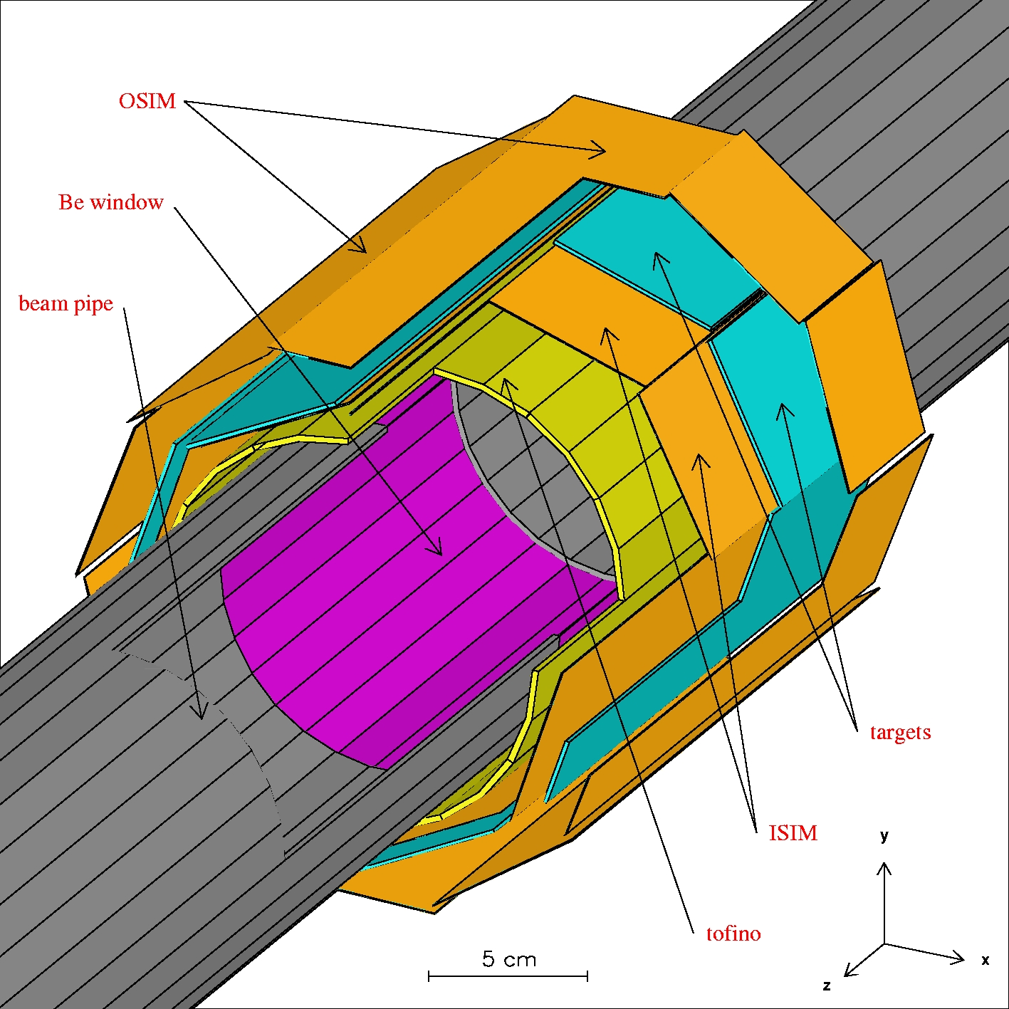
FINUDA @ DAΦNE LNF-INFN
e⁺ + e⁻ → φ (1020) → K⁺ + K⁻ (127 MeV/c)
K⁻ _{stop} + ^{A}Z → ^{A}_{Λ}Z + π⁻
Detector capabilities:
Selective trigger based on fast scintillation detectors (TOFINO, TOFONE)
Clean K⁻ vertex identification
(ISIM P.ID.+ x,y,z resolution + K⁺ tagging)
π, K, p, d, … P.I.D. (OSIM&LMDs dE/dx, TOF)
High momentum resolution
(6‰ FWHM for π- @270 MeV/c for spectroscopy)
1% FWHM for π+ @250 MeV/c
2% FWHM for π- @130 MeV/c for MWD study
(tracker resolution + He bag + thin targets)
Solid angle ~ 2π srad
Solenoid: B=1T
2003 data taking: 190 pb⁻¹ (2x⁶Li, ⁷Li, 3x¹²C, ²⁷Al, ⁵¹V)
2006 data taking: 966 pb⁻¹ (2x⁶Li, 2x⁷Li, 2x⁹Be, ¹³C, D₂O)
XIV International Conference on Hadron Spectroscopy

Slide 7
n-rich hypernuclei search with FINUDA:
previous results
K⁻_{stop} + ⁶Li → ⁶_{Λ}H + π⁺
K⁻_{stop} + ⁷Li → ⁷_{Λ}H + π⁺
M.Agnello et al., PLB 640 (2006) 145
2003-2004 data sample
background:
K⁻ + p → Σ⁺ + π⁻
Σ⁺ → n π⁺ (~130-250 MeV/c)
K⁻ + pp → Σ⁺ + n
Σ⁺ → n π⁺ (~100-320 MeV/c)
cut on K⁻/π⁺ distance
production rate/stopped K⁻: U.L. (90% CL)
⁶_{Λ}H: (2.5 ± 0.4_{stat}^{+0.4}_{-0.1sys}) 10⁻⁵
⁷_{Λ}H: (4.5 ± 0.9_{stat}^{+0.4}_{-0.1sys}) 10⁻⁵
XIV International Conference on Hadron Spectroscopy

Slide 8
⁶_{Λ}H search with FINUDA
2006-2007 data sample: 5x statistics
K⁻_{stop} + ⁶Li → ⁶_{Λ}H + π⁺ (251-254 MeV/c)
INCLUSIVE MEASUREMENT
K⁻_{stop} + ⁶Li → ⁶_{Λ}H + π⁺ (251-254 MeV/c)
⁶_{Λ}H → ⁶He + π⁻ (60-160 MeV/c)
COINCIDENCE MEASUREMENT
from: “Proposal for a new FINUDA data taking”
FINUDA Collaboration February 2008
XIV International Conference on Hadron Spectroscopy
Notes:
Richiedendo la coincidenza del pi- si ritrova la statistica del run precedente e la stessa significativita’ del segnale/rumore (1:1).
250 o 251 ?

Slide 9
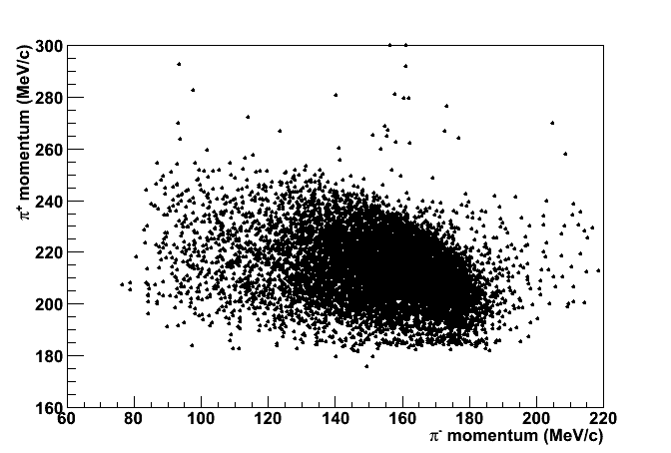
⁶_{Λ}H search with FINUDA
K⁻_{stop} + ⁶Li → ⁶_{Λ}H + π⁺(250-254 MeV/c)
⁶_{Λ}H → ⁶He + π⁻ (60-160 MeV/c)
no evident signal/structure
low production rate
→ new strategy
XIV International Conference on Hadron Spectroscopy

Slide 10
⁶_{Λ}H search with FINUDA
K⁻_{stop} + ⁶Li → ⁶_{Λ}H + π⁺
⁶_{Λ}H → ⁶He + π⁻
M(K⁻) + 3 M(n) + 3M(p) – B(⁶Li) = M(⁶_{Λ}H) + T(⁶_{Λ}H) + M(π⁺) + T(π⁺)
M(⁶_{Λ}H) = 4 M(n) + 2M(p) – B(⁶He) + T(⁶He) + M(π⁻) + T(π⁻)
T(π⁺) + T(π⁻) =
M(K⁻) + M(p) – M(n) – B(⁶Li) + B(⁶He) –T(⁶He) – T(⁶_{Λ}H) – M(π⁺) – M(π⁻)
= 203 ± 1.3 MeV (203.5÷203.2 MeV with B_{Λ}= 0÷6 MeV)
cut on T(π⁺) + T(π⁻): 202÷204 MeV
independent reactions: decay at rest
XIV International Conference on Hadron Spectroscopy

Slide 11
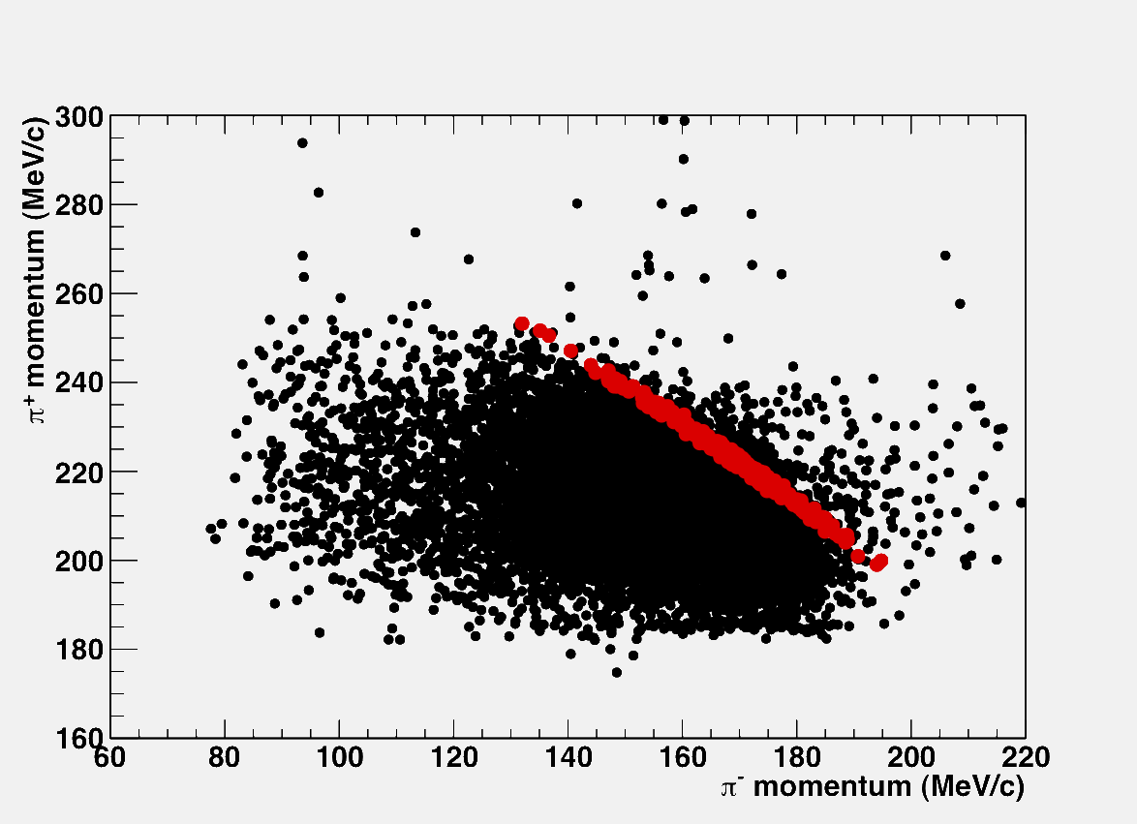
selection:
T(π⁺)+T(π⁻) =
202÷204 MeV
absolute energy scale:
μ+(235 MeV/c) from K_{μ2}
σ_{p}= 0.2 MeV/c
Preliminary
XIV International Conference on Hadron Spectroscopy

Slide 12
249÷255 MeV/c (σ_{p}=1.1 MeV/c)
3 candidate events
2.7 10⁷ K⁻_{stop} events
π⁺ momentum (MeV/c)
130÷138 MeV/c (σ_{p}=1.2 MeV/c)
π⁻ momentum (MeV/c)
Preliminary
π⁻ momentum (MeV/c)
XIV International Conference on Hadron Spectroscopy
Notes:
Anche 2003

Slide 13
Preliminary
1 candidate event
π⁻
(135.1±1.2 MeV/c)
π⁺
(251.3±1.1 MeV/c)
XIV International Conference on Hadron Spectroscopy

Slide 14
⁶_{Λ}H/K⁻_{stop} production rate
Background sources:
fake coincidences: π+(249÷255 MeV/c) & π⁻(130÷138 MeV/c)
K⁻_{stop} + ⁶Li → Σ⁺ + π⁻ + ⁴He + n (end point ~190 MeV/c)
Σ⁺→ n + π⁺ (end point ~282 MeV/c)
K⁻_{stop} + ⁶Li → ⁴_{Λ}H + n + n + π⁺ (end point ~252 MeV/c)
⁴He + π⁻ (p(π⁻) = 133 MeV/c)
K⁻ _{stop} + ⁶Li → π⁰ + ⁶_{Λ}He different
⁶_{Λ}He → ⁶Li + π⁻ (p(π-) = 108.5 MeV/c) ⁶Li
π⁰ + ⁶Li → ⁶_{Λ}He + π+ (end point 278 MeV/c) nuclei
(τ(π⁰))
K⁻_{stop} + ⁶Li → ³_{Λ}H + π⁺ + n + n + n (end point 242 MeV/c)
³_{Λ}H→ ³He + π⁻ (p(π-) = 115 MeV/c)
K⁻_{stop} + ⁶Li → ³He + n + n + Λ + π+ (T_{tot} < 182 MeV)
Λ → n π-
K⁻_{stop} + ⁶Li → ³He + Σ⁺ + n + n + π⁻ (T_{tot} < 180 MeV)
Σ⁺→ n + π⁺
XIV International Conference on Hadron Spectroscopy

Slide 15
⁶_{Λ}H/K⁻_{stop} production rate
Background evaluation:
fake coincidences:
T_{tot}(202÷204 MeV) & π⁺(249÷255 MeV/c) & π⁻(130÷138 MeV/c) for targets
other than ⁶Li
1 event for all other targets → 0.27±0.27 bgd events on ⁶Li = BGD1
K⁻_{stop} + ⁶Li → Σ⁺ + π⁻ + ⁴He + n (end point 190 MeV/c)
Σ⁺→ n + π⁺ (end point 282 MeV/c)
Monte Carlo simulation of the process (detector acceptance, trigger, PR, reconstruction, PId, selections )
1 event for 2.3 10⁶ K⁻_{stop} from MC * BR(K⁻_{stop} p→ Σ⁺ π⁻ ) * [1 - (Σ⁺n→Λp)]
* BR(Σ⁺→nπ⁺) * BR(⁴He + n) → 0.48±0.48 bgd events on ⁶Li = BGD2
Vander Velde-Wilchet et al., Nucl.Phys. A241 (1975) 511 ¹²C
Katz et al., Phys. Rev. D 1 (1970) 1267 ⁴He
H.Outa, Ph.D. thesis: ⁴He BR(⁴He + n ) = 100%
Preliminary
XIV International Conference on Hadron Spectroscopy
Notes:
Fare tabella degli intervalli di Ttot per gli altri bersagli; contare i K-stop del 2003-2004 su tutti I bersagli
BR S→ pi+: 0.4831 eventi simulati: 1.302.853; Vander Velde 0.294±0.010 (NPA: 0.159+/-0.012) ¹²C, Katz: 0.291± 0.047 ⁴He; Outa thesis: 0.45±0.04

Slide 16
⁶_{Λ}H/K⁻_{stop} production rate
Background evaluation:
K⁻_{stop} + ⁶Li → ⁴_{Λ}H + n + n + π⁺ (end point 252 MeV/c)
⁴_{Λ}H →⁴He + π⁻ (p(π⁻) = 133 MeV/c)
Monte Carlo simulation of the process (detector acceptance, trigger, PR, reconstruction, Pid, selections )
2 events for 1.6 10⁶ K⁻_{stop} from MC * BR(⁴_{Λ}H hyperfr. production on ⁷Li) *
(P_{CEX}(πN))² → 0.025 bgd events on ⁶Li = BGD3
H.Tamura et al., Phys. Rev. C 40 (1989) R479
P_{CEX}(πN) = σ_{totCEX} ρ_{nucl} N_{A}/A x = 0.16
σ_{totCEX} = 30 mbarn Jenefsky et al., Nucl. Phys. A 290 (1977) 407
x= R₀ A ^{1/3} = 2.36 10⁻¹³ cm ⁶Li radius
Preliminary
XIV International Conference on Hadron Spectroscopy
Notes:
Eventi simulati: 1.574.573; Tamura: 4LH su 7Li= (3.0+/-0.4) 10-3

Slide 17
⁶_{Λ}H/K⁻_{stop} production rate
R = (events – BGD1 – BGD2 – BGD3) (ε(π-))⁻¹ (ε(π+)) ⁻¹ / (n. K⁻_{stop} on ⁶Li)
ε(π) = ε_{D} ε_{MC}
R = (1.2 ± 0.8) 10⁻⁶/K⁻_{stop}
BGD2: work in progress !!
BGD3: work in progress …
⁶Li target purity ~ 90% → R = (1.3 ± 0.9) 10⁻⁶/K⁻_{stop}
selection cut vs T res.→ R = (2.3 ± 1.6) 10⁻⁶/K⁻_{stop} (2.5 ± 0.4^{+0.4}_{-0.1}) 10⁻⁵/K⁻_{stop}
Systematic error: work in progress
Very preliminary !!
XIV International Conference on Hadron Spectroscopy
Notes:
Gaussiana a due code, entro 0.8 sigma: 57.63%. Sarebbe 1.2+/-0.9 …

Slide 18
kinematics
T_{tot} (MeV) | T(π⁺) (MeV) | T(π⁻) (MeV) | p(π⁺) (MeV/c) | p(π⁻) (MeV/c) | M(⁶_{Λ}H) formation (MeV/c²) | M(⁶_{Λ}H) decay (MeV/c²)
202.5±1.3 | 147.86±0.96 | 54.67±0.84 | 251.3±1.1 | 135.1±1.2 | 5802.33±0.96 | 5801.41±0.84
202.7±1.3 | 146.79±0.96 | 55.94±0.84 | 250.0±1.1 | 136.9±1.2 | 5803.45±0.96 | 5802.73±0.84
202.1±1.3 | 150.11±0.96 | 52.01±0.84 | 253.8±1.1 | 131.2±1.2 | 5799.97±0.96 | 5798.66±0.84
Preliminary
⁵H + Λ
5805.44 MeV
³H + n + n + Λ
5803.74
⁴_{Λ}H + n + n
5801.70
Majling
5801.24
mean value = 5801.43±0.74
Akaishi
5799.64
XIV International Conference on Hadron Spectroscopy
Notes:
Errore sulla media!!

Slide 19
…… thank you!

